Slide 2
Fermentation
Fermentation I’d the metabolic process that converts sugar to acids, gasesor alcohol.
It ocuure in yeast , bacteria and also in oxygen deficient muscle cell .
It is a chemical process by which molecules such as glucose are broken down anaerobically.
Fermentation is the foaming that occurs during the manufacturing of wine and beer .
Conditions for fermentation to occur
fermentation take place when the electron transport chain is unusable .
In this case it becomes cells primary means of ATP production.

Slide 3
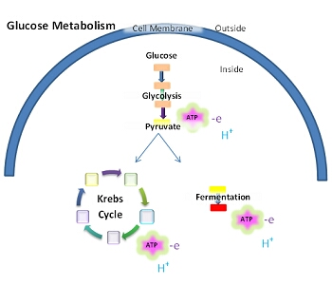
Fermentation turns NADH and pyruvate produced in glycolysis into NAD+ and an organic molecule.
While in the presence of oxygen NADH and pyruvate are used to generste ATP in the process called respiration.
Net energy gain in the fermentation is 2 ATP.

Slide 4
Glycolytic pathways
There are four glycolytic pathway found in different bacteria
Embdon Mayerhof parnas
it is step wise conversion of glucose .
Hexose monophosphate pathway
responsible for synthesis of pentose sugars used nucleotide synthesis.
Entner Doudoroff pathway
found in pseudomonas and related genera .
PhosphoKetolase Pathway
found in Bifidobacterium and Leuconostoc bacter.

Slide 5
Embden Mayerhof Pathway.
It is step wise conversion of glucose to pyruvate and each step require specific enzyme.
Occurs in cytosol .
Not require oxygen.
Occurs in both aerobic and anaerobic bacteria.
2 molecules of pyruvic acid form from each glucose molecule .
Net gain of 2 ATP and 2 NADH.

Slide 7
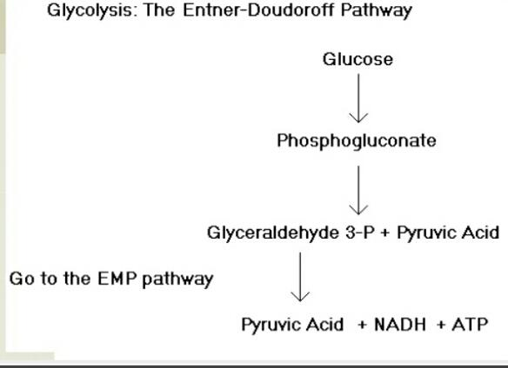
2.Entner Doudoroff Pathway
In this way , glucose convert into phosphogluconate and then into one molecule of pyruvic acid and one glyceraldehyde 3 phosphate.
Glyceraldehyde 3phosphate then follow the EMP pathway and form pyruvic acid and ATP and NADH..

Slide 8
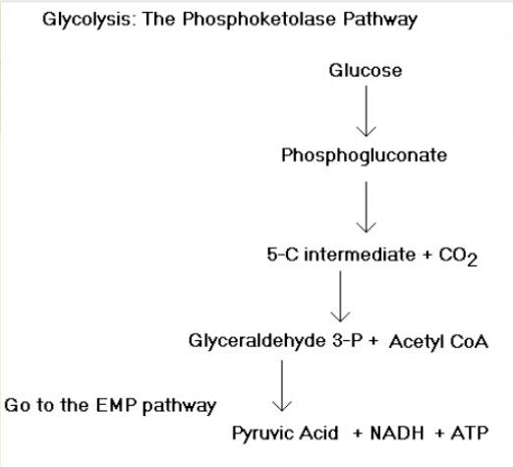
3. Phosphoketolase pathway
In this way phosphogluconate convert into 5carbon intermediate and release carbon dioxide.
Then intermediate compound converted into glyceraldehyde 3 phosphate and acetyl CoA
Glyceraldehyde 3 phosphate by following EMP form pyruvic acid and ATP , NADH.

Slide 9
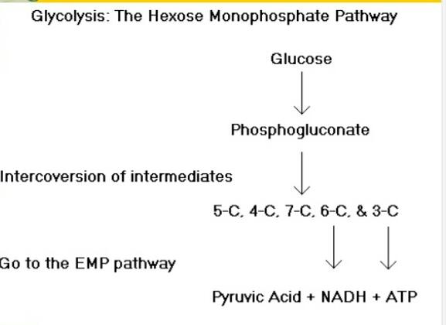
4 . Hexose monophosphate Pathway
In this pathway , Phosphogluconate is Interconnected Into different intermediates which follow the EMP pathway and form pyruvic acid, ATP and NADH.

Slide 10
After the formation of pyruvic acid if oxygen is present then It is subjected to a process called respiration
While in the absence of oxygen it undergoes fermentation
Types of fermentation
There are two types of fermentation
Alcohol fermentation
Lactic acid fermentation

Slide 11
Alcohol fermentation
It is a biological processwhich converts sugars such as glucose , fructose and sucrose into cellular energy producing ethanol and carbon dioxide as side product.
One glucose molecule is converted into two molecule of ethanol and two carbon dioxide molecules.
Ethanol fermentation has many uses including the production of alcoholic beverages, the production of ethanol fuel and bread cooking .

Slide 13
2 .Lactic Acid fermentation
It is a metabolic process by which glucose and other six carbons sugar converted into cellular energy and metabolite lactate.
Lactate dehydrogenase catalyze the interconversion of pyruvate and lactate with interconversion of NADH and NAD+.
One molecule of sugar converted into two molecules of lactic acid.

Slide 15
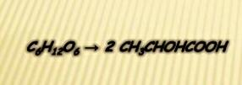
Lactic acid fermentation is further divided into two types .
1.Homolactic Fermentation
2. Heterolactic Fermentation
1 Homolactic Fermentation
In homolactic fermentation one molecule of glucose is converted into two molecules of lactic acid.
It is simplest simplest type of fermentation.
Occurs in lactobacillus.
It also occurs in muscle cell of animals when they need energy faster then the blood can supply oxygen.

Slide 17
Heterlactic Fermentation
In heterlactic fermentation one glucose molecule is converted into one molecule of ethanol and carbon dioxide, acetate or other metabolic product
It is intermediate between lactic acid and other types eg alcoholic.

Slide 19
Applications of fermentation in daily Life
Fermentation is also used
To produce antibiotics.
To produce Ethyl alcohol.
To produce alcoholic beverages eg beer from barley and wine from grapes.
Used to preserve and store vegetables in the form of pickles.
Yougart us formed by fermentation of milk .

