Slide 2
FATS AND OILS
LECTURE 9
FST-403
B. Sc. (Hons). Food and Science and technology
Semester-7
INSTITUTE OF FOOD SCIENCE AND NUTRITION
UNIVERSITY OF SARGODHA, SARGODHA

Slide 3
LECTURE OUTLINE
Physical refining of oil
Degumming
Neutralization
Bleaching
Deodorization

Slide 4
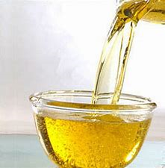
PHYSICAL REFINING OF OIL
Once the crude oil is extracted either through
Mechanical extraction
Solvent extraction
it must be processed and refined before it can be used for consumption in order to remove impurities, including
free fatty acids (FFA)
Phospholipids
pigments
and volatile compounds

Slide 5
PHYSICAL REFINING OF OIL
The processes include in the physical refining of oil are
NEUTRALIZATION
DEGUMMING
BLEACHING
DEODORIZATION

Slide 6
PHYSICAL REFINING OF OIL

Slide 7
PHYSICAL REFINING OF OIL
DEGUMMING
Degumming is the first step in the refining process to remove phospholipids, gums, waxes and other impurities from the crude oil.
The oil is treated with water or dilute acids such as phosphoric acid, which exploits the fact that the phospholipids are attracted to water because of their nature, and turns the lipids into hydrated gums. These gums are insoluble in oil and are then separated from the oil using centrifuges. The separated gums are then dried and manufactured into emulsifying agents such as lecithin.

Slide 8
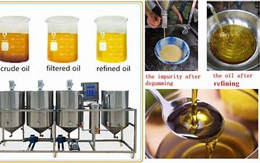
PHYSICAL REFINING OF OIL
Types of degumming
Water Degumming
Acid Degumming
Dry degumming
Enzymatic degumming

Slide 9
DEGUMMING OF OIL
WATER DEGUMMING
The main purpose of water degumming is to produce oil that does not deposit residue during transportation and storage
Approximately 2% water by oil volume is brought into contact with crude oil by mechanical agitation in mixing tank
Complete process requires 30 minutes of agitation at 60 to 171C
Temperature is very important factor because degumming is incomplete at higher temperatures due to increased solubility of phosphatides and lower temperature results in increased viscosity of oil
After degumming, centrifuges separates the sludge and degummed oil

Slide 10
WATER DEGUMMING

Slide 11
DEGUMMING OF OIL
ACID DEGUMMING
The acid-degumming process is a variant of the water-degumming process in that it uses a combination of acid and water. Acid degumming leads to a lower residual phosphorus content than water degumming
The procedure is same as that of water degumming
Oil is heated up to 60C to 70C
Acid addition and mixing is done
Centrifugal separation of gums
Vacuum drying

Slide 12
DEGUMMING OF OIL
DRY DEGUMMING
Dry degumming process is similar to acid degumming just an additional bleaching earth is mixed during process. The main purpose is to decompose the metal ion complexes
85% of acid usually phosphoric is added to oil at 80 to 100C
After a short reaction time, some water is also added
Afterwards 1 to 3% bleaching earth is added and vacuum applied
Then oil is heated to 140C for 15minutes
At the end bleaching earth is removed using filtration process

Slide 13
DEGUMMING OF OIL
ENZYMATIC DEGUMMING
One of the most recent methods is enzymatic degumming. The enzymatic method is based on the conversion of non-hydratable phospholipids to hydratable lyso-phospholipids, which are easy to eliminate with the water phase by centrifugation
It has following steps
Adjustment of pH to about 4.5 with buffer
Addition of enzyme(phospholipase) and reaction time in mixing tank
Separation of sludge from oil

Slide 14
ADVANTAGES OF DEGUMMING OF OIL
It satisfies exports oil requirement for a product free from impurities
It reduces the chemical refining process
Hydrated gums can be converted to emulsifier lecithin
It prepares the oil for physical refining processes due to significant reduction of non volatile impurities

Slide 15
NEUTRALIZATION OF OIL
Neutralization
The second step in the refining process is the separation of the free fatty acids (FFA) from the oil through alkaline neutralization. Depending on the type of oil being processed, there can be either two or three stages during neutralization, where three stages are done to produce a higher quality oil
In this caustic soda is added to the mixture of degummed oil
The negative charge of hydroxyl group reacts with positive charge on FFA
This reaction produces soap and glycerol

Slide 16
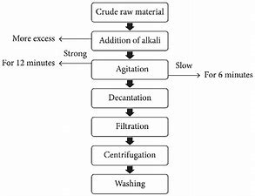
NEUTRALIZATION OF OIL
The reaction is also called saponification reaction
The prepared soap is separated from oil by decantation or centrifugal force

Slide 17
BLEACHING OF OIL
Bleaching
The third stage in the refining process is the removal of any residual pigments through bleaching
The most common bleaching agent employed is bentonite clay
Once the clay is added, the mixture is agitated, which allows the clay to bind the contaminants in the oil, either physically (eg. Van der Waal forces) or chemically (chemisorption)
The mixture is then filtered to remove the clay with the bound contaminants

Slide 18
BLEACHING OF OIL

Slide 19
DEODORIZATION OF OIL
Deodorization
The fourth stage in the refining process is deodorization to remove any volatile substances and odoriferous compounds to produce stable and bland oil
The molecules are distilled using high pressure steam injected through a vacuum system
The temperature of the bleached vegetable oil is further raised from 120 C to 200 C
The oil is subjected to steam distillation under high temperature and vacuum to evaporate all odor substances. The resulting deodorized oil is almost bland and tasteless.

