Slide 1
Foot Orthoses (Shoe)
Iqra nadeem

Slide 2
Foundation for most L/L orthoses
Transfer body weight to the ground and protect the wearer from the terrain and weather.
Individual with an orthopaedic disorder, fotwear can serve two additional purposes:
1) it reduces pressure by redistributing force
2) it serves as the fondation for AFOs and more extensive brace.

Slide 3
Major parts of the shoe are
Upper
Sole
Heel
Reinforcements
These features are found in both the traditional leather shoes and athletic sneaker.

Slide 4
upper
Portion of the shoe over dorsum of the foot is the Upper.
Anterior component:- vamp
Posterior part:- quarter
In a laced shoe, the vamp contains the lace stays, which have eyelets for shoelaces.
Laces provide more precise adjustment over the entire opening than do strap closure, but strap shoe however enable some individuals with limited manual dexterity to manage the shoe more easily.

Slide 5
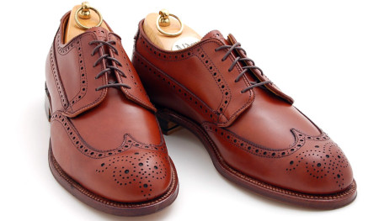
For most orthotic purposes, a blucher lace stay Is preferable.
Distinguished by the separation between the anterior margins of the lace stay and the vamp. Permits substantial adjustability…pt with e

Slide 6
The alternate design is the Bal, or Balmoral, lace stay, in which the lace stay is continuous with the vamp.

Slide 7
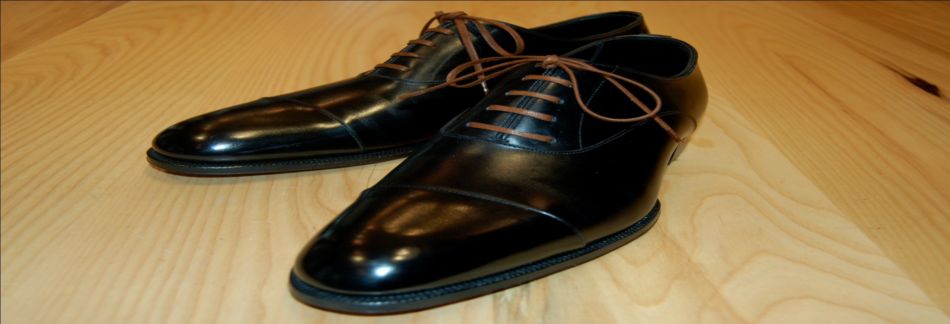

Slide 8
Quarter
Quarter height
Low quarter…. Terminates below malleoli….. Satisfactory for most clinical purposes….. Does not restrict foot and ankle motion.
A high quarter shoe….. Covering the malleoli…… indicated in pes equinus
For foot stability in the absence of an AFO.
Expensive and difficult to don

Slide 9
sole
Bottom portion
Two parts outer and inner sole made of leather.
Leather soles absorb little impact shock and provide minimal traction as compared to rubber sole
To absorb shock, the shoe may have a resilient outer sole, inner sole, or insert.
Regardless of the material, outer sole should not contact the floor at the distal end; the slight rise of the sole is known as toe spring……….rocker effects

Slide 10
Heel
Heel is the portion of the shoe adjacent to the outer sole, under the anatomical heel.
Broad, low heel provides greatest stability and distributes force between the back and front of the foot.
For adults, a 1 in. (2.5cm) heel tilts the centre of gravity slightly forward to aid transition through stance phase, but does not disturb normal knee and hip alignment significantly.

Slide 11
A higher heel places ankle in its extreme plantarflexion range and forces the tibia forward.
Wearer compensates either by retaining slight knee and hip flexion
Or by extending the knee and exaggerating lumbar lordosis.
Higher heel transmits more stress to the metatarsals.

Slide 12
Higher heel also reduces tension on achilles tendon and other posterior structures and accomodates rigid pes equinus.
Heels made of firm material with a rubber planter surface

Slide 13
Reinforcements
Preserve the shape of the shoe
Toe boxing in the vamp protects the toes from stubbing and vertical trauma.
High enough to accommodate hammer toe or similar deformity
Shank piece is longitudinal plate that reinforces the sole between the ant. border of heel & the widest part of the sole at the metatarsal heads.
Patient with Pes valgus, however, should have a shoe with a long medial counter that provides reiforcement along the medial border of the foot…..resisting tendency of the foot to collapse medially.

Slide 14
Last
Model over which the shoe is made.
Traditional wood,custom-made plaster, or computer generated design.
The patient with a markedly deformed foot requires a shoe made over a special last, either factory or custom- made.

