Slide 1
Input devices

Slide 2
Using the input devices
Enables user to enter information and commands into the computer
Input devices are sensory organs.
Input device are important
Two common input devices
Keyboard
Mouse

Slide 3
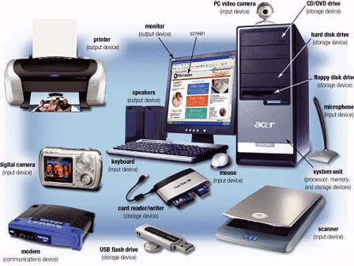
Input Devices
Hardware used to enter data and instructions

Slide 4
Two Common Input Devices
Keyboard
Mouse

Slide 5
The Keyboard
The most common input device for inputting text
and numbers.
Approximate 100 keys
Must be proficient with keyboard
Skill is called keyboarding

Slide 6
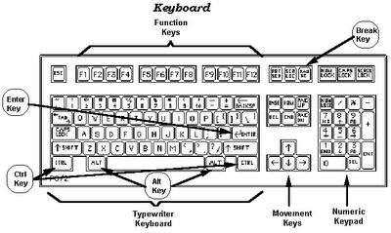
Standard Keyboard Layout
IBM Enhanced Keyboard with 101 keys

Slide 7
Five Groups of Keys
Alphanumeric Keys
Modifier Keys
Numeric Keypad
Function Keys
Cursor Movement keys

Slide 9
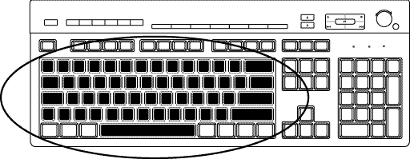
Alphanumeric Keys
Area of computer that looks like a typewriter
Sometimes called QWERTY
Keys having specific functions
Tab
Caps Lock
Backspace
Enter

Slide 10
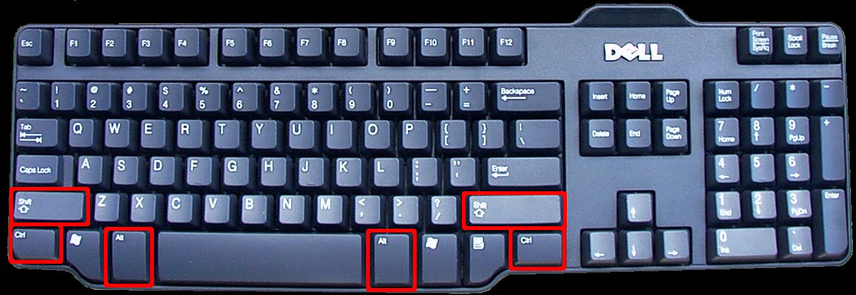
Modifier Keys
Shift
Alt (Alternate)
Ctrl (Control)
Modify the input of other keys

Slide 11
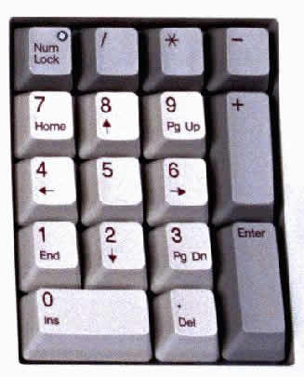
Numeric Keypad
Usually located on the right side of the keyboard,
Has 10 digits and mathematical operators (+, -, *, and /).
Also features a NumLock key
On - forces the numeric keys to input numbers.
Off - perform cursor movement control and other functions.

Slide 12
Function Keys
Keys that act as shortcuts for performing certain functions such as saving files or printing data, e.g. F1 used for help.
Labeled F l, F2
in a row along the top of the keyboard.
Allow you to input commands without typing long strings of characters or navigating menus or dialog boxes.
Each key's purpose depends on the program you are using.
Many programs use function keys along with modifier keys to give the function keys more capabilities.

Slide 13
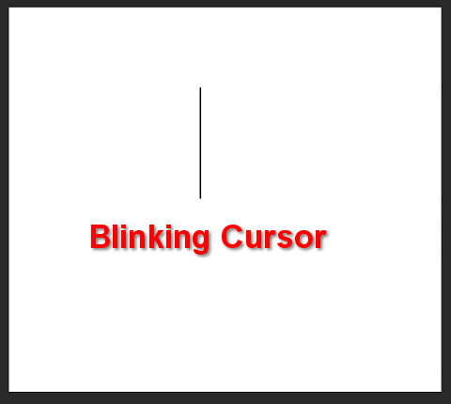
Cursor Movement Keys
Let you move around the screen without using a mouse.
Cursor is a mark on the screen indicates where the characters you type will be entered
Arrow Keys
Home & End
PgUp & PgDn

Slide 14
Special Purpose Keys
Esc (Escape)
Insert
Delete
PrtSc (Print Screen)
ScrLk (Scroll Lock)
Pause
Two special key for Microsoft Windows
Start
Shortcut

Slide 15
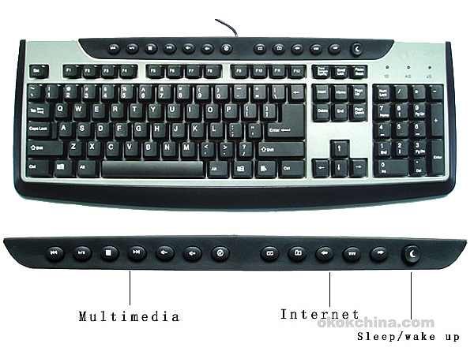
Internet and Multimedia Controls
One of the latest trends is the addition of
Internet & multimedia controls.
Microsoft's Internet Keyboard and MultiMedia Keyboard,
e.g. you can use the buttons to launch a Web browser, check e-mail and start your most frequently used programs.
Multimedia buttons
Control the computer’s CD-ROM
or DVD drive
Adjust the speaker volume

Slide 16
How Keyboard Works
Key is pressed on keyboard
Keyboard controller detects a key press
Keeps the code in its memory, Keyboard buffer
Code represents the key pressed
Controller notifies the operating system via an interrupt (a signal to the processor produced by hardware ).
Operating system responds the interrupt by the reading the code from buffer.
OS passes the code to CPU
Notes:
Teaching tip
Table 5A.3 presents the ASCII code. An exercise that never fails to amuse students is to use the Alt and the number pad to enter letters into an application. As before, open MS Word. Have students hold down the Alt key and type an ASCII value into the number pad. Once they release the Alt, the letter appears. This is a useful skill when the keyboard breaks. Challenge the students to explore numbers above 128.

Slide 17
Dvorak Keyboards
For people who type with one hand or finger
Reduce the amount of motion required to type common English text
Increase typing rate
Reduced errors
But Qwerty is still popular

Slide 18
Dvorak Keyboards
Both Hands
Left Hand
Right Hand

Slide 19
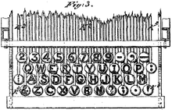
QWERTY Keyboard Layout
Latham Sholes' 1878 QWERTY keyboard layout

Slide 20
Non-standard layout and special-use
Chorded keyboard
Software or virtual keyboard
Foldable keyboard
Projection (as by Laser)

Slide 21
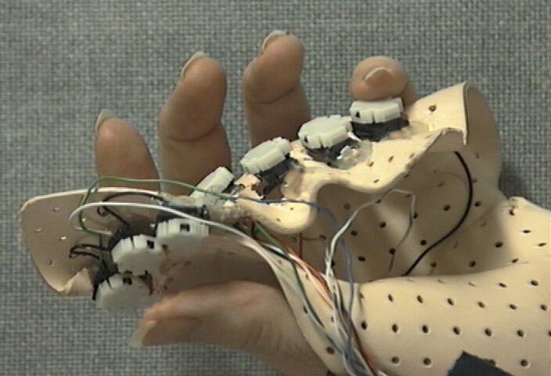
Chorded Keyboard
A "chord" on a piano.
Associate actions with combinations of key presses
As many combinations available, chorded keyboards can effectively produce more actions on a board with fewer keys

Slide 22
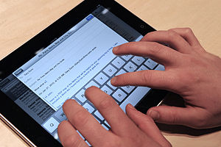
Software or Virtual Keyboards
Is a software component that allows a user to enter characters.
usually be operated with multiple input devices,
Touch screen,
Actual keyboard and
Mouse.

Slide 23
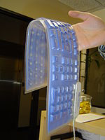
Foldable Keyboards
Made of soft plastic or silicone which can be rolled or folded on itself for travel
When in use, these keyboards can conform to uneven surfaces,
Connected to portable devices and smart phones.

Slide 24
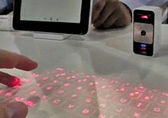
Projection Keyboard
Project an image of keys, usually with a laser, onto a flat surface.
The device then uses a camera or infrared sensor to "watch" where the user's fingers move
Projection keyboards can simulate a full size keyboard from a very small projector.

Slide 25
Wireless Keyboard
Provides increased user freedom
Includes a required combination transmitter and receiver unit that attaches to the computer's keyboard port.
The wireless aspect is achieved either by radio frequency (RF) or by infrared (IR) signals sent and received from both the keyboard and the unit attached to the computer.
A wireless keyboard may use an industry standard RF, called Bluetooth.
RF stands for Radio Frequency is an electrical current used to transfer data remotely.

Slide 26
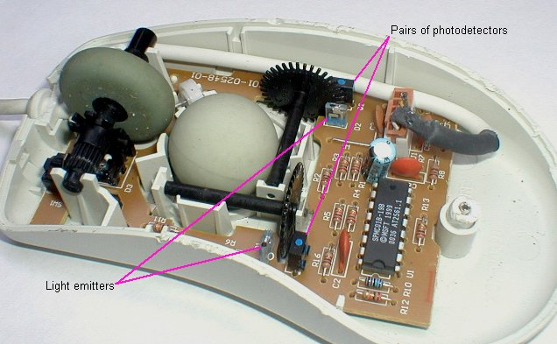
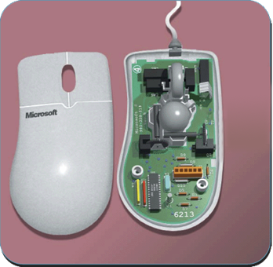
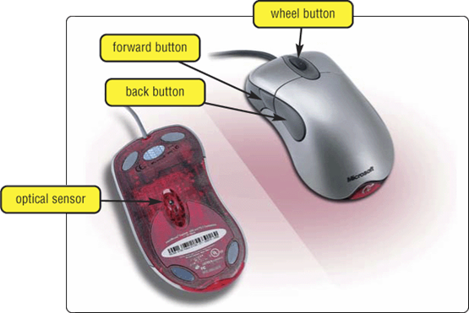
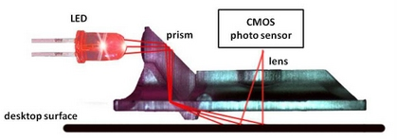
The Mouse
mouse buttons
wheel button
ball

Slide 27
The Mouse
All modern computers have a variant
Allows users to select objects
Pointer moved by the mouse
Mechanical mouse
Rubber ball determines direction and speed
The ball often requires cleaning
Optical mouse
Light shown onto mouse pad
Reflection determines speed and direction
Requires little maintenance

Slide 28
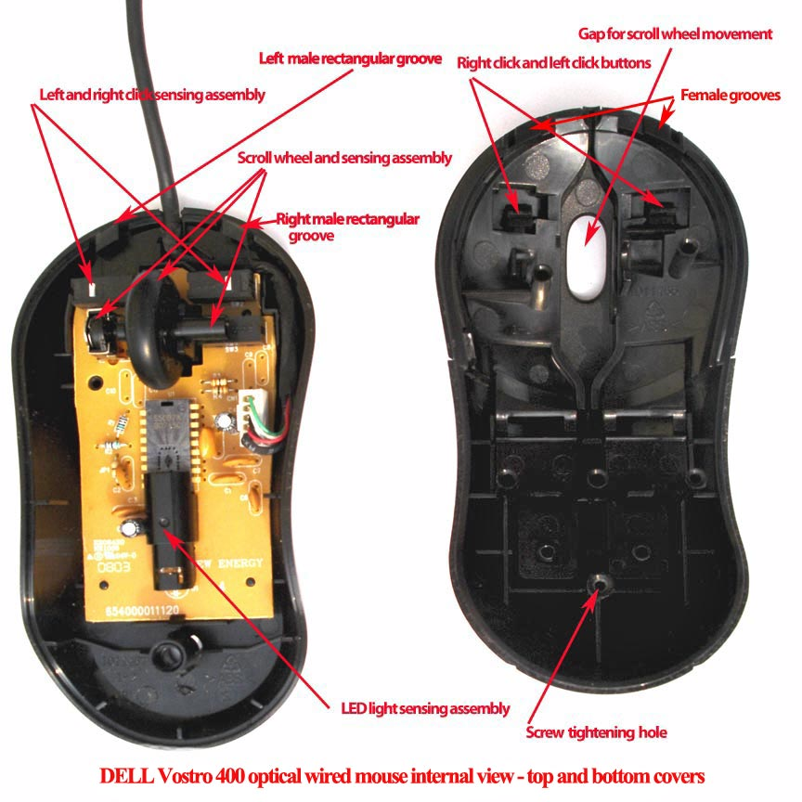
Optical Mouse
2
1

Slide 29
Benefits of Using Mouse
Pointer positioning is fast
Menu interaction is easy
Users can draw electronically

Slide 30
Interacting With a Mouse
Actions involve pointing to an object
Clicking selects the object
Double clicking the object
Clicking and holding drags the object
Releasing an object is a drop
Right clicking activates the shortcut menu
Modern mice include a scroll wheel
Notes:
Insider information
Douglas Englebart patented the first mouse in 1970 as the “X-Y position indicator for a display system.” The name mouse comes from the tail on the device.

Slide 31
Mouse Configuration
Configured for a right-handed user
Can be reconfigured for left handed
Between 1 and 6 buttons
Extra buttons are configurable
Button

Slide 32
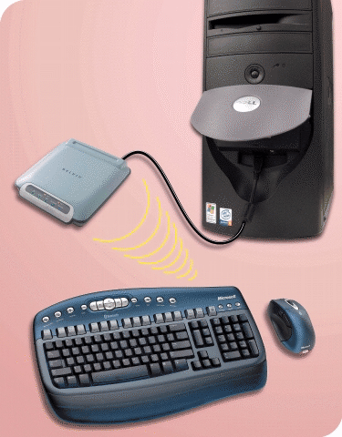
Cordless Keyboard and Mouse
Communicate with a receiver attached to a port on the system unit
Use infra-red (IR) or radio frequency (RF) technology

Slide 33
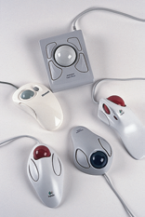
Variants of the Mouse
Trackballs
Upside down mouse
Hand rests on the ball
User moves the ball
Uses little desk space
Mostly two buttons
Can be configured for both
Right-handed and
Left-handed use

Slide 34
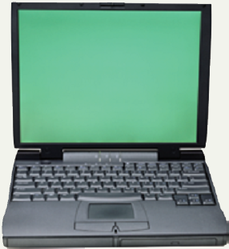
Track Pads
Stationary pointing device
Small plastic rectangle
Finger moves across the pad
Pointer moves with the pointer
Popular on laptops

Slide 35
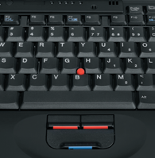
Track Point
Track point
Little joystick on the keyboard between G, H & B keys
Move pointer by moving the joystick
Two buttons beneath Spacebar same as mouse
Save great of time and effort
Notes:
Insider information
The term track point is copyrighted by IBM.

Slide 36
Summary
Standard input devices
Standard Keyboard
Five groups of Keys
How Keyboard works ?
Dvorak Keyboard
Non standard layout and Special Use
The Mouse
Five Techniques of using Mouse
Variants of Mouse

Slide 37
End Note
Well Started is Half Done

Slide 38
?

