Slide 1
Asphyxia & Drowning
Lesson1
Dr Nadir Ali Rana

Slide 2
Asphyxia & Hypoxia
Dr. Nadir Ali Rana
MBBS(Pak), M.Phil. Forensic Medicine (UK) Assistant Professor /HOD Department of Forensic medicine Sargodha medical college, university of Sargodha

Slide 3
Learning Outcomes
Define Asphyxia
What is hypoxia? Give its types
What Is difference between Hypoxia & Asphyxia
Classify Asphyxia
Classify Mechanical Asphyxia

Slide 4
Asphyxia

Slide 5
ASPHYXIA
Asphyxia (Greek) literally means
“absence of pulse”
a state in which body becomes deprived of oxygen.
“a method of rendering the tissue hypoxic”.
‘state of impaired transfer of oxygen to the lungs”.

Slide 6
ASPHYXIA
Definition
“Mechanical interference with the process of oxygenation / respiration upto the level of lungs (lungs included)”
The essential substance of asphyxia is “the struggle to breath against some kind of interference with respiration”

Slide 7
HYPOXIA NORMAL ROUTE OF OXYGEN
ATMOSPHERE
LUNGS
(HB+O2) CIRCULATION TISSUE

Slide 8
HYPOXIA
Hypoxia is defined as “State of reduced oxygen supply to the tissues”.
Types Of Hypoxia
Hypoxic Hypoxia
Anaemic Hypoxia
Stagnant Hypoxia
Histotoxic Hypoxia
( Ref. Gordon’s Classification of Anoxia)

Slide 9
1) Hypoxic Hypoxia
Inability of oxygen to gain access to blood stream. All type of mechanical asphyxias are included in this.
2) Anemic Hypoxia
Oxygen carrying capacity of blood is reduced. e.g., in anemia.

Slide 10
3) Stagnant /Circulatory Hypoxia
Due to shock or circulatory failure, blood is unable to move enough to receive and supply oxygen to the tissue. e.g. congestive cardiac failure.
4) Histotoxic Hypoxia
Oxygen supply to the tissue sufficient but
tissues are unable to take oxygen due to
some pathology/ defect in the metabolism.
e.g. Hydrocyanide poisoning

Slide 11
CLASSIFICATION OF ASPHYXIA
Basically there are two types of asphyxia:
Mechanical:
Flow of oxygen into the lungs is interfered through some physical interference.
OR
: Obstruction of the air passages in an unnatural way either from within or by exerting pressure from the outside. e.g.
Suffocation
Strangulation
Traumatic asphyxia

Slide 12
Non-mechanical:
Supply of oxygen to the body is interfered through some physiological/chemical interference or disease process.
Types of Non-Mechanical Asphyxia
Environmental Asphyxia
Toxicological Asphyxia
Pathological Asphyxia
Iatrogenic Asphyxia

Slide 13
Non-mechanical: (contd.)
A. Environmental asphyxia
Insufficiency of oxygen in the inspired air e.g. at high altitude, in deep wells or closed spaces
B. Pathological Asphyxia
Transfer of oxygen to the lungs is prevented due to blockage caused by a disease of respiratory tree.

Slide 14
Non-mechanical: (contd.)
C. Toxic asphyxia
Met in industrial hazards.
In this, uptake of oxygen is prevented in the lungs due to the presence of some poisonous gases like carbon monoxide
D. Iatrogenic asphyxia
Associated with anesthesia and surgery.

Slide 15
CLASSIFICATION OF MECHANICAL ASPHYXIA

Slide 16
CLASSIFICATION OF MECHANICAL ASPHYXIA
It is classified according to the level of obstruction of air passages which is as under.
At the level of nose and mouth ---- suffocation
A). External---- smothering (by hands, a cloth
or overlaying).
B). Internal ---- gagging (stuffing with a cloth etc).
At the level of neck
A). External
With hands---throttling (manual constriction of neck)
With ligature (soft or hard) --- on next page

Slide 17
Strangulation ( garroting )
In this, the constricting force is applied directly to the ligature by the hands.
Hanging (suspension)
In this, the constricting force is applied indirectly to the ligature through the weight of the body.
B). Internal
Choking -- Internal obstruction at the level of larynx, trachea or main bronchus.

Slide 18
3. At the level of chest
Traumatic asphyxia
It is mechanical immobilization of muscles of respiration.

Slide 19
Questions
What are possible mechanism/ causes of death in asphyxia.
Mention general pathological signs of asphyxia.
Write down specific pathological signs pf asphyxia.

Slide 20
POSSIBLE MECHANISMS OF DEATH IN ASPHYXIA
Cerebral Anoxia/Hypoxia.
Hypoxic Hypoxia/Anoxic Anoxia.
Cardiac Arrhythmia(Vagal inhibition of heart)

Slide 21
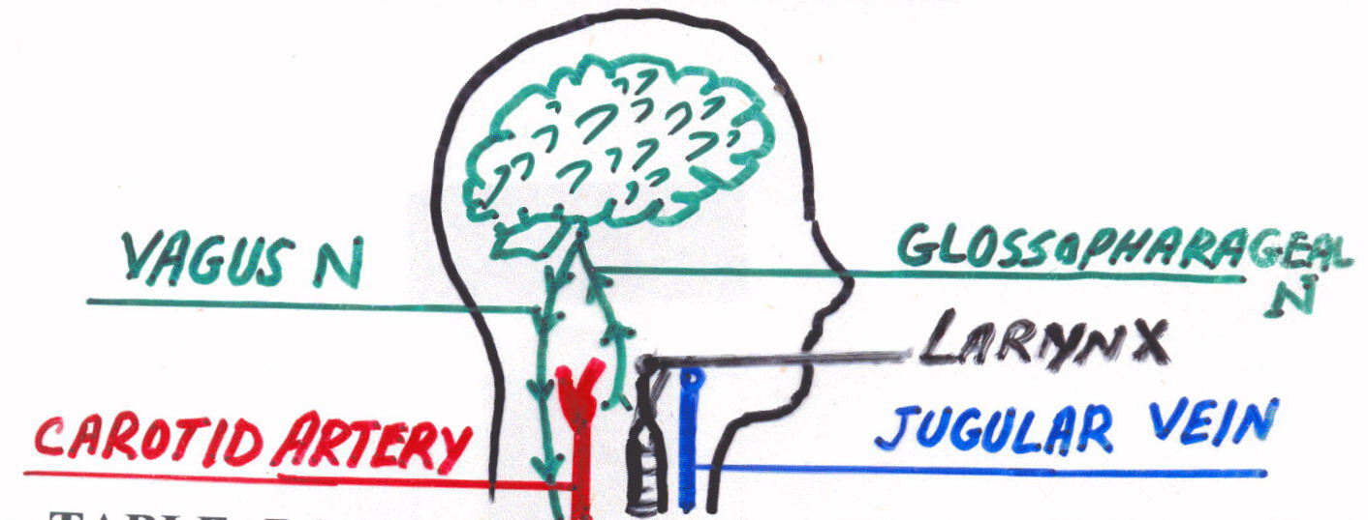
ANATOMY OF ASPHYXIA

Slide 22
Table: Rope Tension Required to Occlude Tubular Structures in the Neck
Structure | Tension (kg) | Tension (Lb)
Jugular veins | 2 | 4.4
Carotid arteries | 5 | 11
Trachea | 15 | 33
Vertebral arteries | 30 | 66
Least Tension needed to occlude all the neck structures | 5-10 | 11-22
Greatest Tension needed to occlude all the neck structures | 20-40 | 44-88

Slide 23
CEREBRAL ANOXIA / HYPOXIA
Most common mechanism.
Occurs due to compression of jugular veins, with or without that of the carotid arteries.
Death occurs within few minutes.

Slide 24
HYPOXIC HYPOXIA/ANOXIC ANOXIA
It is contributory factor in some hangings where the Hyoid bone and tongue are pushed upwards and backward against the Laryngo–Pharynx producing air hunger.

Slide 25
CARDIAC ARRHYTHMIA
Pressure over the carotid sinus provokes “Vagal Reflex” causing bradycardia and cardiac arrest (Vagal inhibition of heart).
It occurs particularly in the elderly or those with underlying cardiac disease.
Petechiae or congestion are usually not present in these cases.

Slide 26
PHYSIOLOGY OF ASPHYXIA
1. Struggle - forceful breathing.
2. Quiescence - unconscious, lifeless.
3. Convulsions - disturbs scene,
incontinence.
4. Apnea - lifeless, weak pulse.

Slide 27
BIOCHEMISTRY OF ASPHYXIA
Agonal changes in biochemistry of blood during mechanical interference with respiration are:
O₂
CO₂
PH
Blood Sugar
Different studies have revealed that these changes has no value in differentiation asphyxial death from other forms of death.

