Slide 2
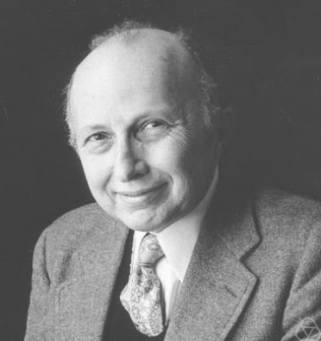
Kruskal Wallis test
The Kruskal-Wallis Test was developed by Kruskal and Wallis (1952) jointly and is named after them.

Slide 3
Kruskal Wallis test
The Kruskal-Wallis test is a nonparametric (distribution free) test, and is used when the assumptions of ANOVA are not met.
In the ANOVA
we assume that distribution of each group is normally distributed
there is approximately equal variance on the scores for each group.
Non-parametric method for testing whether samples originate from the same distribution.

Slide 4
Assumptions
We assume that the samples drawn from the population are random.
We also assume that the cases of each group are independent.
The measurement scale should be at least ordinal.
Variable of interest is continuous.
Population are identical except for possible difference for at least one population.

Slide 5
Procedure
Hypothesis:
Null hypothesis: Null hypothesis assumes that the samples are from identical populations.
Alternative hypothesis: Alternative hypothesis assumes at least one population distribution differs

Slide 6
$$Alpha=0.05$$
Test Statistic
Arrange the data of samples in a single series in ascending order.
Assign rank to them in ascending order. In the case of a repeated value, or a tie, assign ranks to them by averaging their rank position.
Then sum up the different ranks, e.g. R1 R2 R3…., for each of the different groups..
To calculate the value, apply the following formula

Slide 7
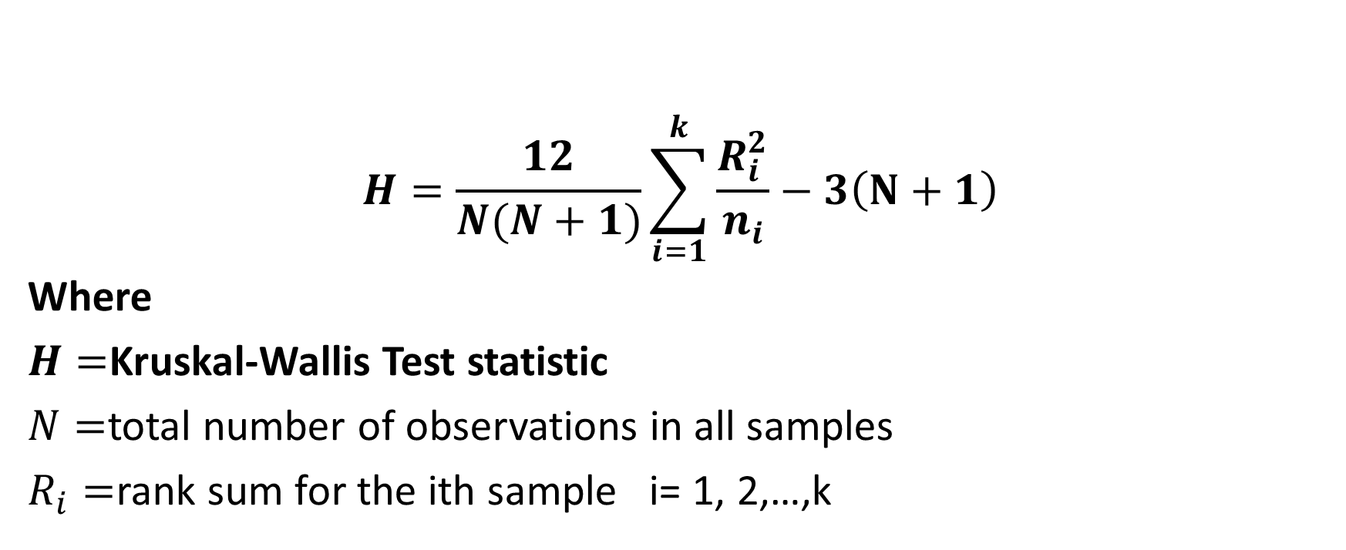

Slide 8
Critical region

Slide 9
Decision
Reject Ho if Calculated value of test exceeds computed value of Chi-square.

