Slide 1
Refining your question cont…
Question about
Experience
Prognosis
Diagnosis

Slide 2
Question about Experience
Diverse
Can cover any aspect of clinical practice
Open
While Formulating Question , specify
Patient / problem
Phenomenon of interest

Slide 3
Patients attitude to his/her condition & principle concern
Concerns of Patient with problem
Whether my pain become chronic ?

Slide 4
Patient Phenomenon
Principle concerns of patient

Slide 5
prognosis
Patient who take treatment
Patients who do not take
Treatment
****************

Slide 6
prognosis
What will be the person’s outcomes
What will happen in future
NOT >Why it will be?
Notes:
What will happen in future

Slide 7
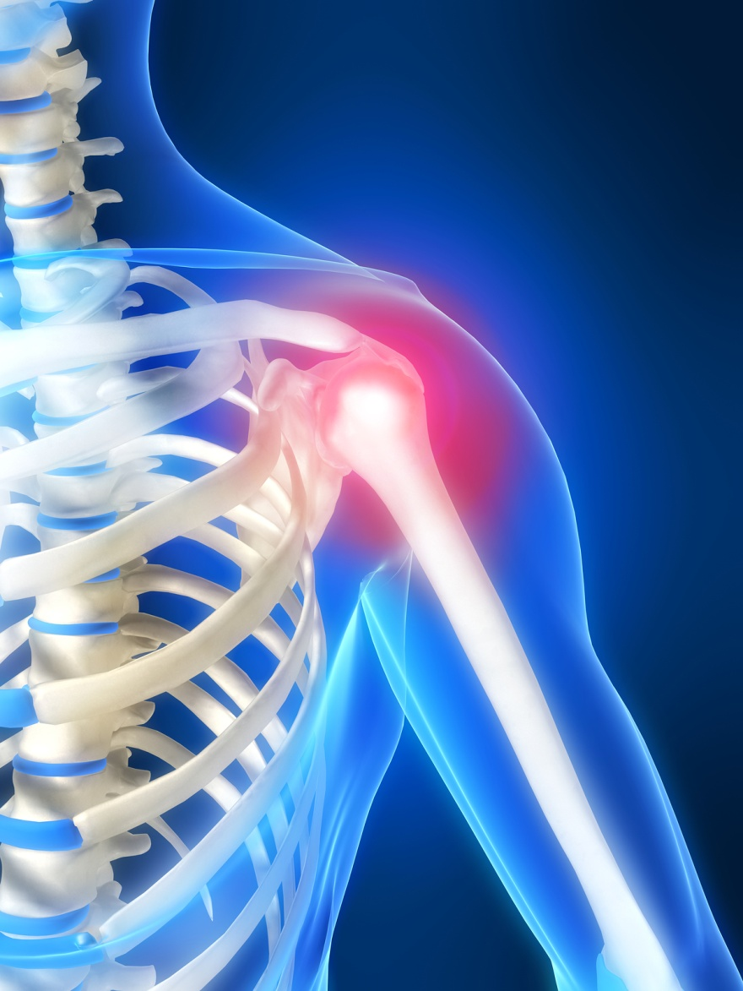
Diagnosis
Accuracy of diagnostic test
Patient
Test
Diagnosis

Slide 8
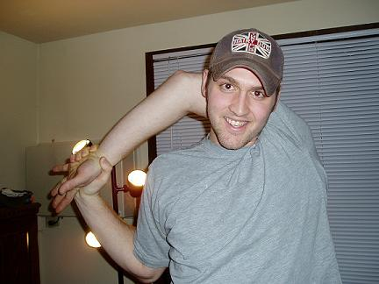
Do you feel confident in Making possible questions…about any presented problem.

