Slide 1
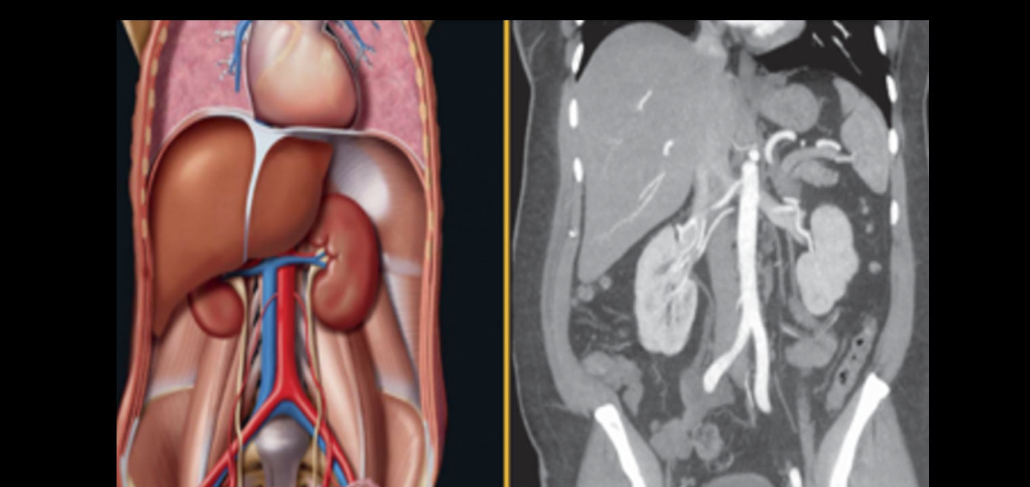
Radiological anatomy of the abdomen and pelvis
BY DR.AYESHA KAMRAN

