Slide 1
Organizational Behavior 15th Ed
Chapter 3
Robbins and Judge
Attitudes and Job Satisfaction
Notes:
Chapter 3 is a focus on Attitudes and Job Satisfaction. Managers should be interested in their employees’ attitudes because attitudes give warnings of potential problems and influence behavior. Creating a satisfied workforce is hardly a guarantee of successful organizational performance, but evidence strongly suggests that whatever managers can do to improve employee attitudes will likely result in heightened organizational effectiveness. Let’s begin with the Learning Objectives of this chapter.

Slide 2
Attitude
LO 1
Attitudes are evaluative statements—either favorable or unfavorable—about objects, people, or events. They reflect how we feel about something.
When I say “I like my job,” I am expressing my attitude about work.
Attitudes are complex.
Notes:
Sometimes we observe people who will change what they say so it doesn’t contradict their behavior. When attitudes and behaviors don’t line up, individuals will experience cognitive dissonance. This incongruity is uncomfortable and individuals will seek to reduce the dissonance to find consistency.
People are willing to live with some discomfort but the degree to which this is true depends upon the importance of the elements, how much influences the individual has in the situation, and the rewards available.

Slide 3
Three Components of an Attitude
LO 1
Three components of an attitude:
Affective
Cognitive
Behavioral
Attitude
The emotional or feeling segment of an attitude
The opinion or belief segment of an attitude (Belief)
An intention to behave in a certain way toward someone or something
Notes:
Attitudes are evaluative statements or judgments concerning objects, people, or events. Attitudes are made up of three components. The cognitive component is made up of the belief in the way things are. The affective component is the more critical part of the attitude as it is calls upon the emotions or feelings. The behavioral component describes the intention to behave in a certain way toward someone or something. These three components work together to aid in our understanding of the complexity of an attitude.

Slide 4
Summarize the Relationship Between Attitudes and Behavior
LO 2
The attitudes people hold determine what they do. Attitude leads to behavior.
When attitudes and behaviors don’t line up, individuals will experience cognitive dissonance. i.e. Product usage
Cognitive Dissonance is incompatibility an individual might perceive between behavior and attitudes. i.e. smoking
No individual, of course, can completely avoid dissonance. i.e. cheating in exam
Notes:
Sometimes we observe people who will change what they say so it doesn’t contradict their behavior. When attitudes and behaviors don’t line up, individuals will experience cognitive dissonance. This incongruity is uncomfortable and individuals will seek to reduce the dissonance to find consistency.
People are willing to live with some discomfort but the degree to which this is true depends upon the importance of the elements, how much influences the individual has in the situation, and the rewards available.

Slide 5
Compare and Contrast the Major Job Attitudes
LO 3
Job Satisfaction
A positive feeling about the job resulting from an evaluation of its characteristics
Job Involvement
Degree of psychological identification with the job where perceived performance is important to self-worth
Psychological Empowerment
Belief in the degree of influence over the job, competence, job meaningfulness, and autonomy
Notes:
OB focuses our attention on a very limited number of job-related attitudes. Most of the research in OB has been concerned with three attitudes: job satisfaction, job involvement, and organizational commitment. The field of Organizational Behavior focuses on how attitudes will influence the workplace. There are several major job attitudes we will look at throughout the book. The first is job satisfaction, which is the positive feeling about the job resulting from an evaluation of its characteristics. The second is job involvement. Job involvement looks at the degree of psychological identification with the job. An additional job attitude is logical empowerment, the belief in the degree of influence their work environment, their competence, the meaningfulness of their job, and their perceived autonomy.

Slide 6
Compare and Contrast the Major Job Attitudes
LO 3
Organizational Commitment
Identifying with a particular organization and its goals, while wishing to maintain membership in the organization.
Notes:
A very important job attitude is organizational commitment or identifying with a particular organization and its goals. There are three dimensions to this job attitude – affective, continuance commitment, and normative.

Slide 7
Compare and Contrast the Major Job Attitudes
LO 3
Perceived Organizational Support (POS)
Degree to which employees believe the organization values their contribution and cares about their well-being.
Higher when rewards are fair, employees are involved in decision making, and supervisors are seen as supportive.
High POS is related to higher OCBs and performance.
Notes:
Perceived Organizational Support is the degree to which employees believe the organization values their contribution and cares about their well-being. The perception of fairness in the employees mind is a key factor in determining employees’ willingness to work hard for the organization. In addition, employees have a higher POS when they perceive they have some input to decision-making processes. Employees with strong POS perceptions have been found more likely to have higher levels of organizational citizenship behaviors, lower levels of tardiness, and better customer service.

Slide 8
Compare and Contrast the Major Job Attitudes
LO 3
Employee Engagement
The degree of involvement with, satisfaction with, and enthusiasm for the job.
Engaged employees are passionate about their work and company.
Notes:
Employee Engagement goes beyond just job satisfaction and includes involvement and enthusiasm for the job. Highly engaged employees have a passion for their work and feel a deep connection to their company. Disengaged employees have essentially checked out—putting time but not energy or attention into their work. Engagement becomes a real concern for most organizations because surveys indicate that few employees—between 17 percent and 29 percent—are highly engaged by their work. Engagement is a very general concept, perhaps broad enough to capture the intersection of the other variables we’ve discussed. In other words, it may be what these attitudes have in common.

Slide 9
Compare and Contrast the Major Job Attitudes
LO 3
Are These Job Attitudes Really Distinct?
No: these attitudes are highly related
Variables may be redundant (measuring the same thing under a different name)
While there is some distinction, there is also a lot of overlap
Overlap may cause confusion
Notes:
There is a high degree of overlap between the different job attitudes. If a worker has higher job satisfaction, they tend to be more engaged and show a stronger commitment to the organization. Researchers are looking into trying to find ways to measure the different attitudes to get at their distinctiveness. This overlap can cause considerable confusion when trying to assess them.

Slide 10
Define Job Satisfaction and Show How It Can Be Measured
LO 4
Job satisfaction
A positive feeling about a job resulting from an evaluation of its characteristics
Two approaches for measuring Job Satisfaction are popular:
The single global rating
The summation of job facets
Notes:
Job satisfaction is defined as a positive feeling about a job resulting from an evaluation of its characteristics. This is an important job attitude because it incorporates so many of the other measures. There are multiple ways to measure job satisfaction, but the most accurate way is to ask the question if people are satisfied in their jobs and provide them with a scale to report their degree of satisfaction. The single global rating is a response to one question, such as “All things considered, how satisfied are you with your job?” Respondents circle a number between 1 and 5 on a scale from “highly satisfied” “highly dissatisfied.” The second method, the summation of job facets, is more sophisticated. It identifies key elements in a job such as the nature of the work, supervision, present pay, promotion opportunities, and relations with coworkers.

Slide 11
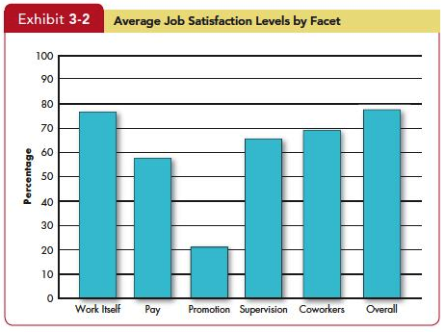
Define Job Satisfaction and Show How It Can Be Measured
LO 4
Insert Exhibit 3.2
Notes:
Most people are satisfied with their jobs in the developed countries surveyed. Research shows that over the past 30 years, the majority of U.S. workers have been satisfied with their jobs. As shown in Exhibit 3-2, people have typically been more satisfied with their jobs overall, with the work itself, and with their supervisors and co-workers than they have been with their pay and with promotion opportunities. Workers do seem to be less satisfied with their pay and promotion opportunities.

Slide 12
Summarize the Main Causes of Job Satisfaction
LO 5
Pay influences job satisfaction only to a point.
After about $40,000 per year (in the U.S.), there is no relationship between amount of pay and job satisfaction.
Money may bring happiness, but not necessarily job satisfaction.
Notes:
Pay has an influence on job satisfaction but not as much as one might think. Typically, once a worker exceeds $40,000 per year, pay has limited impact on the level of satisfied workers.

Slide 13
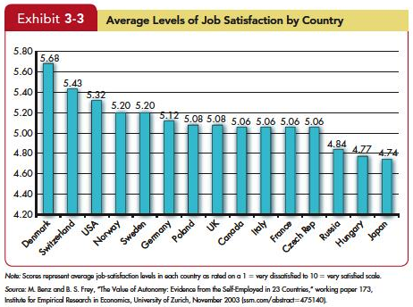
Summarize the Main Causes of Job Satisfaction
LO 5
Insert Exhibit 3-3
Insert Exhibit 3-22
Notes:
Interesting jobs that provide training, variety, independence, and control satisfy most employees. There is also a strong correspondence between how well people enjoy the social context of their workplace and how satisfied they are overall. Interdependence, feedback, social support, and interaction with co-workers outside the workplace are strongly related to job satisfaction even after accounting for characteristics of the work itself.

Slide 14
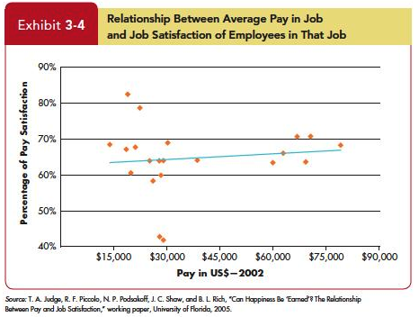
Summarize the Main Causes of Job Satisfaction
LO 5
Insert Exhibit 3-4
Insert Exhibit 3-22
Notes:
For people who are poor or who live in poor countries, pay does correlate with job satisfaction and overall happiness. But once an individual reaches a level of comfortable living (in the United States, that occurs at about $40,000 a year, depending on the region and family size), the relationship between pay and job satisfaction virtually disappears. Money does motivate people, as we will discover in Chapter 6. But what motivates us is not necessarily the same as what makes us happy. Maybe your goal isn’t to be happy. But if it is, money’s probably not going to do much to get you there.

Slide 15
Summarize the Main Causes of Job Satisfaction
LO 5
Personality also plays a role in Job Satisfaction.
People who have positive core self-evaluations, who believe in their inner worth and basic competence are more satisfied with their jobs than those with negative core self-evaluations.
Those with negative core self-evaluations set less ambitious goals and are more likely to give up when confronting difficulties.
Insert Exhibit 3-22
Notes:
Personality also plays a role in Job Satisfaction. Research has shown that people who have positive core self-evaluations who believe in their inner worth and basic competence—are more satisfied with their jobs than those with negative core self-evaluations. Not only do they see their work as more fulfilling and challenging, they are more likely to gravitate toward challenging jobs in the first place. Those with negative core self-evaluations set less ambitious goals and are more likely to give up when confronting difficulties.

Slide 16
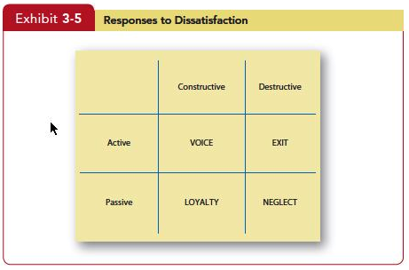
Identify Four Employee Responses to Dissatisfaction
LO 6
Insert Exhibit 3-5
Insert Exhibit 3-22
Notes:
There are a number of ways employees can express job dissatisfaction. These include Exit: a Behavior directed toward leaving the organization, including looking for a new position as well as resigning. Additionally Voice is actively and constructively attempting to improve conditions, including suggesting improvements, discussing problems with superiors, and some forms of union activity. Loyalty is passively, but optimistically, waiting for conditions to improve, including speaking up for the organization in the face of external criticism, and trusting the organization and its management to “do the right thing.” Lastly, Neglect involves passively allowing conditions to worsen, including chronic absenteeism or lateness, reduced effort, and increased error rate. Exit and neglect behaviors encompass our performance variables—productivity, absenteeism, and turnover. Voice and loyalty are constructive behaviors allow individuals to tolerate unpleasant situations or to revive satisfactory working conditions. It helps us to understand situations, such as those sometimes found among unionized workers, where low job satisfaction is coupled with low turnover.

Slide 17
Summary and Implications for Managers
Satisfied and committed employees have lower rates of turnover, absenteeism, and withdrawal behaviors.
Managers will also want to measure job attitudes effectively so they can tell how employees are reacting to their work.
The most important thing managers can do to raise employee satisfaction is focus on the intrinsic parts of the job, such as making the work challenging and interesting.
Although paying employees poorly will likely not attract high-quality employees to the organization or keep high performers, managers should realize that high pay alone is unlikely to create a satisfying work environment.
Insert Exhibit 3-22
Notes:
Some take-away ideas from this chapter on Attitudes and Job Satisfaction can be excellent guidelines for management skill development. Understanding these dimensions of Attitudes and Job Satisfaction will permit a manger’s focus on the skills to apply them to the employee/employer relationship. First, satisfied and committed employees have lower rates of turnover, absenteeism, and withdrawal behaviors. They also perform better on the job. Second, given that managers want to keep resignations and absences down—especially among their most productive employees—they’ll want to do things that generate positive job attitudes. Third, managers will also want to measure job attitudes effectively so they can tell how employees are reacting to their work. As one review put it, “A sound measurement of overall job attitude is one of the most useful pieces of information an organization can have about its employees.” The most important thing managers can do to raise employee satisfaction is focus on the intrinsic parts of the job, such as making the work challenging and interesting. Lastly, paying employees poorly will likely not attract high-quality employees to the organization or keep high performers, managers should realize that high pay alone is unlikely to create a satisfying work environment.

Slide 18
All rights reserved. No part of this publication may be reproduced, stored in a retrieval system, or transmitted, in any form or by any means, electronic, mechanical, photocopying, recording, or otherwise, without the prior written permission of the publisher. Printed in the United States of America.
Copyright © 2013 Pearson Education, Inc. publishing as Prentice Hall
Notes:
All rights reserved. No part of this publication may be reproduced, stored in a retrieval system, or transmitted, in any form or by any means, electronic, mechanical, photocopying, recording, or otherwise, without the prior written permission of the publisher. Printed in the United States of America.

