Slide 1
Apiculture
Dr. M. Asam Riaz
Assistant Professor
Entomology, College of Agriculture, University of Sargodha, Sargodha, Pakistan

Slide 2
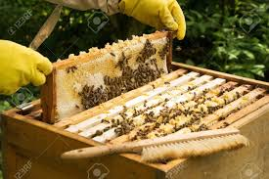
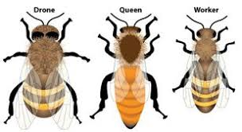
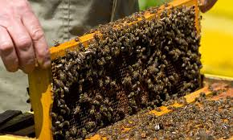
Cottage industry
Apiculture: rearing of honey bees for honey production
https://www.youtube.com/watch?v=IcctTeCYLGc

Slide 3
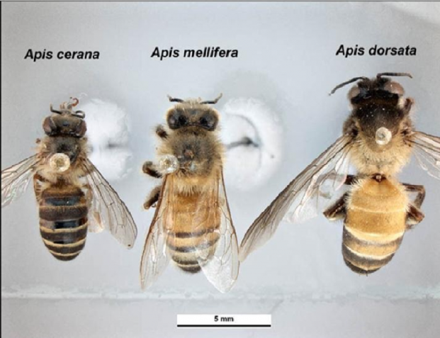
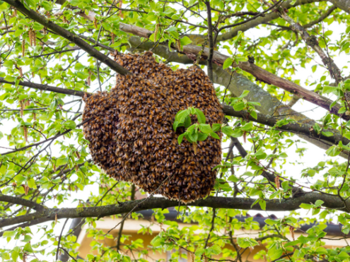
Species of honey bees
Apis dorsata
Wild bee (doomna makhi)
Live in colonies at rock bases or big trees
Honey 80lbs from single comb
Very ferocious (angry bees)
Sting is very painful
Live in open spaces (cant be domesticated)
They follow victims for miles if disturbed

Slide 4
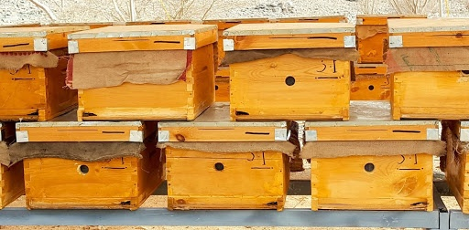
Apis mellifera
European bee (like Apis cerana)
Less swarming (flying of bees from the hive)
Honey 10-30 lbs
Live in concealed environment (can be domesticated) common in Pakistan
Bee hives

Slide 5
Apis cerana
Hill bee or domestic bee
Live in hives in close covers, crevices of rocks, walls and trees
Build several combs parallel to each other
Honey 20lbs per hive
Found in murree hills, hilly tracts of Peshawar, D.I. Khan

Slide 6
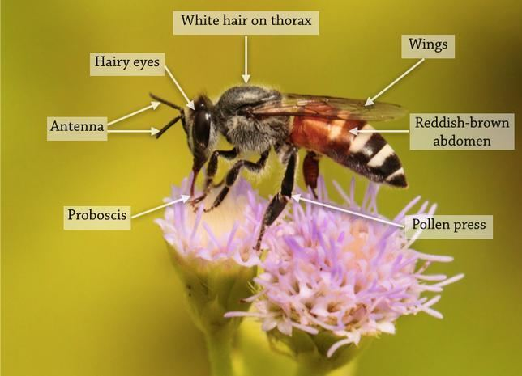
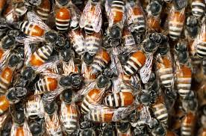
Apis florea
Small in size (choti makhi)
Single comb built in houses, branches or houses
Known as Stingless but they have sting
Honey few lbs (not economical)
Honey is liked for chemical properties

Slide 7
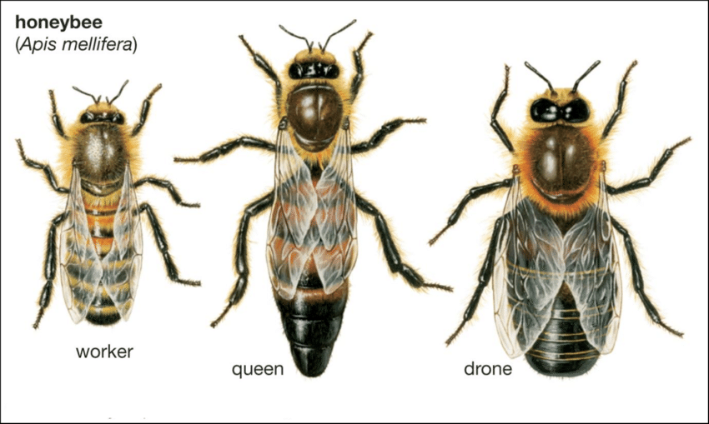
Biology of honey bee
Colony consists of
Queen,
Drones and
Workers
Queen
One queen per colony
Large abdomen and well developed sting (used to kill other queens before emergence)
Live from 2 to 3 years
lays 15, 000 eggs/day during active season
Fertilized eggs produce workers
Unfertilized eggs produce drones
Queen leaves colony only for mating, swarming or asbconding
Larvae of queen is reared in special cell and fed on richer more nourished Royal Jelly.

Slide 8
Drones
These are male bees
Have no sting
Fed by workers
Mate with queen
Live nearly 2 months

Slide 9
Workers
Females bees (don’t lay eggs and main strength of colony
5000 or more in one colony
First three weeks, they work indoor as
nurses,
hive cleaners,
wax makers,
honey makers,
guards and
stores of pollen and nectar
After three weeks, they work outdoor to bring nectars, pollen and water
Life is 6 weeks
In winter, they may live 6 months
Produce 1lbs wax by consuming 8-12lbs of honey

Slide 10
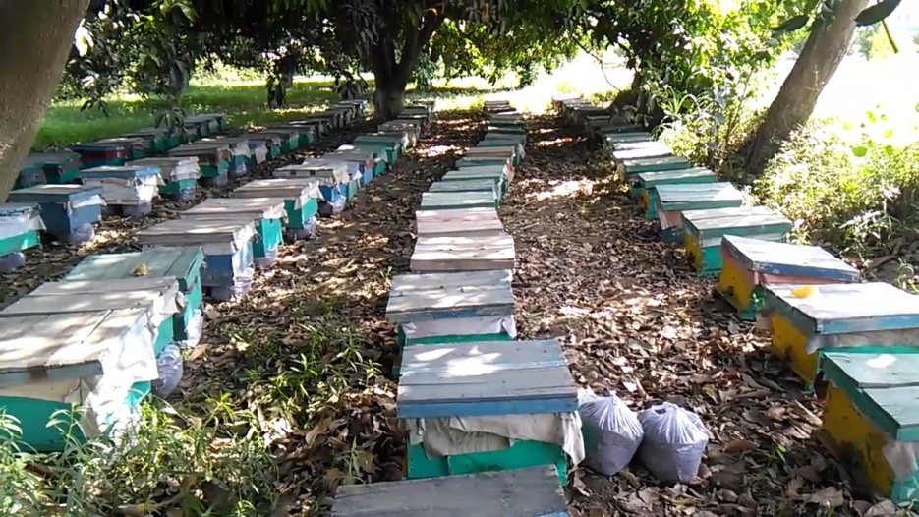
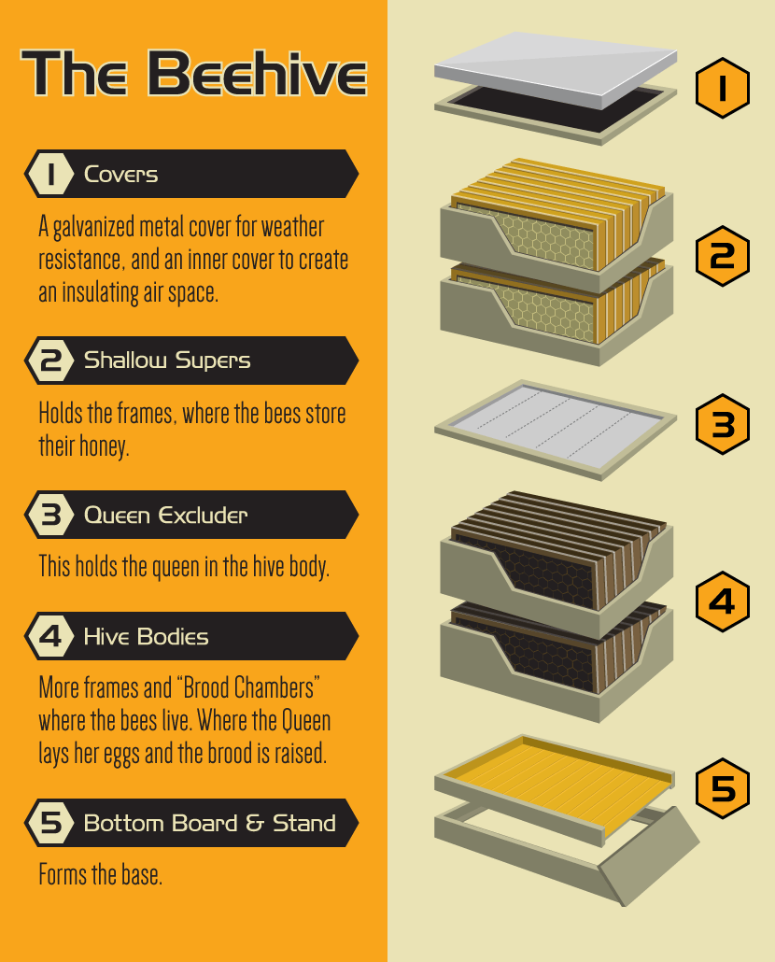
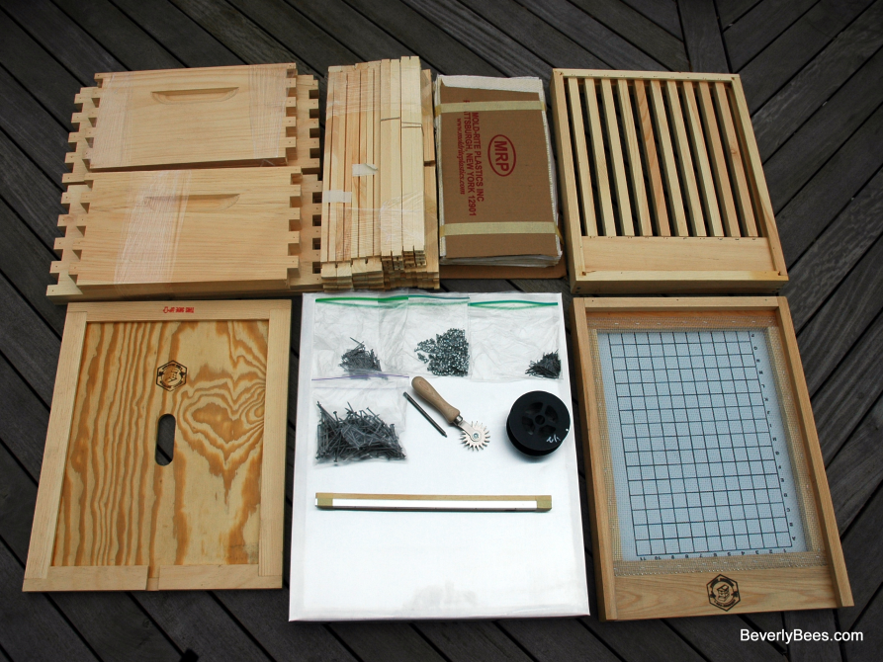
Shallow supers

Slide 11
Cycle of the year
Winter:
Bees don’t work,
sit together in hive and eat honey to produce heat
Spring:
queen starts laying eggs, worker bees rear brood (new larvae)
Colony become very strong during mid March and mid April
Bee hive is crowded and bee usually swarm (fly away with old queen from colony to find new place)
When new queen is about to emerge, old queen leaves with workers filled their stomach with honey and find new places
Scout Bees search for new place and whole colony settle with 2 to 48 hours

Slide 12
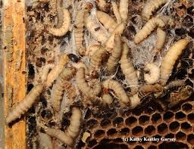
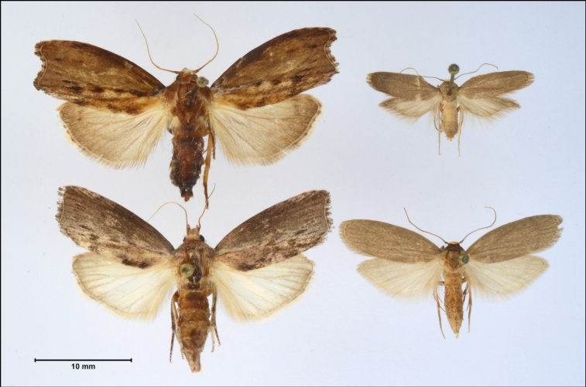
Enemies of bees
Wax moth
Feed on wax
Bees leaves the hive after its attack

Slide 13
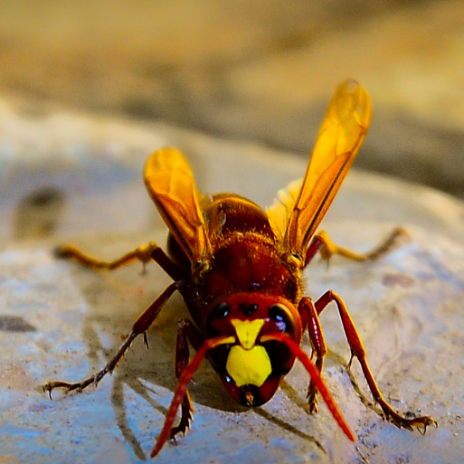
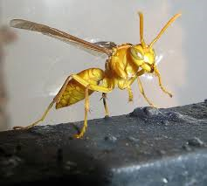
Hornets
Kills bee at hive entrance
Black ants
Theft of honey, pollen and nectar
Bees fight with ants
Bees may leave their hive

Slide 14
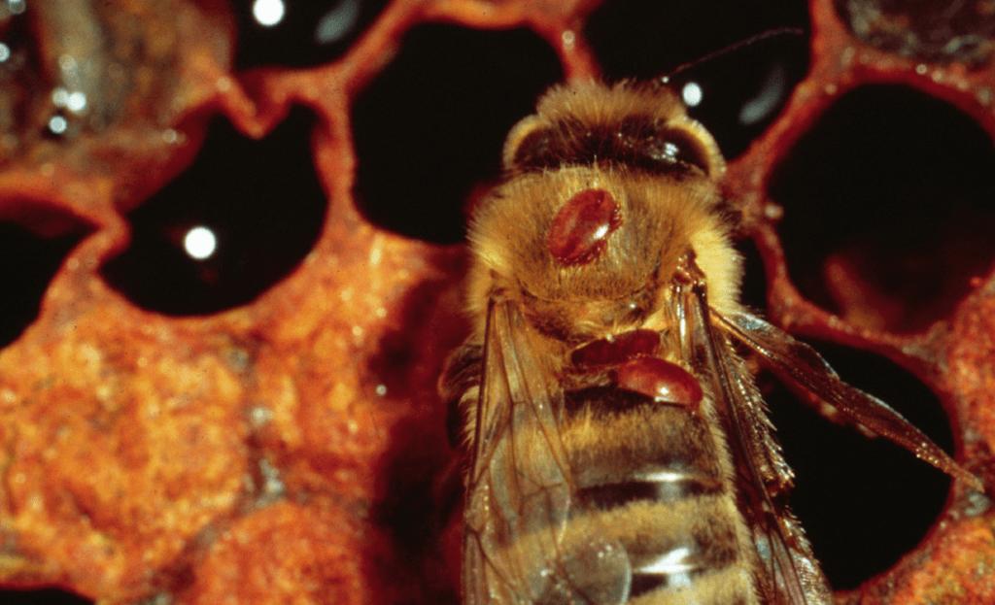
Varroa mites
Parasite of bees
Suck the blood of bees and make them weak

