Slide 1
Titration curve of weak acids

Slide 3
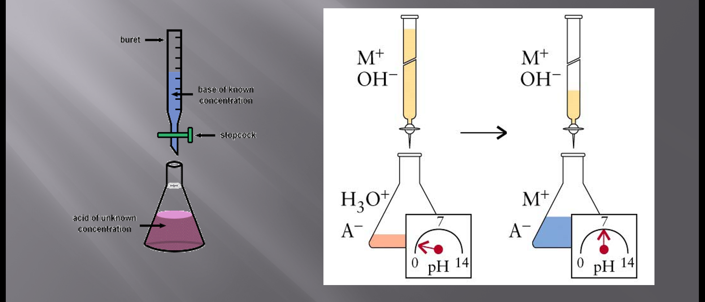
Titration

Slide 4
titration is a procedure for carrying out a chemical reaction between two solutions by the controlled addition from a burette of one solution (the titrant) to the other, allowing measurements to be made throughout the reaction.
For a reaction between an acid and a base, a titration is useful for measuring the pH at various points throughout the reaction. A titration curve is a graph of the pH as a function of the amount of titrant (acid or base) added.

Slide 6
The equivalence point of the titration is the point at which exactly enough titrant has been added to react with all of the substance being titrated with no titrant left over.
In other words, at the equivalence point, the number of moles of titrant added so far corresponds exactly to the number of moles of substance being titrated
In an acid-base titration, there is a 1:1 acid: base stoichiometry, so the equivalence point is the point where the moles of titrant added equals the moles of substance initially in the solution being titrated.)

Slide 7
The equivalence point for a weak acid-strong base titration has a pH > 7.00.
the pH will change rapidly at the very beginning and then have a gradual slope until near the equivalence point.
The gradual slope results from a buffer solution being produced by the addition of the strong acid or base, which resists rapid change in pH until the added acid or base exceeds the buffer's capacity and the rapid pH change occurs near the equivalence point.

Slide 8
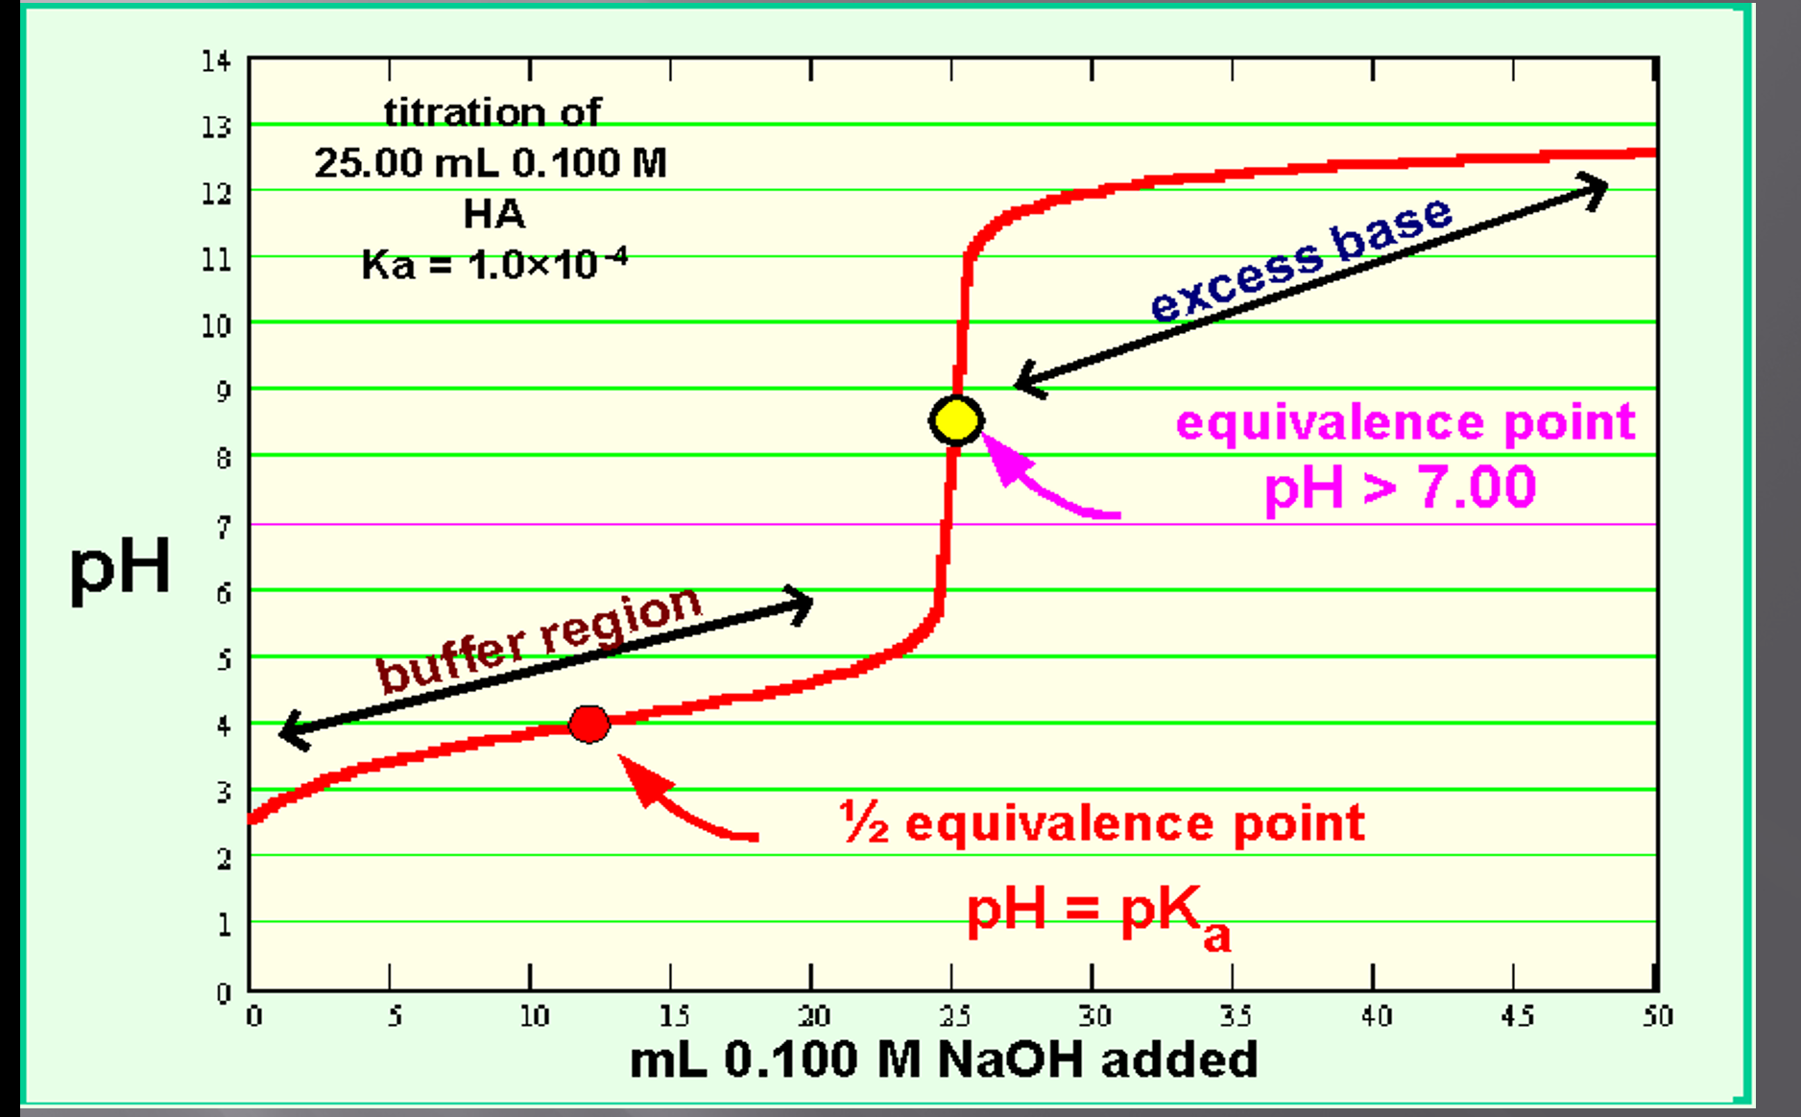

Slide 9
The most common use of titrations is for measuring unknown concentrations. This is done by titrating a known volume of the unknown solution with a solution of known concentration and finding the volume of titrant needed to reach the equivalence .
The volume and concentration of titrant can be used to calculate the moles of titrant added.
For acid-base titrations, the equivalence point can be found very easily.
A pH meter is simply placed in the solution being titrated and the pH is measured after various volumes of titrant have been added to produce a titration curve. The equivalence point can then be read off the curve.

Slide 10
Indicators can also be used to track the pH in a titration, usually as a means of detecting the equivalence point of the titration. The point in the titration at which the colour changes is known as the endpoint of the titration.

Slide 11
The endpoint of a titration is NOT the same thing as the equivalence point.
The equivalence point is a single point defined by the reaction stoichiometry as the point at which the base (or acid) added exactly neutralizes the acid (or base) being titrated.

Slide 12
The endpoint is defined by the choice of indicator as the point at which the colour changes. Depending on how quickly the colour changes, the endpoint can occur almost instantaneously or be quite wide.

Slide 13
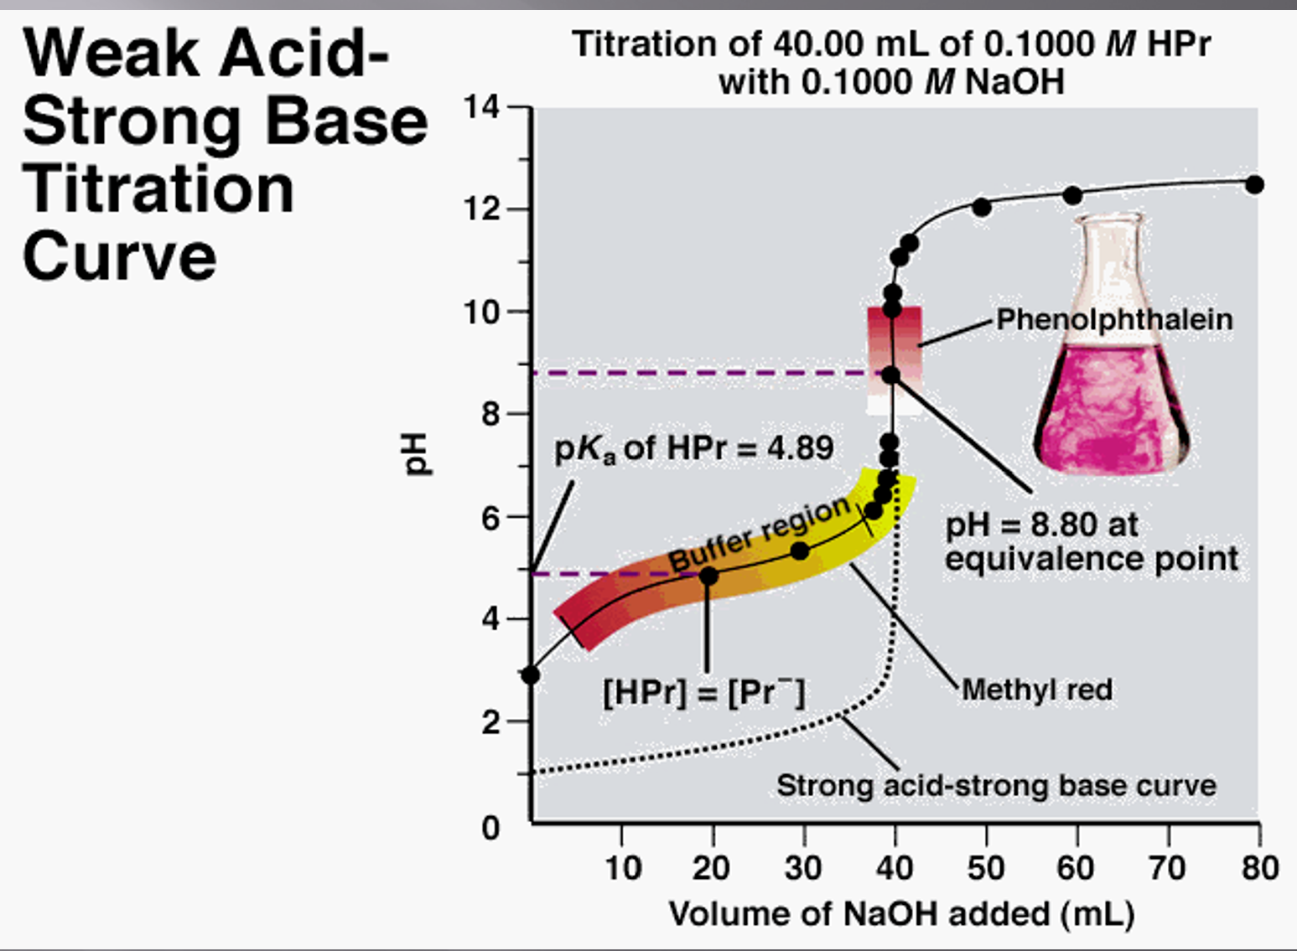

Slide 14
If an appropriate indicator is chosen such that the endpoint of the titration occurs at the equivalence point, then a colour change in the solution being titrated can be used as a signal that the equivalence point has been reached. the endpoint of the titration will occur at the equivalence point if we choose an indicator whose pKa IS EQUAL to the pH of the equivalence point. If such an indicator was chosen, the colour change would be half complete at the equivalence point. Unfortunately, this is very difficult to tell

