Slide 1
Witch weed (Striga)

Slide 2
Description
Present on sugarcane, rice, cow pea, tobacco & small grains.
First time reported in 1956 in USA
Root parasite

Slide 3
Symptoms
Affected plants stunted, wilted, turn yellowish
Flowers small, red, yellowish or white
Single plant can produce 5000-50000 seeds
Life cycle takes 90-120 days

Slide 4
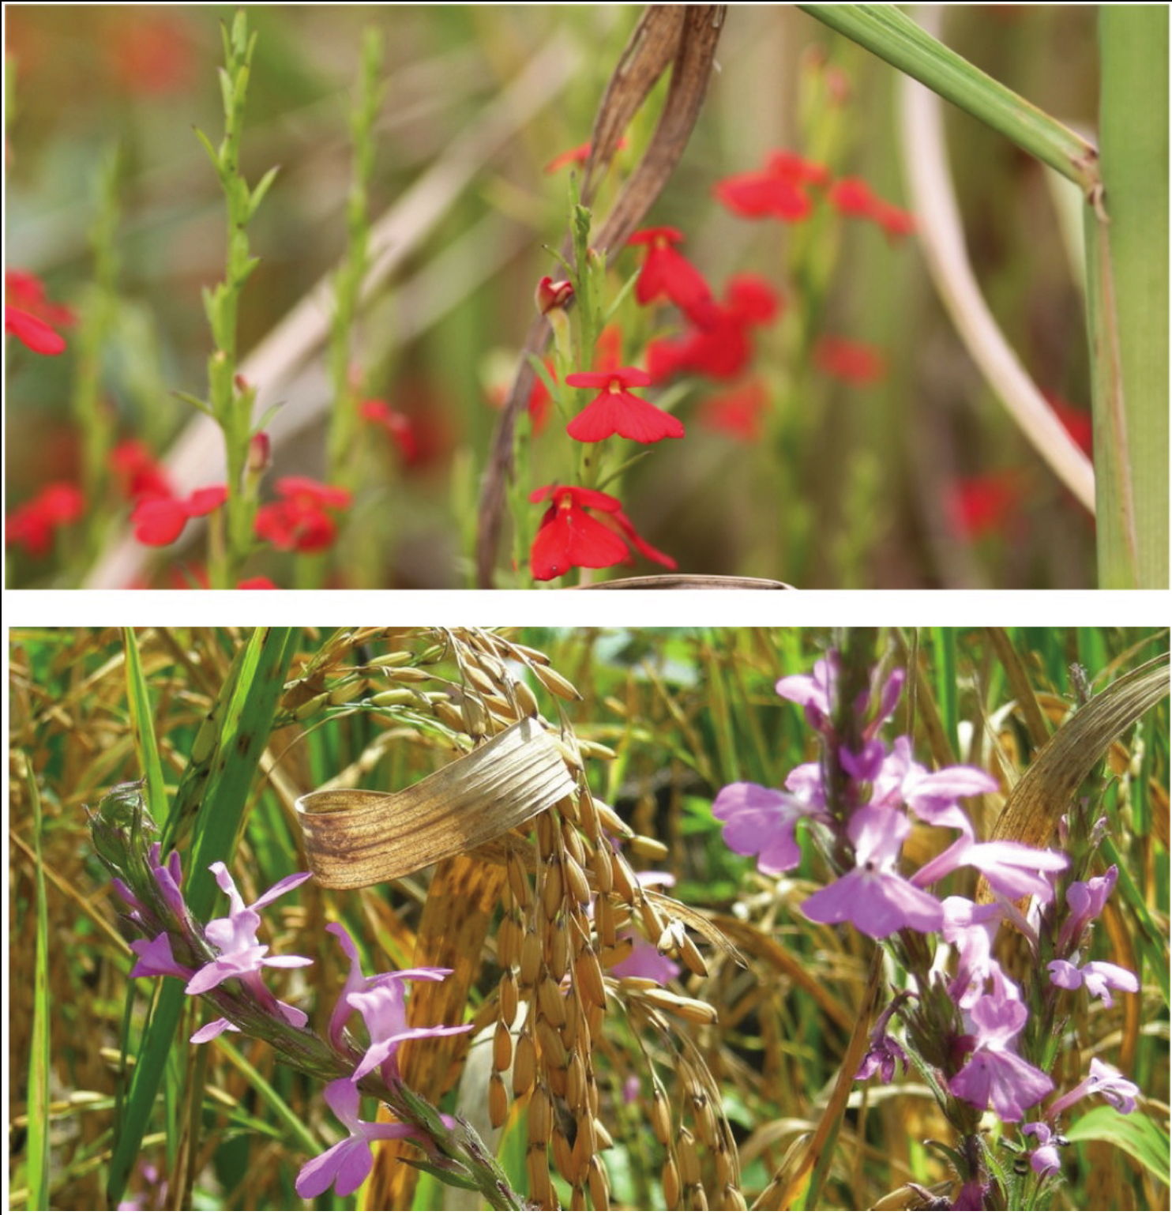
Symptoms

Slide 5
Management
Prevent introduction
Catch crops (stimulate germination & destroy)
Trap crops (initiate germination but not host)

Slide 6
Broomrapes (Orobanchae spp.)

Slide 7
Description
Occur in warm & dry regions worldwide
Cause losses up to 70 %
Root parasite
Produce cup like appressorium

Slide 8
Symptoms
Whitish to yellowish plant 15-50 cm tall
Pretty, white, yellow-white or purple flowers arise singly on stem
Over winter as seed, can survive 10 years in soil
Produce cup like appressorium

Slide 9
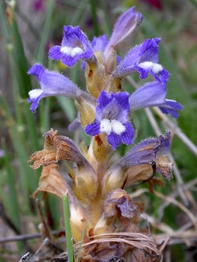
Symptoms

Slide 10
Management
Prevent introduction
Grow resistant crops
Removal of broomrape before seed producing
Fumigate soil with methyl bromide
Flax serve as a trap crop

Slide 11
Mistletoes
Mistletoes occur wherever conifers trees grow
Height of infected plants may reduced from 50-80 %
Some infected plants are killed by mistletoes
Stem parasite

Slide 12
Symptoms
Shoots of mistletoes occur along the twigs of host
Infected twigs and branches develop swellings and cankers on infected areas

Slide 13
Symptoms

Slide 14
Management
Physical removal of parasite is the only control

