Slide 1
Conflict resolution
By: Saba Ashraf
Noon Business School, University of Sargodha

Slide 2
What is conflict?
Conflict is an issue that will inevitably arise in any grouping of individuals, regardless of the context.
One of the most important and difficult aspects of a project manager’s job is to identify and resolve these conflicts because even the smallest argument can stop a promising project in its tracks

Slide 3
What is conflict Management?
Conflict Management is the practice of recognizing and dealing with disputes in a rational, balanced and effective way.
Conflict management implemented within a business environment usually involves effective communication, problem resolving abilities and good negotiating skills to restore the focus to the company’s overall goals

Slide 4
Sources of conflicts in project situations
Sources of Conflicts | Definitions
Conflict over project priorities | View of project participants will differ over sequence of activities and tasks
Conflict over administrative procedures | Managerial and Administrative oriented conflict over how the project will be managed
Conflict over technical options and Performance trade-offs | Disagreements over the technical issues, performance specifications and trade-offs

Slide 5
Sources of conflicts in project situations
Sources of Conflicts | Definition
Conflict over man power resources | Conflicts concerning staffing of project team with personnel from other areas
Conflict over cost | Conflict over cost estimates from support areas regarding work breakdown structures
Conflict over schedules | Disagreements about the timing, sequencing, and scheduling of project related tasks
Personality conflict | Disagreements on interpersonal issues

Slide 6
Techniques for conflict resolution

Slide 7
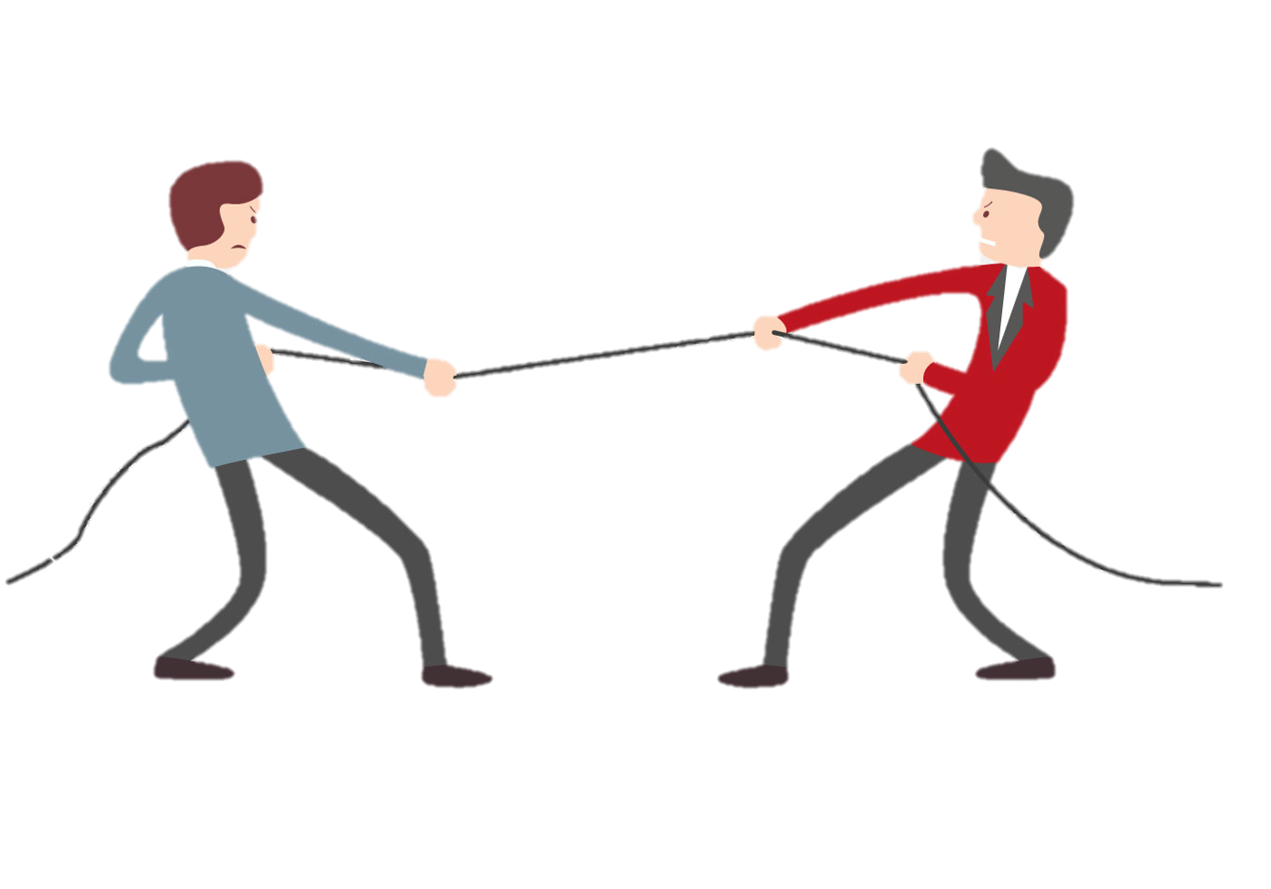
Competing/forcing
Forcing occurs when one party goes all out to win its position while ignoring the needs and concerns of the other party.
As the intensity of a conflict increases, the tendency for a forced conflict is more likely.
This results in a win-lose situation where one party wins at the expense of the other party.
Forcing should be used when:
A “do or die” situation is present.
Stakes are high.
Important principles are at stake.
Relationship among parties is not important.
A quick decision must be made.

Slide 8
Withdrawing/avoiding
It involves giving up, pulling out or retreating.
It also refers to refusal to deal with the conflict. It involves ignoring conflict as much as possible.
It is regarded as a temporary solution because the problem and conflict continue to reoccur over and over again.
Avoiding should be used when:
You cannot win.
Stakes are low.
Stakes are high, but you are not prepared.
You want to gain time.
You want to maintain neutrality or reputation.
You think problem will go away.
You win by delaying.

Slide 9
Smoothing/ accommodating
In this approach, the areas of agreement are emphasized and the areas of disagreement are downplayed.
Conflicts are not always resolved in the smoothing mode. A party may sacrifice it’s own concerns or goals in order to satisfy the concerns or goals of the other party.
Smoothing should be used when:
Goal to be reached is overarching.
You want to create obligation for a trade-off at a later time.
Stakes are low.
Liability is limited.
Any solution is adequate.
You want to be harmonious and create good will.
You would lose anyway.
You want to gain time.

Slide 10
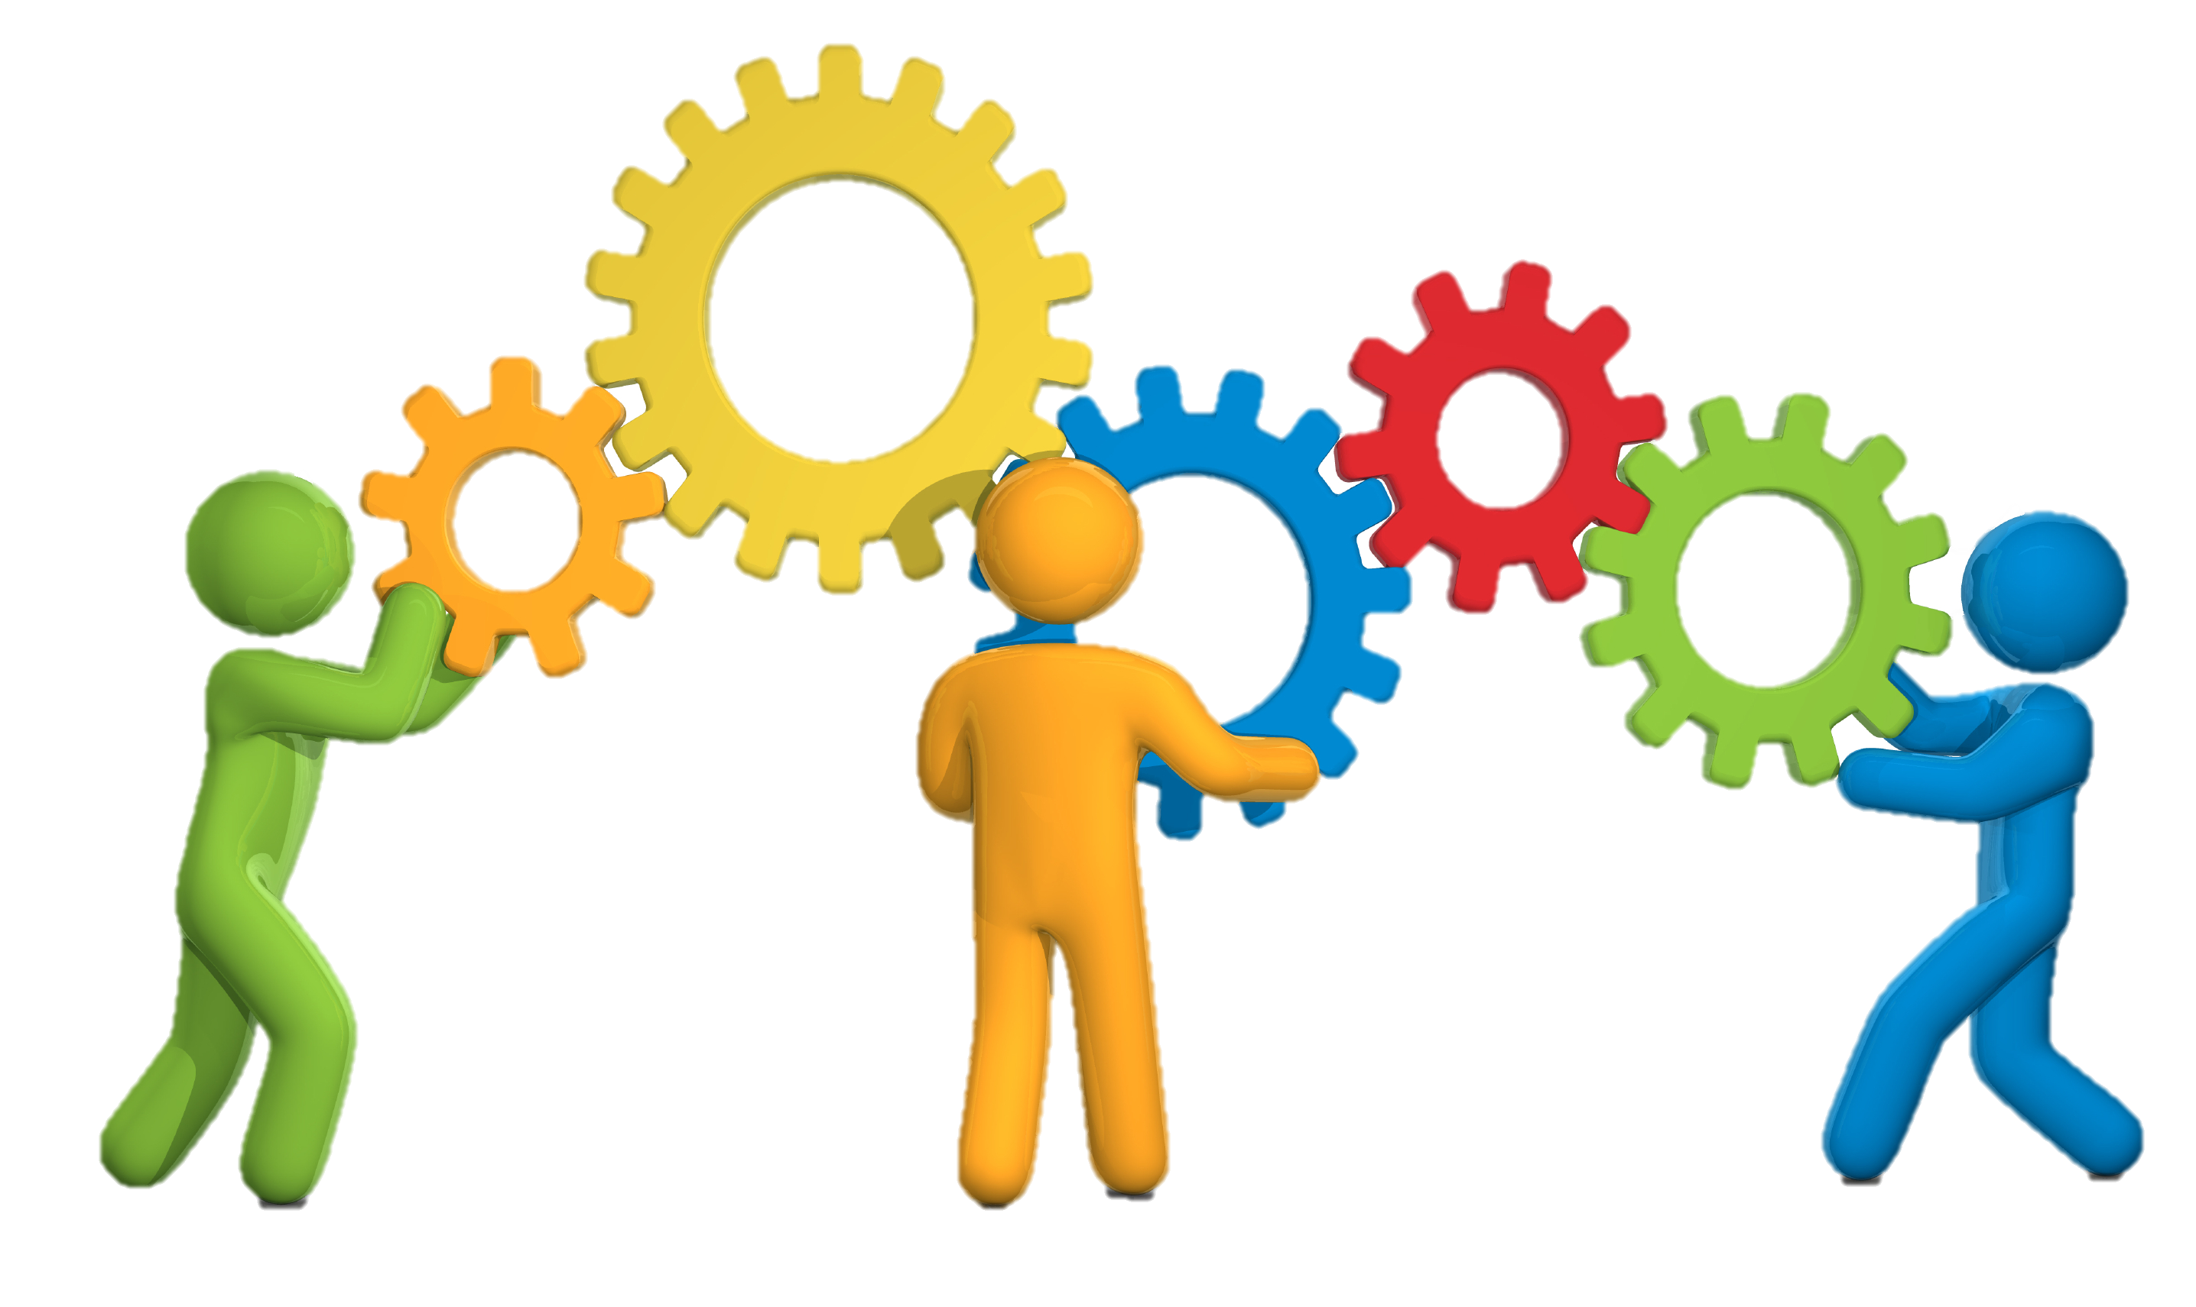
collaborating
This is also described as problem solving, integrating, collaborating or win-win style.
It involves the conflicting parties meeting face-to-face and collaborating to reach an agreement that satisfies the concerns of both parties.
This style involves open and direct communication which should lead the way to solving the problem.
Confronting should be used when:
Both parties need to win.
You want to decrease cost.
You want create a common power base.
Skills are complementary.
Time is sufficient.
Trust is present.
Learning is the ultimate goal.

Slide 11
compromising
It is primarily “bargaining” – receiving something in exchange for something else.
It involves considering various issues, bargaining, using tradeoff negotiations and searching for solutions that bring some degree of satisfaction to both parties involved in the conflict.
In this mode, neither party wins but both get some degree of satisfaction out of the situation.
Both parties need to win.
You are in a deadlock.
Time is not sufficient.
You want to maintain the relationship among the involved parties.
You will get nothing if you do not compromise.
Stakes are moderate.

Slide 12
Managing conflicts
Team ground rules, group norms, and solid project management practices, like communication planning and role definition, reduce the amount of conflict.
Successful conflict management results in greater productivity and positive working relationships.
When managed properly, differences of opinion can lead to increased creativity and better decision making.
If the differences become a negative factor, project team members are initially responsible for their resolution.
If conflict escalates, the project manager should help facilitate a satisfactory resolution.
Conflict should be addressed early and usually in private, using a direct, collaborative approach. If disruptive conflict continues, formal procedures may be used, including disciplinary actions.
The success of project managers in managing their project teams often depends on their ability to resolve conflict. Different project managers may use different conflict resolution methods.

