Slide 1
SPORTS PHYSICAL THERAPY
Akhtar Rasul

Slide 2
LECTURE NO 08 PERIPHERAL NERVE INJURIES (PART “B”)

Slide 3
PERIPHERAL NERVE INJURIES
CHAPTER OBJECTIVES
This chapter aims to introduce the structure and function of nerves and the neurological system, and the pathophysiology of common nerve injuries. The chapter also reviews some common nerve injuries, their assessment and evidence based treatment

Slide 4
PERIPHERAL NERVE INJURIES
Neurological conditions are common in athletes (Dimberg and Burns 2005) often dependant on the nature and intensity of the sporting activity (Toth 2009).
The upper extremity is particularly vulnerable to nerve injury (Dahlin 2008) due to its high mobility (Aldridge et al. 2001) and it is therefore unsurprising that the brachial plexus is the most commonly injured plexus in the body (Wilbourn 2007).

Slide 5
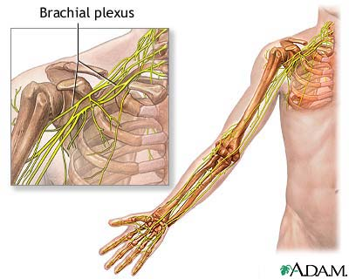
BRACHIAL PLEXUS

Slide 6
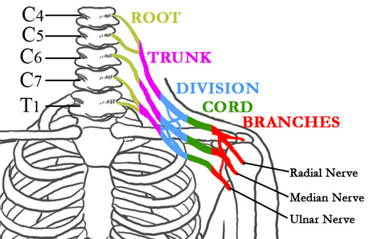
BRACHIAL PLEXUS

Slide 7
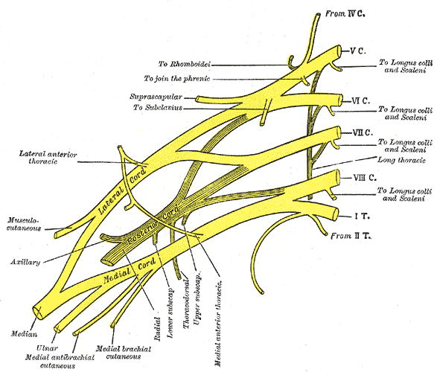
BRACHIAL PLEXUS

Slide 8
BRACHIAL PLEXUS NEUROPATHY
However, in contact and collision sports such as football and rugby, brachial plexus injuries occur often.

Slide 9
BRACHIAL PLEXUS NEUROPATHY Functional Anatomy
The common level of injury is at C5-C6
Damage to other areas of the spinal area can lead to an array of motor and sensory deficits.
C4 - Trapezius; shoulder; top of shoulders
C5 - Deltoid, rotator cuff; shoulder abduction; lateral upper arm or distal radius
C6 - Biceps, rotator cuff; elbow flexion; lateral forearm and thumb
C7 - Triceps; elbow extension; index and middle finger tips
C8 - Extension of fingers; distal thumb; fourth and fifth fingers

Slide 10
BRACHIAL PLEXUS NEUROPATHY Sport Specific Biomechanics
The following 3 mechanisms are common to brachial plexus injury:
Traction caused by lateral flexion of the neck away from the involved side (similar to the mechanism in birth trauma)
Direct impact to the Erb point causing compression to the brachial plexus (often associated with poor-fitting shoulder pads)
Nerve compression caused by neck hyperextension and ipsilateral rotation (The neural foramen narrows in this mechanism.)

Slide 11
BRACHIAL PLEXUS NEUROPATHY History
Symptoms
Pain in neck
Burning sensation between neck and shoulder
Paresthesias
Affected extremity may feel weak or heavy
Symptoms can last anywhere from a few seconds to weeks, depending on the extent of injury.
Numbness in both upper extremities should alert the physician to a possible cervical cord injury.

Slide 12
BRACHIAL PLEXUS NEUROPATHY Physical
The physician should keep a high index of suspicion for potential cervical fracture and/or cord injury in the face of an athlete with any degree of altered level of consciousness. In the alert and awake athlete, a full neurologic examination is warranted.
Assessment of immediate mental status
Cervical nerve root assessment (motor and sensory)
Tenderness over Erb point
Spurling test

Slide 13
Cervical Radiculopathy
C5 radiculopathy
deltoid and biceps weakness
diminished biceps reflex
C6 radiculopathy
brachioradialis and wrist extension weakness
diminished brachioradialis reflex
paresthesias in thumb
C7 radiculopathy
triceps and wrist flexion weakness
diminished triceps reflex
paresthesia in the index,middle, ring)
C8 radiculopathy
weakness to distal phalanx flexion of middle and index finger (difficulty with fine motor function)
paresthesias in little finger

Slide 14
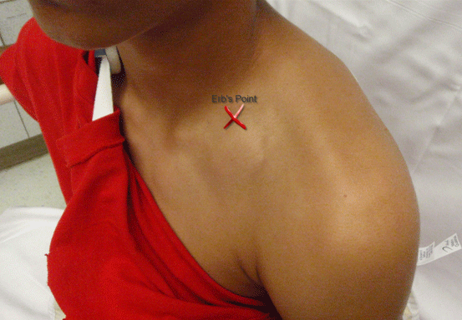
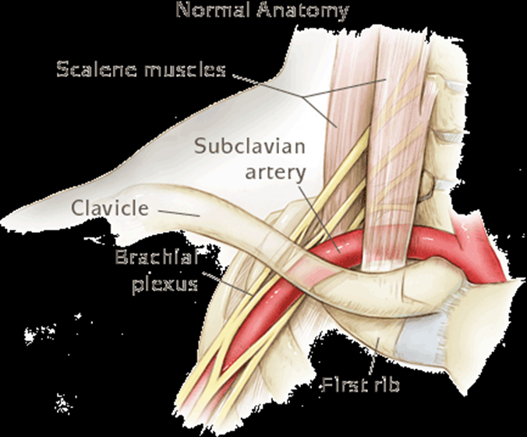
Erb point

Slide 15
BRACHIAL PLEXUS NEUROPATHY Physical
SPURLING TEST
The purpose of the Spurling test is to reproduce the symptoms of a brachial plexus injury by manipulation of the neck. A positive Spurling test successfully reproduces the patient's symptoms.

Slide 16
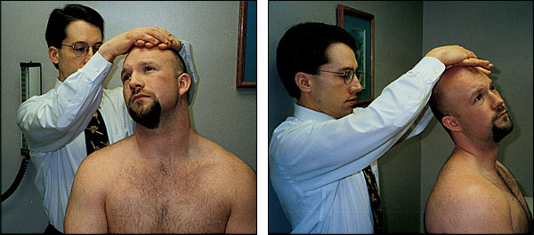
SPURLING TEST

Slide 17
BRACHIAL PLEXUS NEUROPATHY Stinger Syndrome
The superior trunk of the brachial plexus (C5 and C6) is thought to be the structure injured in this syndrome Aldridge et al.
More common in young adults who participate in sport (Unlu et al. 2007) and particularly in contact sports (Wilbourn 2007).

Slide 18
BRACHIAL PLEXUS NEUROPATHY Stinger Syndrome
INJURY BIOMECHANICS
The head and shoulder of the symptomatic side have been forced in opposite directions to each other (Weinstein 1998; Dimberg and Burns 2005)
Another mechanism of injury in Stinger Syndrome is where a compressive force forces the head and neck into the posterolateral corner, causing nerve root compression and thereby injuring the nerve (Weinstein 1998).
Finally, injury to the brachial plexus can occur as the result of a direct blow to the plexus region (Weinstein 1998)

Slide 19
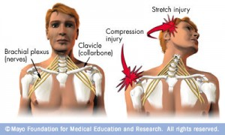

Slide 20
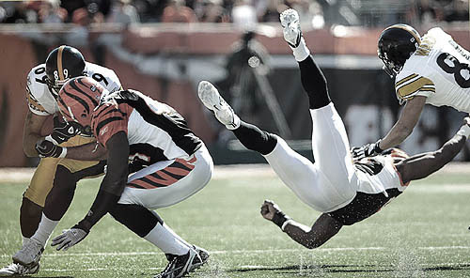

Slide 21
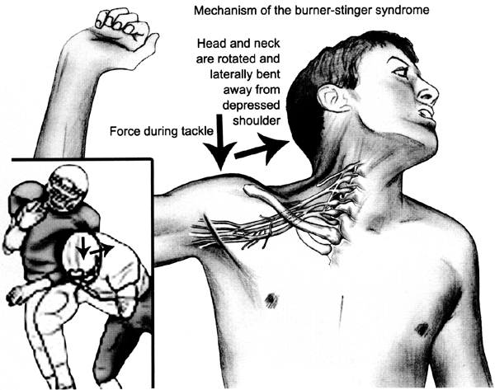

Slide 22
BRACHIAL PLEXUS NEUROPATHY Stinger Syndrome
SYMPTOMS
Generally involve a single upper extremity
Sharp, burning pain
Numbness accompanied by short-lived weakness down the arm
An important ﬁnding with Stinger Syndrome is that symptoms are unilateral (Wilbourn2007) and short-lived.
Neuropraxia and axontmesis are typically associated with this type of injury

Slide 23
BRACHIAL PLEXUS NEUROPATHY Stinger Syndrome
If the symptoms resolve within minutes and there is no evidence of reduced strength or disrupted movement of the neck, the athlete can be considered for return to play in the same competition (Dimberg and Burns 2005).

Slide 24
BRACHIAL PLEXUS NEUROPATHY Stinger Syndrome
TREATMENT STRATEGY
NSAIDs,
Fexibility and strength
Modiﬁcation of activity,
Nuerodynamics sliding techniques in the acute stage
Manual therapy of the cervical spine,
Range of movement activities for the shoulder
Strengthening of the shoulder and neck muscles,
Postural reeducation.

Slide 26
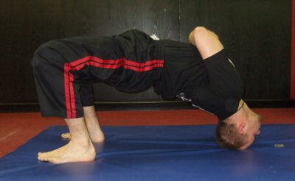
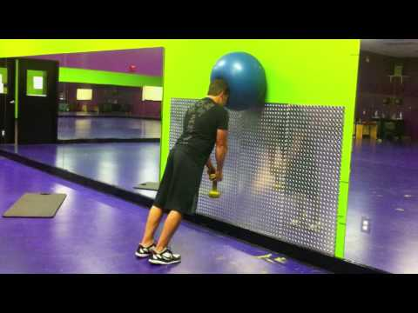
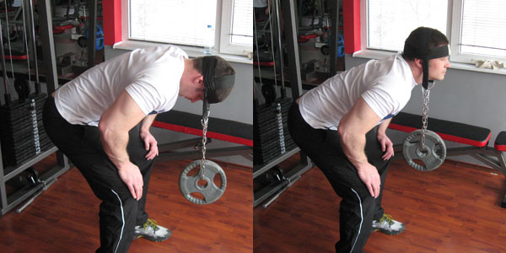

Slide 27
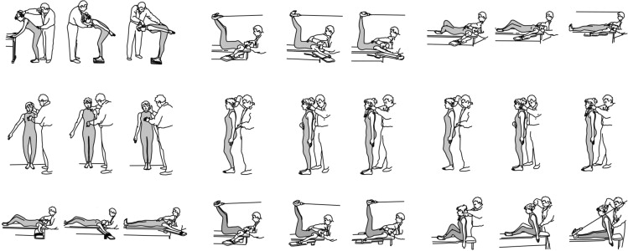
POSTURAL REEDUCATION

Slide 28
BRACHIAL PLEXUS NEUROPATHY Thoracic outlet syndrome
Three types of thoracic outlet syndrome:
Neurologic. Neurologic thoracic outlet syndrome occurs when nerves (brachial plexus) in thoracic outlet become compressed.
Venous. Venous thoracic outlet syndrome occurs when one or more of the veins below the collarbone are compressed, and can lead to blood clots in the veins.
Arterial. Arterial thoracic outlet syndrome results from compression of the large artery under the collarbone.

Slide 29
BRACHIAL PLEXUS NEUROPATHY Thoracic outlet syndrome
CAUSES THE NEUROVASCULAR COMPRESSION
Anterior scalene tightness Compression of the interscalene space between the anterior and middle scalene muscles.
Costoclavicular approximation Compression in the space between the clavicle, the first rib and the muscular and ligamentous structures in the area-probably from postural deficiencies or carrying heavy objects.
Pectoralis minor tightness Compression beneath the tendon of the pectoralis minor under the coracoid process-may result from repetitive movements of the arms above the head (shoulder elevation and hyperabduction).

Slide 30
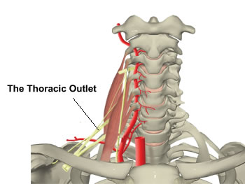

Slide 31
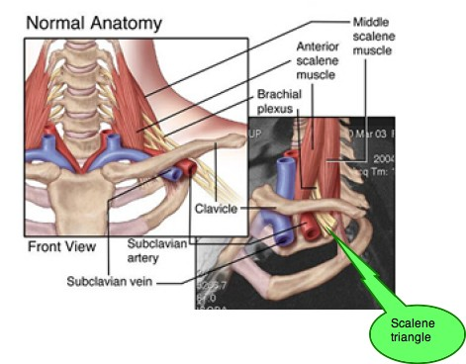

Slide 32
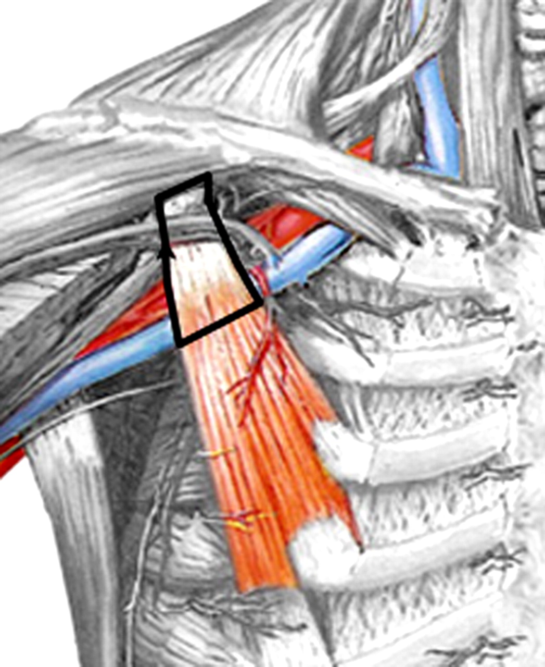

Slide 33
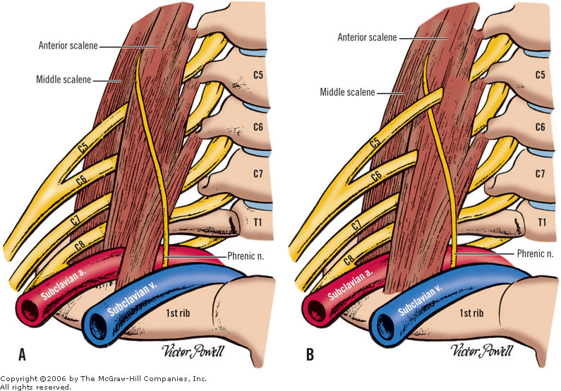
Find the difference

Slide 34
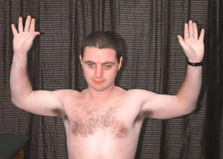
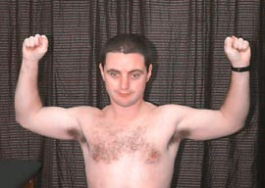
BRACHIAL PLEXUS NEUROPATHY Thoracic outlet syndrome
EAST Test or "Hands-up" Test
The patient brings their arms up as shown with elbows slightly behind the head. The patient then opens and closes their hands slowly for 3 minutes. A positive test is indicated by pain, heaviness or profound arm weakness or numbness and tingling of the hand.

Slide 35
BRACHIAL PLEXUS NEUROPATHY Thoracic outlet syndrome
Adson or Scalene Maneuver
The examiner locates the radial pulse. The patient rotates their head toward the tested arm and lets the head tilt backwards (extends the neck) while the examiner extends the arm. A positive test is indicated by a disappearance of the pulse.

Slide 36
BRACHIAL PLEXUS NEUROPATHY Thoracic outlet syndrome
Conservative treatment usually includes
local heat and a program which address postural retraining, shoulder strengthening and stretching exercises.
All of these exercises should be performed slowly and carefully.
Each position is assumed smoothly to the point where a stretch is felt intensely but with no pain.
Hold the stretch for 30 seconds and then gently and slowly release it. Wait 10 seconds and repeat the stretch 3-5 times. If the stretches increase the symptoms do not continue.

Slide 37
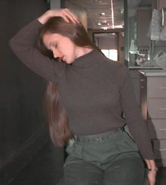
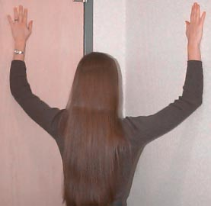
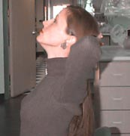

Slide 38
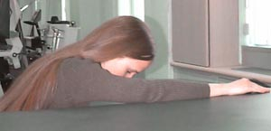

Slide 39
BRACHIAL PLEXUS NEUROPATHY Axillary nerve
The axillary nerve is the terminal branch of the posterior cord of the brachial plexus
Axillary nerve injury is a well-known complication of anterior glenohumeral dislocation
whereby on dislocation, the humeral head moves into the infra-articular fossa

Slide 40
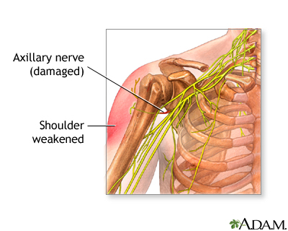
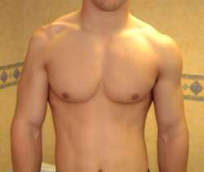

Slide 41
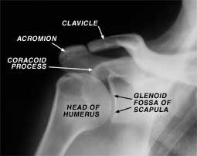
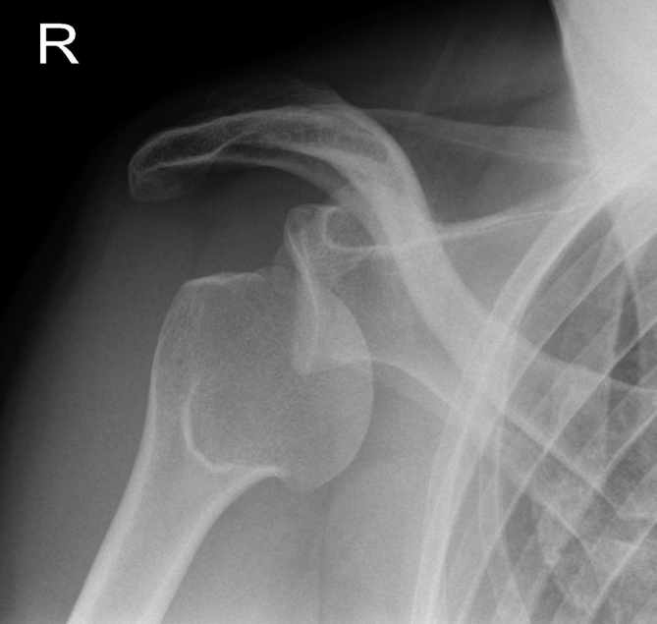

Slide 42
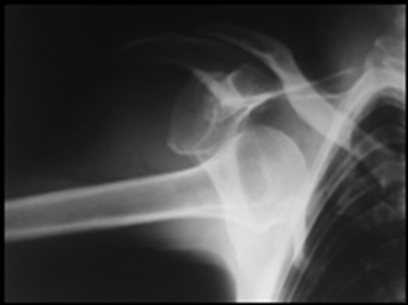
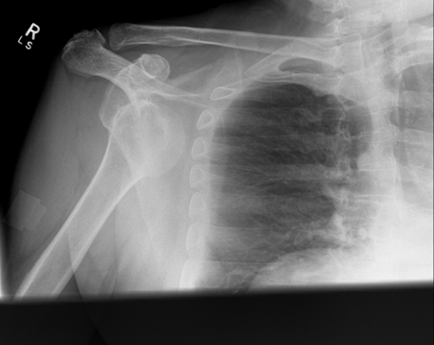

Slide 43
BRACHIAL PLEXUS NEUROPATHY Axillary nerve
MECHANISM OF INJURY
Resulting in stretching of the nerve around the humeral head and tension propagating to the infraclavicular brachial plexus (Pratt 2005)
Blunt trauma to the anterior/lateral aspect of the shoulder, typically seen in tackling during rugby.

Slide 44
BRACHIAL PLEXUS NEUROPATHY Axillary nerve
TREATMENT
Restoring full range of motion at the shoulder is a priority in the conservative treatment for the axillary nerve (Perlmutter and Apruzzese 1998)
Strengthening exercises for the rotator cuff and periscapular muscles should also be undertaken (Aldridge et al. 2001)
Nerve gliding exercises.

Slide 45
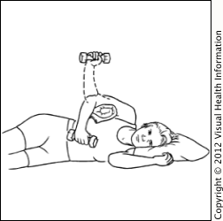
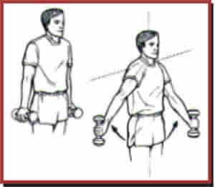
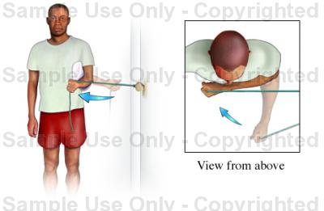
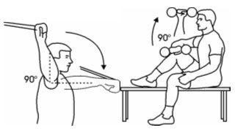

Slide 46
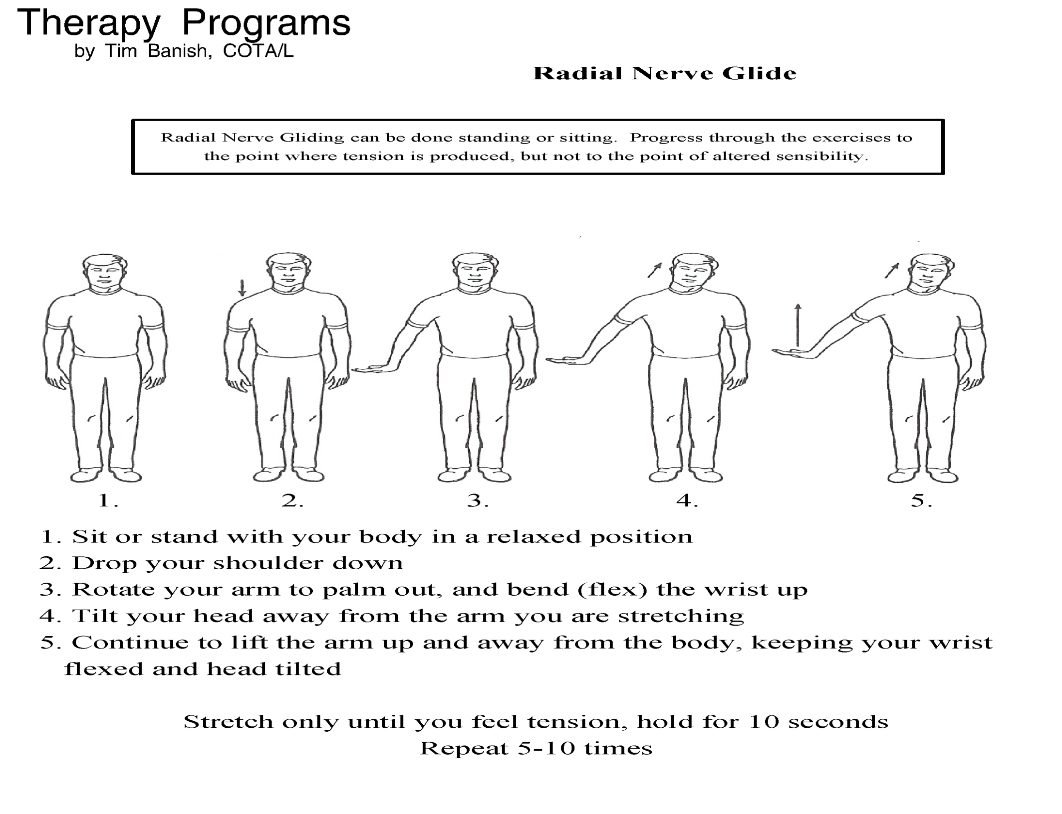

Slide 47
BRACHIAL PLEXUS NEUROPATHY Long thoracic nerve
The long thoracic nerve arises from the ventral rami of C5–C7 spinal nerves (Goslin and Krivickas 1999) and innervates exclusively the serratus anterior muscle
Consequently, traction or stretch of the long thoracic nerve, such as with extreme excursion of the shoulder girdle, is a common mechanism ofinjury for this structure (Goslin and Krivickas 1999; Pratt 2005).

Slide 48
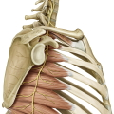
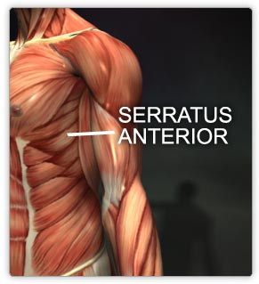

Slide 49
BRACHIAL PLEXUS NEUROPATHY Long thoracic nerve
MECHANISM OF INJURY
Maintaining static postures that keep the shoulder girdle elevated for long periods is an alternate way in which injury to the long thoracic nerve occurs (Goslin and Krivickas 1999; Pratt 2005).This is evident in patients with Saturday night palsy (Pratt 2005),

Slide 50
BRACHIAL PLEXUS NEUROPATHY Long thoracic nerve
CLINICAL FINDINGS
Scapula winging is the most prevalent clinical ﬁnding associated with injury to the long thoracic nerve (Aldridge et al. 2001)
An ache or burning pain in the posterior shoulder with associated weakness in arm elevation and abduction is an early ﬁnding having difﬁculty performing overhead activities

Slide 51
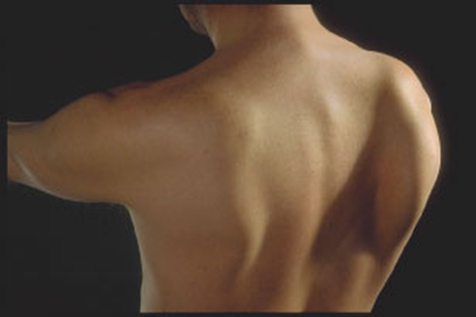

Slide 52
BRACHIAL PLEXUS NEUROPATHY Long thoracic nerve
TREATMENT
Treatment strategies for long thoracic neuropathy involve rest and avoidance or modiﬁcation of the aggravating activity Maintaining shoulder range of motion (Aldridge et al. 2001) and increasing the strength of trapezius and the rhomboids

Slide 53
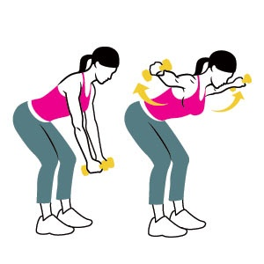
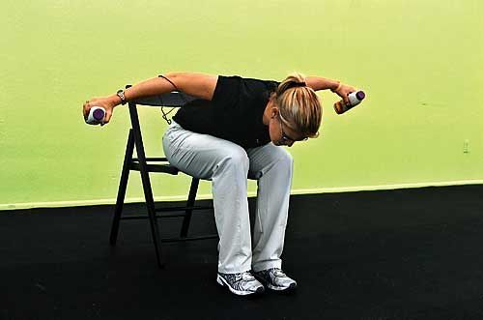

Slide 54
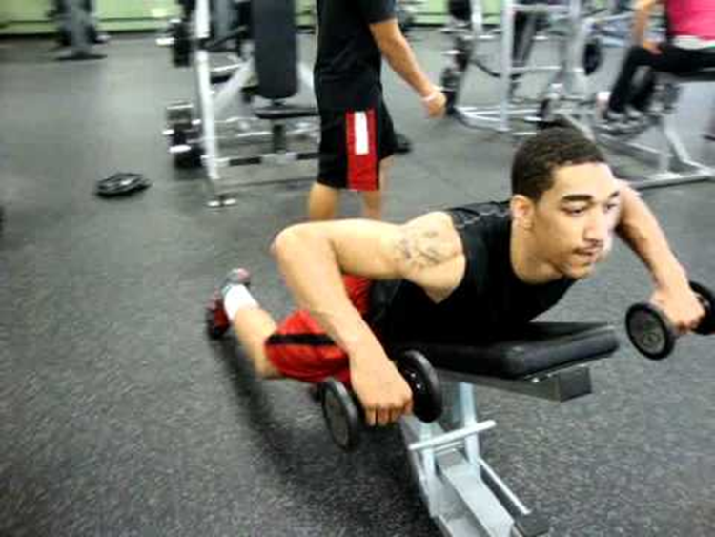

Slide 57
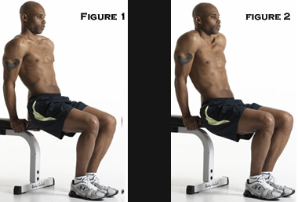
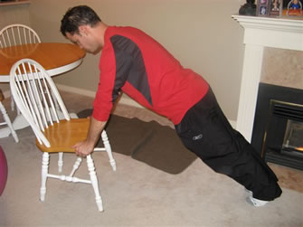

Slide 58
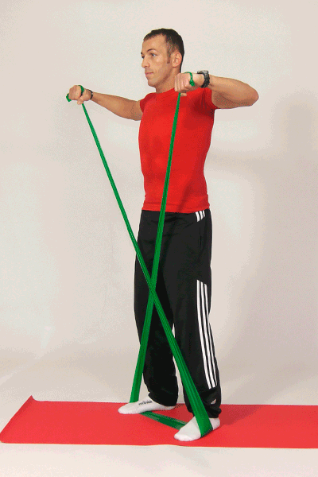

Slide 59
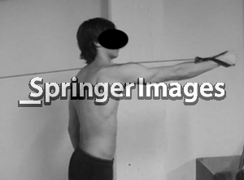
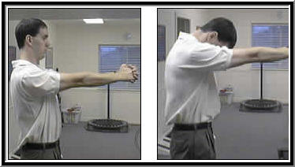
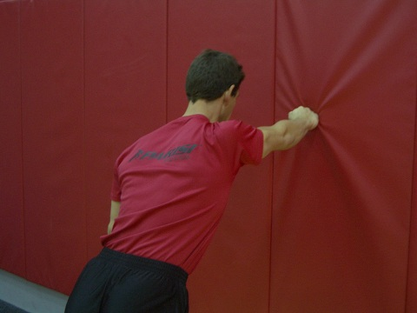
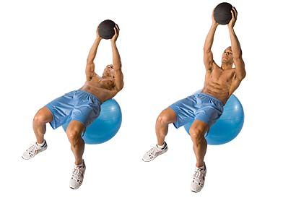

Slide 60
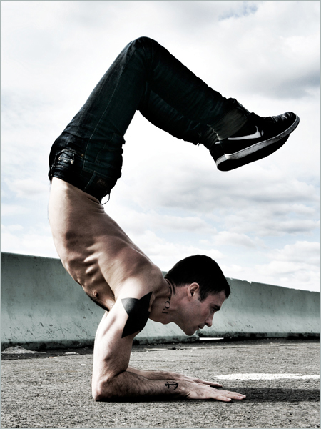

Slide 61
END OF LECTURE 9

