Slide 1
Economic Principles of Livestock Production (PRODUCT-PRODUCT Relationship)
By HANZALA ZULFIQAR

Slide 2
PRODUCT-PRODUCT RELATIONSHIP
Two or more than two outputs
Fixed level of inputs
To get maximum profit
Production Possibility Curve or Production Frontier

Slide 3
There are four relationship exist in Product-Product Relationship
Competitive Products
Supplementary Product
Complementary Product
Joint Product

Slide 4
Competitive Product
Two products are competitive in the use of given resources if an increase in the output of one product involves a reduction in the output of the other product.
The Marginal Rate of Product Substitution (MRPS), which indicates the quantity of one product that must be given up when the output of the other product is increased by one unit, is negative.
$MRPS=\frac{{∆Y}_{2}}{{∆Y}_{1}}$

Slide 5
1. Constant Rate
When the two products substitute for each other at a constant rate, marginal rate of product substitution remains constant over the range of possible product combinations. Example Two breeds of lamb or cows for a given area of range land
2. Decreasing Rate

Slide 8
Increasing Rate

Slide 11
Supplementary Product

Slide 13
Complementary Products

Slide 17
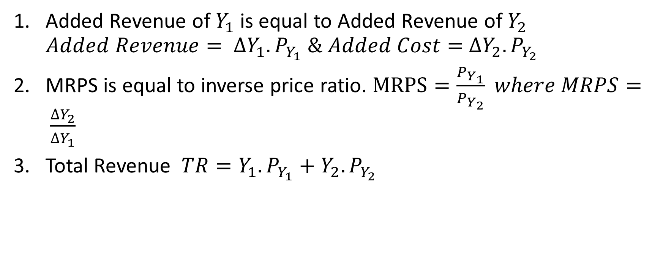
Optimum Product Combination
Added Revenue of $Y_{1}$ is equal to Added Revenue of $Y_{2}$ $Added Revenue= {∆Y_{1}.P}_{Y_{1}} \& Added Cost=$ ${∆Y_{2}.P}_{Y_{2}}$
MRPS is equal to inverse price ratio. $MRPS=\frac{P_{Y_{1}}}{P_{Y_{2}}} where MRPS= \frac{∆Y_{2}}{∆Y_{1}}$
Total Revenue ${TR=Y_{1}.P}_{Y_{1}}+{Y_{2}.P}_{Y_{2}}$

