Slide 1
MILK CHEMISTRY

Slide 2
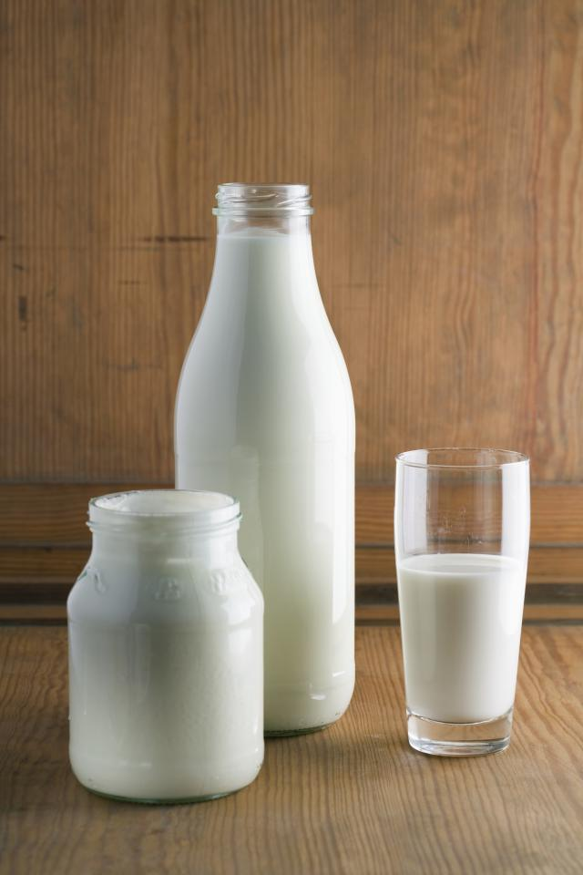
MILK CHEMISTRY
Milk is an oil in water emulsion
The water portion also contains
proteins
carbohydrates (lactose)
vitamins
minerals

Slide 3
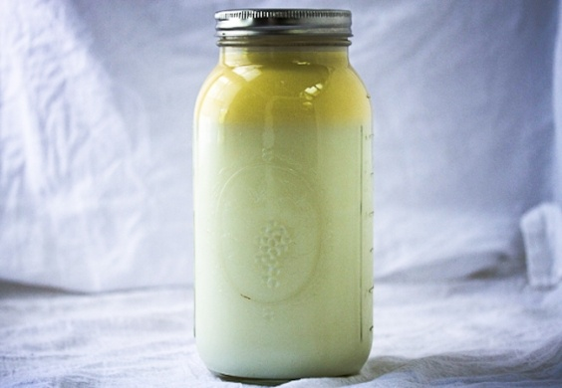
Milk Fat
Milk fat exists in the form of globules – Fat Globules
Fat globules are covered by a thick
membrane – Fat Globule Membrane
Largest but lightest particles of milk
Density = 0.93 gcm⁻³

Slide 4
Milk Fat (cont.)
Milk fat consists of:
Triglyceride (90%)
Diglyceride
Monoglyceride
Fatty acids
Sterols
Carotenoids
Fat soluble vitamins
Trace elements (minerals etc.)

Slide 5
Chemical Structure of Fat
Esters
ester
Fatty acid
alcohol

Slide 6
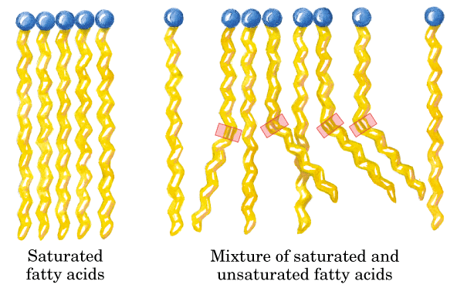
Fatty Acids in Milk
Butyric acid
Caproic acid
Caprylic acid
Capric acid
Lauric acid
Myristic acid
Palmitic acid
Stearic acid
Oleic acid
Linoleic acid
Linolenic acid
Arachidonic acid

Slide 7
Milk Protein
Two types
Casein
Whey

Slide 10
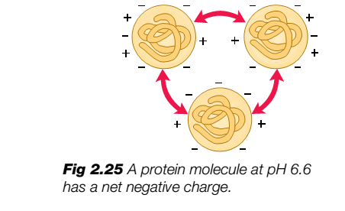

Slide 11
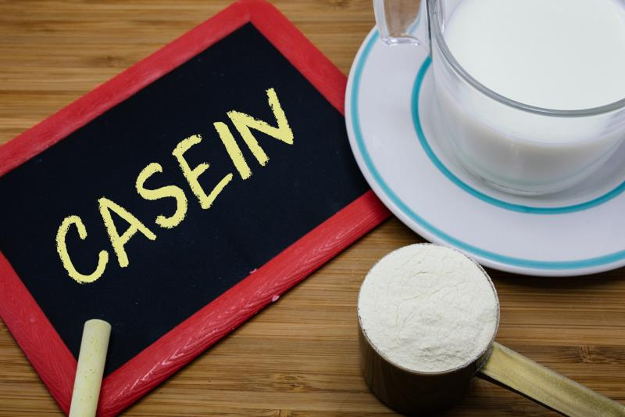
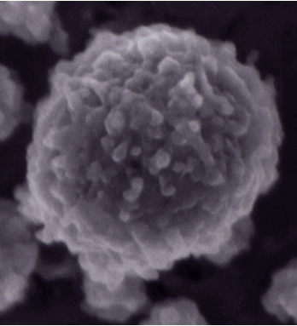
Casein
80% of milk proteins
Nutritionally very important
They precipitate out in milk
Four types of casein

Slide 12
Casein (cont.)
alpha_{S1} Casein - 30.6%
alpha_{S2} Casein - 8%
Beta Casein - 30.8%
Kepa Casein - 10.1%

Slide 13
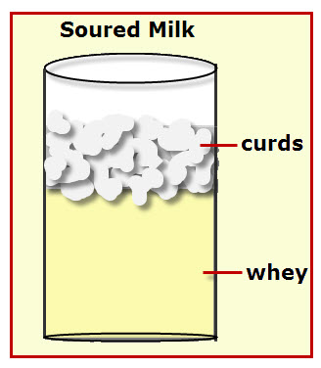
Whey
20% of milk proteins
Gives immunity (make major portion of clostrum)
Milk serum protein
Five types of whey

Slide 14
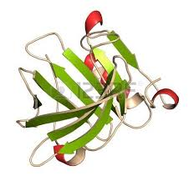
Whey (cont.)
a-lactalbumin - 3.7%
B-lactglobulin - 9.8%
blood serum albumin - 1.2%
immunoglobulin - 2.1
miscellaneous whey - 2.4%

Slide 15
Milk Enzymes Enzymes are bio catalysts and are protein in nature
Milk Enzymes
Natural
Peroxidase
Catalase
Bacterial
Lipase
Phosphatase
Protease

Slide 16
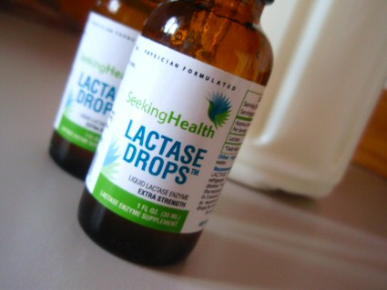
Carbohydrates
Lactose sugar make up the carbohydrate portion of milk. Its content varies between 3.5 – 5.5 %.
Glucose + Galactose → Lactose
Enzyme = Lactose Synthase
Lactose break down gives energy
Lactose → Glucose + Galactose
Enzyme = Lactase

Slide 17
CARBOHYDRATES (cont.)
Lactose is attacked by lactic acid bacteria resulting into the production of:
Lactic acid
Maliec acid
citric acid
propanic acid
This phenomenon makes the milk sour.

Slide 18
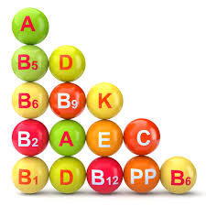
Vitamins
vitamin | Amount mgl⁻
Vitamin A | 0.2 – 2
Vitamin B₁ | 0.4
Vitamin B₂ | 1.7
Vitamin C | 5 -20
Vitamin D | 0.002

Slide 19
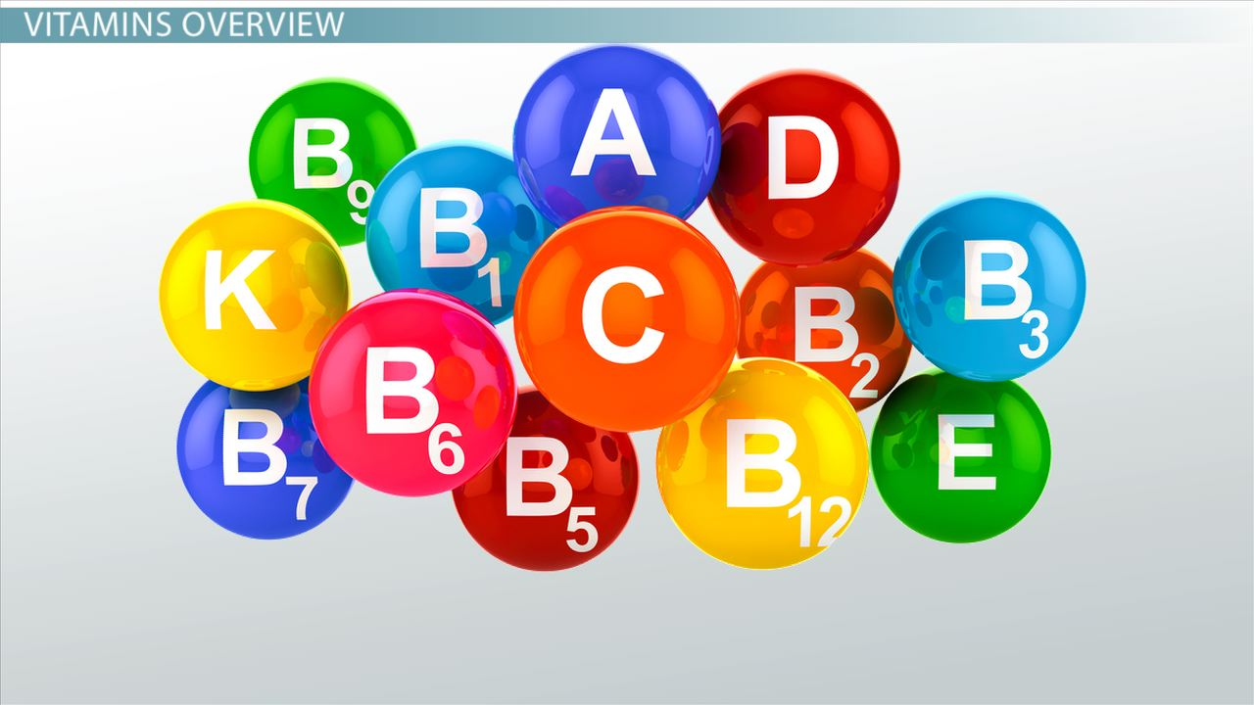
Vitamins (cont.)
Vitamin A and D are found in fat globules or around them while vitamin B and C are found in serum.
Although having an abundant amount of vitamin C, milk is not a good source of it as vitamin C is highly sensitive to heat and light and is lost even at pasteurization.

Slide 20
Minerals
Minerals content = less than 1 %
Most common are calcium, magnesium, sodium and potassium ions and they exist in the form of phosphates, chlorides, citrates and caseinates (mineral salts)

Slide 21
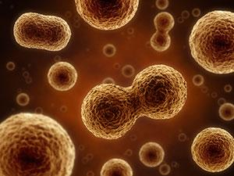
Minor Constituents
Somatic cells
Somatic cells are the cells of the animal other than the reproductive cells
always present in milk
A healthy animal has almost two lac somatic cells per ml
if the animal is diseased then their amount increases
The acceptable limit is four lac somatic cells per ml.

Slide 22
MINOR CONSTITUENTS (cont.)
Dissolved Gases
5 – 6 % by volume dissolved gases are present in milk.
Most of them are nitrogen, oxygen and carbondioxide.
Industries do deaeration in order to tackle the problem of oxidation and volume increase.

Slide 23
