Slide 1
Mathematics Laboratory BS Education-V Teaching Mathematics (EDU-511)
Department of Education University of Sargodha

Slide 3
How to set up a mathematics laboratory in elementary school
Iqra Aslam (Roll No: BEUF18M015)
Teaching of Mathematics (EDU-511)
BS Education (semester 5)
Department of Education
University of Sargodha, 40100 Sargodha, Pakistan
October 2020

Slide 4
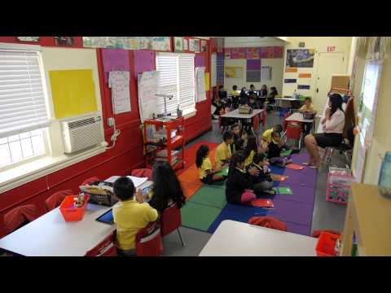
Mathematics laboratory:
The Mathematics Laboratory is a place, rich in manipulative material, to which children have ready access to handle them, perform mathematical experiments, play mathematical games, solve mathematical puzzles and become involved in other activities.

Slide 5
Need and purpose of mathematics laboratory:
It provide an opportunity to students to understand the basic mathematical concepts through concrete objects and situations.
It enables the students to verify or discover several geometrical properties and facts using models or by paper cutting and folding techniques.
It helps the students to build interest and confidence in learning the subject.
It provide greater scope for individual participation in the process of learning.
It provide scope for greater involvement of both the mind and the hand which facilities cognition.
It enables the teachers to demonstrate, explain and reinforce abstract mathematical ideas by using charts, graphs, pictures, posters, etc.

Slide 6
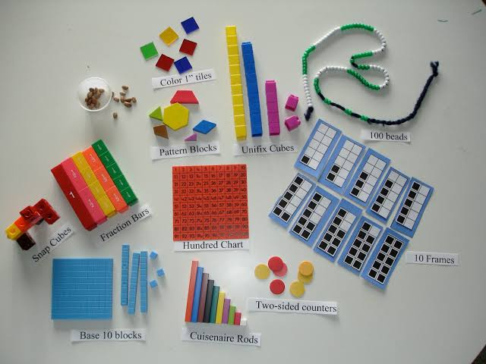
Materials & Equipments for a Mathematics Laboratory:
Materials:
Concrete Materials
The Mathematics Lab should contain such as beads, pebbles, sticks ball frames, balances, weight measuring tapes, scissors, pins, car boards, board pins, chart paper, graph paper, etc. which are very helpful for demonstrating elementary mathematical concepts.

Slide 7
Pictures & charts:
Picture & charts depicting mathematical concepts should find a place in a Mathematics laboratory, pictures of Mathematics; charts showing the contributions of mathematics, History of mathematics, biographers of mathematics are also very helpful for demonstrating students and can be placed in the mathematical Lab.

Slide 8
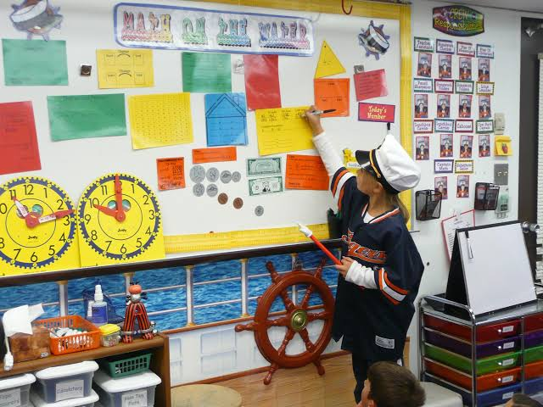
Bulletin Board:
There should be at least one bulletin board in the mathematics laboratory to display various illustrations concerning mathematics.
Black board:
A black board should be provided in the mathematics lab. This helps in writing instructions, drawing geometrical figures and illustration necessary for performing the laboratory work.

Slide 9
Instruments & Equipments:
Drawing Instruments:
In Mathematics Lab, the students are required to draw and sketch geometrical figures, graphs and so on. Therefore in every mathematics lab there should be a set of drawing instruments like compass, rulers, protractor, etc. for the teachers to demonstrate the drawing on the black board and instrument boxes for the students’ use.
Weighing & Measuring Instruments:
Mathematics lab work quite often, involve the important activities of weighing and measuring. Therefore, instruments tapes balances measuring jar should be there used for measuring of different types and graduated cylinder in a mathematics lab.

Slide 10
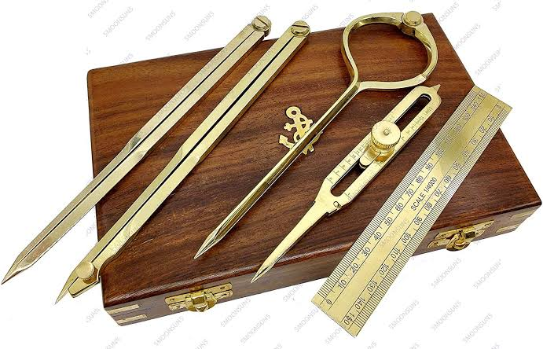
Proportional Dividers:
This instruments works on the principle of proportionality of similar triangles. It can be used for enlarging or reducing figures, picture, maps and graphs. Etc.

Slide 11
Functions of a Mathematics Laboratory:
The primary functions of a mathematics laboratory are to:
Make mathematics teaching & learning interesting and purposeful for the students.
Provide activities that arouse the curiosity of the students & maintain their interest in learning.
Enables students to develop proper skills in handling equipments & gadgets.
Help the students develop power of observation, analysis, and drawing inferences.

Slide 12
Conclusion:
Mathematics Laboratory is a place where students can learn and explore mathematics concepts and verify mathematical facts and theorems through a variety of activities using different materials. These activities may be carried out by the teacher or the student to explore, to learn, to stimulate interest and develop favorable attitude towards mathematics.

