Slide 1
Organization and Administration of Emergency Care
Dr.Waqas

Slide 2
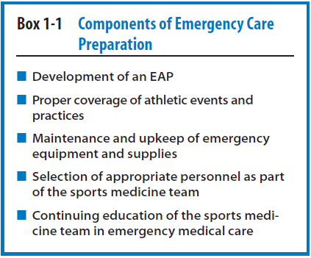

Slide 3
Factors to consider in the proper organization and administration of emergency care in athletic activity include the following:
1. Development and implementation of an EAP
2. The sports medicine staff and emergency team
3. Initial patient assessment and care
4. Emergency communication
5. Emergency equipment and supplies
6. Venue locations
7. Emergency transportation
8. Emergency care facilities
9. Legal need and documentation

Slide 4
Sports Medicine Staff and Emergency Team
The implementation of an EAP cannot take place without the formation of an emergency team.
The primary members of this team consist of the sports medicine staff, which includes team physician , physical therapist and athletic trainer.
During an emergency the makeup of the emergency team can vary depending on who is at the scene at the time of the emergency

Slide 5
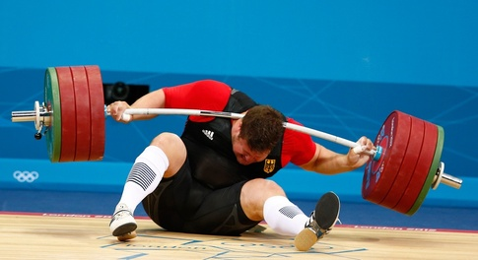

Slide 6
Any member of the emergency team can act as a first responder.
A first responder is defined as a person who has been trained to provide emergency care before EMS arrives on the scene.
All members of the emergency team should be trained and certified in
first aid
cardiopulmonary resuscitation (CPR)
automatic external defibrillation (AED)
and prevention of disease transmission (blood borne pathogens).
Frequent EAP review and practice should be required for all members of the emergency team.

Slide 8
In any emergency situation the roles of the members of the emergency team will vary depending on
how many people are on the team,
the venue that is being used,
and the preferences of the in charge who execute the EAP.

Slide 9
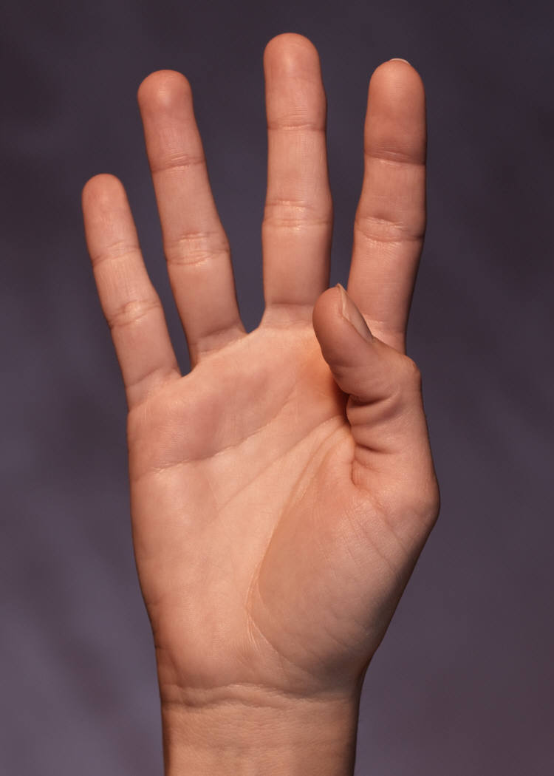
The four roles within the emergency team
1. Immediate care of the athlete
2. Emergency equipment retrieval
3. Activation of the EMS system
4. Direction of EMS to the scene of the emergency

Slide 10
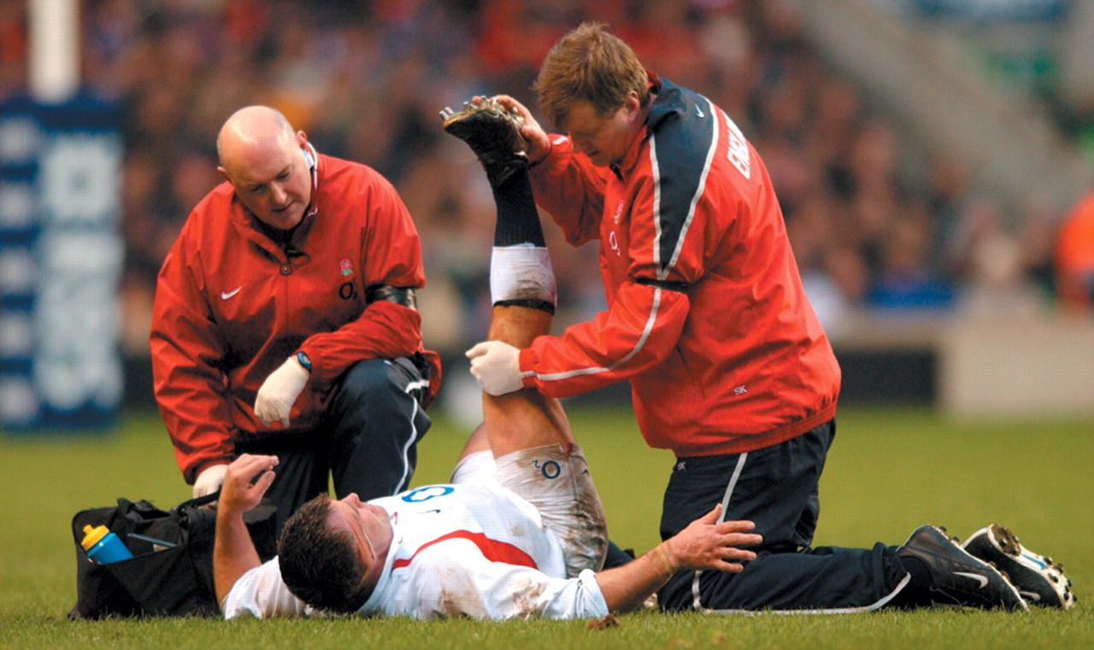
Notes:
Immediate care of injured athlete

Slide 11
The first and most important role involves the immediate
care of the injured athlete.
The most qualified individual should be on the scene capable of provide acute care in an emergency situation.
This person should be trained in
patient care
have good knowledge of the organization’s EAP.
Individuals who are less qualified, such as coaches or
equipment managers, should yield to those who have more appropriate medical care training

Slide 12
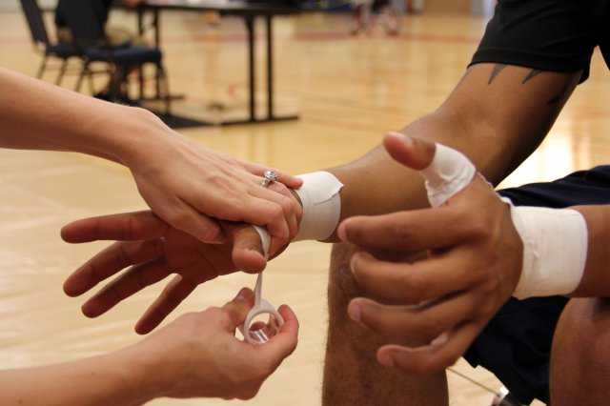

Slide 13
Emergency equipment retrieval may be performed by a person on the emergency team who is familiar with the names and locations of the specific equipment that is required.
Athletic training students would fit this role nicely.
All necessary emergency equipment should be on site, in good condition, and easily accessible.
Examples of emergency equipment include splints, spine board, bag valve mask, an AED device, first aid kit, and cell phone.

Slide 14
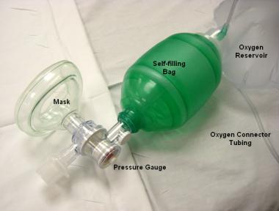

Slide 15
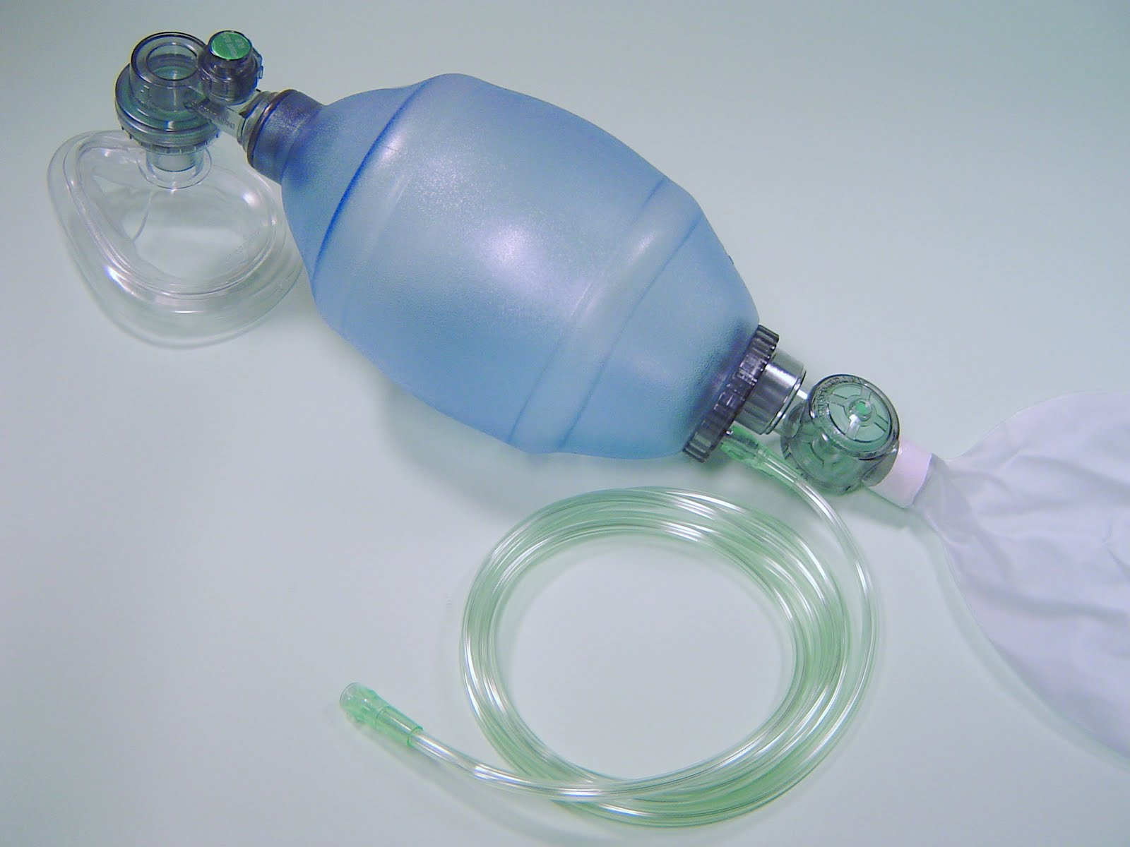
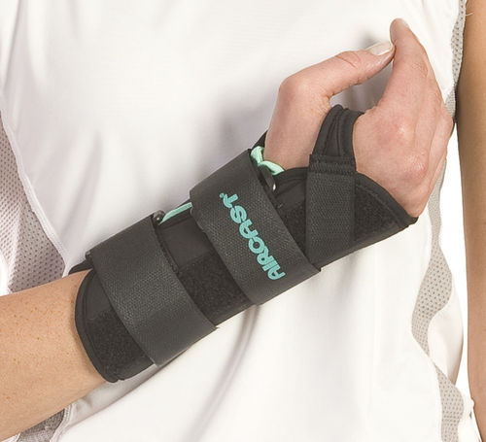
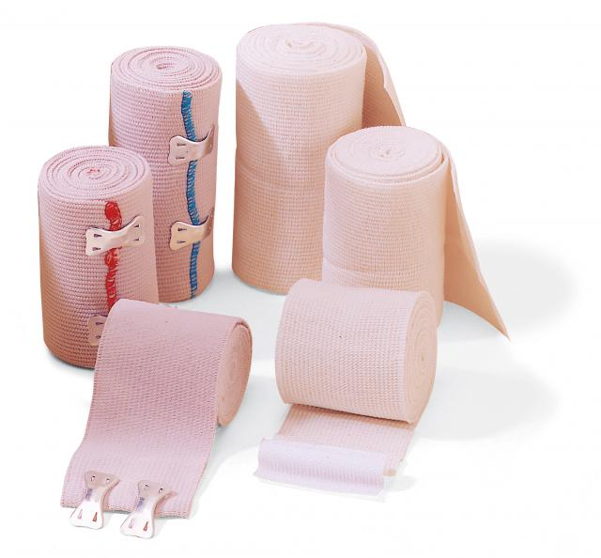
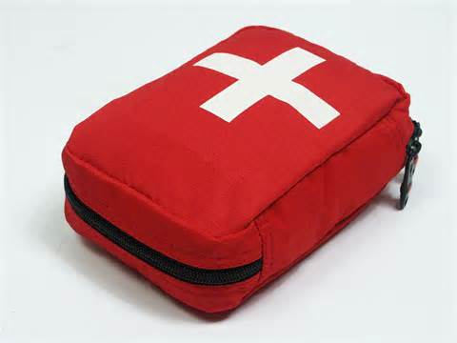
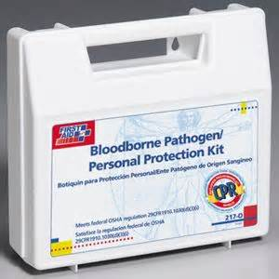
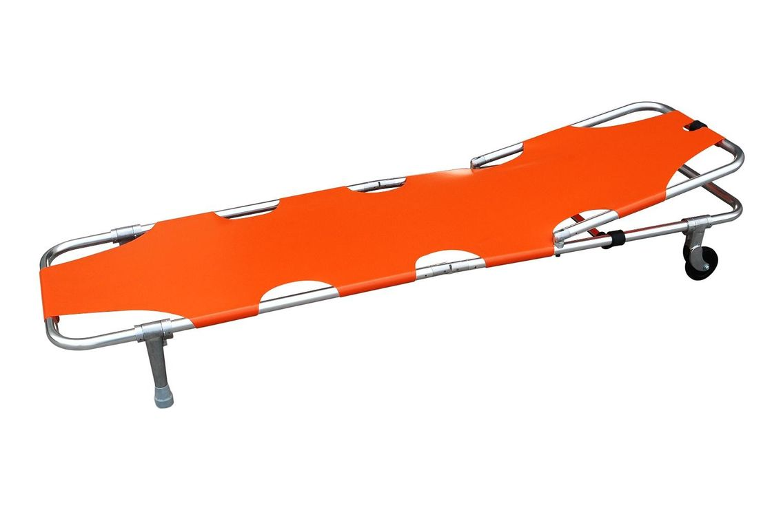

Slide 17
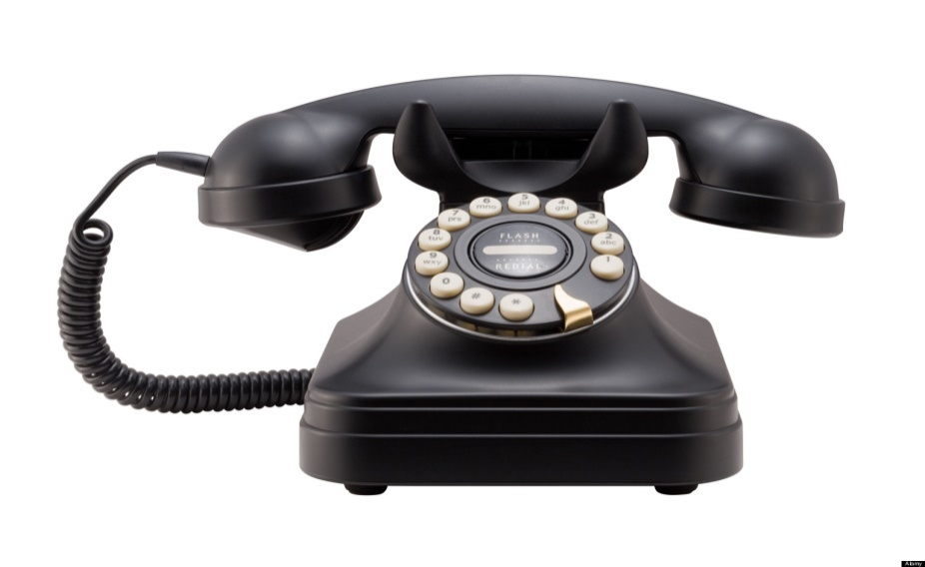
Activation of EMS
The person chosen for this role, such as a team coach, should be someone who is calm under pressure and who can communicate well over the telephone.
This person should be able to communicate the nature of the emergency and the location of the emergency with specific directions to the venue

Slide 18
The emergency team should designate an individual to be in charge of opening any locked gates or doors and directing the local EMS to the scene of the emergency.
An appropriate person for this responsibility would be an equipment manager because he or she typically is responsible for keys to locked gates or doors around the playing areas.

