Slide 1
Theory of Evolution
Idea supported by scientific evidence (but no concrete experiments) over a long period of time
Change in a species due to mutation of the DNA code that occurs over a long time

Slide 2
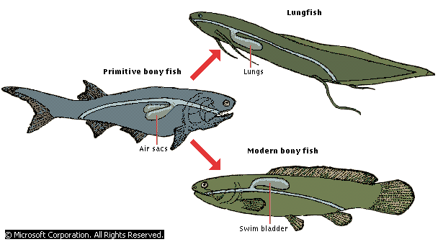
Evolution of Air Breathing:

Slide 3
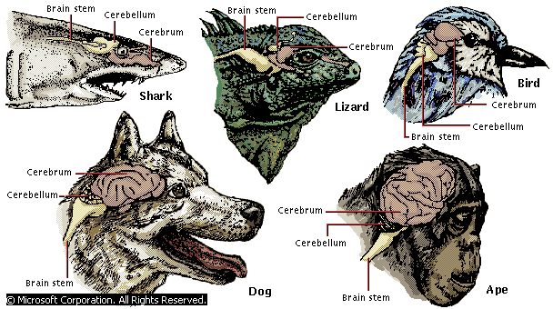
Evolution of Brains:

Slide 4
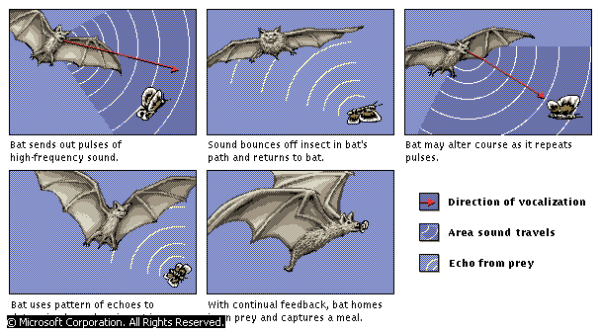
Echolocation & Prey Detection:

Slide 5
Charles Darwin
Natural Selection:
“Survival of fit”
Fit reproduce
Competition for resources
Best adapted species survive

Slide 6
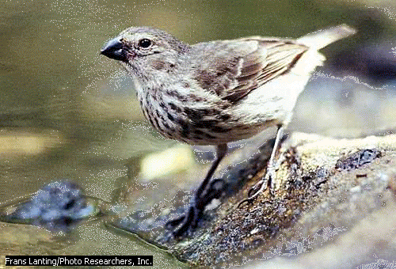
HMS Beagle Voyage 1835

Slide 7
Darwin’s key ideas:
A. REPRODUCTION: Organisms produce more offspring than can survive
B. VARIATION:Variety in traits exist
C. SURVIVAL OF THE FIT: Some traits allow survival & are passed on
D. Over time certain variations make up most of a population & they may be different from their ancestors

Slide 8
Malthus’s contribution:
P
O
P
U
L
A
T
I
O
N
Populations grow to a maximum level
Environmental limitations
Fit animals out compete the less fit
Carrying
Capacity

Slide 9
Evolution Evidence:
1. Adaptations
2. Fossils
3. Comparative anatomy
4. Comparative embryology
5. Comparative Biochemistry
6. Plate Techtonics

Slide 10
1. Adaptations: feautres suited to a particular environemnt that allow organisms to survive
Inuit people, who live in the extreme cold of the Arctic, have short, stout bodies that conserve heat.

Slide 11
Masai people, who live in the arid lands of eastern Africa, have tall, lean bodies that disperse heat well.

Slide 12
Plant Adaptations:
Venus Fly Trap
Captures Animals
Acquires Minerals
For Photo-
synthesis
Help!!!

Slide 13
Leaf Adaptations:
Succulents
Thick
Store Water
Prevent Drying out

Slide 14
Leaf Adapatations:
Pine Needles
Shed snow
Less water loss
Reduced surface area
Tolerate wind

Slide 15
Flower Adaptations:
Fly pollination:
Hair along petals
Putrid smell
Bee pollination:
Smooth petal
Sweet smell

Slide 16
2. Fossil Evidence:
Once living remains of organisms
Limited:
Type of material preserved (bone, shell, impressions, amber)
Incomplete record
Easily disrupted

Slide 17
Plant Fossil Evidence:

Slide 18
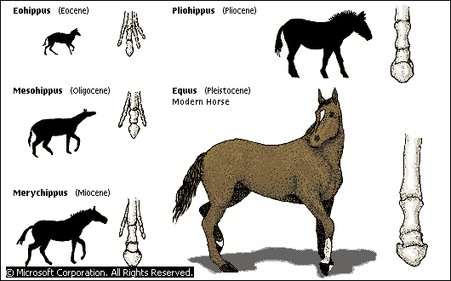
3. Comparative Anatomy: Structural similarities link related species

Slide 19
Comparative Anatomy Structures:
Analogous:
Different ancestors
“analogy”=like
Different underlying structures
Same Function
Similar Environments
Homologous:
Same ancestor
“homo”=same
Same underlying structures
Different Functions
Different Environments

Slide 20
Analogous Structures
Different underlying structures (different ancestors)
Same function, similar environments
Bird Wing
Fly wing

Slide 21
Homologous Structures:
Same underlying structures, different functions, different environments & common ancestor
Bird Wing
Porpoise Flipper

Slide 22
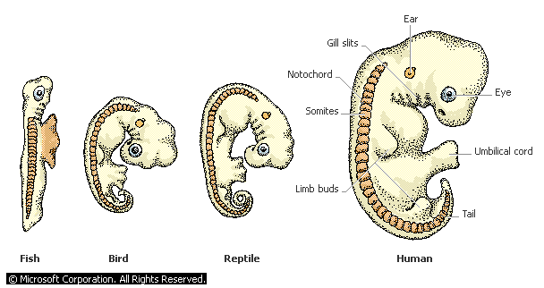
4. Comparative embryology:
Similar embryo development in closely related species

Slide 23
5.Comparative Biochemistry
Similar DNA sequences=
Similar Gene segments of the DNA
Code for similar traits
In closely related species

Slide 24
6. Plate Techtonics
Geological theory:
Continental masses were one land mass that explains
Closely related species have common ancestors on now separated continents

Slide 25
Early Theories of Evolution:
Darwin:
Current theory
Natural Selection
“Survival of fit”
Reproduction of the best adapted species
Lamark:
“Use & Disuse”
Abandoned
No knowledge of genetic traits or mutations in sex cells

Slide 26
Lamark’s Theory
“Use and Disuse”
Use of structure results in evolution
Does not take into account DNA or sex cell mutations

Slide 27
Mechanisms of Natural Selection

Slide 28
Gene pool?
Group of reproducing organisms
Specific frequency of allele types:
25% AA
50% Aa
25% aa

Slide 29
Changes in the Gene Pool:
Changes in the environment=
New mix of allele frequencies:
10% aa
60% Aa
30% AA
Dominant had advantage

Slide 30
Variations:
Differences in traits
Come about by mutations in genes
Random
Occur in sex cells
Passed on to future generations

Slide 31
Bird Beak Adaptations:

Slide 32
Genetic Drift Changes in the gene pool due to:
Random mating
Over a long time period
No immigration of males
No emigration of females
Sufficient resources that match the adaptations

Slide 33
Same Species Must:
Show similar characteristics
Successfully
interbreed
Producing fertile offspring
Donkey + Horse=
Mule (infertile)

Slide 34
Speciation
Evolution
New Species
Over time
By Isolation
Natural Barriers

Slide 35
Geographic Isolation
Separation of organisms by geographic features
Mountains
Lakes, oceans, rivers
Desserts
(May result in new species over time)

Slide 36
Reproductive Isolation When two different species can not mate and have successful offspring
Geographic barriers
Anatomy or physiology
Social behaviors

Slide 37
Reproductive Isolation: Two organisms cannot mate
Separated by geographic boundaries
Anatomical differences
Physiological differences
Social behaviors

Slide 38
Gradualism
“gradual”
Small changes
Over a long time

Slide 39
Punctuated Equilibrium
“punctuation!”
Large changes
Happen rapidly
Periods of no change

Slide 40
Punctuated Equilibrium
Gradualism:
#
S
P
E
C
I
E
S
Time

Slide 41
Adaptive Radiation:
“radiation”= branching from one source
“adaptive”= survival of fit
Evolution of many branches of organisms from a single source

Slide 42
Adaptive Radiation

Slide 43
Divergence
Human arm
“diverge”= branch off
Homologous structures
Same origin
Same underlying structure
Difference functions
Bat wing
Cat limb
Whale flipper
Original Species:
Mammal

Slide 44
Convergence
Bird wing
“converge”=come together”
Analogous features
From different origins
Similar environments=
Similar functions
Different structures
Organisms that fly
Butterfly wing
Bat wing

Slide 45
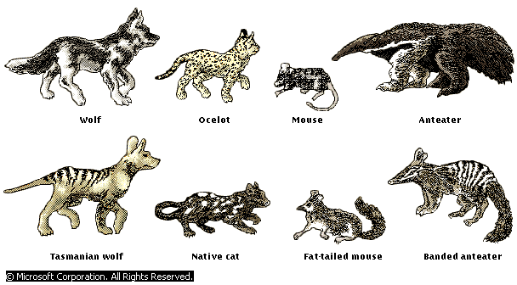
Convergent Evolution
Placental mammals
Marsupial mammals

Slide 46
Convergent Evolution
Although marsupial mammals once populated all land masses, they remain diversified only on the isolated Australian continent, where they have evolved to fill the same ecological niches that placental mammals occupy elsewhere. The Tasmanian wolf, for example, closely resembles the doglike carnivores of other continents. More specialized parallel adaptations include those of the marsupial and placental anteaters, the marsupial sugar glider and placental flying squirrels, and the burrowing marsupial wombat and placental ground hog. In this illustration, placental mammals are in the top row, and their marsupial equivalents are in the bottom row.

