Slide 1
Sericulture
Dr. Muhammad Asam Riaz
Assistant Professor
Entomology, Sargodha University, Sargodha, Pakistan

Slide 2
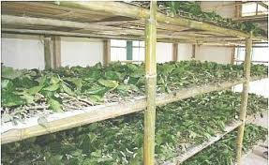
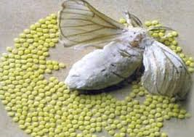
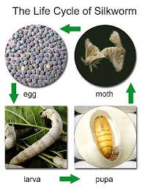
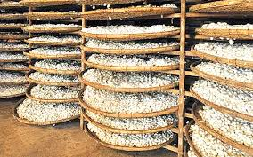
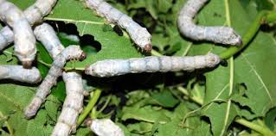
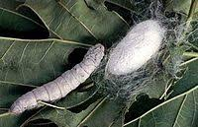
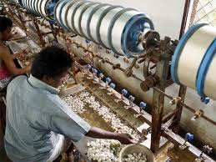
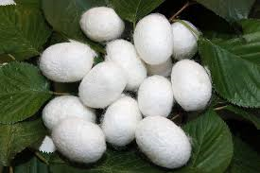
Sericulture: rearing of silk worms for silk production

Slide 3
Sericulture
Rearing of silk moths for silk production
Technical name : Bombyx mori
Family: Bombycidae

Slide 4
Introduction
Silk is used to thread and cloths
Univoltine (produce one generation per year)
Require low temperature and little moisture
Feed on mulberry leaves

Slide 5
Silk seed
Eggs of silkworm is called silk seed
1 ounce 20,000 to 22,000 eggs
1 ounce eggs = 15 full grown mulberry trees
Incubation should be started 15 days before sprouting of mulberry.
Mulberry sprout in beginning of March

Slide 6
Life cycle
Hatching 10-12 days
5 moults
Stop feeding before moulting
Raised their heads
1st instar 3 days 5 kg leaves
2nd instar 5 days 10 Kg leaves
3rd instar 7 days 15 Kg leaves
4th instar 9 days 110 Kg leaves
5th isntar 9-11 days 400 Kg leaves

Slide 7
Pupae spin cocoon (400-500 feet long thread)
Adult comes from cocoon by cutting the cocoon, so to get silk, adult must be killed
Adult are killed by
Sun heating: 2-3 days in sun
Steam : pass over steam to kill pupae

Slide 8
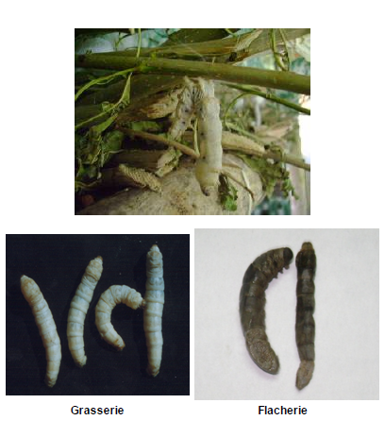
Diseases
Viral
Sluggish with swollen intersegmental region
Milky fluid oozes out
Dead larvae hang by hind legs head downward
Management:
Disinfection (trays, room, appliances, with bleach (5%)
Ensure proper ventilation and air circulation
Sun dry appliances
Collect and burn infected larvae and fecal matter

Slide 9
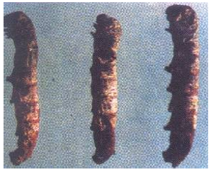
Bacterial
Stunted, appear flaccid
Larvae vomit gut juice,
Dysentery and excrete chain type of fecus
Emit foul smell
Management
Disinfection (trays, room, appliances, with bleach (5%)
Ensure proper ventilation and air circulation
Sun dry appliances
Collect and burn infected larvae and fecal matter
Apply antibiotics like Streptomycin/tetracyclin/ampicilin

Slide 10
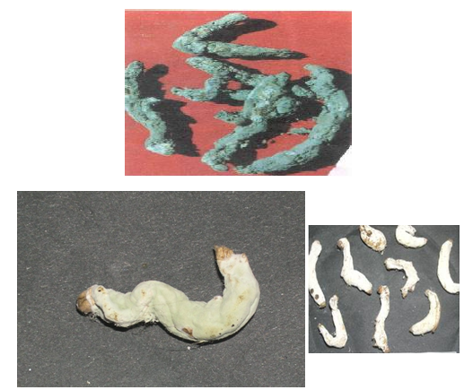
Fungal
Lethargic and flaccid
Oil specks on surface
Become hard, dry and mummify into white or green colour
Management
Disinfection (trays, room, appliances, with bleach (5%)
Ensure proper ventilation and air circulation
Sun dry appliances
Collect and burn infected larvae and fecal matter
Apply Dithane M
Disinfect room with 4% pentachlorophenol
Muscardine

Slide 11
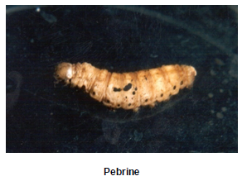
Protozoan
Black spots on body
Larvae becomes rubbery
Management
Disinfection (trays, room, appliances, with bleach (5%)
Ensure proper ventilation and air circulation
Sun dry appliances
Collect and burn infected larvae and fecal matter
Disinfect 2% formalin for 10 minutes

