Slide 1
Management
Fourteenth Edition
Chapter 2
Making Decisions

Slide 2
Learning Objectives
2.1 Describe the eight steps in the decision-making process.
Develop your skill at being creative.
2.2 Explain the four ways managers make decisions.
2.3 Classify decisions and decision-making conditions.
2.4 Describe how biases affect decision making.
Know how to recognize when you’re using decision-making errors and biases and what to do about it
2.5 Identify effective decision-making techniques.

Slide 3
Be A Better Decision-Maker
A key to success in management and in your career is knowing how to be an effective decision-maker.

Slide 4
What is a Decision?
Decision—a choice among two or more alternatives
Notes:
Managers at all levels and in all areas of organizations make decisions. That is, they make choices. Although decision-making is typically described as choosing among alternatives, this view is too simplistic. Why? Because decision-making is (and should be) a process, not just a simple act of choosing among alternatives.
Source: Alex Segre/Alamy

Slide 5
Decision Making
Decision
Making a choice from two or more alternatives.
The Decision-Making Process
Identifying a problem and decision criteria and allocating weights to the criteria.
Developing, analyzing, and selecting an alternative that can resolve the problem.
Implementing the selected alternative.
Evaluating the decision’s effectiveness.

Slide 6
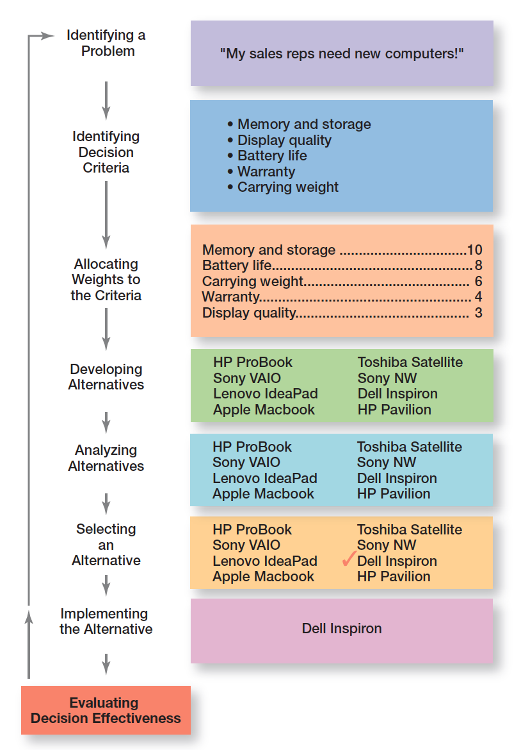
Exhibit 2-1 Decision-Making Process
Exhibit 2-1 shows the eight steps in the decision-making process. This process is as relevant to personal decisions as it is to corporate decisions.

Slide 7
Decision-Making Process Step 1: Identify a Problem
Problem: an obstacle that makes it difficult to achieve a desired goal or purpose.
Every decision starts with a problem, a discrepancy between an existing and a desired condition.
Example: Amanda is a sales manager whose reps/ agents need new laptops.
Notes:
Every decision starts with a problem, a discrepancy between an existing and a desired condition. For our example, Amanda is a sales manager whose reps need new laptops because their old ones are outdated and inadequate for doing their job. To make it simple, assume it’s not economical to add memory to the old computers and it’s the company’s policy to purchase, not lease. Now we have a problem—a disparity between the sales reps’ current computers (existing condition) and their need to have more efficient ones (desired condition). Amanda has a decision to make.

Slide 8
Step 1: Identifying the Problem
Characteristics of Problems
A problem becomes a problem when a manager becomes aware of it.
There is pressure to solve the problem.
The manager must have the authority, information, or resources needed to solve the problem.

Slide 9
Decision-Making Process Step 2: Identify the Decision Criteria
Decision criteria are factors that are important to resolving the problem.
Example: Amanda decides that memory and storage capabilities, display quality, battery life, warranty, and carrying weight are the relevant criteria in her decision
Notes:
Once a manager has identified a problem, he or she must identify the decision criteria important or relevant to resolving
the problem. Every decision-maker has criteria guiding his or her decisions even if they’re not explicitly stated. In our example,
Amanda decides after careful consideration that memory and storage capabilities, display quality, battery life, warranty, and carrying weight are the relevant criteria in her decision.

Slide 10
Step 2: Identifying Decision Criteria
Decision criteria are factors that are important (relevant) to resolving the problem. E.g.:
Costs that will be incurred (investments required)
Risks likely to be encountered (chance of failure)
Outcomes that are desired (growth of the firm)

Slide 11
Decision-Making Process Step 3: Allocate Weights to the Criteria
If the relevant criteria aren’t equally important, the decision maker must weight the items in order to give them the correct priority in the decision.
Example: The weighted criteria for Amanda’s computer purchase are shown in Exhibit 2-2.
Notes:
If the relevant criteria aren’t equally important, the decision maker must weight the items in order to give them the correct
priority in the decision. How? A simple way is to give the most important criterion a weight of 10 and then assign weights to the rest using that standard. Of course, you could use any number as the highest weight. The weighted criteria for our example is shown in Exhibit 2-2.

Slide 12
Decision-Making Process Step 3: Allocate Weights to the Criteria
How? A simple way is to give the most important criterion a weight of 10 and then assign weights to the rest using that standard. Of course, you could use any number as the highest weight. The weighted criteria for our example is shown in Exhibit 2-2.
Notes:
If the relevant criteria aren’t equally important, the decision maker must weight the items in order to give them the correct
priority in the decision. How? A simple way is to give the most important criterion a weight of 10 and then assign weights to the rest using that standard. Of course, you could use any number as the highest weight. The weighted criteria for our example is shown in Exhibit 2-2.

Slide 13
Exhibit 2-2 Important Decision Criteria
Criterion | Weight
Memory and storage | 10
Battery life | 8
Carrying weight | 6
Warranty | 4
Display quality | 3

Slide 14
Decision-Making Process Step 4: Develop Alternatives
List viable alternatives that could solve the problem.
Example: Amanda identifies eight laptops as possible choices (shown in Exhibit 2-3).
decision maker needs to be creative, and the alternatives are only listed—not evaluated
Notes:
The fourth step in the decision-making process requires the decision maker to list viable alternatives that could resolve the problem. In this step, a decision maker needs to be creative, and the alternatives are only listed—not evaluated—just yet. Our sales manager, Amanda, identifies eight laptops as possible choices (see Exhibit 2-3).

Slide 15
Exhibit 2-3 Possible Alternatives
Laptop | Memory and Storage | Battery Life | Carrying Weight | Warranty | Display Quality
HP ProBook | 10 | 3 | 10 | 8 | 5
Lenovo IdeaPad | 8 | 5 | 7 | 10 | 10
Apple MacBook | 8 | 7 | 7 | 8 | 7
Toshiba Satellite | 7 | 8 | 7 | 8 | 7
Apple MacBook Air | 8 | 3 | 6 | 10 | 8
Dell Inspirion | 10 | 7 | 8 | 6 | 7
HP Pavilion | 4 | 10 | 4 | 8 | 10

Slide 16
Decision-Making Process Step 6: Select an Alternative
Choose the alternative that generates the highest total in Step 5.
In our example (Exhibit 2-4), Amanda would choose the Dell Inspiron because it scored higher than all other alternatives (249 total).
Notes:
The sixth step in the decision-making process is choosing the best alternative or the one that generated the highest total in Step 5. In our example (Exhibit 2-4), Amanda would choose the Dell Inspiron because it scored higher than all other alternatives (249 total).

Slide 17
Exhibit 2-4 Evaluation of Alternatives
Laptop | Memory and Storage | Battery Life | Carrying Weight | Warranty | Display Quality | Total
HP ProBook | 100 | 24 | 60 | 32 | 15 | 231
Lenovo IdeaPad | 80 | 40 | 42 | 40 | 30 | 232
Apple MacBook | 80 | 56 | 42 | 32 | 21 | 231
Toshiba Satellite | 70 | 64 | 42 | 32 | 21 | 229
Apple MacBook Air | 80 | 24 | 36 | 40 | 24 | 204
Dell Inspirion | 100 | 56 | 48 | 24 | 21 | 249
HP Pavilion | 40 | 80 | 24 | 32 | 30 | 206

Slide 18
Decision-Making Process Step 7: Implement the Alternative
Put the chosen alternative into action.
By Conveying the decision to those affected and get their commitment to it.
We know that if the people who must implement a decision participate in the process, they’re more likely to support it.
Notes:
In Step 7 in the decision-making process, you put the decision into action by conveying it to those affected and getting their commitment to it. We know that if the people who must implement a decision participate in the process, they’re more likely to support it than if you just tell them what to do. Another thing managers may need to do during implementation is reassess the environment for any changes, especially if it’s a long-term decision. Are the criteria, alternatives, and choice still the best ones, or has the environment changed in such a way that we need to reevaluate?

Slide 19
Decision-Making Process Step 7: Implement the Alternative
Another thing managers may need to do during implementation is reassess the environment for any changes, especially if it’s a long-term decision.
Notes:
In Step 7 in the decision-making process, you put the decision into action by conveying it to those affected and getting their commitment to it. We know that if the people who must implement a decision participate in the process, they’re more likely to support it than if you just tell them what to do. Another thing managers may need to do during implementation is reassess the environment for any changes, especially if it’s a long-term decision. Are the criteria, alternatives, and choice still the best ones, or has the environment changed in such a way that we need to reevaluate?

Slide 20
Decision-Making Process Step 8: Evaluate Decision Effectiveness
Evaluate the result or outcome of the decision to see if the problem was resolved.
If it wasn’t resolved, what went wrong?
Was the problem incorrectly defined? Were errors made when evaluating alternatives? Was the right alternative selected but poorly implemented? The answers might lead you to redo an earlier step or might even require starting the whole process over.
Notes:
The last step in the decision-making process involves evaluating the outcome or result of the decision to see whether the problem was resolved. If the evaluation shows that the problem still exists, then the manager needs to assess what went wrong. Was the problem incorrectly defined? Were errors made when evaluating alternatives? Was the right alternative selected but poorly implemented? The answers might lead you to redo an earlier step or might even require starting the whole process over.

Slide 21
Group work
I need to buy a car.
The important criteria was:
price 10
Security 8
Economy 6
Warranty 4
Think as a team and decide which car you choose.

Slide 22
Exhibit 2-5 Decisions Managers May Make: Planning and Organizing
Notes:
Although everyone in an organization makes decisions, decision-making is particularly important to managers. As Exhibit 2-5 shows, it’s part of all four managerial functions. In fact, that’s why we say that decision-making is the essence of management. And that’s why managers—when they plan, organize, lead, and control—are called decision makers.

Slide 23
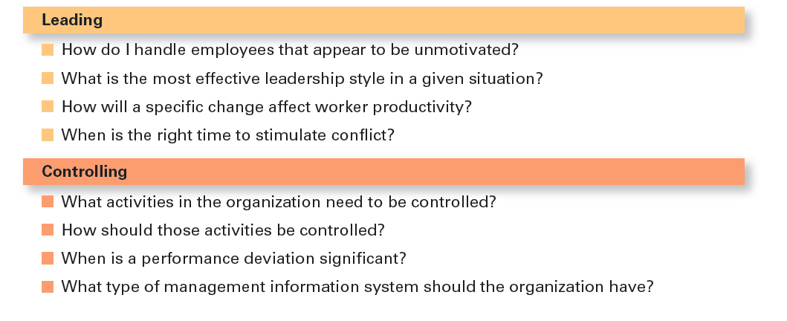
Exhibit 2-5 Decisions Managers May Make: Leading and Controlling

Slide 24
Rationality
Rational Decision-Making: choices that are logical and consistent and maximize value
Assumptions of rationality:
Rational decision maker is logical and objective
Problem faced is clear and unambiguous
Decision maker would have clear, specific goal and be aware of all alternatives and consequences
The alternative that maximizes achieving this goal will be selected
Decisions are made in the best interest of the organization
Notes:
We assume that managers will use rational decision-making; that is, they’ll make logical and consistent choices to maximize value. After all, managers have all sorts of tools and techniques to help them be rational decision makers. Managers aren’t always rational. What does it mean to be a “rational” decision maker? A rational decision maker would be fully objective and logical. The problem faced would be clear and unambiguous, and the decision maker would have a clear and specific goal and know all possible alternatives and consequences. Finally, making decisions rationally would consistently lead to selecting the alternative that maximizes the likelihood of achieving that goal.
These assumptions apply to any decision—personal or managerial. However, for managerial decision making, we need to add one additional assumption—decisions are made in the best interests of the organization. These assumptions of rationality aren’t very realistic and managers don’t always act rationally, but the next concept can help explain how most decisions get made in organizations.

Slide 25
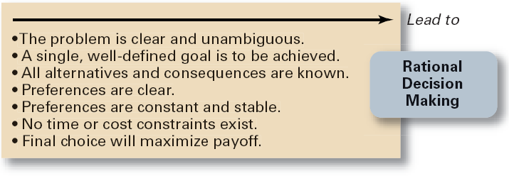
Assumptions of Rationality
Exhibit 6.6

Slide 26
Making Decisions (cont’d)
Bounded Rationality
Managers make decisions rationally, but are limited (bounded) by their ability to process information.
Assumptions are that decision makers:
Will not seek out or have knowledge of all alternatives
Will satisfice—choose the first alternative encountered that satisfactorily solves the problem—rather than maximize the outcome of their decision by considering all alternatives and choosing the best.

Slide 27
Influences on Decision Making
Escalation of Commitment
Increasing or continuing a commitment to previous decision despite mounting evidence that the decision may have been wrong. E.g., positive experience in dealing with some suppliers, currently suffers bad financial performance. strongly influenced by the organization’s culture, internal politics, power considerations.
The Role of Intuition
Intuitive decision making

Slide 28
Intuition
Intuitive decision-making: making decisions on the basis of experience, feelings, and accumulated judgment
Notes:
What is intuitive decision-making? It’s making decisions on the basis of experience, feelings, and accumulated judgment. Researchers studying managers’ use of intuitive decision-making have identified five different aspects of intuition, which are described in Exhibit 2-6.

Slide 29
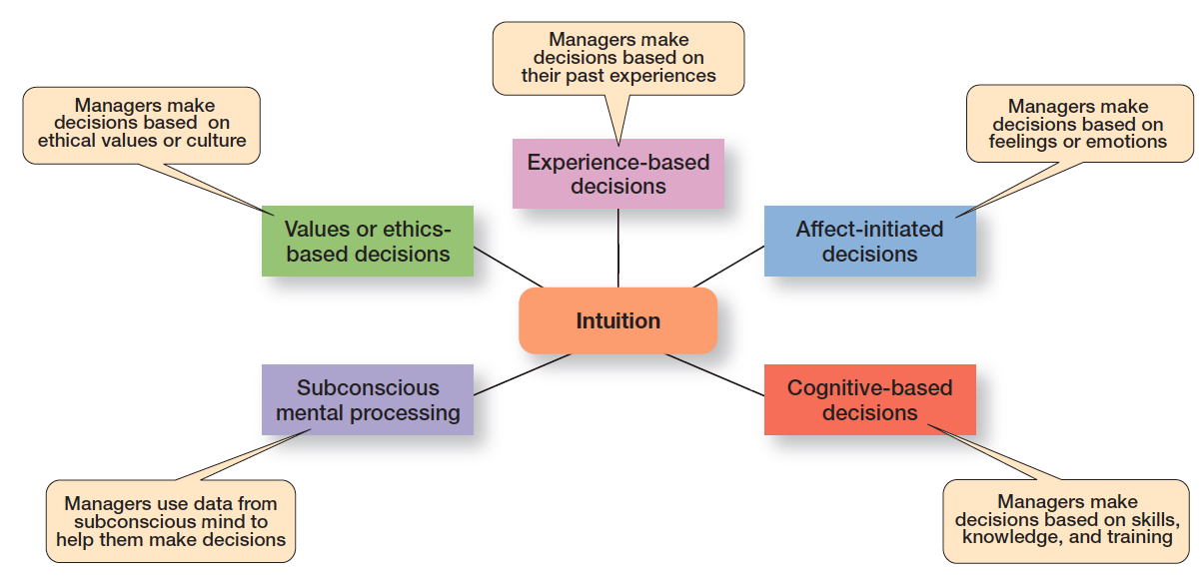
Exhibit 2-6 What is Intuition?
Exhibit 2-6 shows the five different aspects of intuition identified by researchers studying managers’ use of intuitive decision-making.
Notes:
Researchers studying managers’ use of intuitive decision making have identified five different aspects of intuition.
Source: Based on L. A. Burke and M. K. Miller, “Taking the Mystery Out of Intuitive Decision Making,” Academy of Management Executive, October 1999, pp. 91–99.

Slide 30
Evidence-Based Management
Evidence-based management (EBMgt): the systematic use of the best available evidence to improve management practice.
Any decision-making process is likely to be enhanced through the use of relevant and reliable evidence
Notes:
“Any decision-making process is likely to be enhanced through the use of relevant and reliable evidence, whether it’s buying someone a birthday present or wondering which new washing machine to buy.” That’s the premise behind evidence-based management (EBMgt), the “systematic use of the best available evidence to improve management practice.
EBMgt is quite relevant to managerial decision-making. The four essential elements of EBMgt are the decision maker’s expertise and judgment; external evidence that’s been evaluated by the decision maker; opinions, preferences, and values of those who have a stake in the decision; and relevant organizational (internal) factors such as context, circumstances, and organizational members.

Slide 31
Problems and Decisions
Structured Problems
Involve goals that clear.
Are familiar (have occurred before).
Are easily and completely defined—information about the problem is available and complete.
Programmed Decision
A repetitive decision that can be handled by a routine approach.
E.g., registration process at IUG.

Slide 32
Types of Programmed Decisions
A Policy
A general guideline for making a decision about a structured problem. (system)
E.g., Accept all customer-returned merchandise.
Students have the right to review his final mark.
The recruitment must start from job vacancy announcement.

Slide 33
Types of Programmed Decisions
A Procedure
A series of interrelated steps that a manager can use to respond (applying a policy) to a structured problem.
E.g., Follow all steps for completing merchandise return documentation.
Purchasing procedures.
Follow the steps for reviewing marks.
Recruitment procedures.
Registration procedures.

Slide 34
Types of Programmed Decisions
A Rule
An explicit statement that limits what a manager or employee can or cannot do in carrying out the steps involved in a procedure. Examples:
Managers must approve all refunds over $50.00.
No credit purchases are refunded for cash.
Reviewing marks can be within the first week of publishing final results.

Slide 35
Problems and Decisions (cont’d)
Unstructured Problems
Problems that are new or unusual and for which information is ambiguous or incomplete.
Problems that will require custom-made solutions.
Non-programmed Decisions
Decisions that are unique and nonrecurring/ infrequent.
Decisions that generate unique responses.
E.g., making a decision regarding opening a second branch in a new geographical area.
few decisions in the real world are either fully programmed or non-programmed

Slide 36
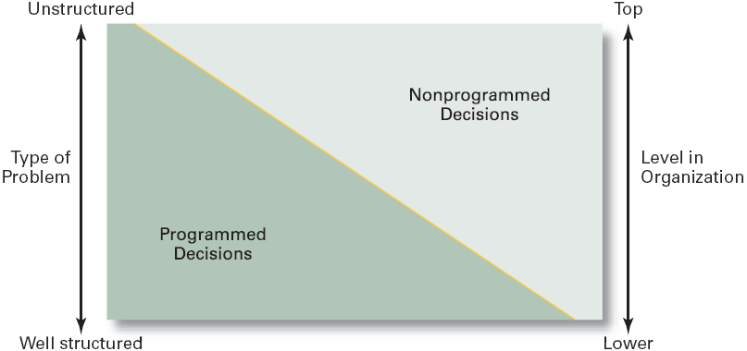
Types of Problems, Types of Decisions, and Level in the Organization
Exhibit 6.8

Slide 37
Exhibit 2-7 Programmed vs Nonprogrammed Decisions
Characteristic | Programmed Decisions | Nonprogrammed Decisions
Type of problem | Structured | Unstructured
Managerial level | Lower levels | Upper levels
Frequency | Repetitive, routine | New, unusual
Information | Readily available | Ambiguous or incomplete
Goals | Clear, specific | Vague
Time frame for solution | Short | Relatively long
Solution relies on… | Procedures, rules, policies | Judgment and creativity
Notes:
Exhibit 2-7 describes the differences between programmed and nonprogrammed decisions. Lower-level managers mostly rely on programmed decisions (procedures, rules, and policies) because they confront familiar and repetitive problems. As managers move up the organizational hierarchy, the problems they confront become more unstructured.

Slide 38
Decision-Making Conditions
Certainty: a situation in which a manager can make accurate decisions because all outcomes are known. E.g., putting a deposit in a bank, the annual return on it is known.
Risk: a situation in which the decision maker is able to estimate the likelihood of certain outcomes
Uncertainty: a situation in which a decision maker has neither certainty nor reasonable probability estimates available
Notes:
The ideal situation for making decisions is one of certainty, a situation where a manager can make accurate decisions because the outcome of every alternative is known. For example, when Wyoming’s state treasurer decides where to deposit excess state funds, he knows exactly the interest rate offered by each bank and the amount that will be earned on the funds. He is certain about the outcomes of each alternative. As you might expect, most managerial decisions aren’t like this.
A far more common situation is one of risk, conditions in which the decision maker is able to estimate the likelihood of certain outcomes. Under risk, managers have historical data from past personal experiences or secondary information that lets them assign probabilities to different alternatives.
What happens if you face a decision where you’re not certain about the outcomes and can’t even make reasonable probability estimates? We call this condition uncertainty. Managers face decision-making situations of uncertainty. Under these conditions, the choice of alternative is influenced by the limited amount of available information and by the psychological orientation of the decision maker.

Slide 39
Heuristics
Heuristics or “rules of thumb” can help make sense of complex, uncertain, or ambiguous information.
However, they can also lead to errors and biases in processing and evaluating information.
Notes:
When managers make decisions, they not only use their own particular style, they may use “rules of thumb,” or heuristics, to simplify their decision-making. Rules of thumb can be useful because they help make sense of complex, uncertain, and ambiguous information. Even though managers may use rules of thumb, that doesn’t mean those rules are reliable. Why? Because they may lead to errors and biases in processing and evaluating information.

Slide 40
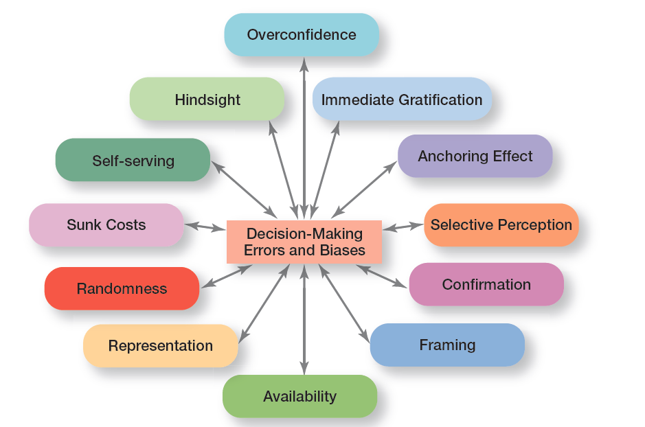
Exhibit 2-11 Common Decision-Making Biases
Exhibit 2-11 identifies 12 common decision errors of managers and biases they may have.
Notes:
Exhibit 2-11 identifies 12 common decision errors of managers and biases they may have. Let’s look at each.

Slide 41
Decision-Making Biases and Errors
Heuristics/ trial and error method
Using “rules of thumb” to simplify decision making. Base on past experience (trial and error method).
Overconfidence Bias
Holding unrealistically positive views of one’s self and one’s performance.
Immediate Gratification Bias/ short term thinking)
Choosing alternatives that offer immediate rewards and that to avoid immediate costs.

Slide 42
Decision-Making Biases and Errors (cont’d)
Anchor/ strongly linked
Fixating on initial information and ignoring subsequent information.
Selective Perception
Selecting organizing and interpreting events based on the decision maker’s biased perceptions. E.g., first impression about price, impression about new investment.
Confirmation Bias
Seeking out information that reaffirms past choices and discounting contradictory information.

Slide 43
Decision-Making Biases and Errors (cont’d)
Framing Bias
Selecting and highlighting certain aspects of a situation while ignoring other aspects. E.g., focus on revenue and ignore maintenance skills.
Availability Bias
Losing decision-making objectivity by focusing on the most recent events.

Slide 44
Decision-Making Biases and Errors (cont’d)
Representation Bias
Drawing analogies/likeness and seeing identical situations when none exist. E.g., considers last summer revenue the same for this year.
Randomness Bias
Creating unfounded meaning out of random events. E.g., event happened by chance. E.g., making high profit because of having high stock of paints and Israel prevented paints from entry.

Slide 45
Decision-Making Biases and Errors (cont’d)
Sunk Costs Errors
Forgetting that current actions cannot correct past events and relate only to future consequences.
Self-Serving Bias
Taking quick credit for successes and blaming outside factors for failures.

Slide 46
Decision-Making Biases and Errors (cont’d)
Hindsight/observation Bias
Mistakenly believing that an event could have been predicted once the actual outcome is known (after-the-fact). E.g., let us start producing and will see the customer reaction.

Slide 47
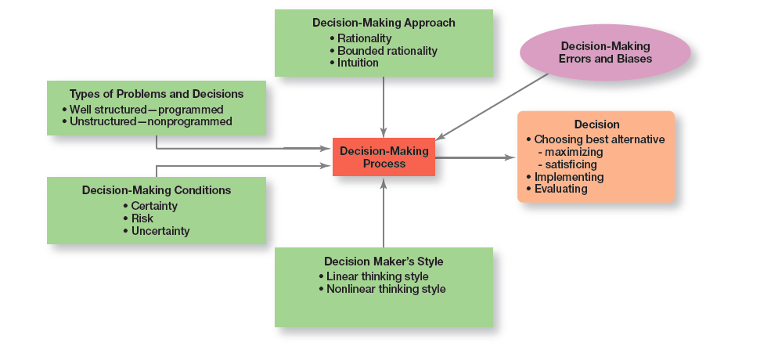
Exhibit 2-12 Overview of Managerial Decision Making
Exhibit 2-12 provides an overview of managerial decision making.
Notes:
Exhibit 2-12 provides an overview of managerial decision-making. Because it’s in their best interests, managers want to make good decisions—that is, choose the “best” alternative, implement it, and determine whether it takes care of the problem, which is the reason the decision was needed in the first place.
Their decision-making process is affected by four factors: the decision-making approach, the type of problem, decision-making conditions, and certain decision-making errors and biases. So whether a decision involves addressing an employee’s habitual tardiness, resolving a product quality problem, or determining whether to enter a new market, it has been shaped by a number of factors.

Slide 48
Guidelines for Making Effective Decisions
Understand cultural differences
Create standards for good decision making
Know when it’s time to call it quits
Use an effective decision-making process
Develop your ability to think clearly
Notes:
Decision-making is serious business. Your abilities and track record as an effective decision maker will determine how your organizational work performance is evaluated and whether you’ll be promoted to higher and higher positions of responsibility. Below are some guidelines to help you be a better decision maker.
Understand cultural differences. Managers everywhere want to make good decisions. However, is there only one “best” way worldwide to make decisions? Or does the “best way depend on the values, beliefs, attitudes, and behavioral patterns of the people involved?”
Create standards for good decision making. Good decisions are forward-looking, use available information, consider all available and viable options, and do not create conflicts of interest.
Know when it’s time to call it quits. When it’s evident that a decision isn’t working, don’t be afraid to pull the plug.
Use an effective decision-making process.
Build an organization that can spot the unexpected and quickly adapt to the changed environment.

Slide 49
Characteristics of an Effective Decision-Making Process
Focuses on what’s important
Is logical and consistent
Acknowledges subjective and analytical thinking, blends analytical with intuitive thinking
Requires only as much information as is needed to resolve particular dilemma
Encourages the gathering of relevant information
Is straightforward, reliable, easy-to-use, flexible
Notes:
Experts say an effective decision-making process has these six characteristics: (1) it focuses on what’s important; (2) it’s logical and consistent; (3) it acknowledges both subjective and objective thinking and blends analytical with intuitive thinking; (4) it requires only as much information and analysis as is necessary to resolve a particular dilemma; (5) it encourages and guides the gathering of relevant information and informed opinion; and (6) it’s straightforward, reliable, easy to use, and flexible.

Slide 50
Big Data and Decision-Making
Big data: the vast amount of quantifiable data that can be analyzed by highly sophisticated data processing
Can be a powerful tool in decision making, but collecting and analyzing data for data’s sake is wasted effort
Notes:
So what is big data? It’s the vast amount of quantifiable information that can be analyzed by highly sophisticated data processing. One IT expert described big data with “3V’s: high volume, high velocity, and/or high variety information assets.”
What does big data have to do with decision making? A lot, as you can imagine. With this type of data at hand, decision makers have very powerful tools to help them make decisions. However, experts caution that collecting and analyzing data for data’s sake is wasted e ort. Goals are needed when collecting and using this type of information. As one individual said, “Big data is a descendant of Taylor’s ‘scientific management’ of more than a century ago.”
While Taylor used a stopwatch to time and monitor a worker’s every movement, big data is using math modeling, predictive algorithms, and artificial intelligence software to measure and monitor people and machines like never before. But managers need to really examine and evaluate how big data might contribute to their decision making before jumping in with both feet. Why? Because big data, no matter how comprehensive or well analyzed, needs to be tempered by good judgment. For instance, a recent government report states: “Companies should remember that while big data is very good at detecting correlations, it does not explain which correlations are meaningful.”

Slide 51
Decision-Making Styles
Dimensions of Decision-Making Styles
Ways of thinking
Rational, orderly, and consistent
Intuitive, creative, and unique
Tolerance for ambiguity
Low tolerance: require consistency and order
High tolerance: multiple thoughts simultaneously

Slide 52
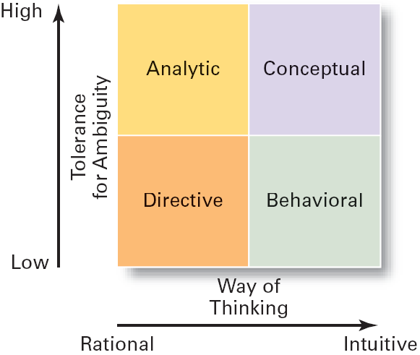
Decision-Making Styles
Source: S.P. Robbins and D.A. DeCenzo, Supervision Today. 2nd ed. (Upper Saddle River, NJ: Prentice Hall, 1998). p. 166.
Exhibit 6.12

Slide 53
Decision-Making Styles (cont’d)
Types of Decision Makers
Directive: Use minimal information and consider few alternatives. E.g., buying a Chinese I-bad.
Analytic: Make careful decisions in unique situations, few alternatives. E.g., Developing a program for purchasing and warehousing.
Conceptual: Maintain a broad outlook and consider many alternatives in making long-term decisions. E.g., Deciding of opening a small business.
Behavioral: Avoid conflict by working well with others and being receptive/open to suggestions.

Slide 54
Types of Decision Makers
Most managers realistically probably have a dominant style and alternate styles,
with some relying almost exclusively on their dominant style and others being more flexible depending on the situation.

Slide 55
Review Learning Objective 2.1
Describe the eight steps in the decision-making process.
1. Identify problem
2. Identify decision criteria
3. Weight the criteria
4. Develop alternatives
5. Analyze alternatives
6. Select alternative
7. Implement alternative
8. Evaluate decision effectiveness
Notes:
A decision is a choice. The decision-making process consists of eight steps: (1) identify problem; (2) identify decision criteria; (3) weight the criteria; (4) develop alternatives; (5) analyze alternatives; (6) select alternative; (7) implement alternative; and (8) evaluate decision effectiveness.

Slide 56
Review Learning Objective 2.2 (1 of 2)
Explain the four ways managers make decisions.
Assumptions of rationality
The problem is clear and unambiguous
A single, well-defined goal is to be achieved
All alternatives and consequences are known
The final choice will maximize the payoff
Notes:
The assumptions of rationality are as follows: the problem is clear and unambiguous; a single, well-defined goal is to be achieved; all alternatives and consequences are known; and the final choice will maximize the payoff. Bounded rationality says that managers make rational decisions but are bounded (limited) by their ability to process information.

Slide 57
Review Learning Objective 2.2 (2 of 2)
Satisficing: when decision makers accept solutions that are good enough
Escalation of commitment: managers increase commitment to a decision, even when they have evidence it may have been a wrong decision
Intuitive decision making: making decisions on the basis of experience, feelings, and accumulated judgment
Evidence-based management: a manager makes decisions based on the best available evidence
Notes:
Satisficing happens when decision makers accept solutions that are good enough. With escalation of commitment, managers increase commitment to a decision, even when they have evidence it may have been a wrong decision. Intuitive decision making means making decisions on the basis of experience, feelings, and accumulated judgment. Using evidence-based management, a manager makes decisions based on the best available evidence.

Slide 58
Review Learning Objective 2.3 (1 of 2)
Classify decisions and decision-making conditions.
Programmed decisions are repetitive decisions that can be handled by a routine approach and are used when the problem being resolved is straightforward, familiar, and easily defined (structured).
Nonprogrammed decisions are unique decisions that require a custom-made solution and are used when the problems are new or unusual (unstructured) and for which information is ambiguous or incomplete.
Notes:
Programmed decisions are repetitive decisions that can be handled by a routine approach and are used when the problem being resolved is straightforward, familiar, and easily defined (structured). Nonprogrammed decisions are unique decisions that require a custom-made solution and are used when the problems are new or unusual (unstructured) and for which information is ambiguous or incomplete.

Slide 59
Review Learning Objective 2.3 (2 of 2)
Classify decisions and decision-making conditions.
Certainty is a situation in which a manager can make accurate decisions because all outcomes are known.
Risk is a situation in which a manager can estimate the likelihood of certain outcomes.
Uncertainty is a situation in which a manager is not certain about the outcomes and can’t even make reasonable probability estimates
Notes:
Certainty is a situation in which a manager can make accurate decisions because all outcomes are known. Risk is a situation in which a manager can estimate the likelihood of certain outcomes. Uncertainty is a situation in which a manager is not certain about the outcomes and can’t even make reasonable probability estimates. When decision makers face uncertainty, their psychological orientation will determine whether they follow a maximax choice (maximizing the maximum possible payoff); a maximin choice (maximizing the minimum possible payoff); or a minimax choice (minimizing the maximum regret—amount of money that could have been made if a different decision had been made).

Slide 60
Review Learning Objective 2.4
Describe how biases affect decision-making.
The 12 common decision-making errors and biases:
Overconfidence
Immediate gratification
Anchoring effect
Selective perception
Confirmation
Framing
Availability
Representation
Randomness
Sunk costs
Self-serving
Hindsight
Notes:
The 12 common decision-making errors and biases include overconfidence, immediate gratification, anchoring, selective perception, confirmation, framing, availability, representation, randomness, sunk costs, self-serving bias, and hindsight. The managerial decision making model helps explain how the decision-making process is used to choose the best alternative(s), either through maximizing or Satisficing and then implement and evaluate the alternative. It also helps explain what factors affect the decision-making process, including the decision-making approach (rationality, bounded rationality, intuition), the types of problems and decisions (well structured and programmed or unstructured and nonprogrammed), the decision-making conditions (certainty, risk, uncertainty), and the decision maker’s style (linear or nonlinear).

Slide 61
Review Learning Objective 2.5 (1 of 2)
Identify effective decision-making techniques.
An effective decision-making process:
Focuses on what’s important
Is logical and consistent
Acknowledges subjective and objective thinking and blends analytical and intuitive approaches
Requires only “enough” information as is needed to solve a problem
Encourages and guides gathering relevant information and informed opinions
Is straightforward, reliable, easy to use, and flexible
Notes:
Managers can make effective decisions by understanding cultural differences in decision-making, knowing when it’s time to call it quits, using an effective decision-making process, and building an organization that can spot the unexpected and quickly adapt to the changed environment. An effective decision-making process (1) focuses on what’s important; (2) is logical and consistent; (3) acknowledges both subjective and objective thinking and blends both analytical and intuitive approaches; (4) requires only “enough” information as is necessary to resolve a problem.

Slide 62
Review Learning Objective 2.5 (2 of 2)
Design thinking: approaching management problems as designers approach design problems
Big Data: when tempered with good judgment, it can be a powerful tool in decision making
Notes:
Managers can make effective decisions by understanding cultural differences in decision-making, knowing when it’s time to call it quits, using an effective decision-making process, and building an organization that can spot the unexpected and quickly adapt to the changed environment. An effective decision-making process (1) focuses on what’s important; (2) is logical and consistent; (3) acknowledges both subjective and objective thinking and blends both analytical and intuitive approaches; (4) requires only “enough” information as is necessary to resolve a problem.

Slide 63
Copyright

