Slide 1
DIGITAL PRINTING

Slide 2
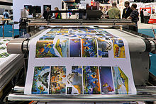
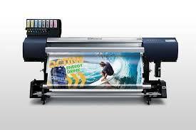
Digital printing
Digital printing refers to methods of printing from a digital based image directly to a variety of media.
It usually refers to professional printing where small-run jobs from desktop publishing and other digital sources are printed using large-format and/or high-volume laser or inkjet printers

Slide 3
What is a digital printer?
There are many types of digital printing machines, including production printing presses such as sheet-fed production printers, cut-sheet digital presses, production inkjet printers and continuous feed printers. Some recognizable brand names of Xerox digital printers include Xerox Color, Versant, Nuvera and D Series production printers and digital presses, as well as Xerox Brenva.

Slide 4
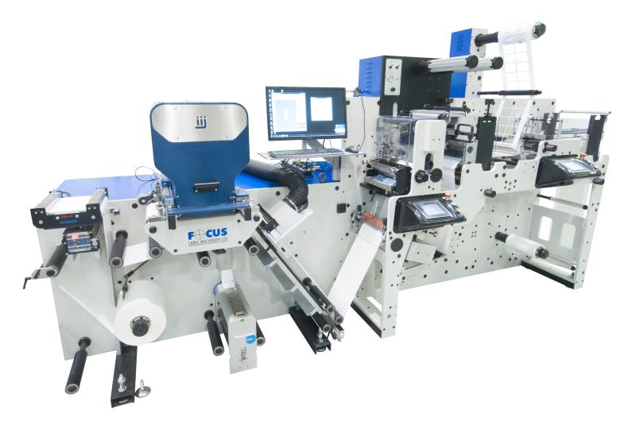

Slide 5
Types of digital print media
Digital printing machines can print on everything from thick cardstock, heavyweight papers and folding cartons to fabric, plastics and synthetic substrates. T-shirt printing is a very popular digital printing application, and some digital printers can print on other fabrics besides T-shirts, including linen and polyester.

Slide 6
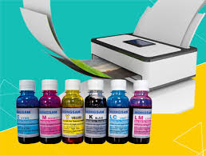
Digital printing inks
Digital printing inks include cyan, magenta, yellow and black (CMYK) toner and ink, as well as extended color gamut inks such as orange, blue and green as well as specialty dry inks for metallic, white or clear effects.
,

Slide 7
PROCESS
The greatest difference between digital printing and traditional methods such as lithography ,flexography, gravure, or letterpress is that there is no need to replace printing plates in digital printing,
whereas in analog printing the plates are repeatedly replaced. This results in quicker turnaround time and lower cost when using digital printing, but typically a loss of some fine-image detail by most commercial digital printing processes. The most popular methods include inkjet or laser printers that deposit pigment or toner onto a wide variety of substrates including paper, photo paper, canvas, glass, metal, marble, and other substances.

Slide 8
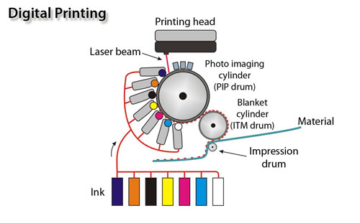
In many of the processes, the ink or toner does not permeate the substrate, as does conventional ink, but forms a thin layer on the surface that may be additionally adhered to the substrate by using a fuser fluid with heat process (toner) or UV curing process (ink).

Slide 9
The Steps of Digital Printing:
The digital image file is uploaded to the website and then converted into a raster graphic image. The image you send goes through the "Raster Image Process" (RIP). This process converts your art, logo or design.
RIPing produces a bitmap and then coordinates the colors. Using a laser within the digital printer, the charges are then erased. This creates the blank "unprinted" space.

Slide 10
The positive charges are removed, and toner is then attracted to the remaining positive charges. The image then exits on the photoreceptor.
The last step involves toner being applied to the sheet and is then fused to the paper (by a "fuser roll.") This is a hot process—think 400 degrees Fahrenheit.

Slide 11
Applications
Digital printing has many advantages over traditional methods. Some applications of note include:
Desktop publishing– inexpensive home and office printing is only possible because of digital processes that bypass the need for printing plates
commercial – Business Stationery - Including business cards, letterheads
Variable data printing – uses database-driven print files for the mass personalization of printed materials

Slide 12
Fine art – archival digital printing methods include real photo paper exposure prints and giclee prints on watercolor paper using pigment based inks.
Print on demand – digital printing is used for personalized printing for example, children's books customized with a child's name, photo books (such as wedding photo books), or any other books.
Advertising – often used for outdoor banner advertising and event signage, in trade shows, in the retail sector at point of sale or point of purchase, and in personalized direct mail campaigns.

Slide 13
Photos – digital printing has revolutionized photo printing in terms of the ability to retouch and color correct a photograph before printing.
Architectural Design – new media that conforms to a variety of surfaces has enabled interior and exterior spaces to be transformed using digitally printed wall murals and floor graphics.
sleeking – The process of adding foil, holographic effects or even glossy and dull finishes by way of digital ink adhesion. This is done by digitally printing a rich blark area where the user wants the sleeking to take place. The machine registers this and only adheres to this specific area.

Slide 14
Digital printing advantages and disadvantages
Digital printing technology excels at producing on demand and short print runs quickly and cost-effectively. Digital printing is also an ideal platform for personalization. If you want to easily modify images and messages using variable data printing (VDP), then digital printing is the only way to go. With advancements in print quality and speed, digital printing’s previous disadvantages are quickly disappearing, and digital printing machines are closing the gap on offset output.

Slide 15
Types of fabric digital printing can print Digital can print any design on all kind of fabric,like cotton ,poly or silk etc

Slide 16
General work flow
Pre-setting process:
Using pre-setting system/coating machine/ padding mangle,appropriate treatment should be done for the fabric before printing.
DTP system:
Print it via digital textile printer after modifying colors & Design with help of Design & RIP software.
Finishing Process:
Printed result has to undergo the finishing process, such as steaming,washing etc

Slide 18
Conclusion
The concept of digital printing on fabrics has opened new opportunities for designers,merchandisers,production and art department,sales persons,etc

Slide 19
Thank you

