Slide 1
Assignment of Bacteriology and Virology

Slide 2
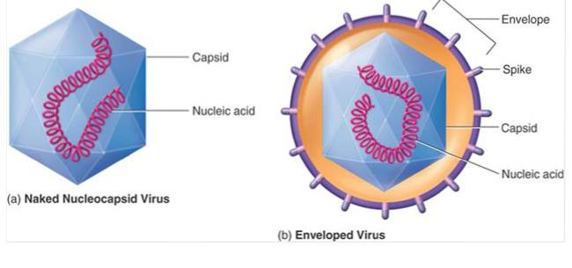
Dessimination of DNA virus(Origen and history)

Slide 3
History of viruses:
No one knows exactly when viruses emerged or from where they came, since viruses do not leave historical footprints such as fossils.
The virus was first described 120 years ago as a filterable, transmissible agent that causes disease in plants and animals

Slide 4
As the viruses do not fossilized, so researchers can only hypothesize about the evolutionary history of viruses and their origin.
There are, however, three hypotheses that have risen as the most accepted:
Devolution or regressive hypothesis:
This hypothesis proposes to explain the origin of viruses by suggesting that viruses evolved from free-living cells. However, many components of how this process might have occurred are a mystery.

Slide 5
Escapist or progressive hypothesis:
This hypothesis accounts for viruses having either an RNA or a DNA genome and suggests that viruses originated from RNA and DNA molecules that escaped from a host ce
3. Self-replicationn hypothesis:
This hypothesis posits a system of self-replication similar to that of other self-replicating molecules, likely evolving alongside the cells they rely on as hosts; studies of some plant pathogens support this hypothesis.

Slide 6
About a century ago at the time of Louise pasture (1882-1985) and Robert Koch (1843-1910) the word virus was generally referred as a poison associated with disease and death.
In 1796, Edward Jenner first vaccinated an 8 years old boy with material removed from cow pox leison on the hand of milkmaid.
In 1884, Charles chamber land found that the agents responsible for rabies are filterable.So, at those times viruses were described as filterable viruses.
In 1892, Ivanowski discovered agent which causes tobacco mosaic disease was filterable.

Slide 7
In 1898 the foot and mouth disease and in 1901 yellow fever agents were also discovered as filterable and ultramicroscopic agents.
Rabies spread in the 1880s in Europe as dogs became a popular pet animal. Louis Pasteur had earlier used rabbits for transmission of rabies for the development of rabies vaccine
In 1908, Karl Landsteiner, an Austrian scientist, reported the transmission of poliomyelitis to monkeys.

Slide 8
Discovery of genetic material:
One big question that remained unanswered until the 1950s was what is the genetic material of life?
A few years later, in 1957, Fraenkel-Conrat and Singer confirmed that the nucleic acid (RNA) is the genetic material by an experiment using TMV.

Slide 9
Origin of Adenovirus:
Adenovirusee were first discovered in 1953, by Rowe and his colleagues. These viruse were first isolated from Adenoid cell culture, hence the family name of Adenoviridae. At present, 51 distinct serotypes have been recognized and recorded.

Slide 10
Discovery of herpes simplex virus:
The virus originated in chimpanzees, jumping into humans 1.6 million years ago.
Researchers at the University of California, San Diego School of Medicine have identified the evolutionary origins of human herpes simplex virus (HSV) -1 and -2, reporting that the former infected hominids before their evolutionary split from chimpanzees 6 million years ago while the latter jumped from ancient chimpanzees to ancestors of modern humans – Homo erectus – approximately 1.6 million years ago.

Slide 11
And in 1919, Lowenstein confirmed experimentally the infectious nature of HSV that Shakespeare had only suspected.
In the 1920's and 1930's, the natural history of HSV was widely studied and it was found that HSV not only infects the skin, but also the central nervous system.

Slide 12
Discovery of small pox virus:
The origin of small pox is basically unknown.
The global spread of smallpox can be traced to the growth and spread of civilizations, exploration, and expanding trade routes over the centuries.
Smallpox was a devastating disease. On average, 3 out of every 10 people who got it died. Those who survived were usually left with scars, which were sometimes severe.

Slide 13
Smallpox is an acute, contagious disease caused by the variola virus, a member of the genus Orthopoxvirus, in the Poxviridae family.
Virologists have speculated that it evolved from an African rodent poxvirus 10 millennia ago.
The name is derived from the Latin word for "spotted" and refers to the raised bumps on the face and body of the patient.

Slide 14
Definition:
A disseminated infection is one in which a localized infection spreads (disseminates) from one area of the body to other organ systems.
Dissemination is used to describe a serious progression of a disease wherein the ability to contain the infection is far more difficult.
A disseminated infection, by contrast, involves the invasion of a foreign pathogen (such as a virus, bacteria, fungus, or parasite) which causes damage to cells and tissues of the body.

Slide 15
Examples of dessiminated infections:
Sexually transmitted infections (neonatal herpes), AIDS, HIV
Disseminated shingles
Disseminated herpes simplex
.

Slide 16
Sexually transmitted infections:
Sexually transmitted infections (STIs) can readily disseminate from the primary site (such as the genitals, anus, or mouth) to other parts of the body if left untreated.
Some of the most serious forms include disseminated syphilis and gonorrhae.
While the primary infection will typically resolve on its own without treatment, the failure to treat can affect other organs (including the brain, bones, and joints) during the secondary and tertiary stages of infection.

Slide 17
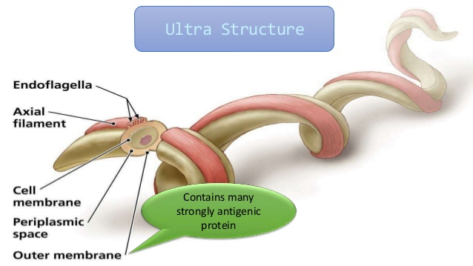

Slide 18
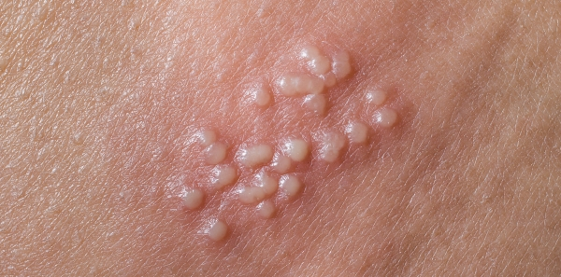

Slide 19
Dessiminated Shingles:
Disseminated shingles involving the herpes zoster virus, is an uncommon condition more often seen in people with severely compromised immune systems (such as those with advanced HIV).
Shingles a viral infection that causes a painful rash. Although shingles can occur anywhere on your body, it most often appears as a single stripe of blisters that wraps around either the left or the right side of your torso.

Slide 20
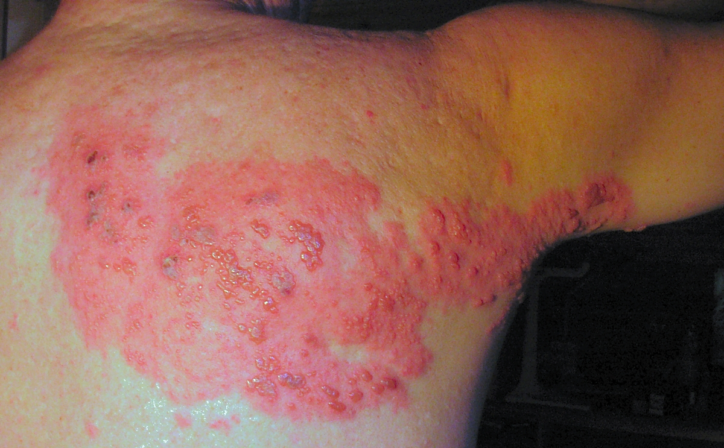

Slide 21
Dessiminated herpes simplex:
Disseminated herpes simplex, the same virus that causes cold sores and genital herpes, can disseminate after the initial adult or neonatal infection.⁵﻿
It most typically involves the brain and spinal cord and can cause a condition known as acute disseminated encephalomyelitis (ADEM)

Slide 23
Modes of dessimination:
Blood Circulatory system
Lymphatic system
Nerves System

Slide 24
Circulatory system:
The most common route of systemic spread of virus involves the circulation.
Viruses such as those causing poliomyelitis, smallpox, and measles disseminate through the blood after an initial period of replication .

Slide 25
Lymphatic system:
Virus progeny diffuse through the afferent lymphatics to the lymphoid tissue and then through the efferent lymphatics to infect cells in close contact with the bloodstream (e.g., endothelial cells, especially those of the lymphoreticular organs). This initial spread may result in a viremia.

Slide 26
Nervous system:
Dissemination through the nerves is less common than bloodstream dissemination,
This mechanism occurs in rabies virus, herpesvirus, and, occasionally, poliomyelitis virus infections.

Slide 28
Mechanism of deamination:
There are four steps of viral dessimination.
Implantation of the virus at a body site
Replication and primary spread
Multiplication within target organs
Shedding of virus

Slide 29
Implantation of a virus at body site:
Virions implant onto living cells mainly via the respiratory, gastrointestinal, skin-penetrating, and genital routes although other routes can be used.

Slide 30
Local replication and local spread:
Most virus types spread among cells extracellularly, but some may also spread intracellularly.
Establishment of local infection may lead to localized disease and localized shedding of virus,.

Slide 31
Multiplication in target cells:
Depending on the balance between virus and host defenses, virus multiplication in the target organ may be sufficient to cause disease and death.

Slide 32
Shedding of virus:
Although the respiratory tract, alimentary tract, urogenital tract and blood are the most frequent sites of shedding, diverse viruses may be shed at virtually every site۔

Slide 33
References:
https://www.ncbi.nlm.nih.gov/books/NBK8149/#:~:text=Intracellular%20spread%20occurs%20by%20fusion,intracellular%20and%20extra%20cellular%20routes.
https://www.verywellhealth.com/disseminated-infection-3132797
https://web.stanford.edu/group/virus/adeno/2004takahashi/webpage/second.html#:~:text=Adenoviruses%20were%20first%20discovered%20in,have%20been%20recognized%20and%20recorded.
https://virus.stanford.edu/herpes/History.html
https://web.stanford.edu/group/virus/adeno/2004takahashi/webpage/second.html

