Slide 1
Monitoring & Evaluation Practical Model
Evaluation & Audit
A. Evaluation
make an “assessment, of an ongoing or completed project, program or policy, its design, implementation and results.
determine the relevance and fulfillment of objectives,
developmental efficiency, effectiveness, impact and
sustainability.
provide information that is credible and useful, enabling the incorporation of lessons learned into the decision-making process of both recipients and donors”.

Slide 2
Practical Model
Principles of evaluation are:
independence of the evaluation process from the programming
and implementation functions;
Credibility, through use of appropriately skilled and independent
experts and the transparency of the evaluation process,
including wide dissemination of results;
Participation of stakeholders, to ensure different perspectives
and views are taken into account; and
Usefulness of the evaluation findings and recommendations,
through timely presentation of relevant, clear and concise
information to decision makers.

Slide 3
Relationship Between M&E
M & E are two different management tools that are closely related, interactive and mutually supportive
Through routine tracking of project progress, monitoring can provide quantitative and qualitative data useful for designing and implementing project evaluation exercises
Through the results of periodic evaluations, monitoring tools and strategies can be refined and further developed

Slide 4
M & E
Monitoring is a long term process / on going in order to ensure activities are taking place according to standards and to find out weaknesses and gaps within the project
Monitoring involve the team that is implementing the project
Monitoring is activity based (??)

Slide 5
M & E
Evaluation: after the end of the project (or at mid term) to find out the weaknesses and the results of the project
Evaluation can be used as a point of reference for future projects (measure outputs, outcomes and impacts)
Evaluation involves external people
Evaluation is a one time event (happens at the end of the project)
Evaluation is result based (???) measures the results through indicators

Slide 6
Comparison Between M&E
Item | Monitoring | Evaluation
Frequency | Regular, ongoing | Episodic
Main action | Keeping track/oversight | Assessment
Basic purpose | Improving efficiency Adjusting work plan | Improve effectiveness, impact, future programming
Focus | Inputs/outputs, process outcomes, work plans | Effectiveness, relevance, efficiency, impact, sustainability
Information sources | Routine systems, field visits, stakeholder meetings, output reports, rapid assessments | Sample Surveys (pre-post project) Special studies
Undertaken by | Project/program managers Community workers Supervisors Community (beneficiaries) Funders Other Stakeholders | External evaluators Community (beneficiaries) Project/program managers Supervisors Funders
Adapted from UNICEF, A UNICEF Guide for Monitoring and Evaluation: Making a Difference? New York, 1991, p.3

Slide 7
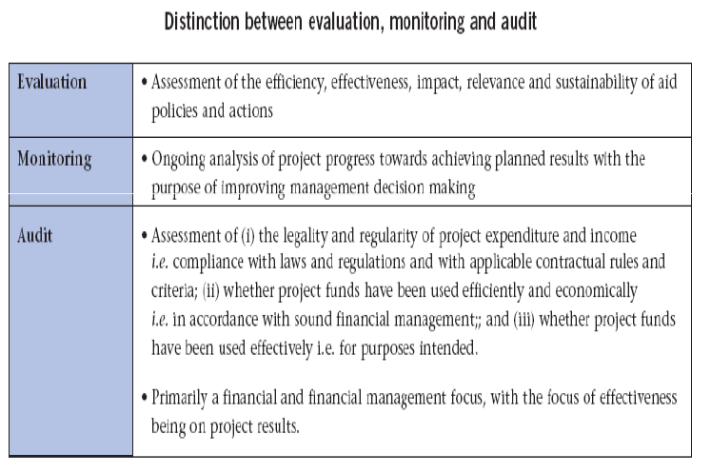

Slide 9
Why Monitor and Evaluate?
Collect accurate information about the TB Programme
Use that information to improve the TB Programme

Slide 10
Monitoring | Evaluation
A continuous process | A specific activity or moment
To provide information to day-to-day decision making (adjustments) | To provide recommendations to strategic decision-making processes
It is carried out by the project team For the project team (to adapt and improve the impacts) and the donors (to follow the progress) | It is carried out by an evaluation team (internal or external to the project team) For the project team and the donors (lesson learned)

