Slide 1
Leaf (Brown) Rust of Wheat:
Dr. Salman Ahmad
Assistant Professor, CoA, UoS

Slide 2
Description:
Most prevalent*(found frequent occurrence) where dews are common
Disease severity increases prior to heading
Early infection results in weak plants, poor roots & tiller formation.
Appears in February after yellow rust.
Leaf rust causes damage by reducing number of kernels per head and kernel size.

Slide 3
Importance:
Cause losses up to 50% in severe cases.
Estimated losses over $350 million in USA alone.

Slide 4
Etiology:
Causal organism: Puccinia recondita f.s.p. tritici
Order: Uredinales
Family: Puccinaceae

Slide 5
Symptoms:
Pustules have uredia that develop as points of bright orange color on leaves.
Spots are rare on sheath & stalk.
These pustule are bigger in size than of yellow rust, scattered irregularly.
Infected plants take longer time to produce mature ears*(grain bearing part).
Rust pustules can be distinguished from other leaf spot diseases by rubbing finger on leaf surface.

Slide 6
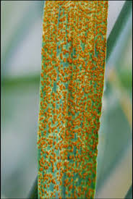
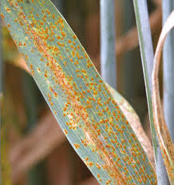
Brown color uredia on the leaves as these are brown colour, disease is named as brown rust
dfd

Slide 7
Disease cycle:
Uredia*(sac like structure that bears urediniospores) over seasons on volunteer plants.
Alternate host Thallactrum flavum (bushy plant) also harbors fungal spores.
Aeciospores from alternate host dispersed by wind.

Slide 8
Epidemiology:
Free water on leaf & 18.3-23.9°C favors the spore germination.

Slide 9
Management:
Destruction of alternate host.
Use fungicides i.e. carbendazim, propiconazole, difenoconazole.
Sow resistant varieties i.e. Anaj 2017 and Akbar 2019.

