Slide 1
A Service-Based Model of a CASE Environment
Chapter # 4

Slide 2
Contents
Overview of the PSE Reference Model
Description of Reference Model Services
Uses of the Reference Model

Slide 3
Overview of the PSE Reference Model
In this chapter, we focus on the services aspect, and examine what we actually mean by "service." .
We also consider the variety of services typically found in an environment, and the interrelationships between services and other aspects of an environment (i.e., interfaces between services)
This examination is an abstract description called a “reference model.”
The PSE(Project Support Environments) Reference Model is a conceptual description of the functionality that may be provided by a CASE environment
Notes:
U.S. Navy Next Generation Computer Resources (NGCR) Program
the Project Support Environments Standards Working Group (PSESWG)

Slide 4
Overview of the PSE Reference Model
This description is general and is bounded neither by a particular application domain nor by any specific lifecycle paradigm for a development project.
The reference model we use as our exemplar is the one developed by the U.S. Navy Next Generation Computer Resources (NGCR) Program.
As part of the work of the NGCR, the Project Support Environments Standards Working Group (PSESWG) defined an environment reference model as its starting point for selecting interface standards.
The working group examined many existing efforts (e.g., the Software Technology for Adaptable, Reliable Systems (STARS) Program, the National Institute of Standards and Technology (NIST) Integrated Software Engineering Environment (ISEE) working group), synthesized many aspects from them, and eventually created an entirely new document called A Reference Model for Project Support Environments

Slide 5
What is the aim of an environment reference model ?
To describe from a purely conceptual viewpoint what functionality an environment can be expected to provide.
A reference model is explicitly not intended to define the physical architecture of an environment.
A reference model is, however, intended to help understand integration issues in an environment, and to provide a basis for identifying interface areas.
Where possible, such interfaces may be standardized, thus improving the ability to:
understand, compare, and contrast available technology
relate users' requirements to actual implementations, and
assess the ease (or otherwise) with which different software tools and products can be integrated.

Slide 6
The Centrality of Services in the Reference Model
The central notion of the PSE Reference Model is that of a service.
We observe both the actual software component that provides this service (often called a tool), and the human work (often called a task) for which this service is necessary.
A tool is a computer program used to help develop, test, analyze, or maintain another computer program or documentation.
When an environment is considered from the viewpoint of how it supports human activities, then either the environment will provide a service to a human user, or a human user will perform some task with the aid of the environment.

Slide 7
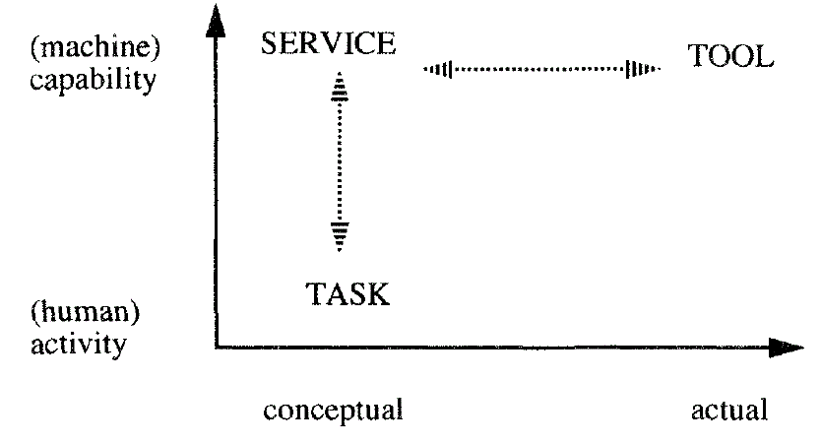
In brief, services are abstract capabilities of the environment, tasks make use of and provide context for those capabilities, and tools are the actual executable software components that realize environment services.
Notes:
Figure 13 illustrates the distinction between these concepts. Service can be contrasted with tool along an axis of conceptual versus actual, or it can be contrasted with task along an axis of capability versus activity.

Slide 8
Differences Between Conceptual Models and Actual Environments
The conceptual viewpoint that governs the reference model provides an abstract description of the functionality that may be found in an environment.
An actual viewpoint would describe a particular realization of the conceptual view in terms of an environment architecture with specific tools and standards.

Slide 9
Relationship Between Conceptual and Actual Worlds.
Figure illustrates the distinction between conceptual service descriptions, having no duplication of functionality, and a set of actual software components, many of which may overlap in their functional capabilities. As the figure shows, tools may duplicate other tools' functionality, and a tool often provides both framework and end-user services.

Slide 10
Description of Reference Model Services
The reference model is a catalogue of service descriptions spanning the functionality of a populated environment.
The service descriptions are grouped in varying ways, either by degrees of abstraction, or functionality.
The highest-level division classifies services either as end-user or framework services.
The former includes services that directly support the execution of a project (i.e., engineers, managers, and secretaries).
The latter services relate to users who facilitate, maintain, or improve the operation of the computer system itself (e.g., a human user performing such tasks as tool installation),
or the services be used directly by other services in the environment.

Slide 11
A Graphical Depiction of the Reference Model Service Groups.
Notes:
End-user services are further subdivided into technical engineering, project management, technical management, and support services

Slide 12
Technical Engineering Services
The following services are defined in the reference model:
system engineering services
(requirements engineering, design and allocation, simulation and modelling, static analysis, testing, integration, reengineering, host-target connection, target monitoring, and traceability);
software engineering services
(requirements analysis, design, simulation and modelling, code verification, software generation, compilation, static analysis, debugging, testing, build, reverse engineering, reengineering, and traceability);
life-cycle process engineering services
(process definition, process library, process exchange, and process usage).

Slide 13
Project Management and Technical Management Services
The following project management services are described in the reference model:
planning, estimating, risk analysis, and tracking.
The following technical management services are defined in the reference model:
configuration management, change management, information management, and reuse management.

Slide 14
Support Services
The reference model describes the following support services:
common support services
(text processing, numeric processing, figure processing, audio and video processing, calendar and reminder, and annotation);
user communication services
(mail, bulletin boards, and conferencing);
Administration services
(tool installation and customization, PSE user and role management, PSE resource management, PSE status monitoring, PSE diagnostic, PSE interchange, PSE user access, and PSE instruction).

Slide 15
Framework Services
Framework services comprise the infrastructure of an environment.
The reference model defines the following framework services:
object management, process management, communication, operating system, user interface, and policy enforcement.
In addition to these services, the NIST/ECMA Reference Model contains services related to framework administration and configuration;
Notes:
Since 1989, NIST has sponsored a series of workshops developing a reference model specifically for environment frameworks. The product of that group is a document
published jointly by NIST and the European Computer Manufacturers’ Association (ECMA), and is commonly known as the NIST/ECMA Frameworks
Reference Model [62]. This document contains detailed descriptions of 50 framework services. The PSESWG elected essentially to use the NIST document
in its entirety, and the PSESWG Reference Model simply contains abstracts of the more extensive descriptions found in the NIST/ECMA document

Slide 16
Uses of the Reference Model
While our particular interest in the reference model is related to our examination of CASE tool integration, there are also some immediate and pragmatic uses for the reference model, particularly in defining or characterizing an integrated environment.
We now consider some of these, including:
choosing interface areas for potential standardization;
producing mappings and comparisons based on the reference model;
describing the integration requirements of a system;
defining tool and environment architectures.

Slide 17
Choosing Interface Areas for Potential Standardization
An important point to emphasize is that within the end-user services there are a number of different interface areas that may be of interest. For example:
Interfaces that permit two instances of one end-user service to interoperate, or to allow one instance to be replaced by another.
Interfaces that permit different services within one life-cycle step to work together
Interfaces between two specific steps in a life-cycle domain.
Interfaces to an engineering domain, or to the management domain
Interfaces between management and engineering services.
Notes:
(e.g., different entity-relationship (ER) design editors, or different C compilers)
(e.g., cooperation between compilers and debuggers, or between ER design editors and design analyzers).
These can be interfaces within an engineering domain (e.g., a mapping between identifiers in the coding language and the design language), or interfaces within a management domain (e.g., a mapping between work breakdown structure (WBS) and schedule elements).

Slide 18
Mapping Environment Implementations to the Reference Model
Mapping: A key activity within the PSESWG work is the validation of the reference model through its application either to an interface standard or to existing tools and environments.
Although producing a mapping is an extremely useful exercise, it is not a simple task (time, complexity, mapping guidelines, examples, training)
Reference model permits different products to be compared directly with each other, using a common vocabulary and a common reference point.
Such comparisons are especially useful because they distinguish products' abstract functionality from their implementation mechanisms.
Notes:
Project Support Environments Standards Working Group (PSESWG)

Slide 19
Describing the Integration Requirements of a System
By defining a system's services, the reference model can be used as a basis for describing the integration requirements of a system.
The advantage of doing this is that these requirements can be described in an abstract way, in terms of required services and the interfaces necessary among and within those services.
When considering the integration of a number of tool products with a particular framework product, the reference model can help in a number of ways.
it can help determine the amount of overlap in providing the same services;
identify the sets of interfaces provided by the products;
look for patterns of commonality among the tool services;
and derive an integration strategy.
Notes:
desired degree of tightness of integration based on the process to be supported,
and the need for flexibility to accommodate product heterogeneity, product replacement, and adaptability of process over time

Slide 20
Defining Tool and Environment Architectures
The reference model and the interface areas identified by it should be able to accommodate a number of different tool and environment architectures and tool integration approaches.
In particular, tools and environments may cooperate in different ways to provide some, or all, of the services defined.
For example, an individual tool product typically provides a number of different services within the one tool.
Often it may only offer an interface to a subset of those services. Similarly, tools may implement those services in different ways.
For example, a tool may implement all of its services itself and only rely on platform services to support its operation, or it may utilize other tools and services in its implementation (e.g., a relational database).

