Slide 1
Anatomical and physiological adaptations in halophytes

Slide 2
Anatomy

Slide 3
Anatomy of halophytes reveals a number of xerophytic adaptations in them. These are as follows:
Presence of thick cuticle on the aerial parts
The epidermis of xerosucculents and coastal halophytes is characterised by a cover of waxy layers in addition to thick cuticle
Leaves
May be dorsiventral or isobilateral. They develop protected stomata which are not deeply sunken. Epidermal cells are thin-walled. The palisade consists of several layers of narrow cells with intercalated tannin and oil cells

Slide 5
Modification of stem
Stems in the succulent plants possess thin-walled water storing parenchyma cells in them.
Mucilage cells may be found in abundance.
Epidermal cells of various mangrove species contain large quantities of tannins and oil droplets.
Cortex is fleshy, several cells thick and in old stems it may become lacunar.
Salinity causes extensive lignification of stele
Trichomes
Leaves and stems of coastal halophytes are abundantly covered with various types of simple and branched trichomes giving the plants a greyish appearance

Slide 7
The trichomes may exert a protective function in plants by:
(a) Affecting water economy
(b) Affecting the temperature of the leaves, and
(c) Preventing sea water droplets from reaching the live tissues of leaves

Slide 8
Cork Warts
Leaves of many species of mangrove are dotted with local cork formation “cork warts”. Salt secreting glands may be found in some halophytes.
Stilt roots and pneumatophores
The stilt roots of mangrove plants show normal features with periderm on the surface and extensively developed pith
Pneumatophores show variations in their internal structures
Generally, they show conjoint, collateral vascular bundles with endarch xylem at maturity.
Very young pneumatophores, however, show root features, i.e., exarch xylem and radial arrangement of vascular tissues
Generally the negatively geotropic breathing roots show features of stem and not of roots

Slide 9
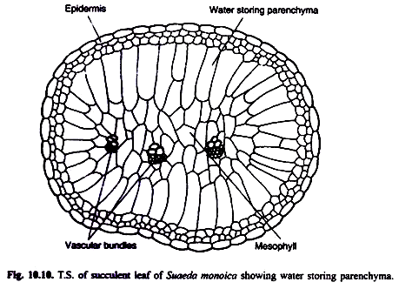

Slide 10
Physiology

Slide 11
Question to ponder
Halophytes grow in an environment where water is available to the plants in abundance then why xeromorphy develops in these plants?

Slide 12
Answer
Previously physiological drought was believed to be the main cause of developments of xeromorphy in halophytes, but recent physiological experiments on these plants have proved that xeromorphism in these plants is, apparently, an example of purposeless adaptation. Physiological experiments make it clear that the halophytes do not experience difficulties, whatsoever, in absorbing too saline water.

Slide 13
This point is concluded taking into consideration the following reasonable facts:
(i) They show high rates of transpiration,
(ii) They show exudation of sap that contains dissolved salts, and
(iii) They develop many shallow absorbing roots.
Saline conditions are not essentially “dry” for all plant species. Under saline conditions sometimes higher transpiration rates have been observed in halophytes than in neighbouring salt hating plants

Slide 15
Excessive accumulation of sodium does not harm these plants.
Halophytes grow in saline habitats not because they are salt loving but because they tolerate high concentration of salts better than other plants of non- saline habitat.
Active accumulation of salts also increases the osmotic concentration of cell sap in these plants and thus makes them able to absorb salty water very easily.

