Slide 1
Khat Thuluth
Thuluth means “one third,” It was first formulated in the 7th century A.D., and fully developed in the 9th century. It is noted for its cursive letters and its use as an decorative script.

Slide 2
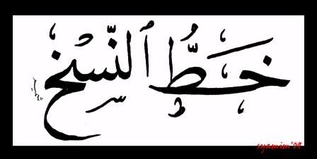
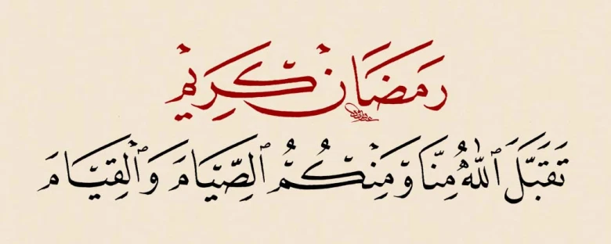
Khat Nasakh
Nasakh: means “copy” in Arabic, is one of the earliest scripts, redesigned by Ibn-Muqlah in the 10th century A.D., It is noted for its clarity to read and write, and was used to copy the Qur’an.

Slide 3
Khat Taliq or Farsi
Ta’liq: means “hanging,” referring to the shape of the letters, is a cursive script developed by the Persians in the early part of the 9th century A.D., and it is also called Farsi (Persians).

Slide 4
Khat Diwani
Diwani: was developed by the Ottomans from the Ta’liq style. This style became a favorite script for writing in the Ottoman chancellery, and its name was derived from the word “Diwan,” which means the “Royal Court.”

Slide 5
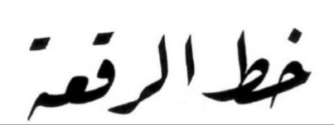
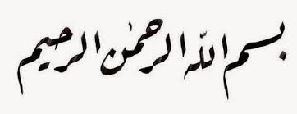
Khat Riqa
Riq’a: It is noted for its simplicity and its short horizontal stems. The word Riq’a means “a small sheet,” which could be an indication of the media on which it was originally created.

Slide 6
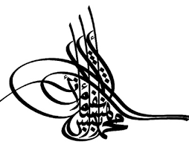
Khat Tughra
Tughra’ was used by the Ottoman sultans as their signature. It was supposed to be impossible to imitate.
Signature of an Ottoman Sultan

