Slide 1
Theme Painting
By Andleeb Rana

Slide 2
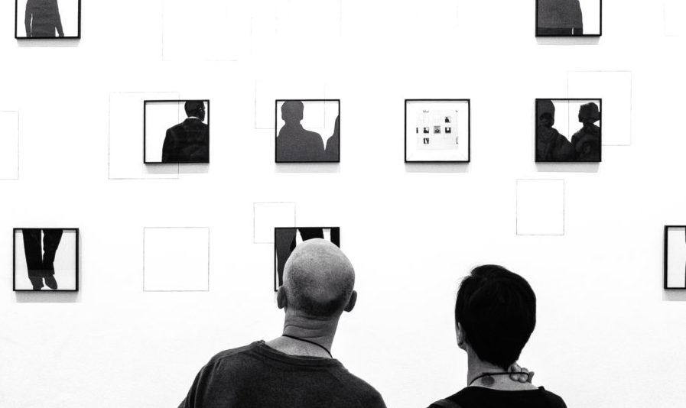
What is theme?

Slide 4
Theme painting In art, theme is usually about life, society or human nature, but can be any other subject. Themes are the fundamental and often universal ideas explored in a work. Themes are usually implied rather than explicitly stated.

Slide 5
Santhal Maidens, ca. 1950s, oil, by Zainul Abedin Jalaluddin Ahmed

Slide 6
Visual Arts Themes differ from motifs in the visual arts. in that themes are ideas conveyed by the visual experience as a whole, while motifs are elements of the content.

Slide 7
Slow thought

Slide 8
Categories: Religious. Religious theme of art. Politics and the Social Order. Theme of art that involves societies. ... Stories and Histories. theme of art that involves stories whether real or make believe. Genre. Scenes of every day life. Personal Expression. Fantasy. The Natural World. Art for arts sake.

Slide 9
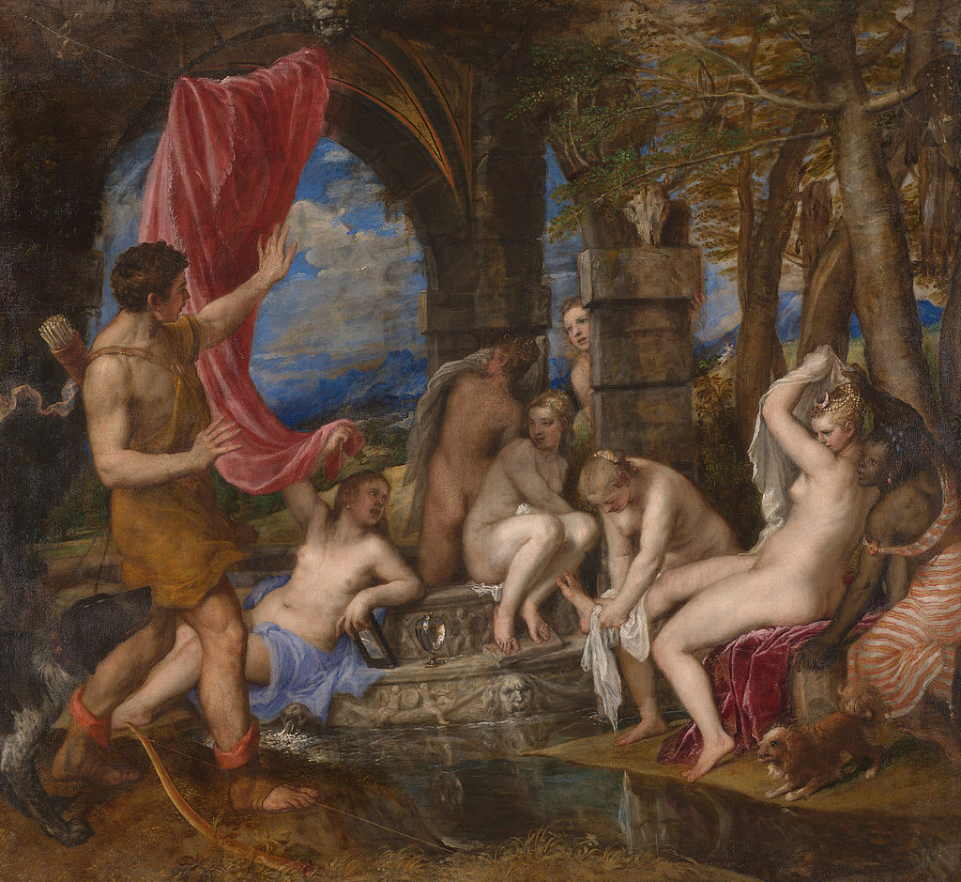
Diana and Actaeon by Titian

Slide 10
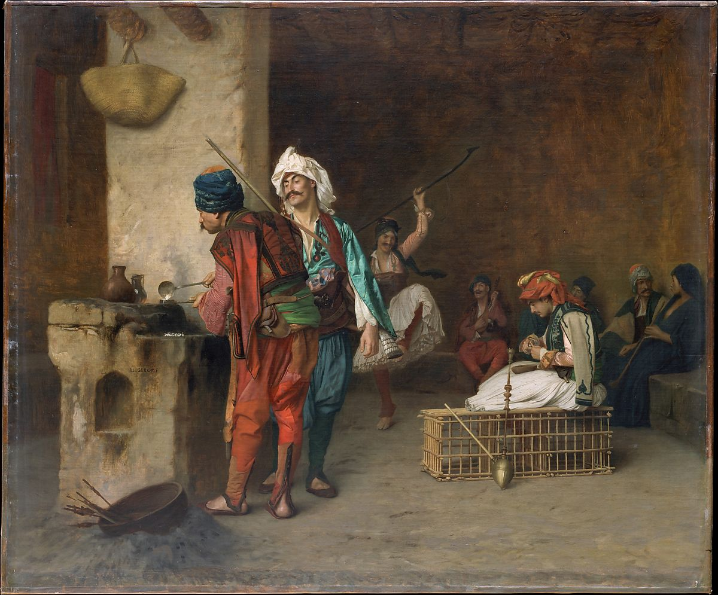
Cafe House, Cairo (Casting Bullets) 1884 by Jean Leon Gerome

Slide 11
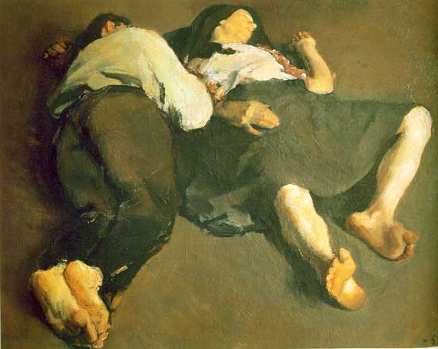
peaceful-sleep Corne liu Baba 2012

Slide 12
Thematic patterning Thematic patterning means the insertion of a recurring motif in a narrative. The narrative is interrupted several times by stories within the story.

Slide 13
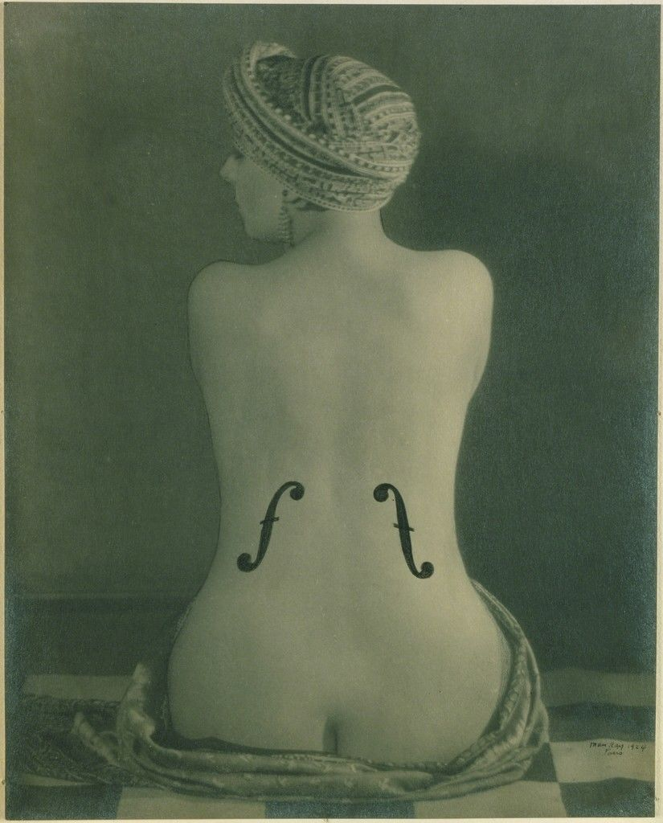
Le Violon d Ingres Man Ray 1924

Slide 14
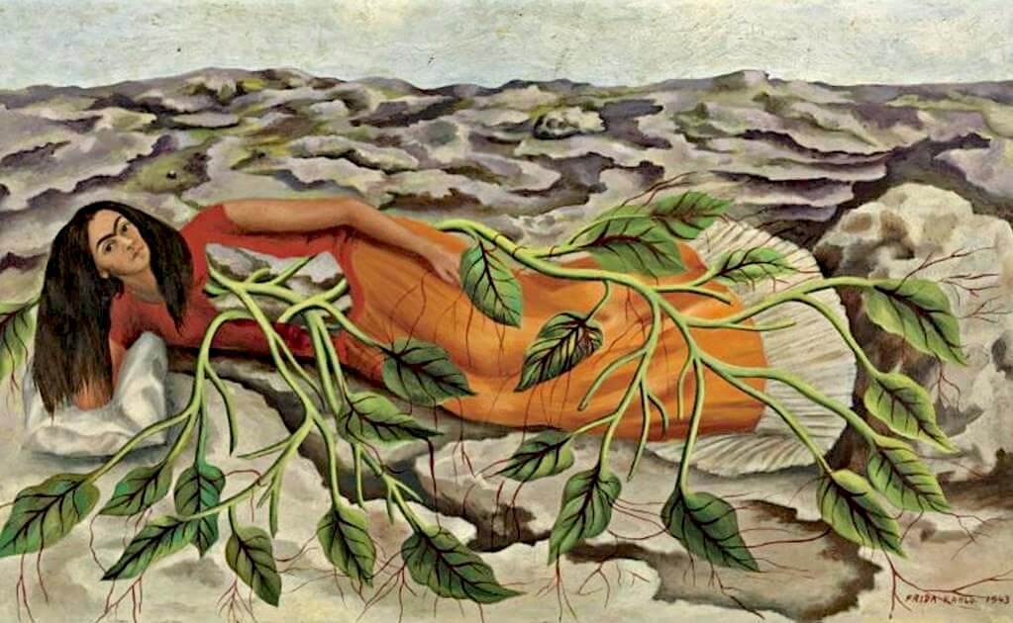
roots by Frida Kahlo1943

Slide 15
Examples Some common themes are "love," "war," "revenge," "betrayal," "patriotism," "grace," "isolation," "motherhood," "forgiveness," "wartime loss," "treachery," "rich versus poor," "appearance versus reality," and "help from other-worldly powers."

Slide 16
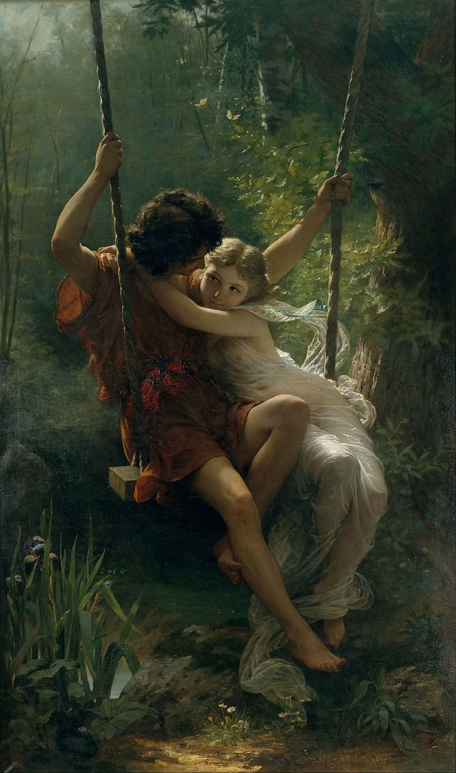
Springtime 1873 by Pierre Auguste Cot

Slide 17
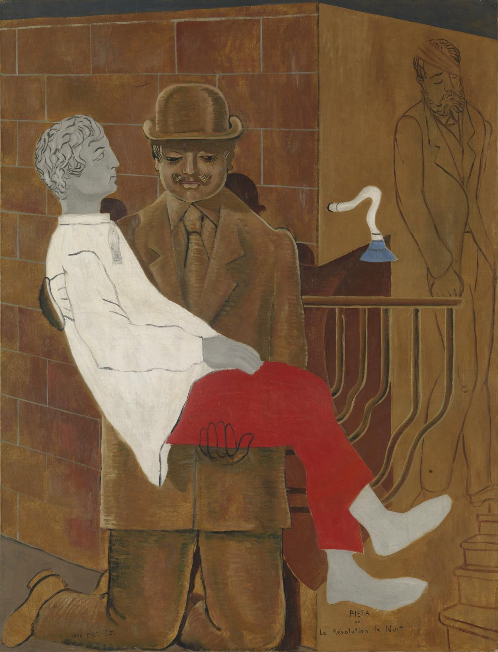
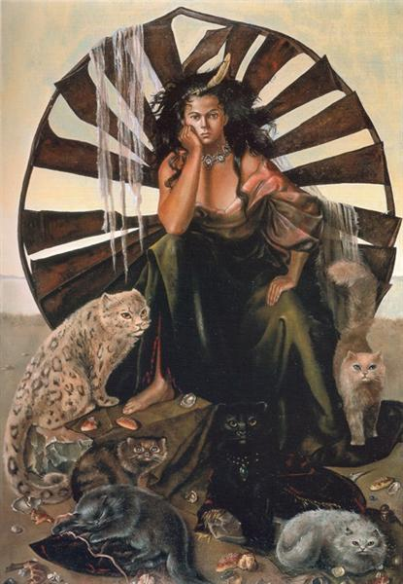
Pieta or Revolution by night by Max Ernst
Ideal life Mythology by Leonor Fini 1950

Slide 18
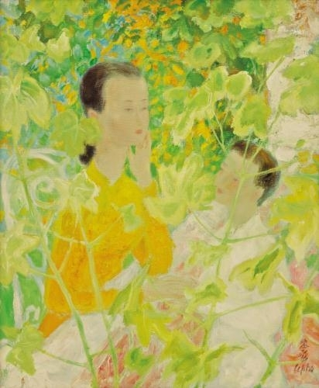
summer Le Pho 2013

Slide 19
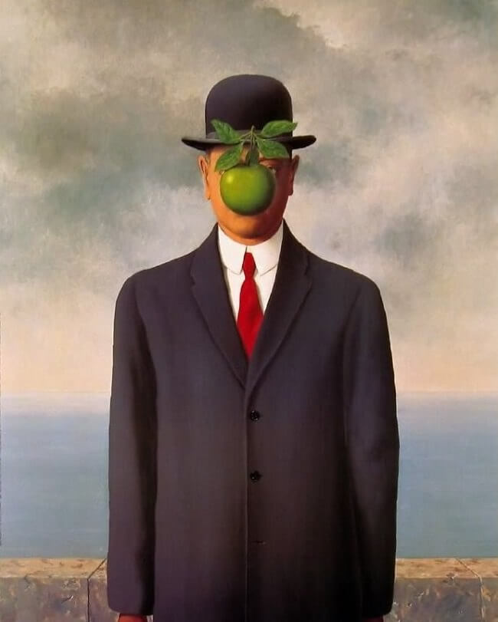
son-of-man Rene Magritte 1946

Slide 20
Thank You

