Slide 1
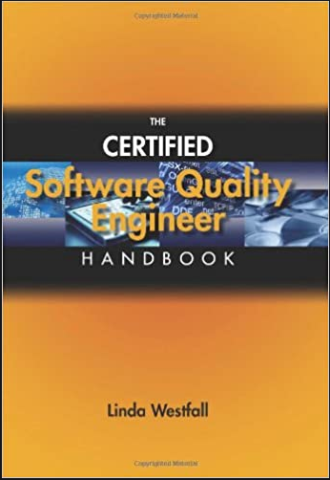
Software Testing & Quality Engineering
Chapter 7
Quality Audits
Linda Westfall Quality Press

Slide 2
Objectives
Audit Defined
Audit Types
Audit Roles and Responsibilities
Audit Process

Slide 3
Audit Defined
Quality system audit, as defined by ANSI/ASQC A3-1987, is a systematic and independent evaluation of the quality system and its execution, looking at both design and performance of the system.
Auditing is defined as the on-site verification activity, such as inspection or examination, of a process or quality system, to ensure compliance to requirements.
It is a fact finding process that compares actual results with specified standards and plans.
It provides feedback for improvement.
It differs from inspection, which emphasizes acceptance or rejection, and surveillance, which is ongoing continuous monitoring.
An audit can apply to an entire organization or might be specific to a function, process, or production step.
Some audits have special administrative purposes, such as auditing documents, risk, or performance, or following up on completed corrective actions.

Slide 4
Types of Audits
Quality audits may be classified according to
the party conducting them
Internal Audits
External Audits
their scope
System Audit
Process/Function Audit
the audit method used
Location Oriented
Function Oriented
In general, three parties are involved in an audit:
the organization requesting the audit, or client,
the party conducting the audit, or the auditor, and
the organization to be audited, or the auditee.

Slide 5
Types of Audits Continued
When the auditor is an employee of the organization being audited (auditee), the audit is classified as an internal quality audit. For the purposes of maintaining objectivity and minimizing bias, internal auditors must be independent from the activity being audited.
On the other hand, when the auditors are employees of the client or an independent organization or third party hired for the purpose, the audit is termed an external quality audit. In this case, the auditors are clearly independent of the auditee and are in a position to provide the client with an unbiased, objective assessment. This is the type of audit required to permit listing in a register or to meet mandatory quality requirements. However, the time required and costs involved in an external audit are much higher as compared to internal audits.

Slide 6
Types of Audits Continued
Another way to classify quality audits is by scope and extent.
An audit may be as comprehensive as needed or requested by the client. The most comprehensive type of audit is the quality system audit, which examines suitability and effectiveness of the system as a whole. This involves both the documentation and implementation aspects of the quality system. Reasons for initiating a system audit may range from evaluating a potential supplier to verifying an organization’s own system.
Audits of specific elements of a system, processes, products or services are also possible. These are limited in scope and are typically referred to using a modifier preceding the term quality audit. Examples include process quality audits and product quality audits. (Refer to notes section of slide)
The method by which the quality audit is conducted provides yet another way to classify. Audits may be conducted by location or function. A location-oriented audit provides an in-depth examination of all the quality related activities within a given location. In a function-oriented audit, an activity is examined in all the locations where the activity is carried out.
It is important to note that these classifications are not mutually exclusive and, in practice, cross-classifications of a quality audit are possible.
Notes:
Process audit:
This type of audit verifies that processes are working within established limits. It evaluates an operation or method against predetermined instructions or standards to measure conformance to these standards and the effectiveness of the instructions. A process audit may:
Check conformance to defined requirements such as time, accuracy, responsiveness, etc.
Examine the resources (equipment, materials, people) applied to transform the inputs into outputs, the environment, the methods (procedures, instructions) followed
Check the adequacy and effectiveness of the process controls established by procedures, work instructions, flowcharts, and training and process specifications.
Product audit: This type of audit is an examination of a particular product or service, such as hardware, processed material, or software, to evaluate whether it conforms to requirements.
System audit: An audit conducted on a management system. It can be described as a documented activity performed to verify, by examination and evaluation of objective evidence, that applicable elements of the system are appropriate and effective and have been developed, documented, and implemented in accordance and in conjunction with specified requirements.

Slide 7
Roles and Responsibilities in Audits
The client: The client, the party that initiates the audit, selects the auditor and determines the reference standard to be used. The client, typically the end user of the audit results, determines the type of audit needed (system, process, product, and so on) as well as its time and duration.
The Auditor: The selected auditor, whether an individual or a group, needs to adhere to the role of a third party. That is, the auditor must maintain objectivity and avoid bias in conducting the audit. The auditor must comply with any confidentiality requirements mandated by the auditee. An experienced individual is appointed as lead auditor to communicate audit requirements, manage the auditing activities, and report the results. For rules, qualifications, and evaluation criteria for an auditor, see ANSI/ISO/ASQ QE19011S-2008.
The Auditee: The auditee has the responsibility of accommodating the audit, which entails providing the auditors access to the facilities involved and copies of all relevant documentation. The auditee is also expected to provide the resources needed and select staff members to accompany the auditors.

Slide 8
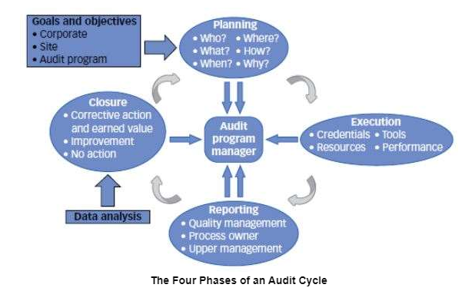
Audit Process

Slide 9
Audit planning and Process
Audit planning and preparation: Audit preparation consists of planning everything that is done in advance by interested parties, such as the auditor, the lead auditor, the client, and the audit program manager, to ensure that the audit complies with the client’s objective. This stage of an audit begins with the decision to conduct the audit and ends when the audit itself begins.
Audit execution: The execution phase of an audit is often called the fieldwork. It is the data-gathering portion of the audit and covers the time period from arrival at the audit location up to the exit meeting. It consists of multiple activities including on-site audit management, meeting with the auditee, understanding the process and system controls and verifying that these controls work, communicating among team members, and communicating with the auditee.
Audit reporting: The purpose of the audit report is to communicate the results of the investigation. The report should provide correct and clear data that will be effective as a management aid in addressing important organizational issues. The audit process may end when the report is issued by the lead auditor or after follow-up actions are completed.
Audit follow-up and closure: According to ISO 19011, clause 6.6, "The audit is completed when all the planned audit activities have been carried out, or otherwise agreed with the audit client." Clause 6.7 of ISO 19011 continues by stating that verification of follow-up actions may be part of a subsequent audit.
Notes:
Corrective action is action taken to eliminate the causes of an existing nonconformity, defect, or other undesirable situation in order to prevent recurrence (reactive). Corrective action is about eliminating the causes of problems and not just following a series of problem-solving steps.
Preventive action is action taken to eliminate the causes of a potential nonconformity, defect, or other undesirable situation in order to prevent occurrence (proactive).

Slide 10
Purpose of Quality Audit
The following four purposes of quality audits are listed in ANSI/ISO/ASQ QE19011S-2008:
To meet requirements for certification to a management system standard.
To verify conformance with contractual requirements.
To obtain and maintain confidence in the capability of a supplier.
To contribute to the improvement of the management system
The audit final report should include, at a minimum, the following: 1. Type of audit conducted 2. Objectives of audit 3. Identification of involved parties: auditor, auditee, and third party. members 5. Critical nonconformities and other observations 6. Audit standards and reference documents used 7. Determination of proper corrective action(s) 8. Duration of audit 9. Audit report distribution and date. Audit results and recommendations 11. Audit-related records

