Slide 1
Topic: Bacterial Photosynthesis

Slide 2
Photosynthesis:
Photosynthesis is the conversion of light energy into chemical energy in the form of ATP.
Prokaryotes that can convert light energy into chemical energy include the photosynthetic cyanobacteria,the purple and green bacteria,halobacteria etc.
Net euation:
6CO2 + 12H2O + Light Energy → C6H12O6 + 6O2 + 6H2O
Half of the photosynthesis in ecosystem is carried out by microbes.

Slide 3
Photosynthesis reactions divided into two stages:
Light reaction: Light energy is absorbed and converted into chemical energy such as ATP and NADPH.
Dark reaction: carbohydrates made from CO2 is stored in ATP and NADPH.
Photosynthetic bacteria contain light absorbing pigments and reaction centers and capable of converting light energy into chemical energy..
Photosynthetic Pigments in cyanobacteria:
Chlorophyll
Carotenoids
Phycobilin
Photosyntheic pigment if anoxygenic bacteria:
Bacteriochlorophyll

Slide 5
Different groups of photosynthetic bacteria:
Purple bacteria
Green sulfur bacteria
Green gliding bacteria
Cyanobacteria
Filamentous Anoxygenic Phototrophs
Phototrophic Acidobacteria
Phototrophic Heliobacteria

Slide 6
Oxygenic photosynthesis
Oxygenic photosynthetic bacteria are unicellular or multicellular and possess chlorophyll a.
They perform photosynthesis in a similar manner to plants.
They contain light harvesting pigments (such as, phycobilins) , absorb CO2 and release oxygen.
The synthesis of carbohydrates results in release of molecular O2 and removal of CO2 from atmosphere.
It occurs in lamellae which house the thylakoids containing chlorophyll a/b and phycobilin
pigments to gether light energy.
Electron source in oxygenic photosynthesis is water(H2O).

Slide 7
This process involves two photosystems:
PS2- which generates a proton motive force for making ATP.
PS1 - which generates low potential electrons for reducing power.
cyanobacteria perform oxygenic photosynthesis.
Cyanobacteria perform photosynthesis using water as an electron donor in a similar manner to plants. This results in the production of oxygen and is known as oxygenic photosynthesis.
Cyanobacteria are often blue-green in colourand are thought to have contributed to the biodiversity on Earth by helping to convert the Earth's early oxygen deficient atmosphere to an oxygen rich environment.
Cyanobacteria are mostly found in water but can survive on land and in rocks. They are also endosymbiont they can live within the cells or body of another organism.

Slide 8
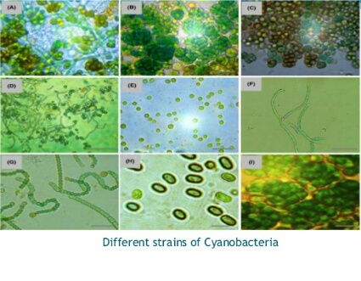

Slide 9
Anoxygenic photosynthesis:
Anoxygenic photosynthetic bacteria consume CO2 , light energy to create organic compounds ,sulfur or fumarate compounds instead of O2.
It occurs in purple bacteria, green sulfur bacteria, green gliding bacteria, Filamentous Anoxygenic phototrophs (FAPs), phototrophic Acidobacteria and Phototrophic Heliobacteria.
It uses bacteriochlorophyll instead of chlorophyll and involves one photosystem (PS1) to generate ATP in cyclic manner.
Bacteriochlorophyll: These are biomolecules similar to chlorophyll.
They absorb light strongly in Infrared region between 700nm to 1000nm.
Electron carriers in anoxygenic photosynthesis are:
Quinone
cytochrome bc complex

Slide 10
Purple Bacteria:
purple bacteria can be divided into two main types:
Chromatiaceae: which produce sulphur particles inside their cells.
Ectothiorhodospiraceae: which produce sulphur particles outside their cells.
They cannot photosynthesize in places that have an abundance of oxygen.
They are found in either stagnant water or hot sulphuric springs.
Purple sulfur Bacteria
They use hydrogen sulphide as their reducing agent (instead of using water to photosynthesize) ,
releasing sulphur (rather than oxygen).
Example: Rhodomicrobium

Slide 11
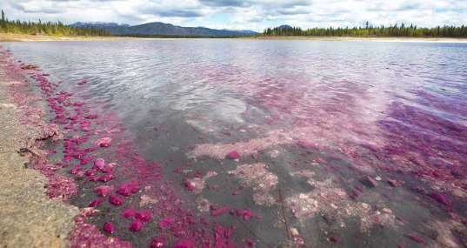

Slide 12
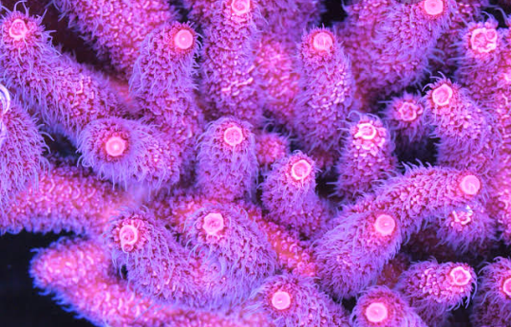
Purple non-sulphur bacteria:
They use hydrogen as their reducing agent, do not release sulphur.
They can tolerate small amounts of sulphur, and too much hydrogen sulphide is toxic to them.
Example: Rhodobacter

Slide 13
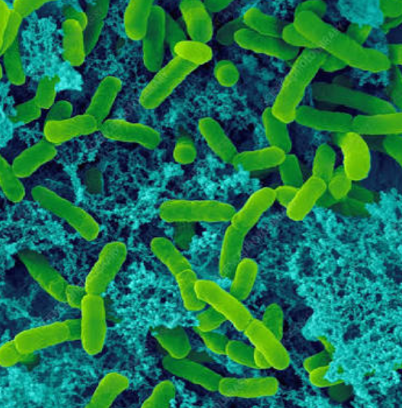
Green sulphur bacteria:
They are generally non- motile and occurs in multiple shapes such as spheres, rods, and spirals.
They are found in deep ocean and can survive in extreme conditions, like other types of photosynthetic bacteria.
Example: Chlorobium

Slide 14
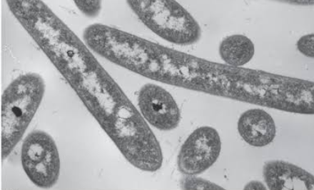
Phototrophic Acidobacteria:
They are found in alot of soils. Some are acidophilic.
Phototrophic Heliobacteria:
They are found in soils , especially water saturated fields, like rice paddies.
They use bacteriochlorophyll g..
They are photoheterotroph - they cannot use carbon dioxide as their primary source of carbon.

Slide 15
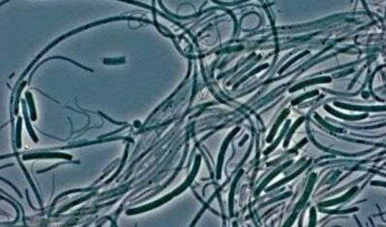
Green and red filamentous anoxygenic phototrophs (FAPs):
Previously called green non- sulphur bacteria, until it was discovered that they could also use sulphur components to work through their processes.
This type of bacteria use filaments to move around.
Their colour depends on the type of bacteriochlorophyll the particular organism uses.
This bacteria can either be photoautotrophic , chemoorganotropic or photoheterottophic.

Slide 16
Applications of Photosynthetic Bacteria:
Water purification , bio- fertilizers , animal feed and bioremidiation of chemicals among
many others.
They are used in the treatment of polluted water since they can grow and utilize toxic
substances such as H2S and H2SO3.
some researchers have engineered photosynthetic bacteria to produce simple sugars
and lactic acid.

