Slide 2
CONTOURING
It is a tillage practice of plowing the land in sloppy areas across the slope not along the slope.
This include Plowing, furrowing and planting across the slope.
Contour plowing or contour farming

Slide 3
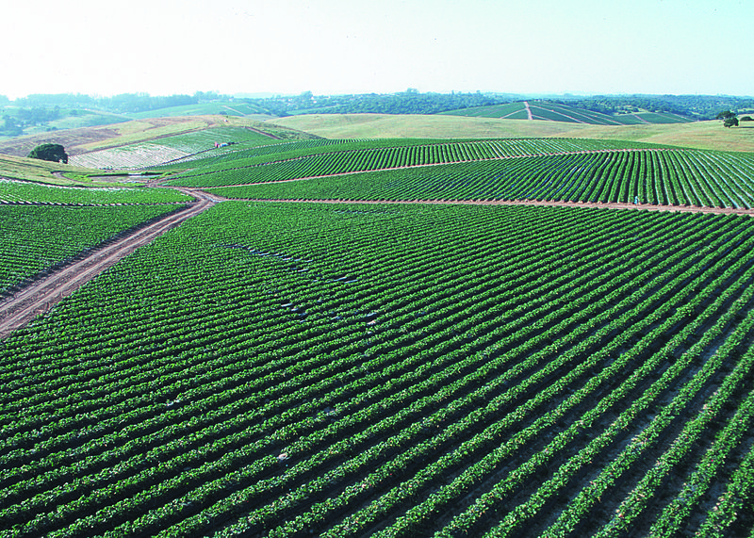

Slide 4
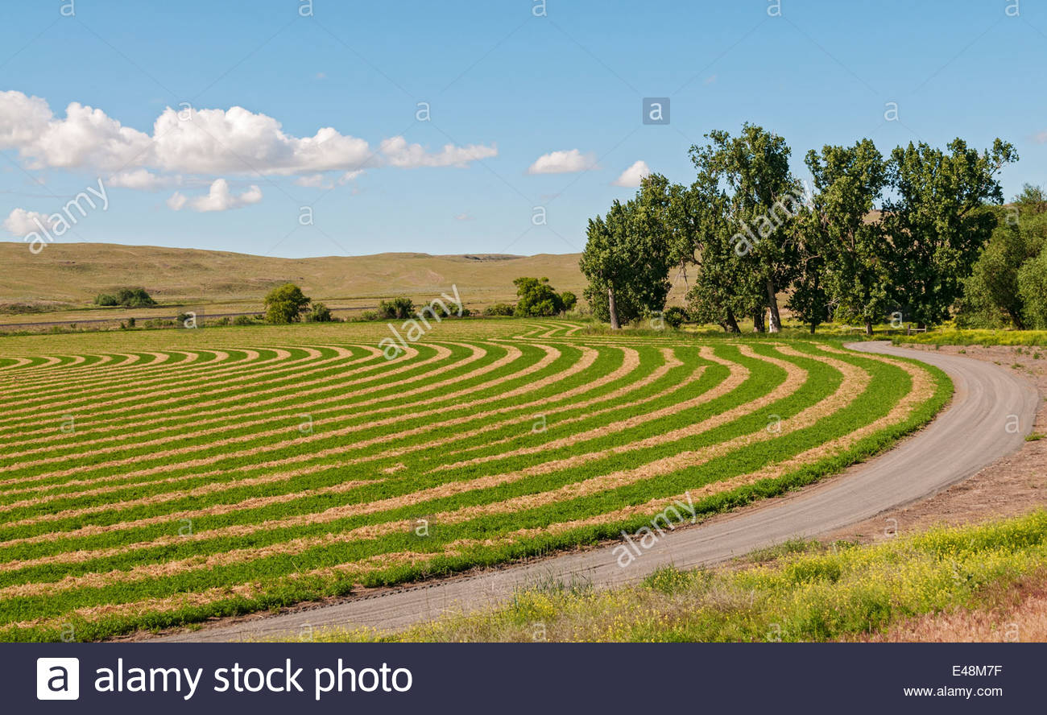

Slide 5
History
The Phoenicians first developed the practice of contour farming between 1500 BC and 300 BC.
This was one of the main procedures promoted by the US Soil Conservation Service (the current Natural Resources Conservation Service) during the 1930s.

Slide 6
APPLICABILITY
This best management practice applies to agricultural users whose crops are irrigated on moderately sloping lands.
This method is most effective on slopes between two (2) and ten (10) percent.

Slide 7
IMPLEMENTATION
The steps necessary for implementing contour farming are.
Topographic survey of field.
Layout of a baseline contour with markers.
Prepare field borders to allow room for farm implements to turn.
Perform all farming activities parallel to baseline contour(s).

Slide 8
HOW CONTOURING IS DONE
Plant rows and tillage lines are kept at right angle to the normal flow of surface runoff.
Normally bunding is done along the slopes to reduce its length of slope.
The land slope is broken up into smaller simply by constructing earthen embankment of suitable sizes on contours.

Slide 11
ROLE IN CONSERVATION
From this method sloppy land is utilized properly.
It also reduces the erosion.
Reduces transport of sediments, other solid and particles attached to them.
It reduces the run off.
It give the water more time to infiltrate into the soil , instead of directly rushing off.

Slide 12
Reduced sheet, rill and gully erosion.
Increased moisture retention .
Improved irrigation distribution uniformity.
Can reduce size and cost of downstream runoff management
Low cost for erosion control.
It reduces soil loss by 50% on slopes of 2-8%
If the soil is permeable and its infiltration capacity is high, a large part of the rainfall water enters into the soil.

Slide 13
Contour farming is a sustainable agricultural method as it:
Provides food locally to satisfy human food requirements. (social benefits)
Enhances environmental quality and the natural resource. (conserve water and prevent soil erosion)
It can be practiced on a large scale, providing market for the crop internationally which builds or promotes economic development. (economic benefit)

Slide 14
Reducing fertilizer loss not only saves the farmer time and money, but it also decreases risk of harming regional freshwater systems.
Contour farming is most effective when used with other soil conservation methods like strip cropping, terrace (agriculture) farming, and the use of a cover crop.

Slide 15
DISADVANTAGS
Not suitable for lands with heavy overland flows unless these flows can be diverted to safe outlets.
Curved rows impractical for some farm machinery or for drip tape installation
On slowly permeable soil the effect of contouring is much smaller because the surface storage is soon filled up and since only little water enters the soil, much of it flows off superficially.

