Slide 1
ERP
First Week
Introduction to ERP

Slide 11
Notes:
SAP
A German software company whose products allow businesses to track customer and business interactions. SAP is especially well-known for its Enterprise Resource Planning (ERP) and data management programs. SAP is an acronym for Systems, Applications and Products.

Slide 17
Notes:
The Y2K bug was a computer flaw, or bug, that may have caused problems when dealing with dates beyond December 31, 1999. The flaw, faced by computer programmers and users all over the world on January 1, 2000, is also known as the "millennium bug."
When complicated computer programs were being written during the 1960s through the 1980s, computer engineers used a two-digit code for the year. The "19" was left out. Instead of a date reading 1970, it read 70. Engineers shortened the date because data storage in computers was costly and took up a lot of space.
As the year 2000 approached, computer programmers realized that computers might not interpret 00 as 2000, but as 1900. Activities that were programmed on a daily or yearly basis would be damaged or flawed. As December 31, 1999, turned into January 1, 2000, computers might interpret December 31, 1999, turning into January 1, 1900.

Slide 20
Notes:
Quality Assurance Division
Social Security Administration

Slide 21
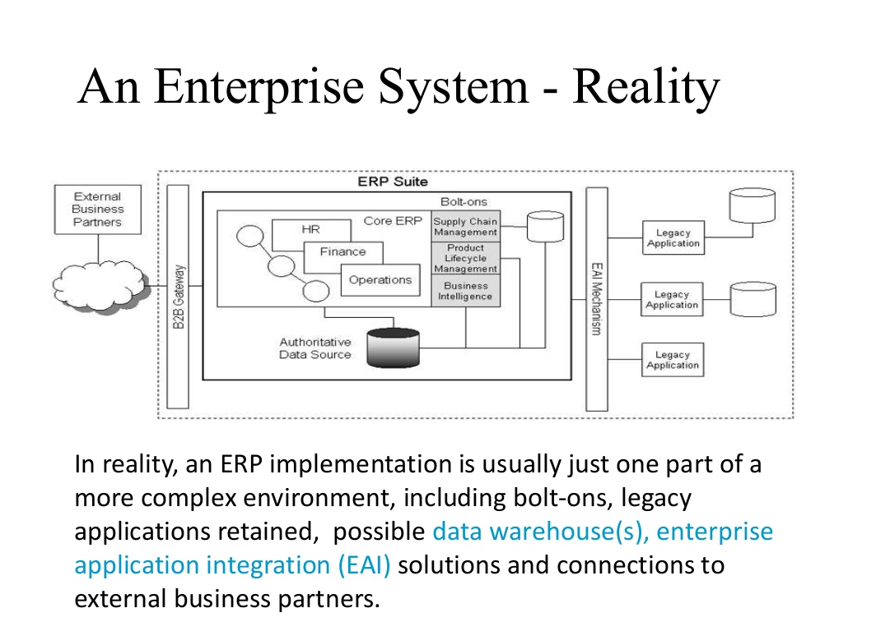
Notes:
Business-to-Business (B2B) Gateways integrate data from back-end systems enabling information exchange across trading partners
Bolt-on is an artificially intelligent, comprehensive execution system providing very specific functionality or technology to complement ERP systems. Bolt-ons employ client-specific business rules to meet unique needs.
Application integration is the process of enabling independently designed applications to work together.
Enterprise application integration establishes a middleware framework that helps data flow freely between applications without significant changes to database configurations or the applications themselves, leading to a streamlined process and increased data availability.

