Slide 1
TEACHING AIDS
” “We remember 20% of what we HEAR
We remember 30% of what we SEE
We remember 50% of what we SEE & HEAR
We remember 90% of what we SAY & DO”
“I hear, I forget
I see, I remember
I do, I understand

Slide 3
TEACHING AIDS
Teaching aids are the tools that teachers use them in the classroom such as flash cards,maps,cassette and blackboard.
A teaching aid is a tool used by teachers to help learners improve reading and other skills, illustrate or reinforce a skill, fact, or idea, and relieve anxiety, fears, or boredom, since many teaching aids are like games.

Slide 4
Categories of Teaching Aids
3 categories
1) Audio Aids
2) Visual Aid
3) Audio – Visual Aid
A-V aid imply, “anything by means of which learning process may be encouraged or carried on through the sense of hearing or the sense of sight.”

Slide 5
CLASSIFICATION OF AUDIO VISUAL AIDS
PROJECTED & NON PROJECTED AIDS
NON PROJECTED
GRAPHIC- picture, charts, maps, graphs, puppets, flash cards, posters
PROJECTED
SILENT- slides, film strips, OHP
DIPLAY BOARDS- BB, bulletin board,
flannel board,
magnetic board, specimens
3- D AIDS- globes, models, objects, field trip
AUDIO AIDS- radio,
taperecorder,
language laboratory
ACTIVITY AIDS- CAI, demonstrations,
dramatics,
experiments,
programmed instruction
SOUND- films

Slide 7
EDGAR DALE’S CLASSIFICATION OF AUDIO VISUAL AIDS

Slide 8
NEED & IMPORTANCE
Clarity
Attention & interest
Best motivators
Use of maximum senses
Saving time & effort
Fixing and recalling the knowledge
Meeting the individual differences
Encouraging activities
Introductory variety
Development of scientific attitude
Direct experiences
Promotion of international understanding

Slide 9
PRINCIPLES OF SELECTION & EFFECTIVENESS IN USE
PRINCIPLE OF SELECTION
Educational value
Realization of objectives
Pupil centeredness
Interest and motivation
Simplicity
Relevancy and suitability
Accuracy
Encouragement
Well preparedness
Avoiding too many aids
Means to an end
Integration
availability of resources- size of classroom, finance, facilities, experienced teachers

Slide 10
PRINCIPLE OF USE
preparation- awareness, teacher's preparation, students participation
Proper presentation- handling, checking, timely presentation, avoiding distraction
Protection and preservation
Action
Follow up
Evaluation

Slide 11
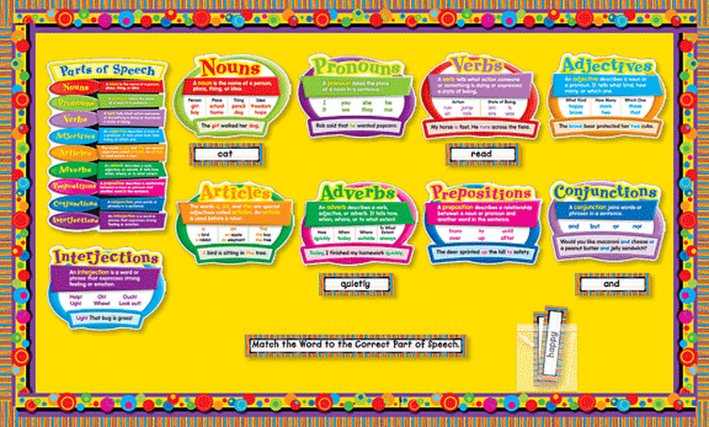
CHARTS

Slide 13
CHART
A chart is a useful way to present and display information or instructions, especially in a classroom or other educational situation. It can range in size from a large wall chart to a single piece of paper.
Acc to Edgar Dale , “a chart is a visual symbol summarising or comparing or contrasting or performing other helpful services in explaning subject matter”

Slide 14
TYPES OF CHARTS
Picture chart
Time chart
Tree chart
Table chart
Graphic chart
Flow chart
Pie chart

Slide 15
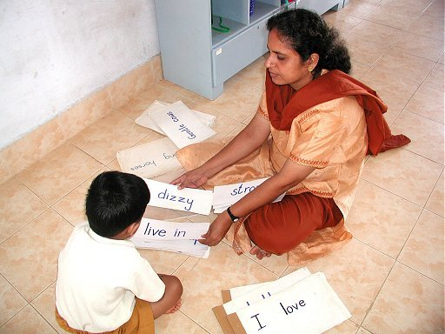
FLASH CARDS

Slide 17
FLASH CARDS
Flash cards are useful for drilling new letters, words, and other information. They are normally used in a classroom, but can also be used more informally.
A flash card is part of a set of cards on which are written items to be studied. They are “flashed” (shown quickly) one by one to a learner to elicit a quick response.

Slide 18
Flash cards are sets of cards printed with information to be studied, such as
definitions
formulas
letters
multiplication tables
prefixes
words.
If there is an answer or solution to what appears on the front of the card, it is printed on the back so that the person showing the cards can see if the learner's answer is correct

Slide 19
FLIP CHARTS

Slide 21
FLIP CHARTS
Flip charts are useful in teaching situations where you need to teach a number of people at a time. They are used when books are unavailable, scarce, or too expensive for individuals to have their own copy when other media such as overheads and slides are not available, and where group learning is most culturally appropriate.
A flip chart is a collection of large pages which are bound together at the top. The pages are “flipped” or brought up and to the back as they are used.
A flip chart is bound together at the top in such a way that the pages can be easily turned and lie flat.

Slide 22
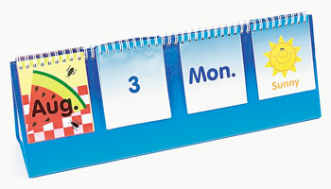
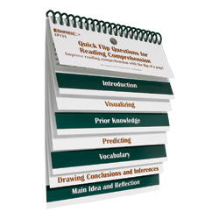
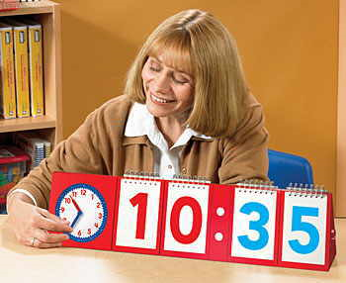
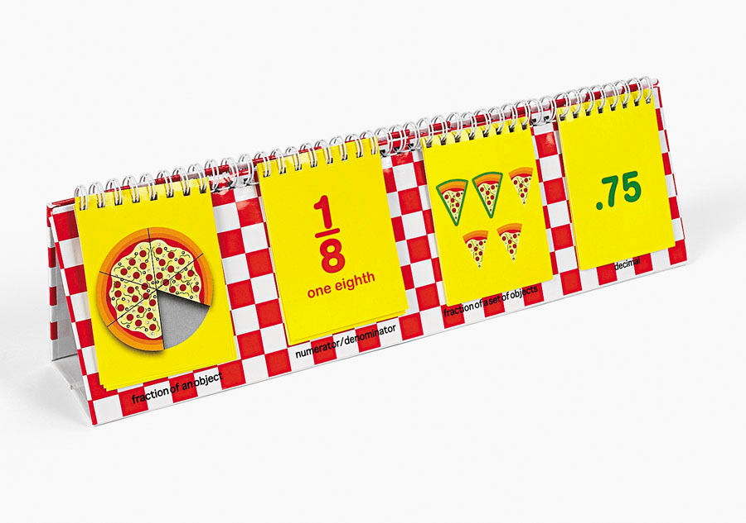
FLIP CARDS

Slide 23
FLANNEL BOARD

Slide 24
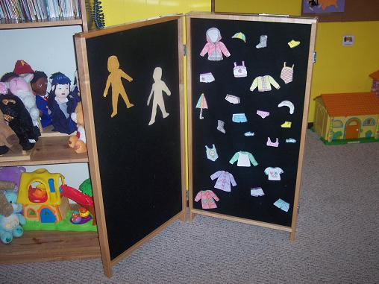

Slide 25
FLANNEL BOARD
It consists of a piece of flannel or felt made from wool, stretched tightly over a strong backing of plywood. Pictures, cards and similar material can be made stick on it.

Slide 27
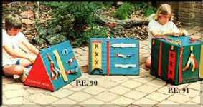
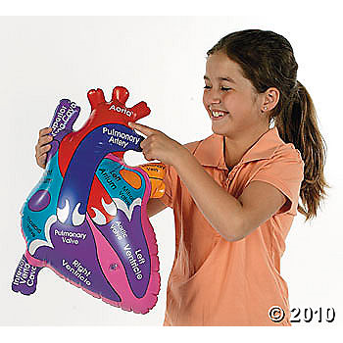
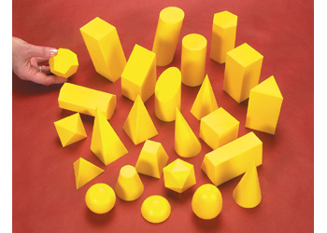
MODELS

Slide 28
MODEL
Models are replicas or copies of real objects with suitable change in size, complexity, timing, safety and cost factors.
CLASSIFICATION-
Simplified
Scale
Working
Cross-sectional
Mock-ups

Slide 29
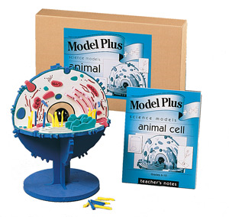

Slide 31
GLOBE a globe is a spherical model of earth

Slide 32
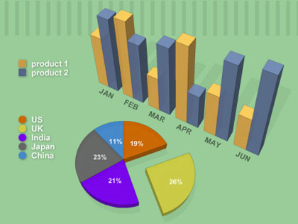
GRAPHS

Slide 33
GRAPHS
Flat pictures which employ dots, lines or pictures to visualize numerical and statistical data to show statistics or relationships.
Graphs are by nature a summarizing device.
Effective tools for comparisons and contrast.

Slide 34
KINDS
Line
Bar
Pictorial
Circle or pie
Flannel

Slide 35
CARTOONS

Slide 36
CARTOONS
A cartoon is an interpretive picture, usually a drawing, intended to convey a message or point of view about things, events or situation; may make free use of exaggeration and symbolism.

Slide 37
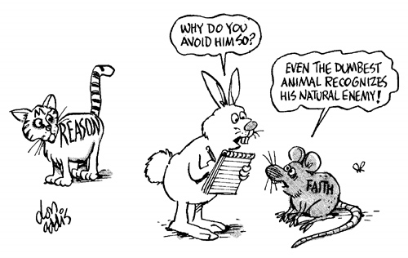

Slide 38
PUPPETS

Slide 39
SLIDES( TRANSPARENCIES)
Any positive transparency mounted individually for use in a projector or viewing transmitted light.

Slide 40
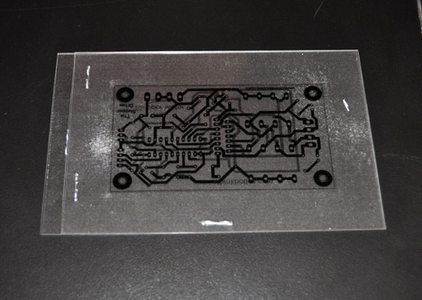

Slide 41
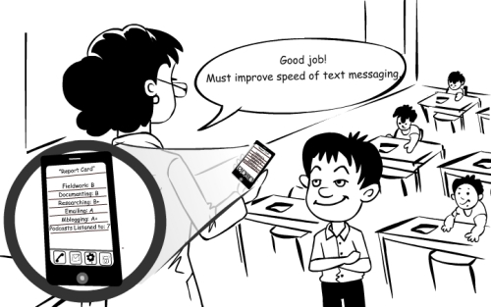
MOBILE TECHNOLOGY

Slide 42
Internet and Wi Fi
Touch screen
Games and quizzes
Mobile applications
Any time & anywhere

Slide 43
The value of mobile learning
It is important to bring new technology into the classroom.
Devices used are more lightweight than books and PCs.
Mobile learning can be used to diversify the types of learning activities students (or a blended learning approach).
Mobile learning supports the learning process rather than being integral to it.
Mobile learning can be a useful add-on tool for students with special needs. However, for SMS and MMS this might be dependent on the students’ specific disabilities or difficulties involved.
Mobile learning can be used as a ‘hook’ to re-engage disaffected youth.

Slide 44
Benefits
Relatively inexpensive opportunities, as the cost of mobile devices are significantly less than PCs and laptops
Multimedia content delivery and creation options
Continuous and situated learning support
Decrease in training costs
Potentially a more rewarding learning experience

Slide 45
Technical challenges include
Connectivity and battery life
Screen size and key size
Meeting required bandwidth for nonstop/fast streaming
Number of file/asset formats supported by a specific device
Content security or copyright issue from authoring group
Multiple standards, multiple screen sizes, multiple operating systems
Limited memory
Risk of sudden obsolescence

Slide 46
Social and educational challenges include
Accessibility and cost barriers for end users
How to assess learning outside the classroom
Content's security or pirating issues
Frequent changes in device models/technologies/functionality etc.
Developing an appropriate theory of learning for the mobile age
Design of technology to support a lifetime of learning
No restriction on learning timetable
Personal and private information and content
No demographic boundary
Disruption of students' personal and academic lives
Access to and use of the technology in developing countries
Risk of distraction

Slide 47
INTERACTIVE WHITE BOARD

Slide 48
an interactive whiteboard is a large display that connects to a computer and a projector
use of graphics and other visuals to represent information

Slide 49
Uses
Running software that is loaded onto the connected PC, such as a web browsers or other software used in the classroom.
Capturing and saving notes written on a whiteboard to the connected PC
Controlling the PC from the white board using click and drag, markup which annotates a program or presentation
Using OCR software to translate cursive writing on a graphics tablet into text
Using an Audience Response System so that presenters can poll a classroom audience or conduct quizzes, capturing feedback onto the whiteboard
Multimedia lessons and presentations including audio and video
Collaborative problem solving
Showcasing student projects and presentations
Virtual field trips
Recorded lessons that can be used by substitute teachers

Slide 50
PRESENTATION
ON
DEVELOPING
LOW
COST
NO
COST
MATERIALS

Slide 51
OVER VIEW

Objectives
What is low cost no cost materials?


Why
How
How
low cost no cost materials
to develop low cost no cost materials?
to utilize low cost no cost materials in


classroom?

Slide 52
LEARNING OUTCOMES

By the end of this session C.Ps could be
to:
Develop their understanding of low cost cost materials;
Develop some no cost and low cost
materials;
Use no cost and low cost materials in
classrooms.
able
1.
no
2.
3.

Slide 53
DEFINITION OF NO COST LOW COST MATERIALS

Low cost no cost materials are the teaching
aids which require no cost or available cheaply, and developed by locally available resources and expedite the process of learning in the classroom.
Low cost no cost materials are developed from the waste and help the teachers in making the teaching interesting and concrete.


Slide 54
IMPORTANCE OF LOW COST NO COST MATERIALS

Low-cost teaching aids can be used in
nursery, primary, middle, secondary and
senior secondary schools.
Low-cost teaching aids can be used for supplementary and illustrative education the sciences as well as the humanities.

in
However, they are most suitable for subjects
like science, geography, mathematics and art
and crafts.

Slide 55
LET’S
DEVELOP
SOME
NO
LOW
COST
MATEIALS
Examples of
“home made”
Primary mathematics teaching
aids

Slide 56
CONCEPTS OF SHAPES IN MATH

Slide 57
NUMBER
AND
LETTER FANS
For example, if a fan has
nine blades, and each blade has one of the following letters:
s, t, e, a, i, m, p, r, c
Here are twenty spellings
that
cat
tear
could be
mat
meat
tested:
pat
cast pair tease
rat
seat pear mist
steam
praise
peas
price

Slide 58
SIGNAL RESPONSE” CARDS: MATHEMATICS

Slide 59
EXAMPLE
“LITERACY
DOMINOES
The “secret”
of
designing successful
dominoes sets is to ensure that the right- hand side of the last domino matches the left-hand side of the first domino!

Slide 60
AN
EXAMPLE
OF A MATHS DICE GAME
Roll three dice.
Arrange to
choose
a score.
Play, say, five rounds. Add
scores.
Highest total score could be the
winner
Variation: lowest total score could be the winner, etc.
What ideas do you have!?
For more ideas, see:www.davidsmawfield.com/resources-practitioners/

Slide 61
EDUCATIONAL
“SNAKES AND LADDERS
This can be used for any subject, at any level.
Make an appropriate pack of
question cards.
Question cards are placed in a
pile face down. Move by throwing
a dice.
Land on a snake: Answer a
question.
Wrong answer = slide
down the snake.
Correct answer
= stay put!
Land on a ladder : Answer a
question.
Wrong answer = stay
put! Correct answer = climb the

Slide 62
FLANNEL
BOARD
Arguably one of the best teachings aids ever – but one
that largely seems
forgotten about! This is all the more unfortunate as images from magazines
and the Internet are more available than ever!

Slide 63
MATHEMATICAL AND OTHER MODELS WITH
PIPE CLEANERS AND STRAWS

