Slide 1
Amyotrophic lateral sclerosis

Slide 2
Motor neuron diseases (MND)
Lou Gehrig’s disease
Degeneration and loss of motor neurons in the spinal cord, brain stem and brain, resulting in a variety of UMN and LMN clinical signs and symptoms.

Slide 3
Incidence; range of 0.4 to 2.4 cases per 100,000, with the incidence
Prevalence; 4 to 10 cases per 100,000
The average age at onset is the mid-to-late 50s
Affects men slightly more than women
In about 5% to 10% of individuals the disease is inherited as an autosomal dominant trait

Slide 4
70% to 80% of individuals develop limb-onset ALS
20% to 30 % develop bulbar-onset ALS
Bulbar-onset ALS is more common in middle-aged women, and initial symptoms may include difficulty speaking, chewing, or swallowing

Slide 5
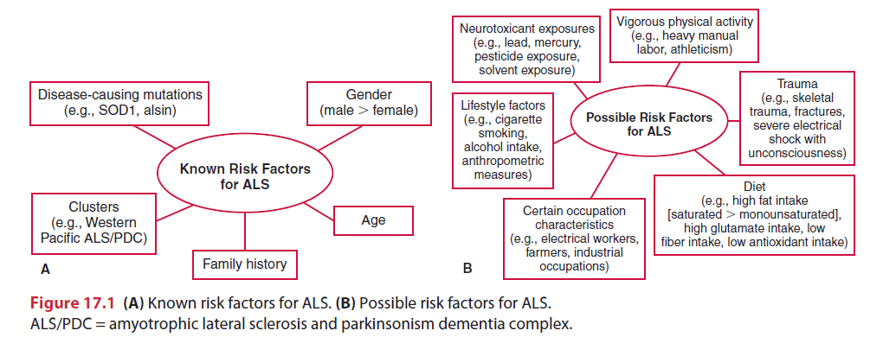

Slide 6
Motor neuron disorders
Subtype | Nervous system pathology
Amyotrophic lateral sclerosis | Degeneration of the corticospinal tracts, neurons in the motor cortex and brainstem and anterior horn cells in the spinal cord.
Primary lateral sclerosis | Degeneration of upper motor neurons.
Progressive bulbar palsy | Degeneration of motor neurons of cranial nerves IX to XII.
Progressive muscular atrophy | Loss of chromatolysis of motor neurons of the spinal cord and brainstem.

Slide 7
Etiology
Superoxide dismutases (SOD)
Glutamate
Clumping of neurofilament proteins into spheroids in the cell body and proximal axon is one of the histopathological characteristics of ALS.
Autoimmune reactions (eg. Calcium channels blockage)
Lack of neurotrophic factors could contribute to the development of ALS and other neurodegenerative disorders
Exogenous or environmental factors apoptosis and viral infections

Slide 8
Pathophysiology
Progressive degeneration and loss of motor neurons in the spinal cord, brainstem, and motor cortex
UMNs in the cortex are affected, as are the corticospinal tracts.
Brainstem nuclei for cranial nerves V (trigeminal), VII (facial), IX (glossopharyngeal), X (vagus), and XII (hypoglossal) and anterior horn cells in the spinal cord are also involved.
Brainstem nuclei for cranial nerves controlling external ocular muscles (III: oculomotor, IV: trochlear, and VI: abducens) are usually spared

Slide 9
Motor neurons of the Onufrowicz nucleus (Onuf’s nucleus), located in the ventral margin of the anterior horn in the second sacral spinal level, are also generally spared
These neurons control striated muscles in the pelvic floor, including anal and external urethral sphincters

Slide 10
The sensory system and spinocerebellar tracts are also generally spared in ALS.
Re-innervation and ultimate failure of re-innervation

Slide 11
Clinical Manifestations
Clinical manifestations of ALS vary depending on the localization and extent of motor neuron loss, the degree and combination of LMN and UMN loss, pattern of onset and progression, body region(s) affected, and stage of the disease.
At onset, signs or symptoms are usually asymmetrical and focal.
Progression of the disease leads to increasing numbers and severity of impairments.

Slide 12
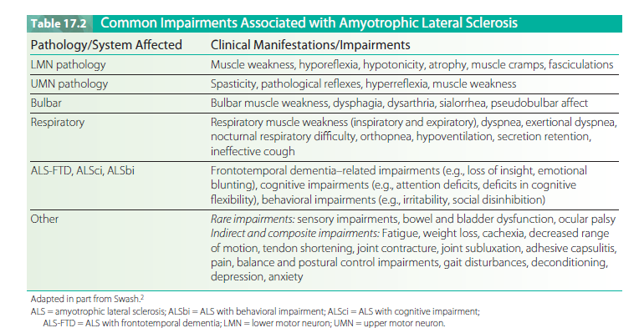

Slide 13
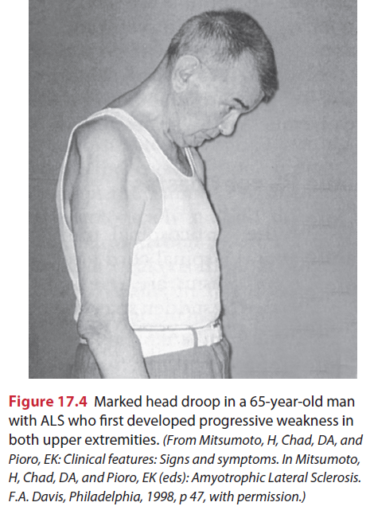

Slide 14
Diagnosis
Genetic test
Clinical presentation
Laboratory studies
EMG
Nerve conduction velocity (NCV) studies
Muscle and nerve biopsies
Neuroimaging studies

Slide 15
Diagnosis criteria
The diagnosis of ALS requires the presence of
LMN signs by clinical, electrophysiological or neuropathological examination
UMN signs by clinical examination and
Progression of the disease within a region or two other regions by clinical examinations of via the medical history,
And the absence of
Electrophysiological and pathological evidences of other diseases that may explain the UMN and LMN signs, and
Neuroimaging evidence of other disease processes that may explain the observed clinical and electrophysiological signs

Slide 16
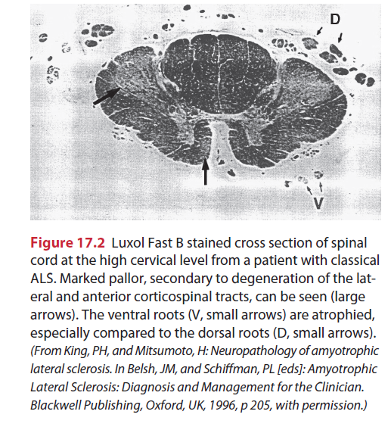

Slide 17
Disease course
ALS has a progressive and deteriorating disease trajectory, and the progression from pathology to impairments to functional limitations to disabilities is inevitable.
Time from onset to death ranging from several months to 20 years, studies have found the average duration of ALS to be between 27 and 43 months, and the median duration to be between 23 and 52 months.
Death occurs within 3 to 5 years after diagnosis and usually results from respiratory failure

Slide 18
PROGNOSIS
Age at time of onset
Individuals with limb onset ALS have a better prognosis than those with bulbaronset ALS
Less severe involvement at the time of diagnosis
No symptoms of dyspnea at onset Psychological status

Slide 19
Management
Disease modifying agents
Glutamate inhibitor; Riluzole (Rilutec)
Palliative care is”.. the active total care of patients whose disease is not responsive to curative treatments.
Although there is no cure for ALS, it is still considered a “treatable disease” and rehabilitation plays a integral role in the overall comprehensive care of the patient.
Medical management is symptomatic and individualized and involves supportive care to address impairments as they arise.

Slide 20
Medical management may include the prescription of anticramping and antispasticity agents, drying agents for sialorrhea, and antidepressants; recommendations and referrals for precutaneous endoscopic gastrotomy (PEG) tubes and ventilator support (noninvasive ventilation, tracheostomy); and discussion of advanced care directives
Management of dysphagia, dysarthria, anxiety, depression
Pain control

Slide 21
In 1999 a multidisciplinary task force was established to develop recommendations for management of ALS.
Informing the patients and family about the diagnosis and prognosis.
Symptom management of sialorrhea and pseudobulblar affect
Nutrition management and PEG decisions (e.g. dysphagia)
Management of respiratory insufficiency and ventilation decisions (infections, aspiration, low oxygen, hypercarbia, respiratory arrest)
Advance directives and palliative care

Slide 22
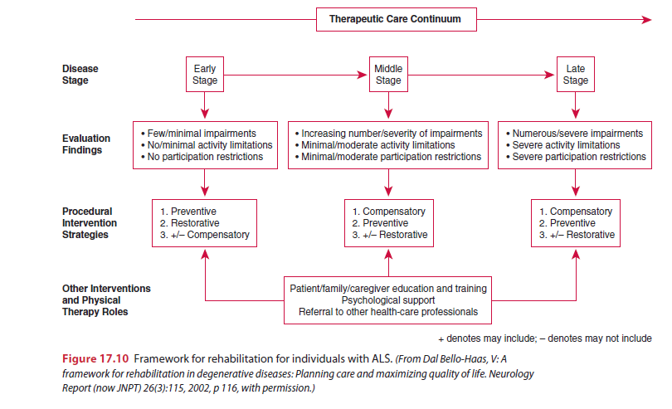
Rehabilitation Framework

Slide 23
Physical therapy examination
Psychosocial function
Pain
Muscle performance
Motor function
Tone and reflexes
Cranial nerve integrity
Sensation
Postural alignment, control and balance
Gait
Respiratory function
Integument
Functional status
Environmental barriers
Fatigue

Slide 24
Disease specific and quality of life measures
Disease specific measures;
ALS Functional Rating scale (ALSFRS)
The revised version
Appel ALS Scale (AALS)
ALS Severity Scale (ALSSS)
Norris Scale.
Quality of life measures
SF-36
The Schedule for Evaluation of Individual Quality Life-Direct Weighing (SEIQoL-DW)
Sickness Impact Profile (SIP).

Slide 25
Physical Therapy Interventions
Cervical muscle weakness
Dyartheria and dysphagia
Upper extremity weakness
Shoulder pain
Respiratory muscle weakness
Lower extremity muscle weakness
Gait training
Activities of daily living
Decreased mobility
Muscle cramps and spasticity
Psychosocial issues

Slide 26
Exercise and ALS
Disuse atrophy
Overuse fatigue

Slide 27
Physical Therapy Interventions
Restorative
Compensatory
Preventory

Slide 28
Early stage
Stages | Common impairments and functional limitations | Interventions
Early | Mild to moderate weakness in specific muscle group Difficulty with ADLs and mobility toward the end of the stage | Restorative/prevention Strengthening exercises a142,169,170 Endurance exercises171 Active ROM, 172 Active –assisted POM, stretching exercise Compensatory Determine potential need for aadaptive of assistive devices Determine potential need for ergonomic modification of home/workplace Energy conversation Educate the patients about the disease process, energy conservation , and support groups

Slide 29
Middle stage
stage | Common impairments and functional limitations | Interventions
Middle | Progressive decrease in mobility throughout stages Wheelchair needed for long distances; Increased wheelchair use toward end of stage Serve muscle weakness in some groups; mild to moderate weakness in other groups Progressive decrease in ADKL skills throughout stage Plan | Compensatory Support weak muscles(assistive and supportive devices, adaptive equipment, slings, orthoses) Modification to work place /home (e.g, install ramp, move bedroom to first floor) Wheel vchair prescription Education of caregiver regarding functional training Preventative Active 172 active assistive , and passive ROM, stretching exercise Stretching exercise 142,169,1709early middle) Endurance ecercise 171(early middle) Determine need for pressure-relieving devices(e.g., pressure distributing matteress)

Slide 30
Late stage
Stage | Common Impairments and functional limitations | Interventions
Late | Wheel chair dependent or restricted to bed Complete dependence with ADLs Severe weakness of UE, LE, neck and trunk muscles Dysarthria, dysphagia Respiratory compromise pain | Preventative Passive ROM Pulmonary care a Hyospital bed and pressure-relieving devices Skin care, hygiene Compensatory Caregiver education regarding transfers, positioning, Mechanical

Slide 31
Type of Semi rigid and Rigid Cervical Collars
 | Examples | Advantages | Disadvantage
Collars Without Anterior neck access | PHILADPHIA® Collar (A) | Offers good Support | Patient may feel confined may cause pressure on trachea patient may experience difficulty breathing or swallowing can be uncomfortably warm
Collars with anterior neck access(for tracheotomy) | Miami-j® Collar(B) Aspen Collar© Malibu Collar(D) Canadian collar(E) Headmaster Collar(E) | Padding absorbs and wicks moisture away from skin suitable for individuals with cervical weakness in all 3 planes Open design allow for circulation of air light weight No pressure on trachea some patients consider collar more cosmetically appealing | Patient may feel confined may be uncomfortably warm more expensive May put pressure on chin and sternum Some models more expensive Some models require custom cutting Not adequate if rotation and lateral flexion weakness is also present

Slide 32
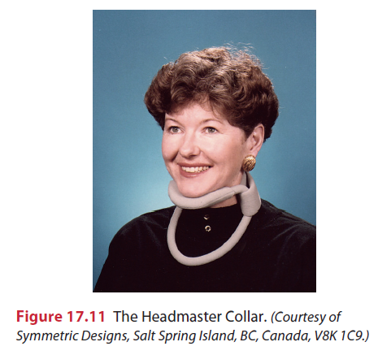
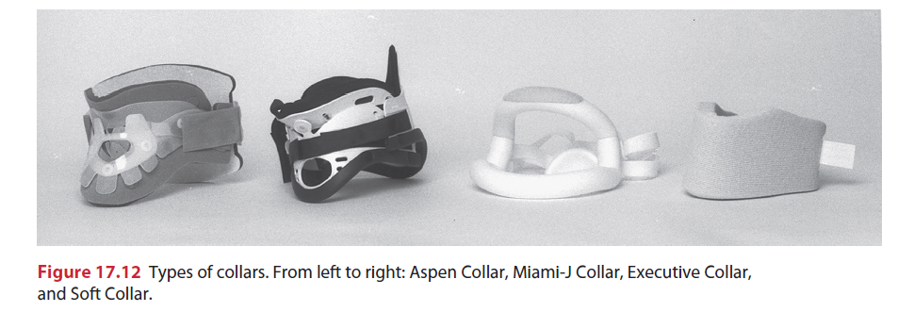

Slide 33
Common Types of Adaptive Equipment
Feeding and Eating | Foam tubing to increase the size of utensil handles; utensil and cup with modified handles or holders; long –levered jar opener; plate guard; serrated or rocker knife; wrist splint/adapted cuff(for holding tools and instruments); mobile arm support; Dycm®
Self-care and Bathing | Bathing benches; bath tube seat; shower commode; handle shower head; grab bars; raised toilet seat; long handle sponge; electric toothbrush or shaver; strap- fitted hair brushes
Dressing | Zipper pulls or hooks; button hooks; long handle shoe horn; Velcro® clothing closures; elastic shoe laces
Writing and Reading | Foam tubing to increase the size of the pen or pencil ; Triangular pencil grip: pen holders; books holders, automatic page turner; adjustable angle table
Other | Key holder; doorknob adapters; lamp extension switch; Personal alarm system; switch operated environmental controls; speaker phone with automatic dialing, telephone holder; use of telecommunication devices for the deaf(TDD)

Slide 34
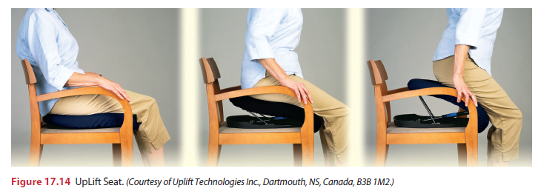
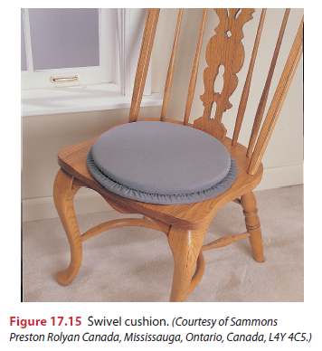

Slide 35
Summary
Amyotrophic lateral sclerosis, the most common and devastatingly fatal motor neuron disease among adults, causes a progressive increase in the number and severity of impairments, activity limitations, and participation restrictions.
Other than a small percentage of cases, etiology for the most part is unknown, and it is hypothesized that multiple mechanisms may be responsible for the disease.
Although there is no cure for ALS and its course cannot be altered, it should be considered a “treatable disease.”
Medical management is primarily symptomatic, and a team approach to care is considered optimal.
Rehabilitation management is focused on maximizing function and promoting independence to the highest level possible, and ensuring optimal quality of life throughout the course of the disease and across health care settings.

Slide 36
The physical therapist plays an integral role in designing and implementing therapeutic interventions for individuals with ALS that will allow them to maintain independence and function for as long as possible.
The selection of interventions, grounded in evidence-based research whenever possible, is based on the stage and progression of the disease and may be restorative, compensatory, or preventative.
These interventions should take into consideration the individual’s goals and psychosocial factors that may affect decision making, such as the individual’s acceptance of the diagnosis and the individual’s social and financial resources.
Because of the progressive nature of the ALS, the physical therapist must not only address the patient’s current problems, but also plan for the patient’s future needs.

Slide 37
Thanks!

