Slide 1
Socio-Cultural Development Vygotsky’s Theory
BS-III Semester

Slide 2
Objectives:
Vygotsky’s Background
Two main Elements of Socio-Cultural Theory
Two Features of Zone of Proximal Development
Four Basic Principals of Vygotsky’s Framework

Slide 3
Vygotsky’s Background
Vygotsky was born in Russia on 1896.
His father founded the “Society of Education in Gomel” and held a wide range of active interest including foreign language, history, literature, theatre and arts.
His mother was a teacher.
He graduated with a degree of Law from Moscow University.

Slide 4
Vygotsky completed 270 scientific articles, many lectures and 10 books based on psychological and teaching theories.
Much of his work is still discovered and explored today.
He died at the age of 37 on 1934 with TB.

Slide 5
Introduction
According to him social interaction plays a very important role in cognitive development.
Did not focus on individual child but on the child as a product of social interaction.
Focus on dynamic interaction rather than child himself.
People thinking varies dramatically between cultures because different cultures stress different things.

Slide 6
Two Main Principles
1. The More Knowledgeable Other (MKO)
Refers to anyone who has better understanding or higher ability level than the learner.
Normally thought of as being teacher, trainer, older, adult, but MKO can be a peer, a younger person, even computers.

Slide 7
Zone of Proximal Development
Difference between what child can achieve independently and what he/she can achieve with guidance or help.
Abbreviated as ZPD

Slide 8
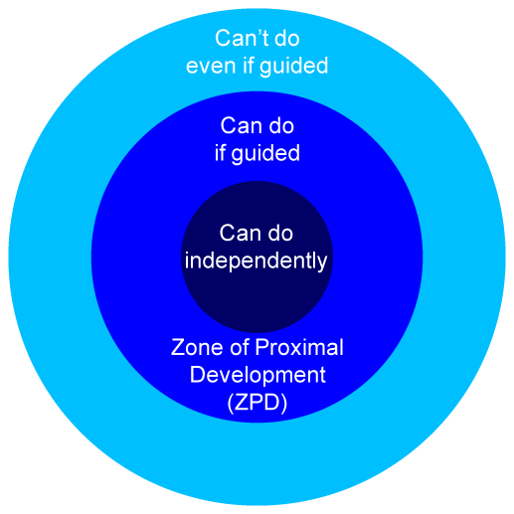

Slide 9
Two Features of ZPD
1- Scaffolding
Appropriate assistance given by the teacher to assist the learner accomplish a task.
Requires that an instructor show examples how to solve a problem, while controlling the learning environment so that students can take things step by step expanding their knowledge without excessive frustration.

Slide 10
2- Reciprocal Teaching
A highly successful teaching method, it provides an environment of open dialogue between student and teacher which goes beyond a simple question and answer session.

Slide 11
4 Basic Principles of Vygtosky’s Theory
Children construct their knowledge
Development can not be separated from its social context.
Learning is mediated.
Language plays a central role in mental development.

Slide 12
Two Types of Mental Function
Lower Mental Function
Are those which are born, are the natural functions and are genetically determined.
Higher Mental Function
Are acquired and developed through social interaction.

Slide 13
Conclusion
Social interaction emphasized that effective learning happens through participation in social activities, making the social context of learning crucial.
Vygotsky’s Theory provide tools for the development of individual learning.

