Slide 1
Lecture 12 Breeding role as a way to achieve directional technological development

Slide 2
Breeding
Animal breeding involves the selective breeding of domestic animals with the intention to improve desirable (and heritable) qualities in the next generation
Selection among individuals
Mating
Towards the direction breeding goal traits

Slide 4
Historical background of animal breeding
Subjective assessment was used
Objective selection became possible by Sir Robert Bakewell (1725 – 1795) in UK
New Leicester breed developed from old Leicester breed
Big in size, good quality wool and a good fatty shoulder
Exported to Australia and N America
With the growing number of selection generations it became difficult to remember relationship among animals
Pedigree recording started and herd book established
Methods of selection, animal identification, recording gradually improved
Genome selection

Slide 5
Breeding program
Breeding program is the organized structure that is set up to genetically improve livestock population
Two general question must be answered in designing and implementing a breeding program
Where to go?
How to get there?

Slide 6
Definition of breeding goal
Which trait/character of a breed need to be improved?
Decided with full participation of the community
Current and future market demand should be considered
Thus information on current and predicted consumer demands
Valuable market related information

Slide 7
Breeding goal
A breeding goal is the specification of the traits to be improved including the emphasis given to each trait
It gives the direction in which we want to improve the population

Slide 8
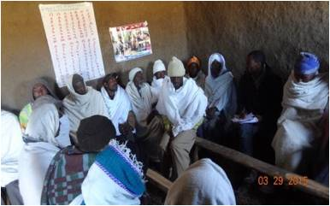
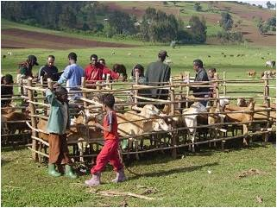
Definition of breeding goal
Different methods can be used
Finally results presented to the community to agree on common breeding objectives
Individual interview flock ranking

Slide 9
Breeding goals depend on the production system
The use of the animals and the wishes of the users determine to a great extend the breeding goal and the breeding programs
In the breeding programs for animal functions other than food production several traits play an important role in addition to selective breeding for the obvious breeding goal traits
health and welfare of the animals, and adaptation to feed of lower quality and extreme climates to be capable to produce and reproduce

Slide 10
The choice of the appropriate breed
It is a 1st step in initiating a breeding programme
More attention should be given on the adoptive performance of breed
High producing animals (Holstein Friesian) are imported in tropical areas but not succeeded due to adoptive performances
In all food production systems adaptation of the animals to the conditions within the system is important.
Adaptive fitness is characterized by survival, health and reproduction related traits

Slide 11
Breeding goals are directed towards the future and require tenacity
Breeding goal consists of a single criterion that facilitates the ranking of animals in line with this goal
The breeding goal aims at the future
The breeding goal usually involves the improvement of multiple traits
The breeding goal should be formulated carefully and should hold consequently for many generations to become successful as a breeder
A trait should be included in the breeding goal based on its economic value and its heritability

Slide 12
Breeding goals consists of several traits
The breeding goal for food production aims
improving gross efficiency (amount of product divided by the amount of feed consumed) reducing cost price by:
improving productivity (higher yield and financial returns
improving feed conversion(less feed per kg of product and less costs)
improving reproduction, health and survival (less replacement animals needed and less costs)

Slide 13
The breeding goal determines which traits should be recorded
Breeding goal traits might be
Quantitative Traits:
The traits which are measured in units (Kg, or simply in numbers)
Kg of milk
Grams of growth
No. of Eggs
Qualitative Traits:
Traits are measured in classes Product traits, scores for body traits, disease incidences or performance impressions
Good, Moderate or Bad meat quality

Slide 14
Weighing the different traits of the breeding goal
In case of commercial breeding programs many traits are recorded and have an influence on the profit of animals produced by these commercial breeding programs
In order to rank the individual selection candidates for the breeding goal traits it is necessary to comprise the values for the respective traits into one single selection criterion
The value of this criterion can be obtained by summing up the breeding value for each trait multiplied by a weighing factor based on the relevance of that trait in the breeding goal

Slide 15
Directional technological development
Technology adoption plays a strategical role in livestock production system
Breeding goals promote higher global technological level
Likelihood of viability in dairy sheep farms increases with implentation of a breeding program
The adoption of technological inovations practices in animal feeding and land use increased milk production

