Slide 1
Aryan
History and geography
Amtur rauf

Slide 2
Arrival
Arrival of Aryans in 1500 B.C.
1. Migrated from southern Russia
2. With superior weapons and chariots conquered Indus region

Slide 3
Who were they?
Who were the Aryans?
• Invaders from central Europe (Russia/Germany)
• Entered India through the Khyber Pass•
Herders in search of pasteur land
What kind of people were they?
1. War like
2. Nomadic Herdsmen

Slide 4
Two periods
Two periods of Aryan Civilization•
The Vedic Age (1500 – 1000 BC)•
The Epic Age (1000 – 500 BC)

Slide 5
Indo-Aryans
Nomads from the North who established Indian civilization around 1750 BC
We know about them through their religious writings called Vedas
Aryans today are called Indo-Europeans and Indo-Iranians, depending on location
Indo-Aryans brought new religion (Hinduism) and a new language (Sanskrit) to northern India
The word Aryan has to do with ancestry and language group
Hitler misused this word to his own benefit, to try to show “pure” roots of his people

Slide 6
They also brought the idea of the caste system
Distinct social classes appeared in Indian society
People were not able to move classes after birth
The fifth class was the Untouchables – garbage collectors, movers of dead bodies, etc.
Farming provided a living for people in the North
Trade provided a living for people in the South
Silk, cotton, wool, ivory, spices, gems
To Far East, SW Asia, Africa, and Europe

Slide 7
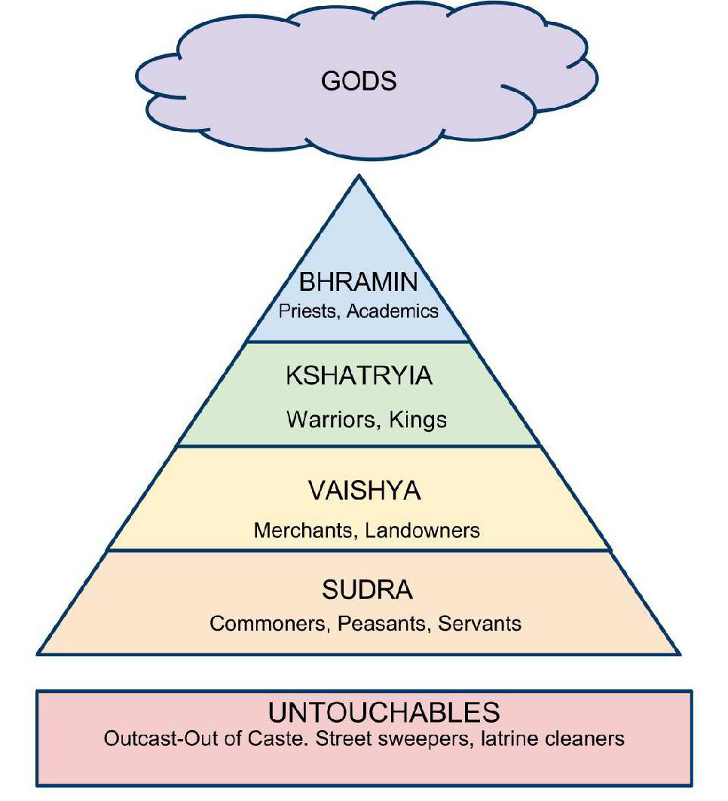
Indian Caste System

