Slide 1
Motivation and sports
Motivation is the process that initiates, guides, and maintains goal-oriented behaviors.
Types of motivation;
Intrinsic Motivation: A motivation that comes from within a person. For example: Learning a new language because you like experiencing new things, not because your job requires it.
Extrinsic Motivation: A motivation that comes in the result of external rewards. For example: Competing in the sports for trophies or completing a work for money.
A research showed the motivations that lead the participants to enjoy during sports.
Physical Well-being.
Psychological Well-being.
Improvement of performance.
Assertive achievement.

Slide 2
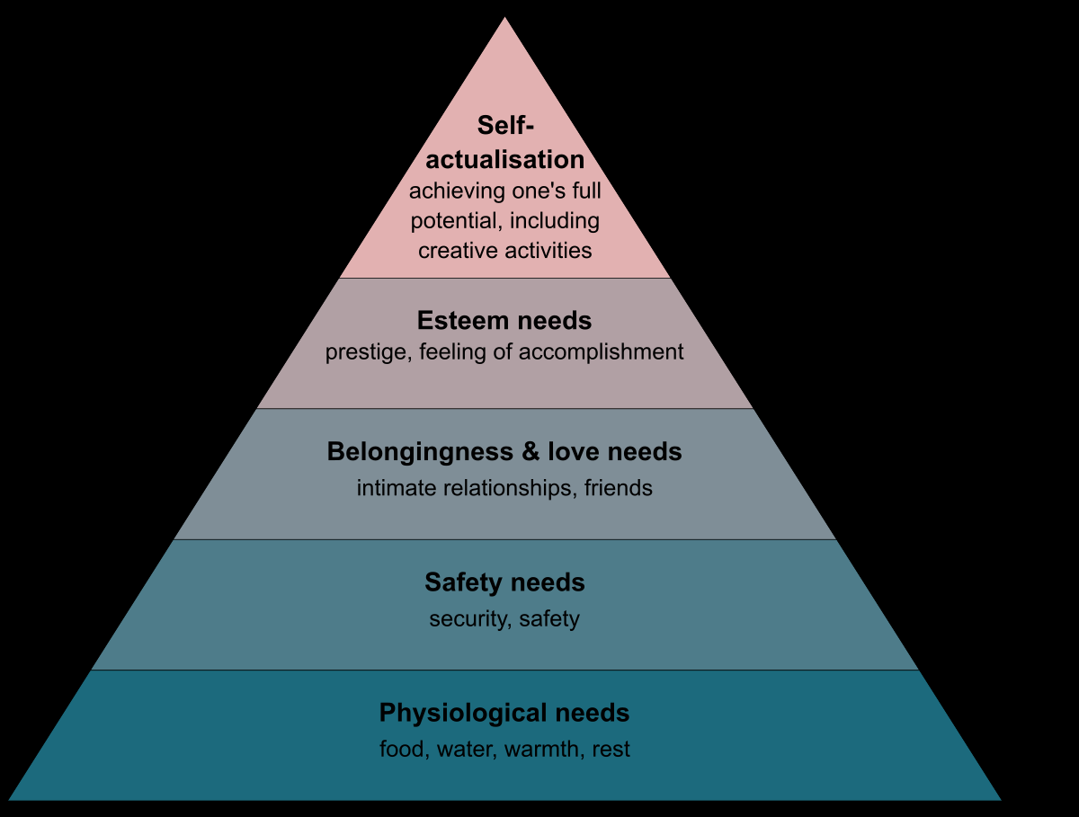
A scale used to measure the level of motivation of an individual is Participant Motivation Inventory (PMI).
A technique used to boost up the intrinsic motivation of an individual by adding some extrinsic motivation is known as “The additive principle”.
Theories of motivation;
Maslow’s theory of needs.

Slide 3
Maslow’s theory of needs: Maslow’s theory maintains that a person does not feel a higher until the needs of current level have been satisfied. A motivational theory in psychology comprising a five-tier model of human needs.
Physiological Needs: Food, warmth, water.
Safety Needs: Having a safe environment.
Social Needs: Have relationships with others.
Esteem Needs: To become competent and to be recognized.
Aesthetic Needs: Need for beauty, order and balance.
Self-actualization: To find personal fulfilment and achieve one’s potential.

Slide 4
McClelland-Atkinson theory of need achievement: It states that every person has one of three main driving motivators: the needs for achievement, desire to succeed and fear of failure.
Achievement motivation = desire to succeed – fear of failure.
Mastery environment: One in which there is a focus on mastery of skills. This is association with promotion of task orientation.
Performance environment: One in which there is a comparison of the individual abilities.

Slide 5
Attribution theory: An attempts to determine the cause of an event or behavior.
Types of attributions;
Internal attribution: People assume that an event or a person's behavior is due to personal factors such as traits, abilities, or feelings.
External attribution: People assume that a person's behavior is due to situational factors.
Self-serving bias is the common habit of a person taking credit for positive events or outcomes, but blaming outside factors for negative events.

Slide 6
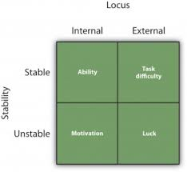
Weiner’s model of attribution: Weiner (1992) proposed a model of self-attribution based on two factors, whether we make an internal or external attribution and whether this attribution is stable over the time or varies from situation to another.
If our results are stable, we will attribute success to ability and failure to task difficulty.
If our results are unstable, we will attribute them to effort or luck.
Reattribution training: A therapy used to
alternate an athlete’s attribution state.

Slide 7
Self-efficacy: refers to the belief we have in our own abilities.
People's beliefs in their efficacy are developed by four main sources of influence are as follow;
Previous experiences: Athletes who have previously succeeded in particular task will have higher self-efficacy for related task.
Observational learning: Observing other people successfully completing a task may increase the self-efficacy of spectator.
Direct persuasion: Self-efficacy is influence by encouragement and discouragement. It persuades a person to believe that they have the skills and capabilities to succeed.
Psychological cues: The psychological state of a person can influence how a they feel about their personal abilities in a particular situation. For example: If we feel relaxed while completing a task, we may interpret this in term of an ease with the task, leads to increase self-efficacy.

Slide 8
Counterfactual thinking: It is our tendency to create possible alternatives to life events that have already occurred, it can be quite unrealistic. This type of thinking is known as counterfactual thinking (CFT).
Types of counterfactual thinking:
Upward CFT: The thoughts that how the situation could have been better.
Downward CFT: The thoughts how the situation could have been worst.
Burn-Out: This phenomenon was proposed by Freudenberger (1974).
“A state of emotional, physical, and mental exhaustion caused by excessive and prolonged stress”.
Symptoms:
Depersonalization: Emotionally cut off from the others.
Impaired performance and satisfaction.
Emotional exhaustion: Feeling drained and resigned.

Slide 9
Eating disorders: Any of a range of psychological disorders characterized by abnormal or disturbed eating habits.
Anorexia nervosa: The term anorexia literally means "loss of appetite." However, this definition is misleading because people with anorexia nervosa are often hungry but refuse food anyway. They have intense fears of becoming fat and see themselves as fat even when they are very thin.
Bulimia nervosa: An eating disorder characterized by binge eating followed by compensatory behavior, most commonly vomiting or purging.

