Slide 1
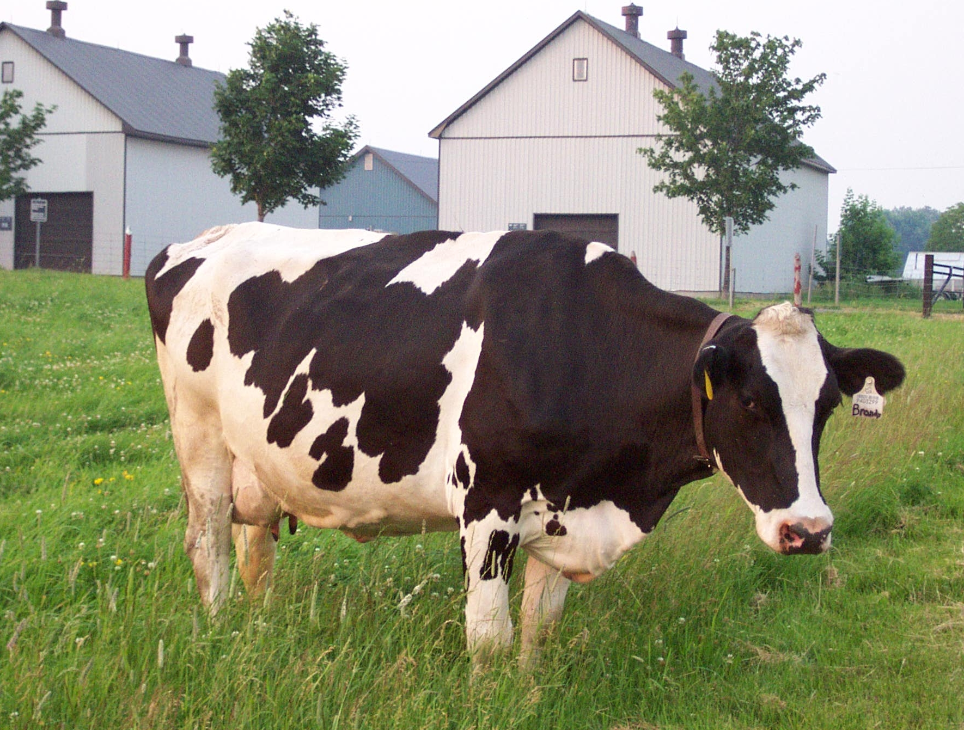
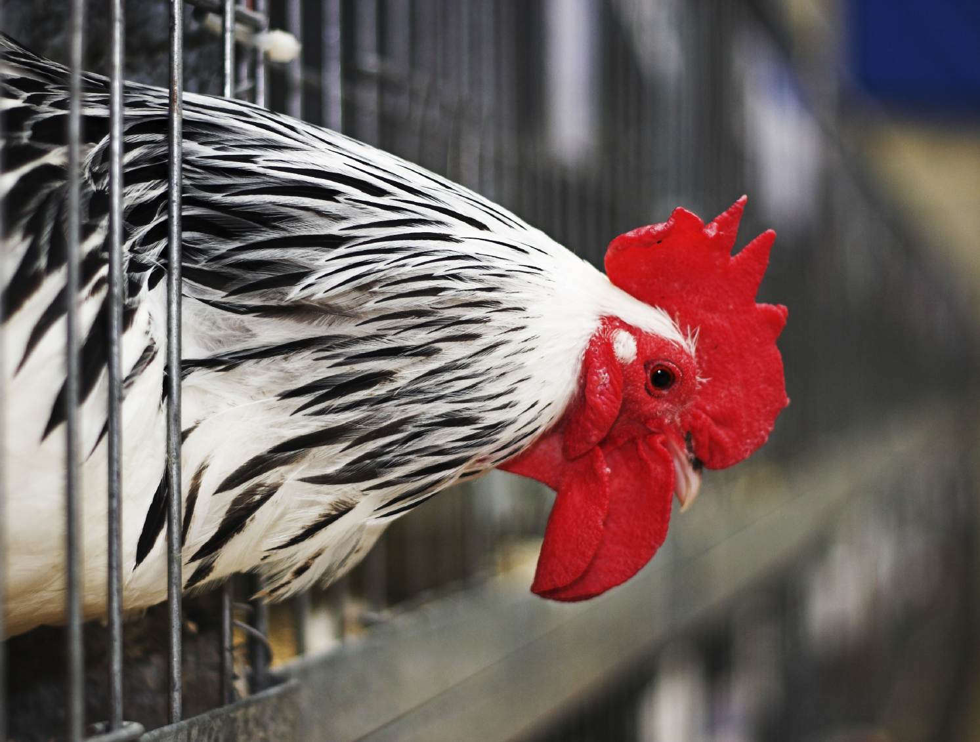
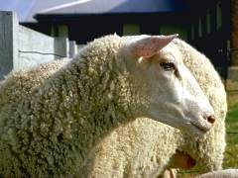
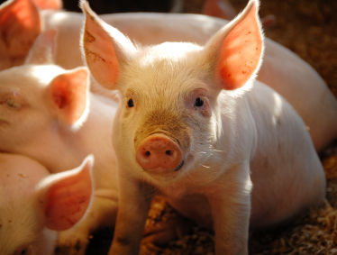
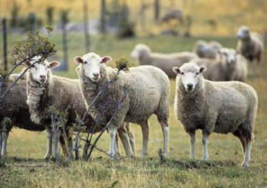
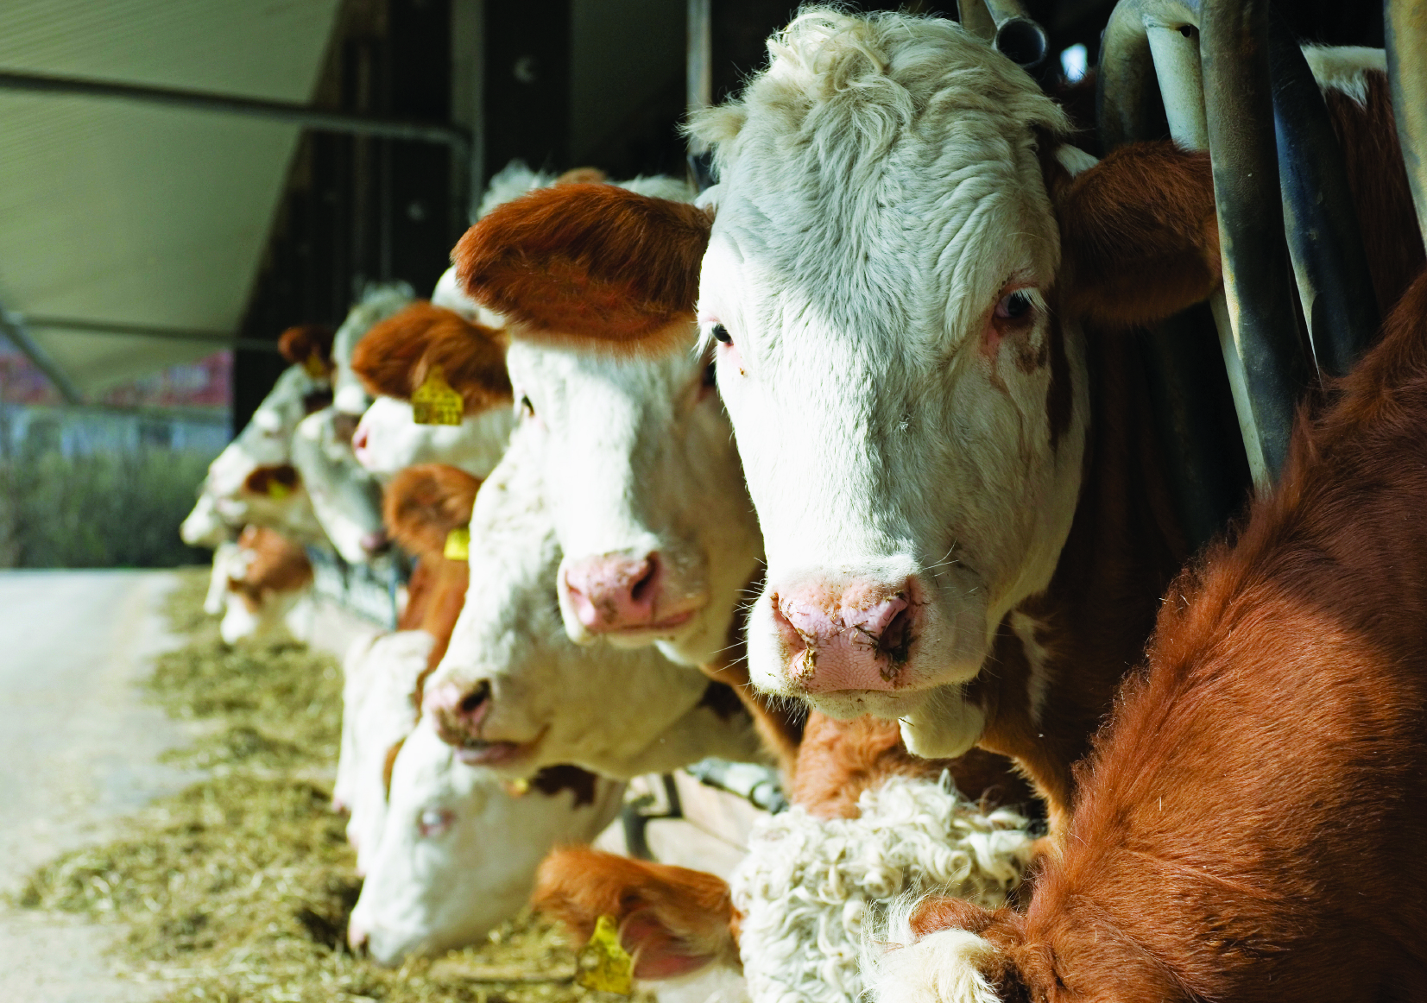
CCAC Training Module on: the Ethical Use and Care of Farm Animals in Science
www.ccac.ca

Slide 2
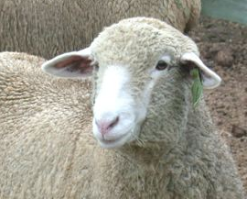
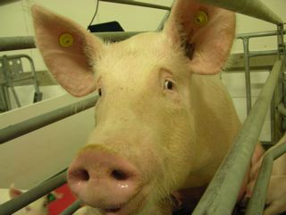
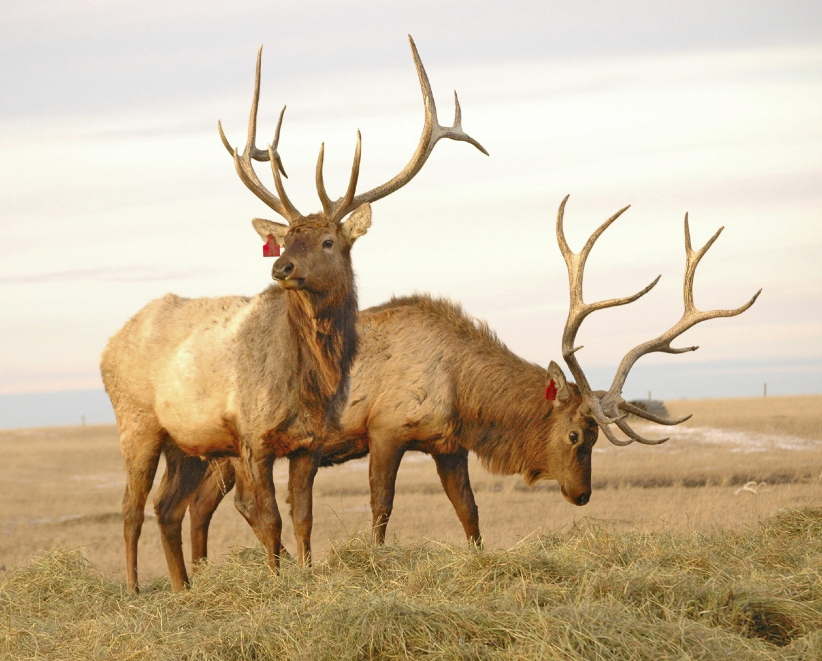
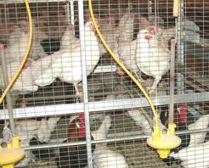
Relevance of this Training Module
This training module is relevant to all farm animal users, including those working with:
dairy and beef cattle
sheep
goats
swine
poultry
horses
farmed wildlife
Photo courtesy of Animal Resources Centre, University of Saskatchewan
Photo courtesy of M. Smit
Photo courtesy of Animal Resources Centre, University of Saskatchewan

Slide 3
Training Module Goals
Introduce investigators, teachers, animal care personnel and students to the care, housing, and handling requirements of farm animals used in science
Present an overview of animal care practices that help ensure good welfare and discuss potential welfare challenges associated with the use and care of farm animals in science
Provide investigators with references and resources relating to the use of farm animals in science

Slide 4
Training Module Outline
Introduction to farm animal welfare
what is a farm animal?
understanding animal welfare
regulations and standards
Overview of factors affecting farm animal welfare
provision of fundamental needs (feed, water, environment and housing)
acquisition (sourcing, transportation, identification, ensuring good health status)
routine handling and specialized procedures
termination of scientific use

Slide 5
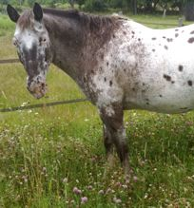
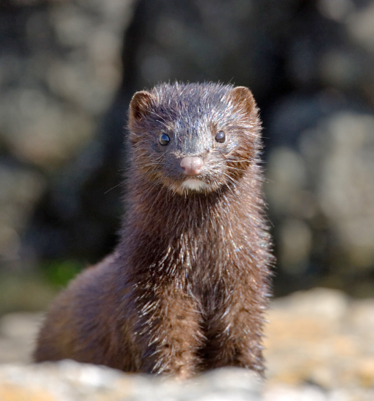
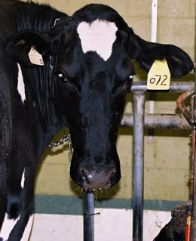
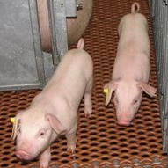
What is a Farm Animal?
Mammal or bird used in agriculture for:
food
fibre
fertilizer
work
Photo courtesy of G. Zobel
Photo courtesy of Agriculture and
Agri-Food Canada
Photo courtesy of Dr. D. Wilson

Slide 6
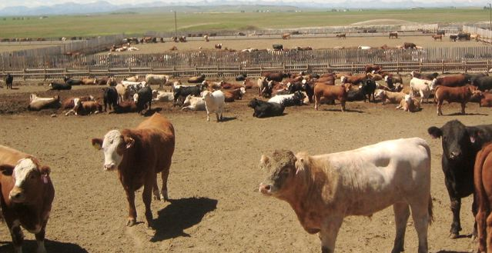
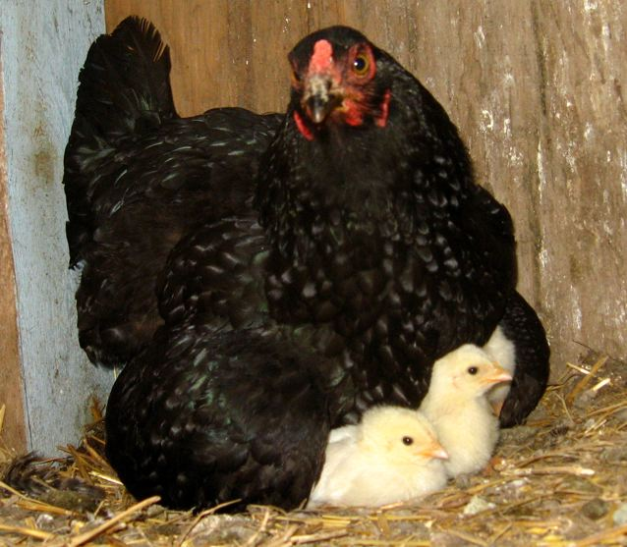
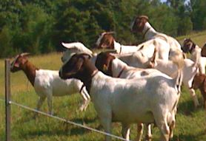
Farm Animal Welfare
Photo courtesy of Dr. D. Wilson
Photo courtesy of UBC Animal Welfare Program
Photo courtesy of O. Zobel
Photo courtesy of O. Zobel

Slide 7
What is Animal Welfare?
Animal welfare is a combination of all three factors
The animal is healthy, free of injury and productive
Biological
Functioning
Natural
Living
Affective
State
The animal is living as naturally as possible and can carry out behaviours it is highly motivated to perform
The animal feels well - absence of aversive states (e.g., fear) and presence of positive states (e.g., pleasure)
Redrawn from Fraser et al., 1997

Slide 8
Regulations & Guidelines Concerning Farm Animals
Federal
Transport: Health of Animals Regulations (Part XII)
Humane Handling and Slaughter: Meat Inspection Act (Sections 61-80)
Suffering: Criminal Code of Canada (Section 444-446)
New Drugs: Health Canada (Veterinary Drugs Directorate)
New Vaccines: Canadian Food Inspection Agency (CFIA) (Veterinary Biologics Section)
Provincial and territorial
Non-governmental organizations and voluntary standards
Recommended Codes of Practice: National Farm Animal Care Council (NFACC)
Canadian Veterinary Medical Association (CVMA)
Canadian Federation of Humane Societies (CFHS)

Slide 9
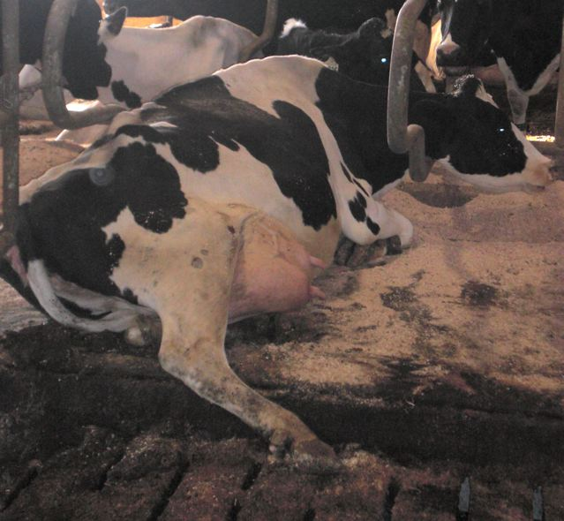
A Note on Agricultural Industry Standards
When research must have direct relevance to the agricultural industry, use the best industry standards, as approved by the ACC
National industry recommended codes of practice are considered minimal acceptable standards
Scientific institutions should take a leadership role in the exploration and implementation of the best practices
Photo courtesy of UBC Animal Welfare Program
Stalls in older facilities may be too small for today’s larger dairy cows

Slide 10
Standard Operating Procedures (SOPs)
Approved SOPs outline correct methodology for performing routine and common practices and procedures
following SOPs helps ensure good animal welfare and human safety
All animal care personnel should be familiar with and know the location of facility-specific SOPs pertaining to:
routine and specialized husbandry, care and handling
routine assessment of health and welfare of groups and individual animals
minimizing disease and managing disease outbreaks
safe handling and usage of drugs and other chemicals

Slide 11
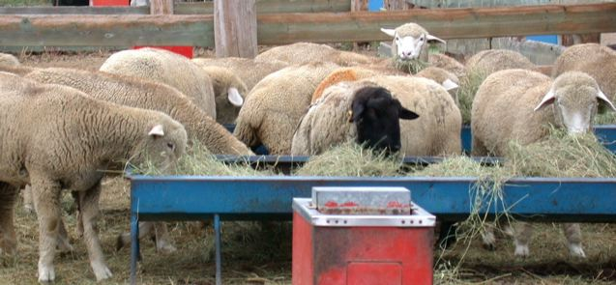
Fundamental Needs
Photo courtesy of Animal Resources Centre, University of Saskatchewan

Slide 12
Feed and Water
Feed
palatable and nutritionally adequate
sufficient quantities and frequencies of deliveries to minimize hunger and competition
Water
fresh, potable, ice-free, available 24 h/d and supplied at sufficient pressure to meet animals’ drinking rates
National Research Council (NRC) guidelines provide species-specific nutritional requirements

Slide 13
The Farm Animal Environment: Why does it Matter?
Investigators typically do not have a direct input into the facilities in which they work – why should they care about how animals are housed?
Housing directly influences the welfare, security and behaviour of animals and humans, which potentially impacts research outcomes.

Slide 14
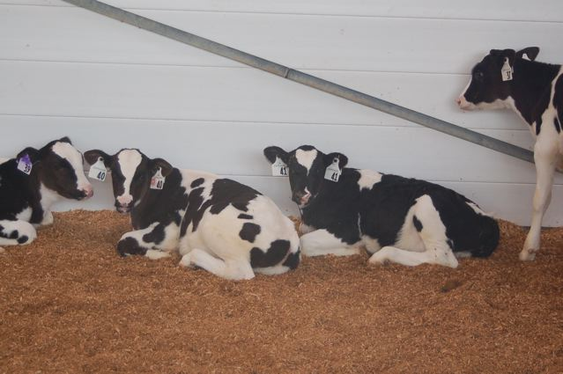
Housing Requirements
Safe and clean shelter, resistant to the elements
Water and feed (see slide 12)
Good air quality
Access to outdoors, if possible
Space for feeding, moving, sleeping, and appropriate contact with other animals
Ability to separate animals based on gender, age, health or treatment requirements
Photo courtesy of UBC Animal Welfare Program
Group housed dairy calves
Housing should be suited to the physical, behavioural and social needs of the species housed

Slide 15
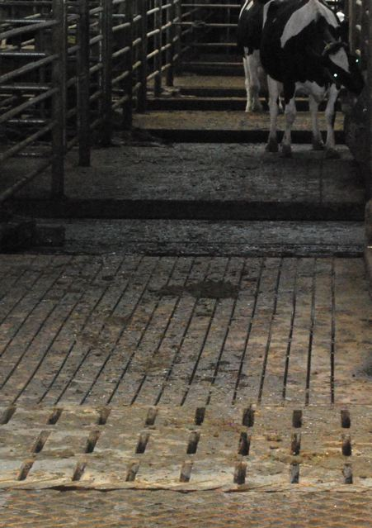
Housing Factors Potentially Affecting Welfare
Type of housing (indoor versus outdoor)
Space allocation
Flooring and footing
Lying areas and bedding
Manure handling systems
Thermal and non-thermal (air quality) conditions and ventilation systems
Lighting intensity and duration
Photo courtesy of UBC Animal Welfare Program
Slatted concrete floors are useful for channeling manure away from animals, but can increase incidence of hoof damage and lameness

Slide 16
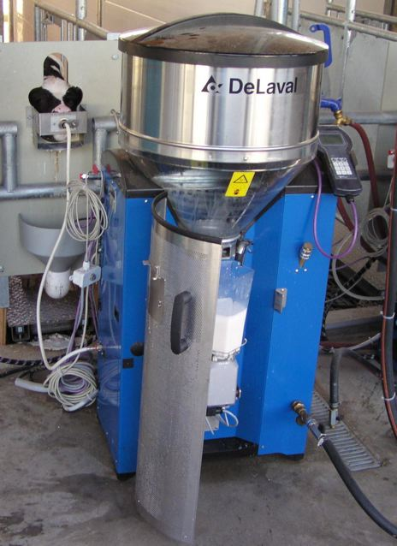
Animal Welfare Effects of Facility Maintenance Issues
Become familiar with animal care and emergency SOPs
Vital systems (e.g., mechanical ventilation, water and feed delivery)
need daily monitoring
report problems immediately
Before beginning research, identify who (e.g., facility manager) should be made aware of facility, systems or management issues that may affect animal welfare
Photo courtesy of UBC Animal Welfare Program
Automatic feeding systems need routine monitoring and maintenance

Slide 17
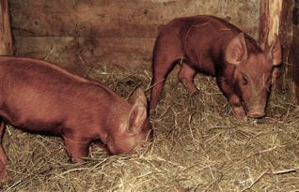
Environmental Improvement
Animal environments should be designed to address internally motivated behaviour
Example: provision of straw addresses pigs’ motivation to perform rooting behaviours
Photo courtesy of O. Zobel
Some environmental improvements should be provided to prevent suffering
Example: provision of nest boxes addresses hens’ motivation to lay eggs in a protected nest area
Notes:
Istockphoto.com
6760881

Slide 18
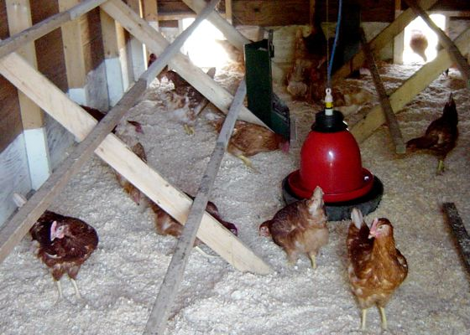
Improving Farm Animal Environments
Provide:
Appropriate hygiene level
Appropriate grouping (size and animal compatibility)
Comfortable lying and walking surfaces
Opportunity for social contact
Opportunity to express normal behaviours
Means to minimize stress during weaning
Minimized periods of isolation and restraint
Photo courtesy of UBC Animal Welfare Program
A chicken coop that provides perches, scratching material, space, and access to the outdoors

Slide 19
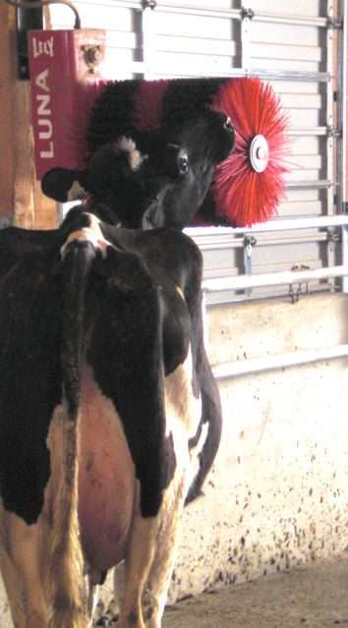
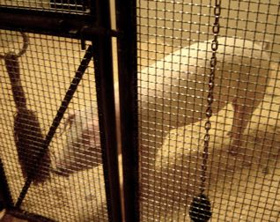
Environmental Enrichment
Improvements which, when absent, do not cause animals to suffer, but when present may provide pleasure
Example: provision of scratching devices to dairy and beef cattle
For more information:
CCAC training module on: environmental enrichment (2003)
Photo courtesy of UBC Animal Welfare Program
Photo courtesy of Dr. D. Jeffery
Young pig provided with a novel object to stimulate chewing and play behaviour
Notes:
Istockphoto.com
6760881

Slide 20
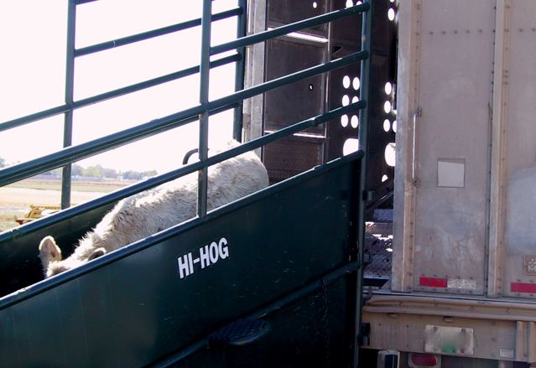
Acquisition
Photo courtesy of Agriculture and Agri-Food Canada

Slide 21
Importance of Proper Acquisition
Source animals from reputable sources with good health management
records of husbandry and any treatment (e.g., vaccines)
Prevent disease outbreaks – verify health status by quarantining upon arrival
Consider the effect of genotype on welfare
selection for maximum production in agricultural industry may have negative welfare consequences

Slide 22
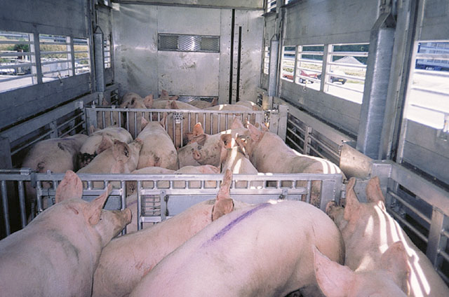
Transporting Farm Animals for Use in Science
Must comply with Federal Health of Animals Regulations (Part XII)
Should followRecommended Code of Practice for the Care and Handling of Farm Animals – Transportation
Photo courtesy of Dr. P. Chevillon, IFIP, France
Pigs loaded for transportation

Slide 23
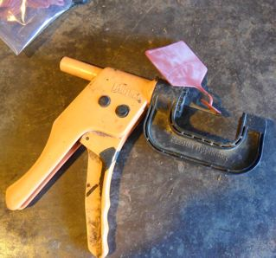
Importance of Proper Identification and Animal Record Keeping
Identification according to federal (CFIA) and provincial systems
Physical identification (e.g., ear tagging) done by trained individuals to avoid injury (e.g., nerve damage)
Identification system including individual animal records and experimental protocol information
Photo courtesy of Agriculture and Agri-Food Canada
Manual applicator for easy-to-read feedlot tags
Important to know each animal’s history – treatment in one study may impact animal welfare and outcomes in another study

Slide 24
Importance of Acclimation
Before using animals in any scientific application, acclimation to experimental conditions is required
Combination of acclimation and quarantine, if possible
Length of acclimation period based on species, handling experience, age, previous environment, feed intake, etc.
Special consideration for transitions (outdoor indoor)
physiological changes
dietary changes
familiarization with new type of environment
mixing and socialization

Slide 25
Quarantine: Essential for Maintaining Good Health and Welfare
Quick detection and response to health problems in new or sick animals
protection of the health of other animals in the facility
Monitoring at least twice daily
feed and water intake
physical appearance
behaviour
If questionable, record body temperature
Introduce animals to the rest of the herd/flock only after good health status is established

Slide 26
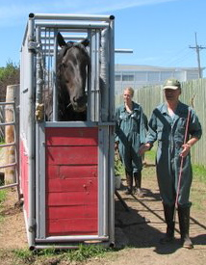
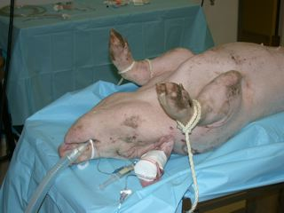
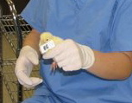
Routine Handling and Specialized Procedures
Photo courtesy of Animal Resources Centre,
University of Saskatchewan
Photo courtesy of Dr. D. Wilson
Photo courtesy of Dr. D. Wilson

Slide 27
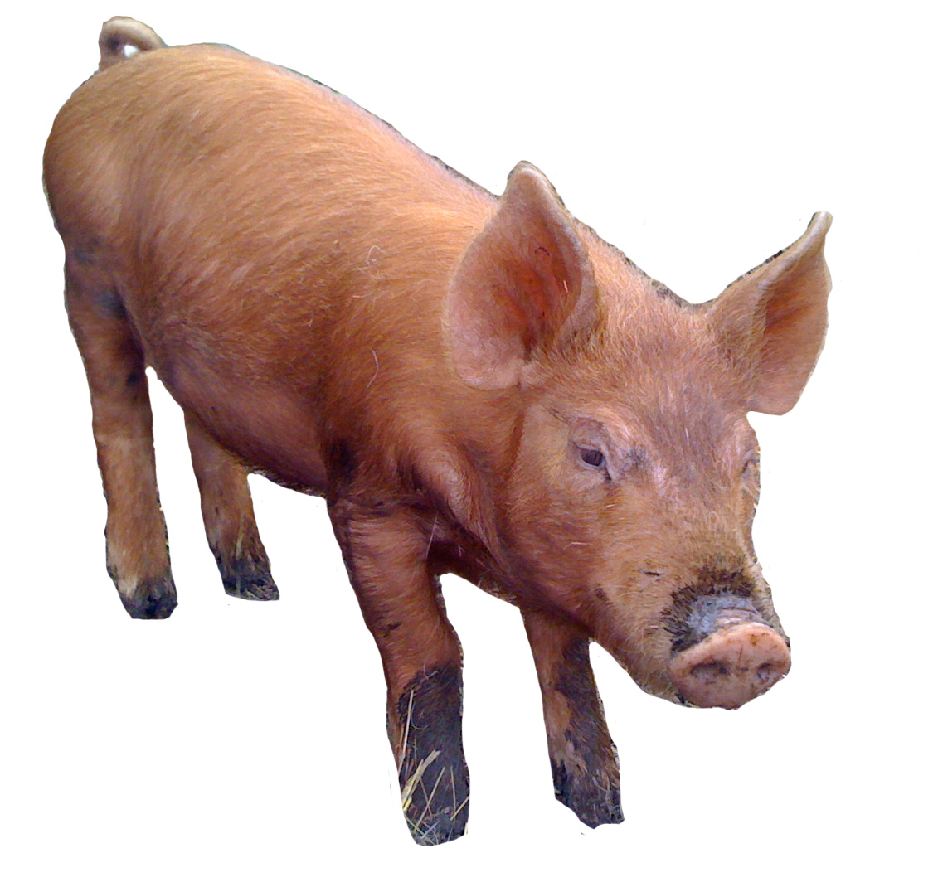
Human Contact and Handling
Perceived Fear
Reduced Welfare
Increased stress response
Negative handling experience
Negative behavioural and production consequences
Biased Research Results

Slide 28
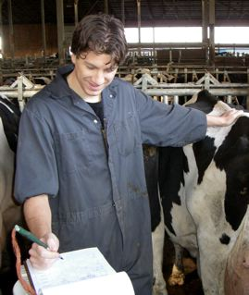
Effective, Low-Stress Handling
Skill set acquired through animal behaviour training and supervised experience
proper techniques for avoiding fearful response to handling, lifting, moving and herding
knowledge of animals’ herding tendencies and flight zones is essential
Photo courtesy of Dr. M. Gordon
Experienced technician recording information during a herd health check
Electric prods must not be used in routine handling

Slide 29
Avoiding Fear Response
Slow and calm movements
Stroking or scratching upon approach
Consistent handling
Quick approach
Loud noises and shouting
Ear, tail, leg pulling
Use of electric prods

Slide 30
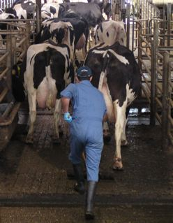
On-Farm Human Safety
Working with animals: fifth highest cause of on-farm, human fatalities in the past decade
Most common activities being performed when fatalities occurred:
herding
feeding and watering
inspecting and veterinary procedures
Photo courtesy of UBC Animal Welfare Program
Dairy cows being carefully herded to the milking parlour
Minimize risks of injury – Be familiar with all animal handling and restraint SOPs, and ask for help if uncertain

Slide 31
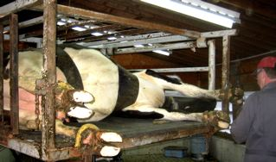
Restraining Farm Animals
Farm animals should be handled and restrained with species-specific equipment
Restraint devices
should be appropriate for intended procedure
are not acceptable for routine housing
Photo courtesy of UBC Animal Welfare Program
Dairy cow safely restrained for hoof trimming in a hydraulic lift
Electro-immobilization must not be used

Slide 32
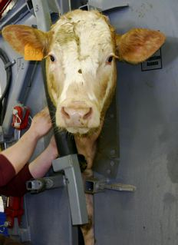
Minimizing Stress Associated with Restraint
Preconditioning: Training animals to cooperate with restraint and procedures prior to scientific use
Goal: Reduce animal stress and ensure handler safety while using minimum restraint
Photo courtesy of Dr. M. Lowerison
Beef cow safely restrained for blood sampling

Slide 33
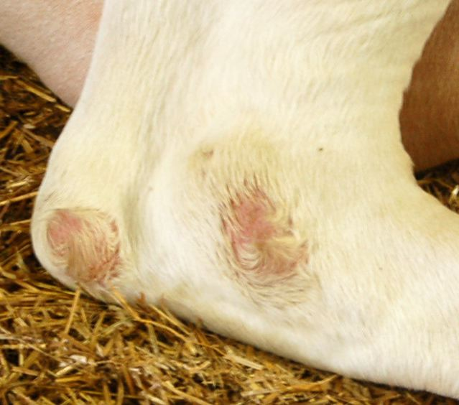
Consequences of Restraint Devices
Possible problems:
contusions, abrasions, hoof and claw damage, feather loss, ulcers, fluid accumulation, lameness, joint injuries, weight loss
Treatment must be:
provided as required
defined in animal care protocol, along with endpoints for removal from restraint device
Photo courtesy of UBC Animal Welfare Program
Hocklesionscaused by lying on hard or inadequately bedded surfaces
Unless scientifically justified and approved by the ACC, prolonged restraint must be avoided

Slide 34
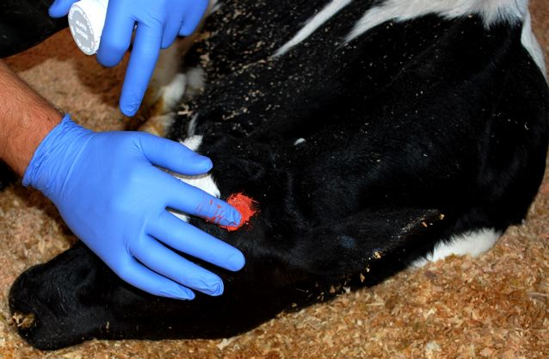
Routine Invasive Procedures and their Effect on Welfare
Many common routine procedures (e.g., beak trimming, dehorning, castration) cause pain
Pain mitigation is required (see slide 35)
Photo courtesy of UBC Animal Welfare Program
Application of caustic paste to the horn buds of a sedated dairy calf
Unless justified by the research goals, commercial agricultural practices cannot be used if procedures are:
painful or distressing
harmful to the animals (physically, psychologically or socially)

Slide 35
Pain Management
All procedures capable of causing pain should be accompanied by appropriate pain mitigation
monitor and provide relief for pain, discomfort and distress in all stages of procedure
Analgesics
Before
Sedatives
Anesthetics
During
Analgesics
After
Ensure pain mitigation provided is appropriate for procedure and species – consult a veterinarian first

Slide 36
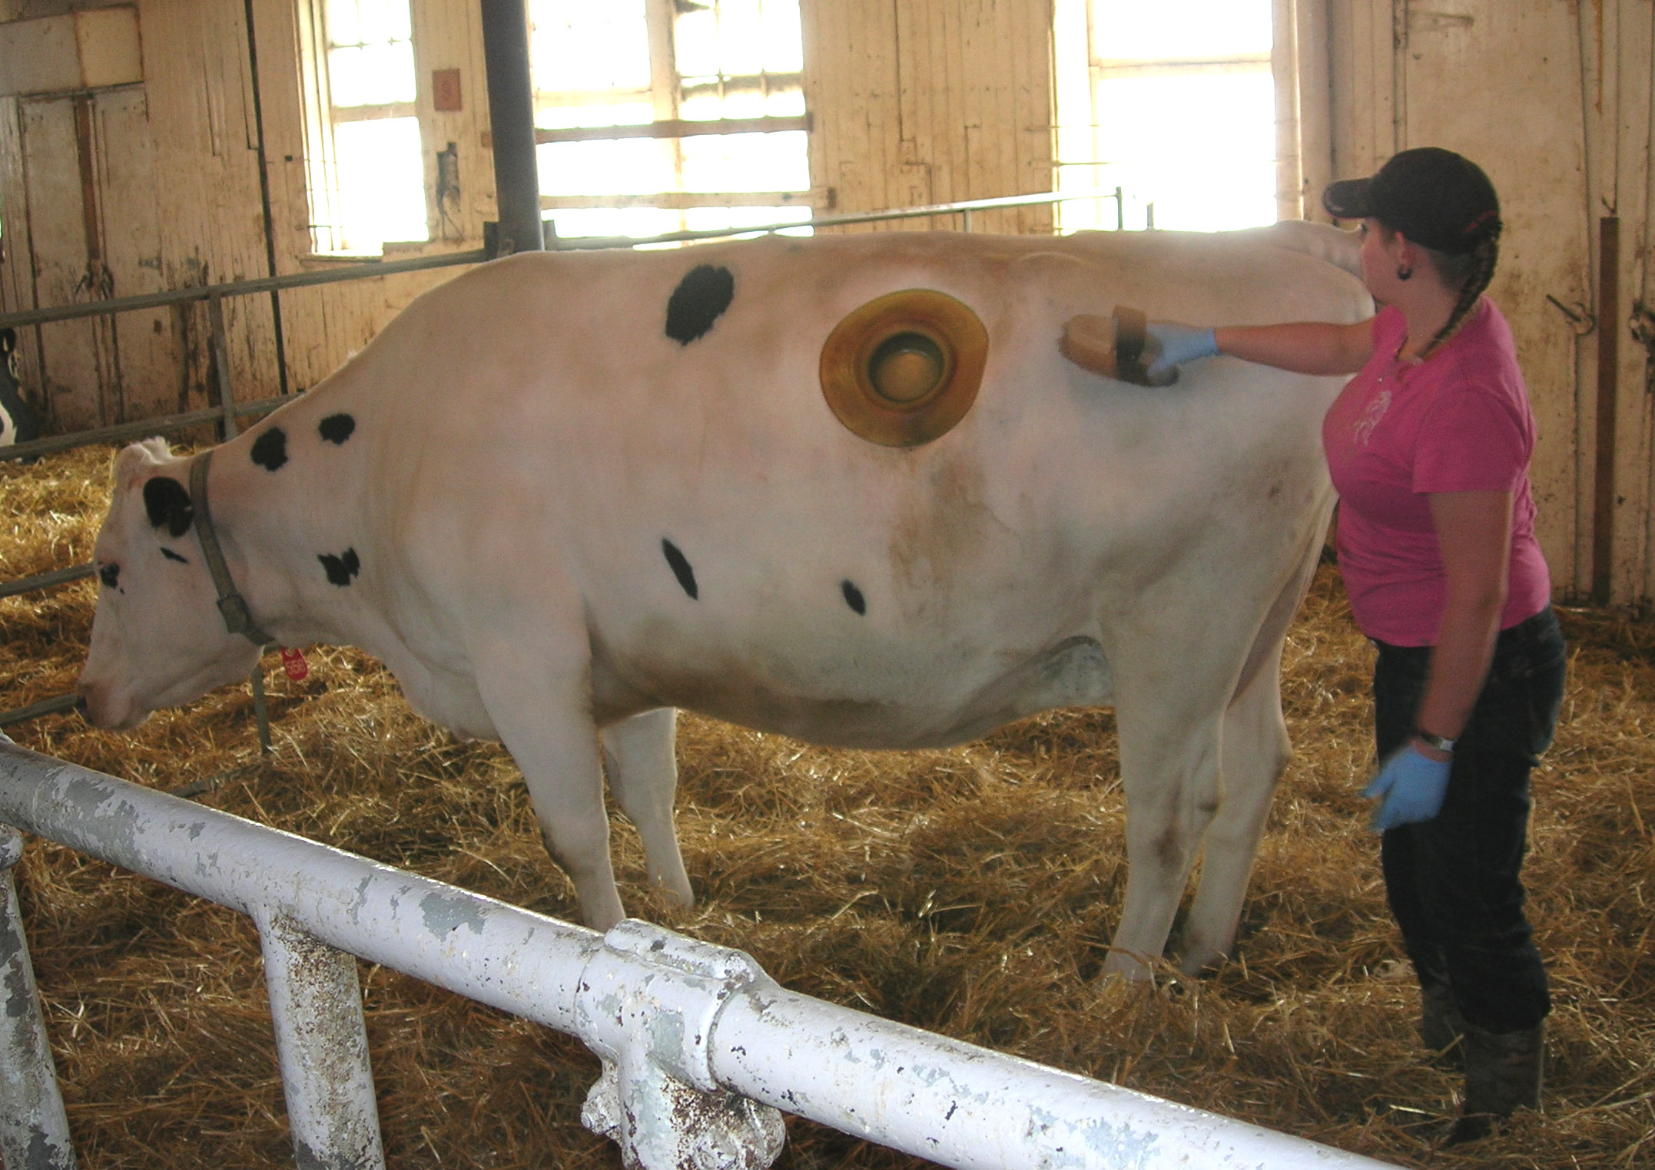
Specialized Procedures
Animals used in specialized procedures require additional care and monitoring to address their needs
Choosing least invasive procedures reduces:
pain and distress
Preconditioning animals to restraint and procedure minimizes:
distress for animal
interference in scientific results
Consideration should be given to reducing:
animal use
the impact of repeated procedures on an individual animal
Photo courtesy of Animal Resources Centre, University of Saskatchewan
Fistulated dairy cow

Slide 37
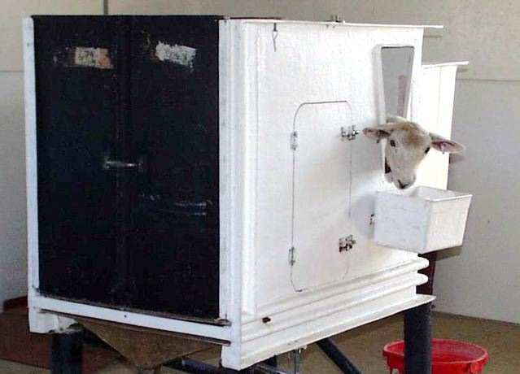
Metabolism Crates
May be required in nutrition and physiological studies
May restrict movement but must:
allow animals to rise, rest and maintain a comfortable posture
prevent injury
Photo courtesy of Agriculture and Agri-Food Canada
Ewe in an enclosed metabolism crate
Important to precondition animals to minimize isolation effects
Consider alternatives when available

Slide 38
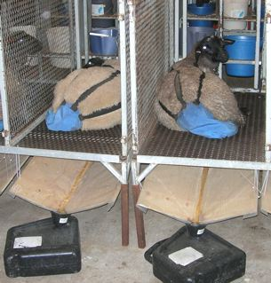
Meeting Farm Animal Needs in Metabolism Crates
Thermal requirements differ for farm animals in crates
Crates approved for short-term use only
maximum 7 consecutive days (then 24 hour exercise period) for a total of no more than 2 months
adjust timeline according to changes in behavioural and physiological states
Photo courtesy of Animal Resources Centre,
University of Saskatchewan
Ewes restrained in wire metabolism cage

Slide 39
Minimizing the Welfare Effects of Blood & Tissue Sampling
Sampling and associated restraint procedures may be distressing for animals
Ways of minimizing distress:
consider remote sampling
precondition animals
use anesthetic when appropriate
Sampling should only be performed by well trained individuals

Slide 40
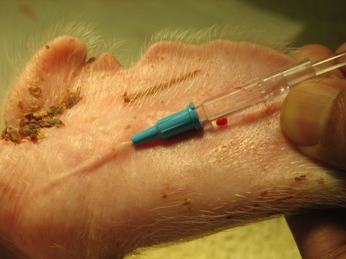
Blood Sampling Guidelines
Sampling rules
no more than 10% of total blood volume
take actual amount needed, not maximum
Multiple sampling
cannulation should be considered
removecannulae following sampling and monitor for signs of irritation, infection, septicemia and anemia
Photo courtesy of Dr. D. Wilson
Blood sampling from the ear vein of
a young pig

Slide 41
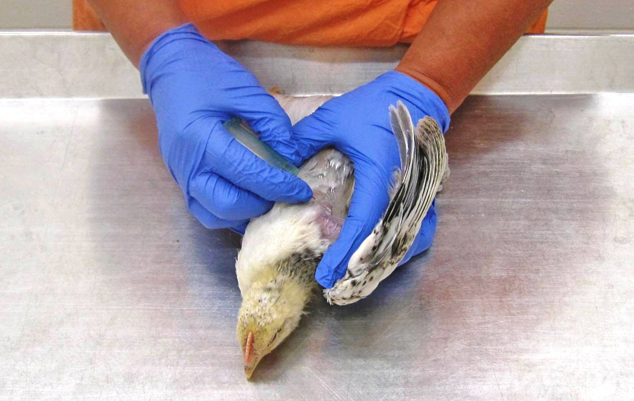
Blood Volumes: Single Sample (e.g., 0.8 kg chicken)
TABLE 1
Species | One Bleed Max (ml/kg)
Cattle | 7.7
Goat | 6.6
Sheep | 6.6
Pig | 6.6
Chicken | 9.9
1. One bleed max
9.9 ml/kg
2. Weigh animal
0.8 kg chicken
3. Multiply bleed max by weight
7.9 ml
Photo courtesy of Dr. A. A. Olkowski
Blood collection fromwingvein of a chicken

Slide 42
Blood Volumes: Multiple Samples (e.g., 40 kg goat, sampled every 2 weeks)
1. Mean Volume
70 ml/kg
2. Weigh animal
40 kg goat
3. Multiply mean volume by weight
Total blood volume = 2800 ml
2800 x 10% = 280 ml / sample
4. Multiply total blood volume by % blood removed
Table 2
Species |  | Blood volume mean (range) ml/kg
Cattle |  | 57 (52 – 61)
Goat |  | 70 (57 – 89)
Sheep |  | 66 (60 – 74)
Pig |  | 65 (61 – 68)
Chicken |  | 60
Table 3
Recovery time before next sampling (wks) | Blood removed (% of total blood volume)
1 | 7.5
2 | 10

Slide 43
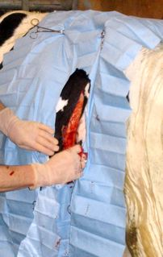
Surgery
Minor surgery
produces little or no physical impairment
Major surgery
penetrates or exposes body cavity
impairs physical or physiological functioning
Photo courtesy of UBC Animal
Welfare Program
Emergency surgery to correct a displaced abomasum
Surgery should only be performed by well trained individuals

Slide 44
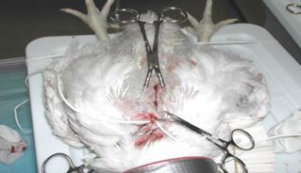
Requirements for Major & Non-Survival Surgeries
Major survival surgery and long, non-survival surgery :
facilities intended for surgery
standard aseptic surgical procedures
Short, non-survival surgery
good surgery practices, but not necessary to follow all aseptic standards
Photo courtesy of Dr. A. A. Olkowski
Short term, non-survival study measuring blood flow dynamics in a chicken

Slide 45
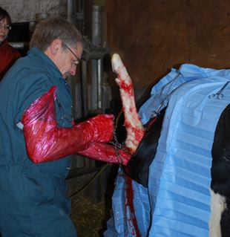
Requirements for Minor & Therapeutic Surgeries
Minor surgery
according to standard veterinary practices
Therapeutic and emergency surgery
techniques should be as sanitary as possible
pain mitigation as appropriate
consider likelihood of emergency surgery in protocol and make necessary provisions
Photo courtesy of UBC Animal Welfare Program
Cesarean section (chain used for leverage when pulling calf)

Slide 46
Fistulation / Catheterization
Consider various approaches, types and materials available during experimental planning
Special considerations
personnel trained to understand special care requirements and catheter endpoints
for safety of personnel and animals, employ restraint devices during catheterization and sampling
implanted telemetry devices to ensure clear identification of animals for post-op and long-term monitoring

Slide 47
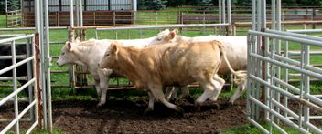
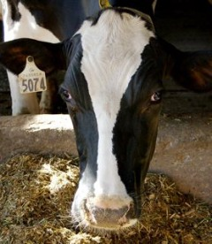
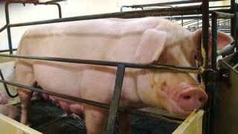
Termination of Scientific Use of the Farm Animal
Photo courtesy of Dr. D. Wilson
Photo courtesy of M. Smit
Photo courtesy of UBC Animal Welfare Program

Slide 48
Endpoints
Ending or minimizing pain and distress of an experimental animal
Stop procedure
Provide treatment for pain and distress
euthanize
Goal: Use earliest possible endpoint to minimize pain, distress and discomfort while still achieving scientific objectives of protocol
Note: Endpoint selection should involve consultation with the veterinarian and the ACC

Slide 49
Return to Herd or Flock
In many instances farm animals may be reintroduced into a herd or flock upon the end of their scientific use
Photo courtesy of Animal Resources Centre, University of Saskatchewan
Photo courtesy of Animal Resources Centre, University of Saskatchewan
Sheep in wire metabolism cages
Sheep outside in a small herd

Slide 50
Emergency Euthanasia
Necessary for:
animals that cannot be moved due to disease or injury
preventing animal suffering due to severe un-relievable pain and distress
emergency disease control
Methods should:
minimize pain, distress and potential disease spread
consider effects on personnel
See species-specific sections of the CCAC guidelines on: the care and use of farm animals in research, teaching and testing (2009) for acceptable emergency euthanasia methods

Slide 51
Disposal of Farm Animals Used in Science
All farm animals used in science should be handled, transported and disposed of in accordance with federal, provincial and municipal regulations
Not all animals will be approved for food chain disposal
important to be aware of appropriate and legal carcass disposal routes

Slide 52
Summary
Care, housing, handling practices and specialized procedures all influence farm animal welfare
Good welfare requires a balance of three components:
biological functioning
natural living
affective states
Animal users should strive to achieve their scientific goals in line with the best possible animal welfare standards
Photo courtesy of UBC Animal Welfare Program
Dairy heifers grazing

