Slide 1
DAS
Department of Animal Sciences, UOS
Common Feeds and their Classification
Common feeds and their classification
2020
Notes:
Experimental—deceleration, disability, supine, mice
Theory—mites, honeybees, identity, probit
Lifespan—primates, etc
Human—self reinforcing, wasp, NBA
Thank
Background
Invasive/Greece/Hawaii
CDFA Medfly panel
Aging research
LBAM
Workshop
Zalom et al
Retreat/Workshop
LMAM see that little changes
New day in science/policy

Slide 2
Common feeds and their classification
Roughages:
A coarse bulky feeds, high in fiber contents (more than 18%) and low in total digestible nutrients (less than 60%).
Concentrates:
Feeds which are rich in total digestible nutrients (more than 60%) with low fiber contents (less than 18%)
Additives
Food supplements for farm animals that cannot get enough nutrients from regular meals that the farmers provide and include vitamins, amino acids, fatty acids and minerals
Notes:
Experimental—deceleration, disability, supine, mice
Theory—mites, honeybees, identity, probit
Lifespan—primates, etc
Human—self reinforcing, wasp, NBA
Thank
Background
Invasive/Greece/Hawaii
CDFA Medfly panel
Aging research
LBAM
Workshop
Zalom et al
Retreat/Workshop
LMAM see that little changes
New day in science/policy

Slide 3
Roughages
Green
Pasture
Green chop
Silage
Tree leaves
Notes:
Experimental—deceleration, disability, supine, mice
Theory—mites, honeybees, identity, probit
Lifespan—primates, etc
Human—self reinforcing, wasp, NBA
Thank
Background
Invasive/Greece/Hawaii
CDFA Medfly panel
Aging research
LBAM
Workshop
Zalom et al
Retreat/Workshop
LMAM see that little changes
New day in science/policy

Slide 4
Conti…
Pasture
Grasses
Legumes
Shrubs and trees
Notes:
Experimental—deceleration, disability, supine, mice
Theory—mites, honeybees, identity, probit
Lifespan—primates, etc
Human—self reinforcing, wasp, NBA
Thank
Background
Invasive/Greece/Hawaii
CDFA Medfly panel
Aging research
LBAM
Workshop
Zalom et al
Retreat/Workshop
LMAM see that little changes
New day in science/policy

Slide 5
Conti…
Green chop
a. Legumes
Berseem, Lucerne & Cowpea
b. Non-legumes
Maize, Sorghum, Millet & Mott grass
c. Tree leaves
Ipil ipil & Mulberry etc.
Notes:
Experimental—deceleration, disability, supine, mice
Theory—mites, honeybees, identity, probit
Lifespan—primates, etc
Human—self reinforcing, wasp, NBA
Thank
Background
Invasive/Greece/Hawaii
CDFA Medfly panel
Aging research
LBAM
Workshop
Zalom et al
Retreat/Workshop
LMAM see that little changes
New day in science/policy

Slide 6
Conti…
2. Dry
Hay
Straws & Stover
Corn cobs
Hulls & Bagasse
Notes:
Experimental—deceleration, disability, supine, mice
Theory—mites, honeybees, identity, probit
Lifespan—primates, etc
Human—self reinforcing, wasp, NBA
Thank
Background
Invasive/Greece/Hawaii
CDFA Medfly panel
Aging research
LBAM
Workshop
Zalom et al
Retreat/Workshop
LMAM see that little changes
New day in science/policy

Slide 7
Concentrates
Energy feeds
a. Cereal grains
Maiz, rice, wheat, barley & soghum
b. Grain milling byproducts
Wheat bran & rice polish
Notes:
Experimental—deceleration, disability, supine, mice
Theory—mites, honeybees, identity, probit
Lifespan—primates, etc
Human—self reinforcing, wasp, NBA
Thank
Background
Invasive/Greece/Hawaii
CDFA Medfly panel
Aging research
LBAM
Workshop
Zalom et al
Retreat/Workshop
LMAM see that little changes
New day in science/policy

Slide 8
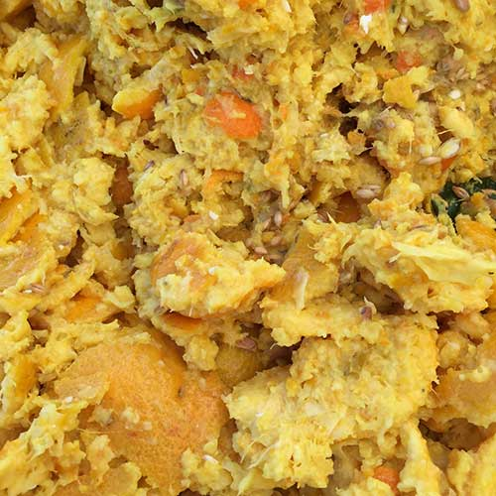
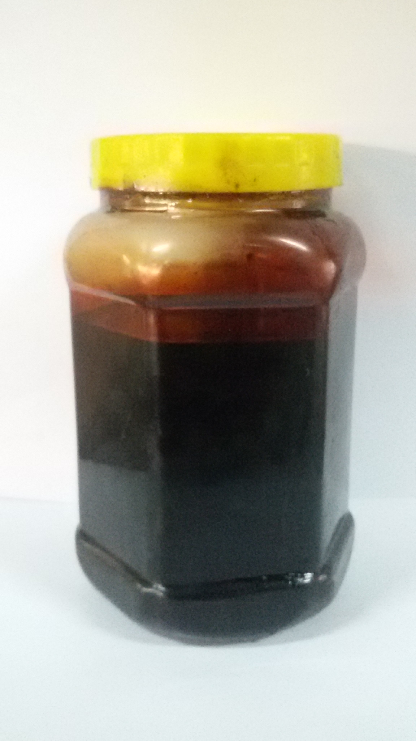
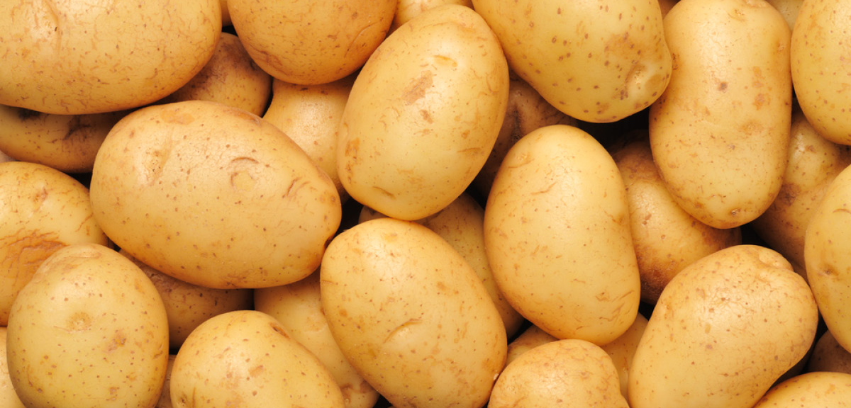
Conti…
c. Roots & Tubers
Potatoes
d. Agro-industrial byproducts
Molasses & Enzose
e. Food processing byproducts
Bakery wastes & citrus pulp

Slide 9
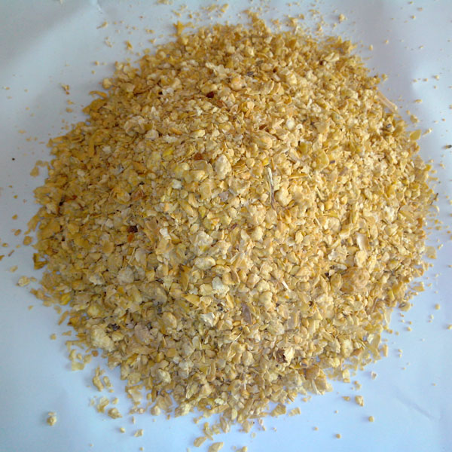
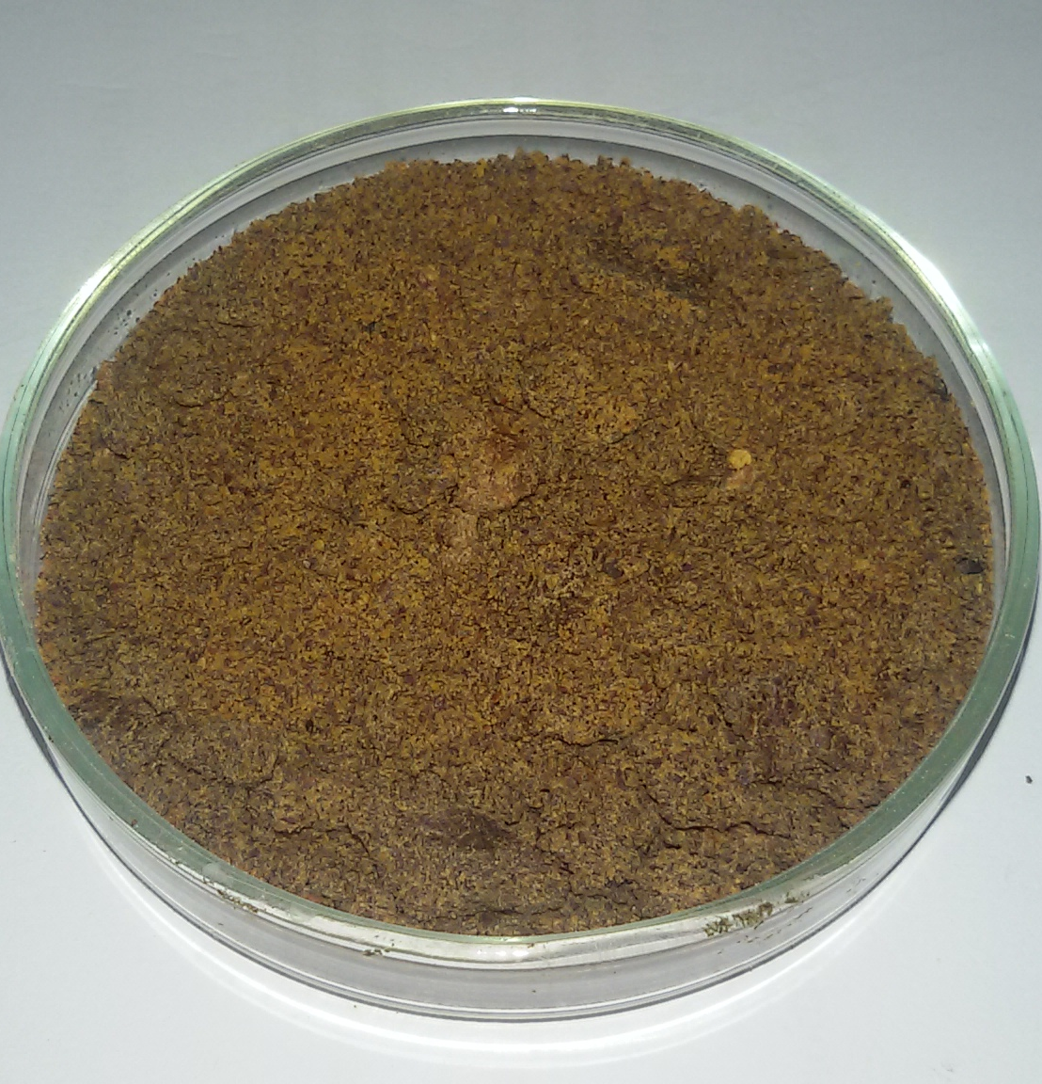
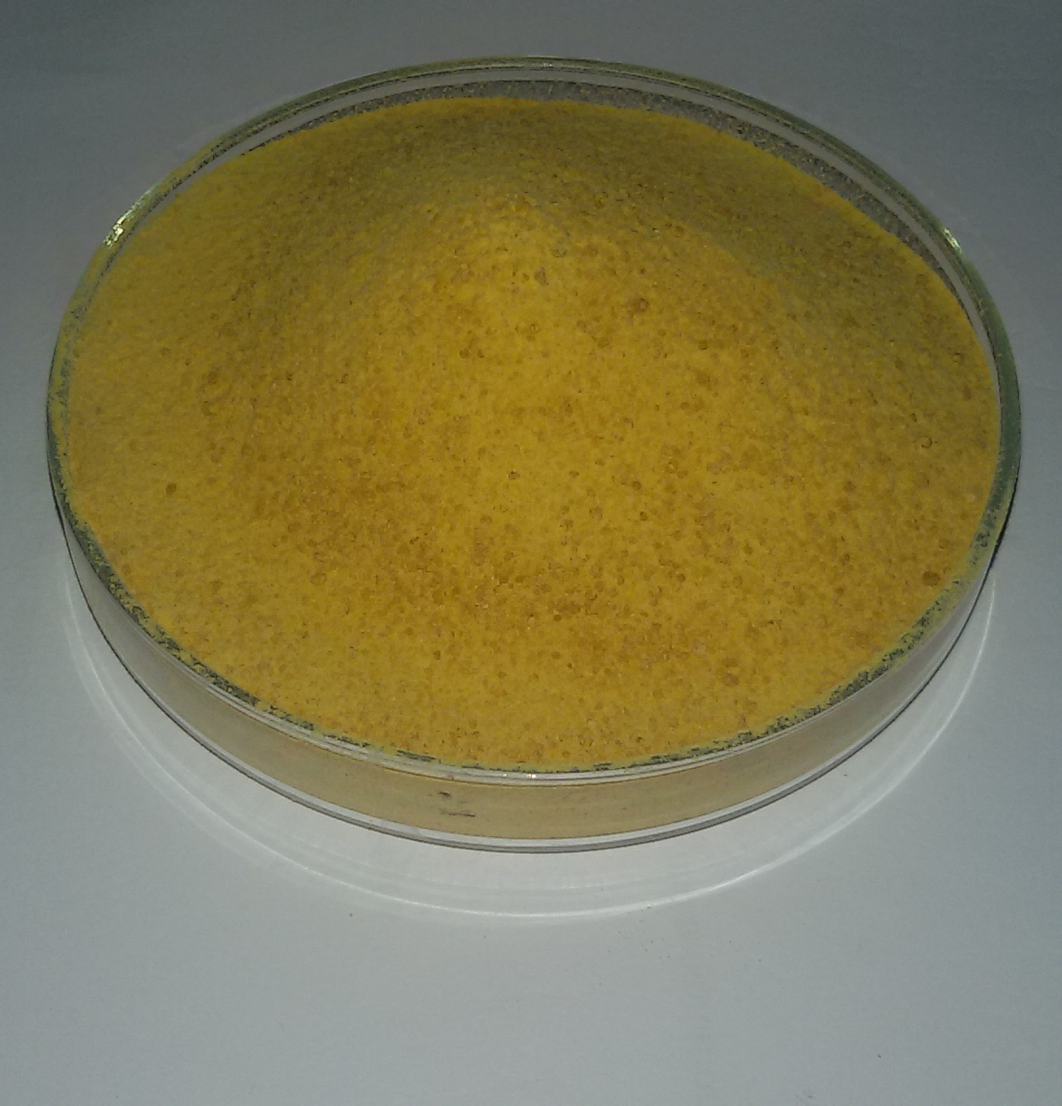
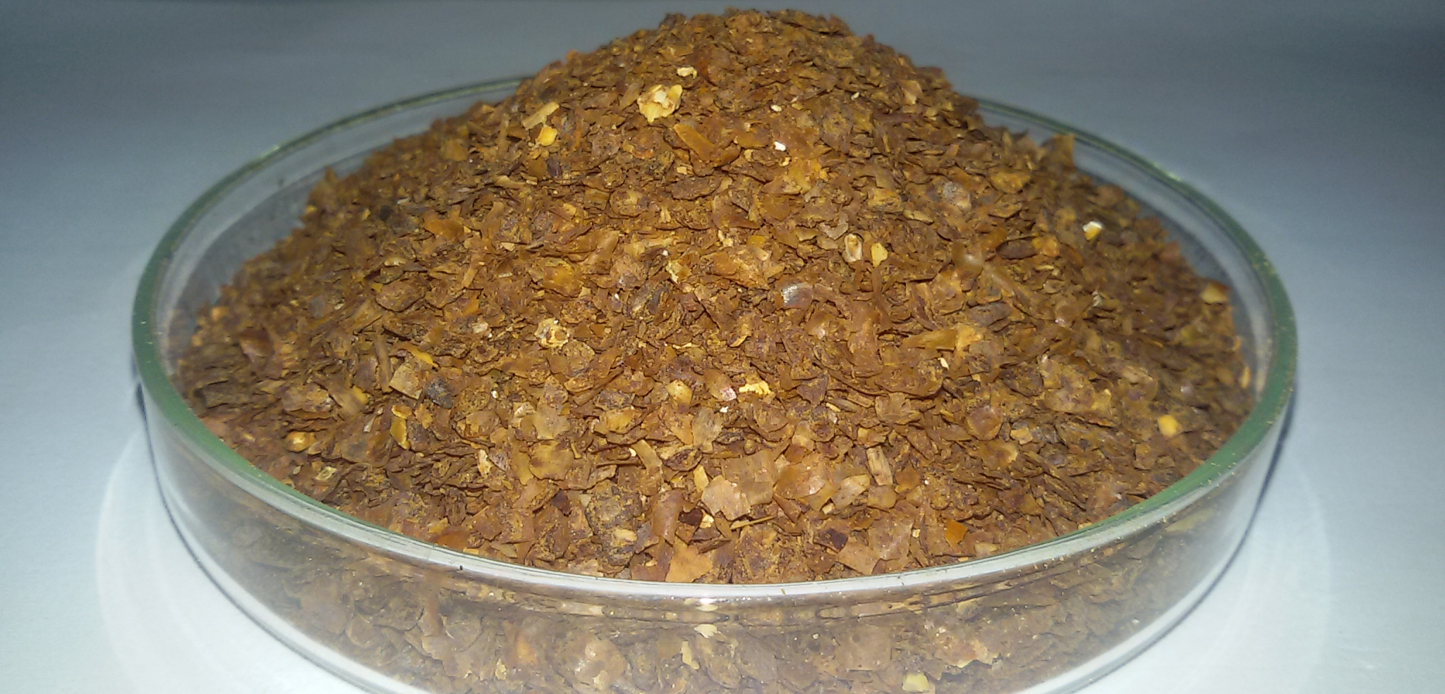
Conti…
2. Protein supplements
a. Vegetable protein sources
Soybean meal, cotton seed meal, sunflower meal & maize gluten etc.

Slide 10
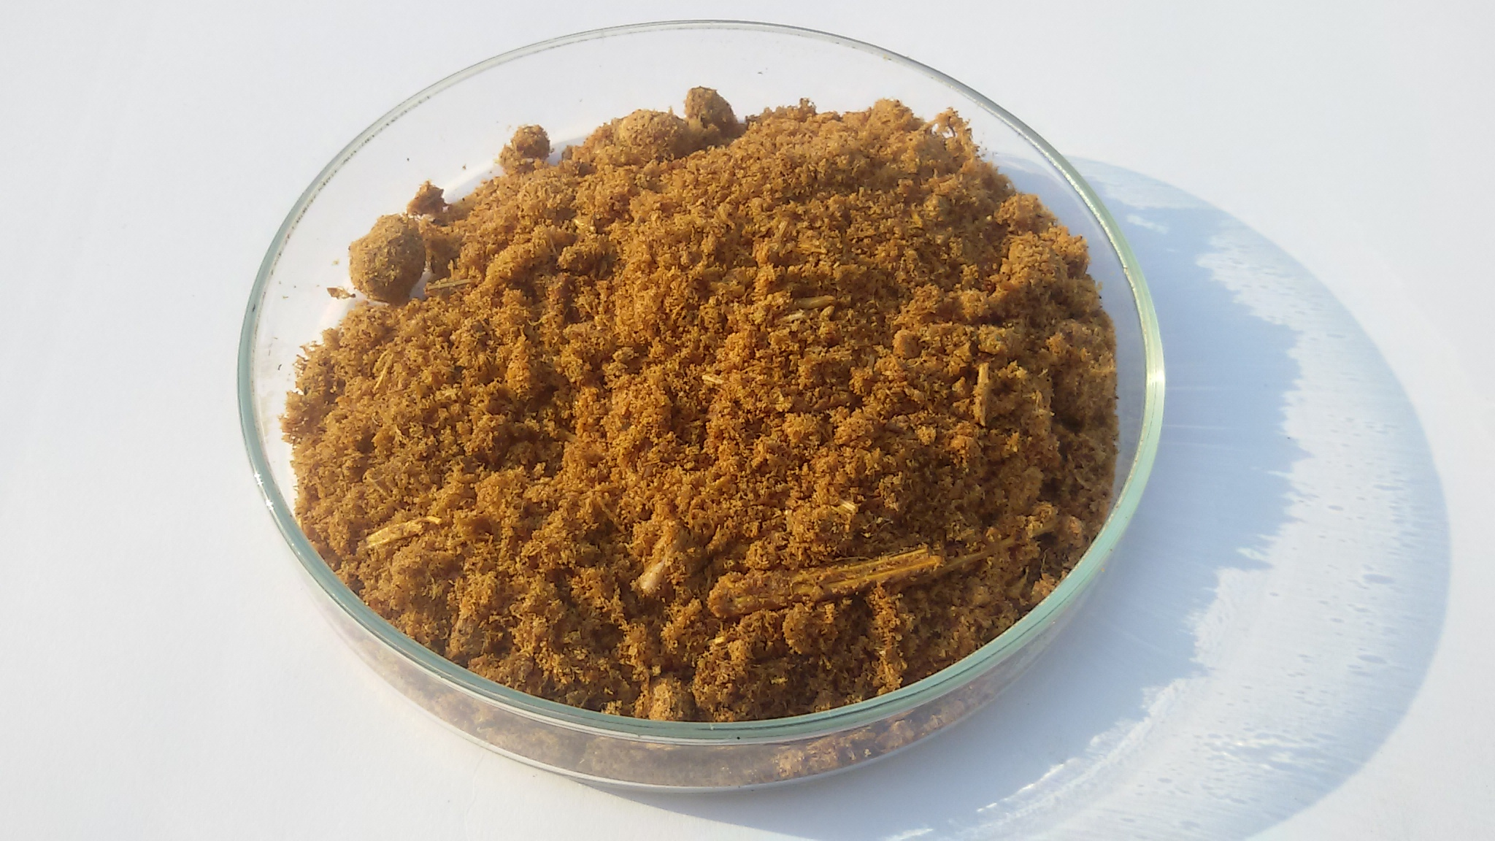
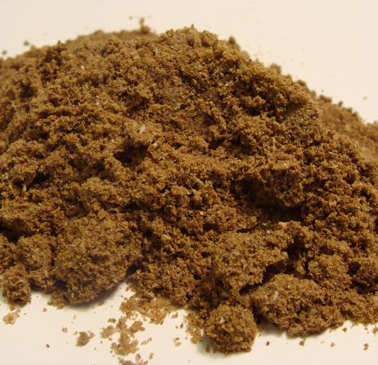
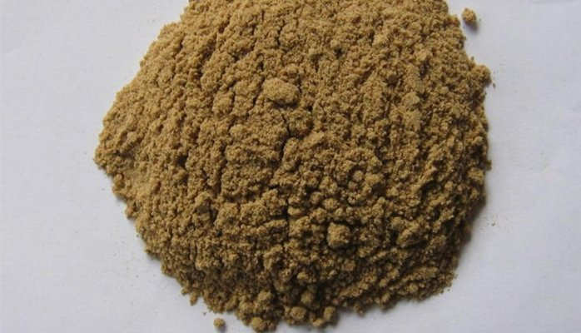
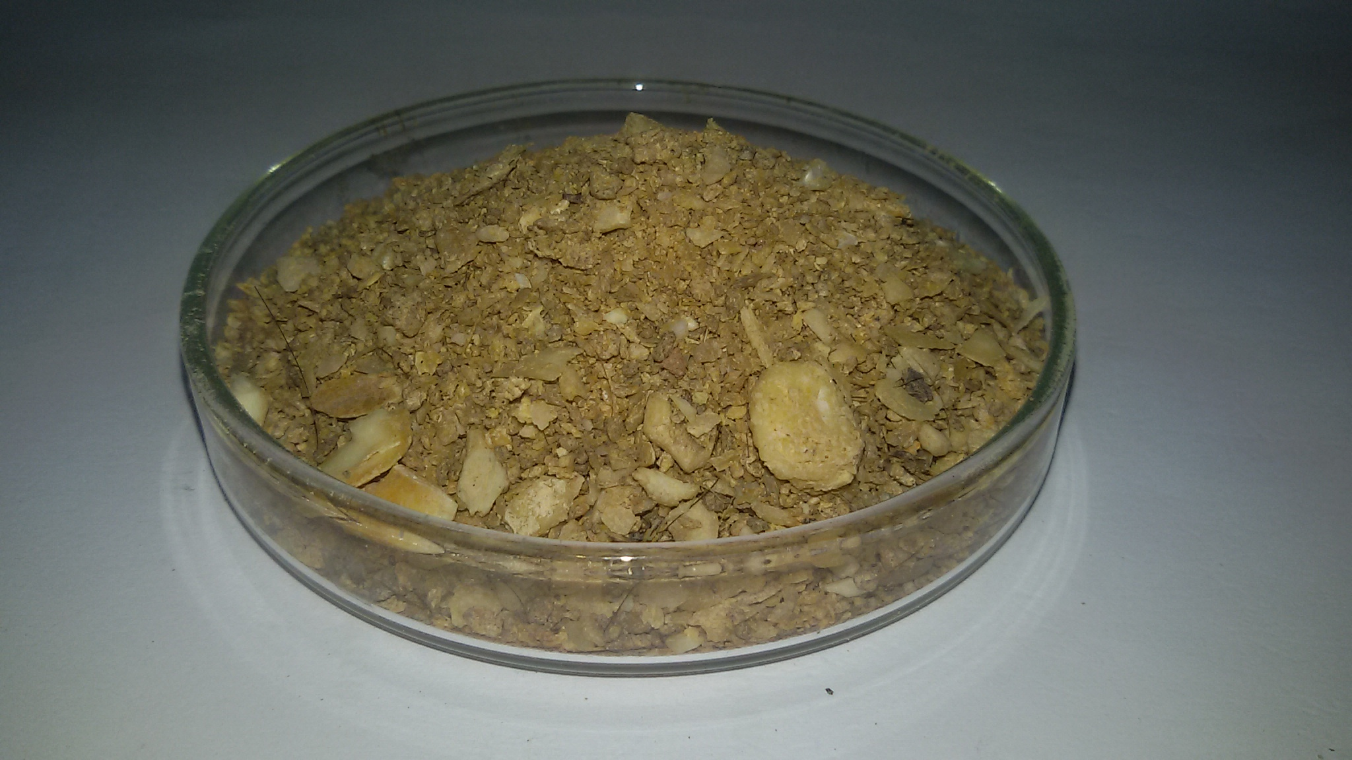
Conti…
b. Animal protein sources
Meat meal, blood meal, fish meal & feather meal, bone meal

Slide 11
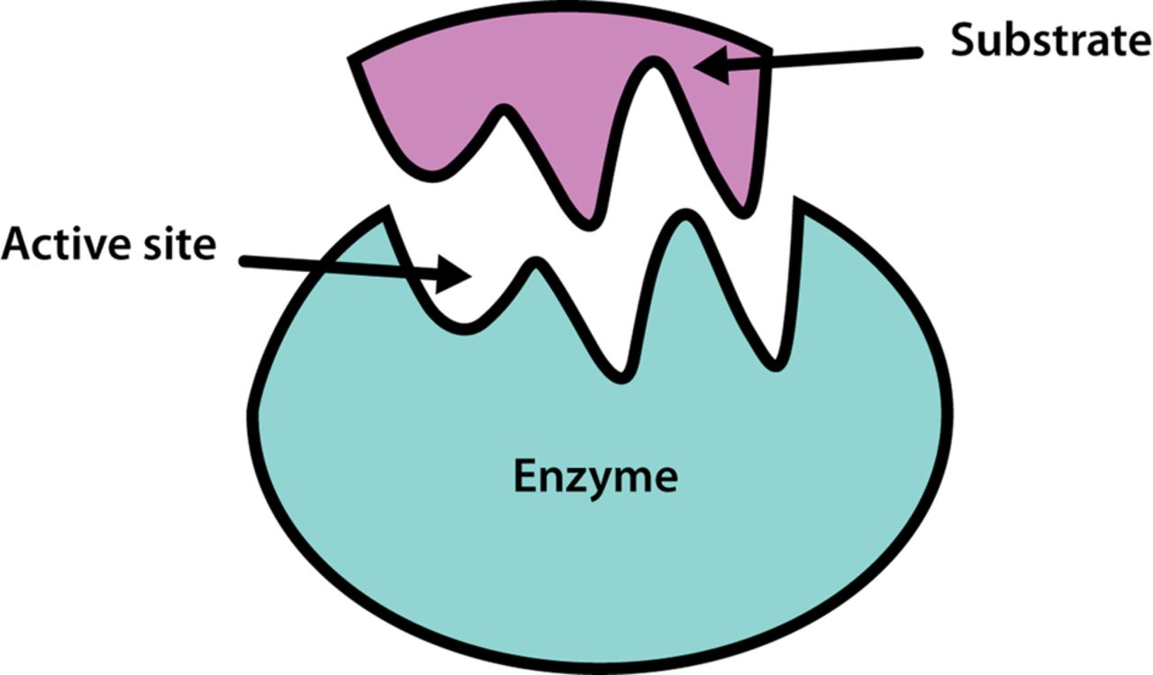
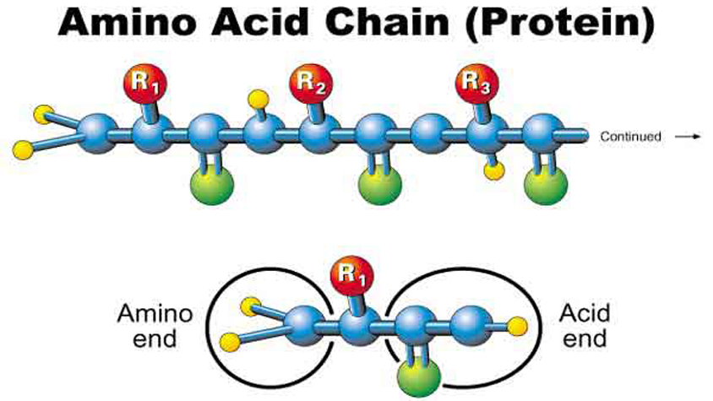
Additives
Mineral supplements
Vitamin supplements
Synthetic amino acids
Drugs (antibiotics & ionophores)

Slide 12
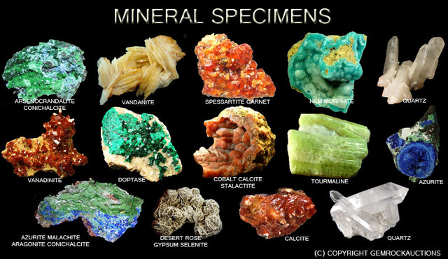
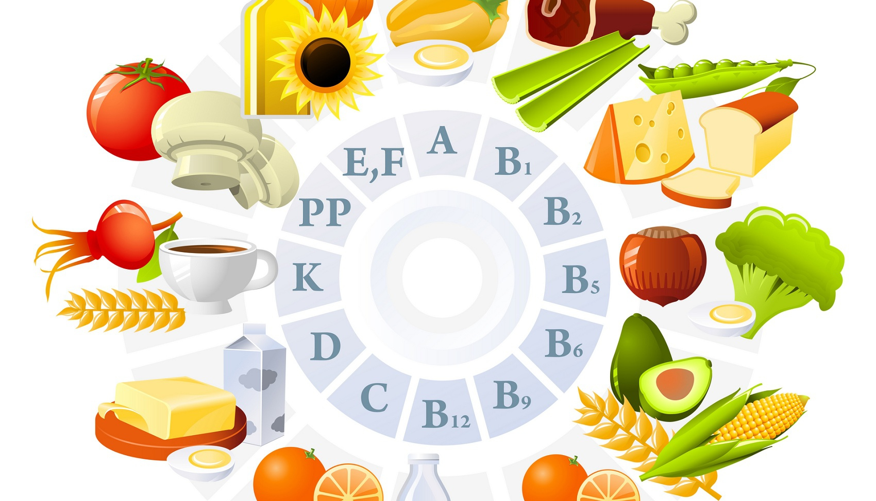
Additives
Preservatives (antioxidant & Mold inhibitor)
Buffers
Enzymes
Probiotics
Flavors

Slide 13
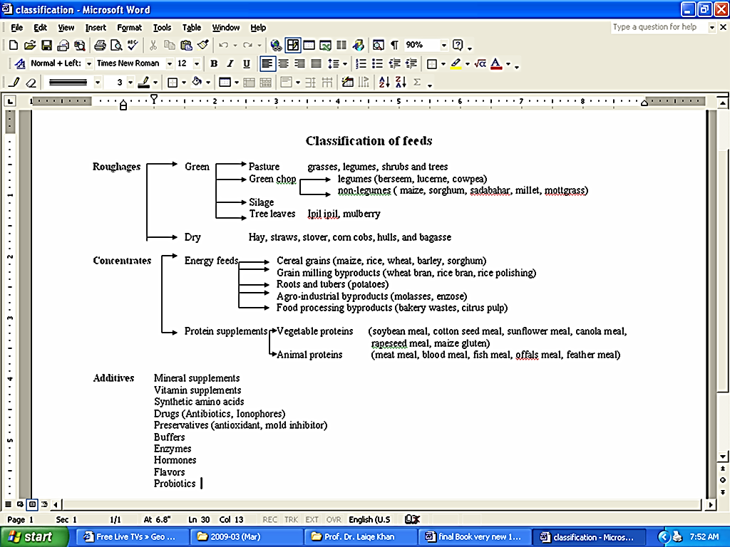
Notes:
Experimental—deceleration, disability, supine, mice
Theory—mites, honeybees, identity, probit
Lifespan—primates, etc
Human—self reinforcing, wasp, NBA
Thank
Background
Invasive/Greece/Hawaii
CDFA Medfly panel
Aging research
LBAM
Workshop
Zalom et al
Retreat/Workshop
LMAM see that little changes
New day in science/policy

