Slide 2
BY
DR.MAZHAR

Slide 3
RHEUMATIC HEART DISEASE
Rheumatic heart disease is the most common form of heart disease in children in the world. A case of rheumatic fever can cause the heart to inflame and leave permanent damage to the heart, specifically the heartvalves.

Slide 4
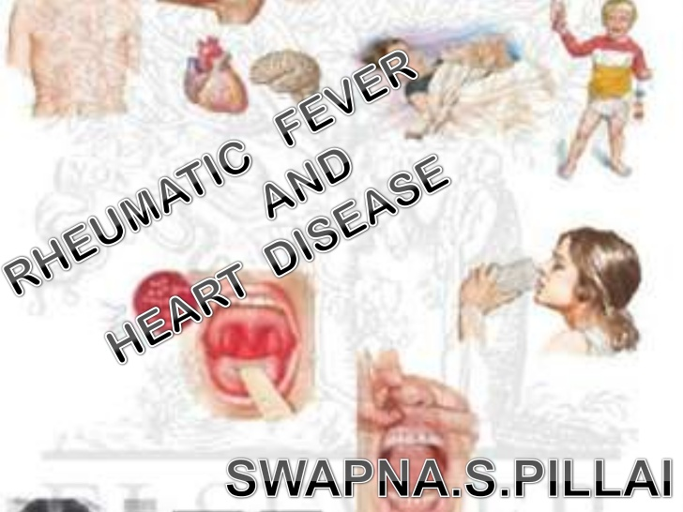
RHEUMATIC HEART DISEASE
RHEUMATIC FEVER AND RHEUMATIC HEART DISEASE CAN NOT BE SEPERATED….
RHEUMATIC FEVER IS A FEBRILE DISEASE AFFECTING CONNECTIVE TISSUE PARTICULARLY OF HEART AND JOINTS….
MAIN ORGANISM INVOLVE IS GROUP A BETA HAEMOLYTIC STREPTOCOCCI….

Slide 5
CONSEQUENCES OF RHD
CONTINOUS DAMAGE TO HEART
INCREASING DISABILITIES
REPEATED HOSPITALIZATION
PREMATURE DEATH BY AGE 35
RHD IS MOST PREVENTABLE CHRONIC DISEASE.

Slide 7
EPIDEMIOLOICAL FACTORS
1)AGENT FACTOR
a)AGENT:
ONSET OF RF IS PRECEDED BY STREPTOCOCCAL SORE THROAT …..
STRAINS WITH “RHEUMATOGENIC POTENTIEL” ARE MOSTLY INVOLVED….
RECENTLY COXSACKIE B-4 VIRUS HAS BEEN SUGGESTED AS A CAUSATIVE AGENT AND STREPTOCOCCUS ACTING AS A CONDITIONING AGENT
b) CARRIERS:
CARRIERS ARE FREQUENT

Slide 8
2)HOST AND ENVIRONMENTAL FACTORS:
a)AGE:
RF IS TYPICAL DISEASE OF CHILDHOOD AND ADOLESCENCE (5-15YEARS)
b)SEX:
EFFECTS BOTH EQUALLY
c)SOCIO-ECONOMIC STATUS:
RF IS A DISEASE OF LOW SOCIO-ECONOMIC STATUS

Slide 9
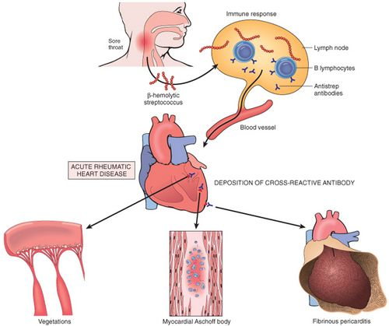
d)IMMUNITY:
AN IMMUNOLOGICAL BASIS BETWEEN RF AND RHD HAS APPROVED…

Slide 10
CLINICAL FEATURES
FEVER
POLYARTHRITIS
CARDITIS
NODULES
BRAIN INVOLVEMENT
SKIN (RASH OF VARIOUS TYPES)

Slide 11
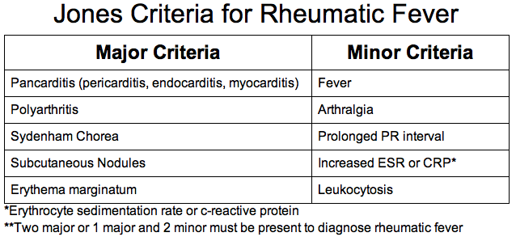
DIAGNOSIS
2002-2003 WHO CRITERIA FOR DIAGNOSIS OF RF AND RHD ARE BASED ON REVISED JONES CRITERIA

Slide 12
DIAGNOSIS OF PRIMARY RF
MAJOR AND MINOR
MENIFESTATIONS OF RF
+
LAB MENIFESTATIONS
+
PRECEDING STREPTOCOCCAL
INFECTIONS

Slide 13
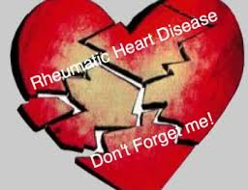
DIAGNOSIS OF RECURRENT RF
MINOR MENIFESTATIONS
+
EVIDENCE OF RECENT STREPTOCOCCAL INFECTIONS

Slide 14
PREVENTION
PRIMARY PREVENTION
SECONDARY PREVENTION
NON-MEDICAL MEASURES
EVALUATION

Slide 15
PRIMARY PREVENTION
AIM OF PRIMARY PREVENTION IS TO PREVENT 1ST ATTACK OF RF BY IDENTIFYING ALL PATIENTS WITH STREPTOCOCCAL INFECTIONS AND TREAT THEM WITH PENICILLIN…
TO PREVENT 1 RHD CASE SEVERAL THOUSAND CASES OF STREPTOCOCCAL INFECTIONS MUST BE IDENTIFIED AND TREATED…
FOR PATIENTS ALLERGIC TO PENICILLIN ERYTHROMYCIN IS DRUG OF CHOISE…

Slide 16
SECONDARY PREVENTION
PREVENTION OF RECURRENCES
IDENTIFY RF CASE AND GIVE THEM IM INJECTION OF BENZATHINE BENZYL PENICILLIN CONTINUE FOR 5 YEARS OR UNTILL CHILD REACHES 18 YEARS…
PATIENTS WITH CARDITIS SHOULD CONTINUE FOR 10 YEARS OR AT LEAST UNTILL 25 YEARS OF AGE…

Slide 17
NON-MEDICAL MEASURES
TO IMPROVE LIFE CONDITION
TO BREAK POVERTY DISEASE POVERTY CYCLE
EVALUATION
IN EVLUATION THE PREVELENCE OF RHD IN SCHOOL CHILDREN FROM PERIODIC SURVEYS OF RANDOM SAMPLES IS BEST INDICATOR

Slide 18
SO,,,,,,,,,,,,,,

Slide 20
ANY QUESTION??????????????

