Slide 1
Web onepts

Slide 2
Web:
The World Wide Web is a collection of electronic documents that are linked together like a spider Web. The source of these documents, or Webpages, are companies, organizations, and individuals from around the globe. These Webpages are stored, or hosted on computers called servers. The Web is made up of the following elements:
• Your personal computer (PC)
• Web browser software to access the Web (i.e. MS Explorer)
• A connection to the Internet via an Internet Service Provider (ISP)
• Servers to host the data Webpages are stored on Web servers located around the globe. Entering the address, or Uniform Resource Locator (URL), of a Webpage into your Web browser sends a request to the server that hosts the page. The server then sends the Webpage to your computer and your Web browser displays it on your screen.
The Web is an Internet-based distributed information system. Anyone with a computer connected to the Internet can easily retrieve information by giving a Web address or by simply clicking a mouse button. The Web is a great way to disseminate information and making it available 24/7. Information can also be collected from Web users and customers through online forms. Maintainers and administrators can control and update Web content from anywhere on the Web. All these make the Web a powerful tool for mass communication, e-business and e-commerce. Compared with TV, radio, news papers, and magazines, putting the word out on the Web is relatively simple and inexpensive. But a website is much more than such one-way communication media. It can be a virtual office or store that is always open and supported by workers from anywhere.

Slide 3
As a communication medium, the Web consists of these major components:
• Networks—The local-area and wide-area networks connecting computers world-wide forming the Internet.
• Clients—Web browsers that enable end-users to access the Web
. • Servers—Constantly running programs that serve up information to the Web.
• Documents—Web pages, mostly coded in HTML, that supply information on the Web.
• Protocols—The Hyper Text Transfer Protocol HTTP that Web clients and servers use to talk to one another and the TCP/IP (Transmission Control Protocol) on which HTTP depends. A basic understanding of these components and how they work together lays a good foundation for Web Design and Programming. Let’s begin by taking a look at networking
World Wide Web (WWW or Web)
The World Wide Web (WWW or Web) is often confused with the Internet
• The Web didn’t exist until the 1980s
• In 1989 Tim Berners-Lee created a set of technologies that allowed information on the Internet to be linked together through the use of links, or connections in documents –
• The language used to write these documents with links is HTML 37 Dr. Owen Conlan, Introduction to Web Technologies The Web
• The Web was mostly text based until Marc Andreessen created the Mosaic browser in 1992
• Accredited for popularizing the WWW
• People started thinking about adding videos, sound, and graphics on the Web.
• Now many people think of the Web as the graphical or illustrated part of the Internet

Slide 4
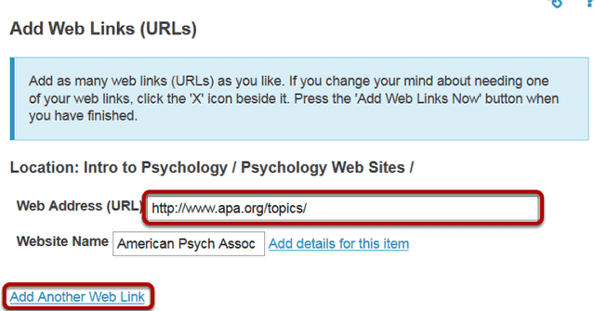
Webpages and Websites A Webpage is an electronic document written in a computer language called HTML (Hypertext Markup Language). Webpages may contain text, graphics, video, animation, and sound, as well as interactive features, such as data entry forms. Each Webpage has a unique address known as a URL (Uniform Resource Locator), which identifies its location on a particular server. Webpages usually contain hyperlinks to other Webpages. Hyperlinks are text and images that reference the URLs of other Webpages

Slide 5
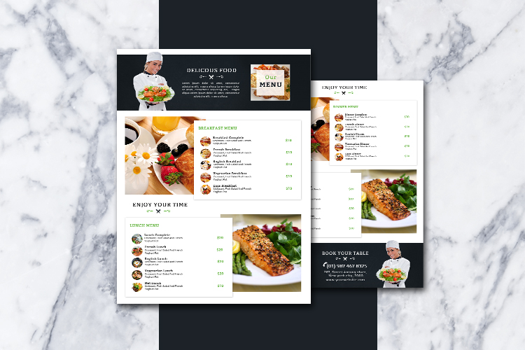
A Website is one or more Webpages that relate to a common theme. This set of pages goes together and the user is able to navigate from one page to the others via hyperlinks. Individual Webpages are linked together through a system of hyperlinks, enabling you to jump from one page to another by clicking on the links. Websites are nonlinear. In other words, you can navigate through the content pages in any order you wish.

Slide 6
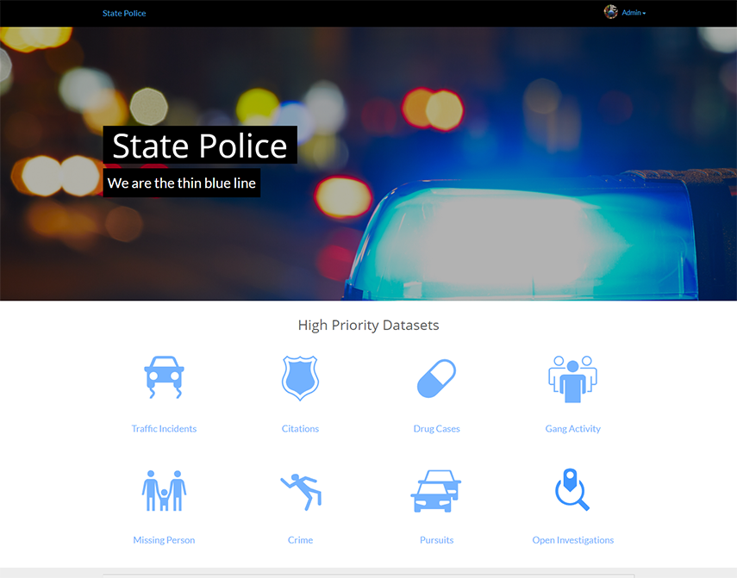
How a web page look like?
The first page of any Website is called the homepage. Think of a homepage as the starting point of a Website. Like the table of contents of a book or magazine, the homepage usually provides an overview of what you'll find at the Website. It acts as an index, often indicating the content of the entire Website. A Website can have one page or many. If there isn't a lot of information to convey, the homepage may be the only page of the Website. However, usually you will find at least a few other pages associated with the homepage.

Slide 7
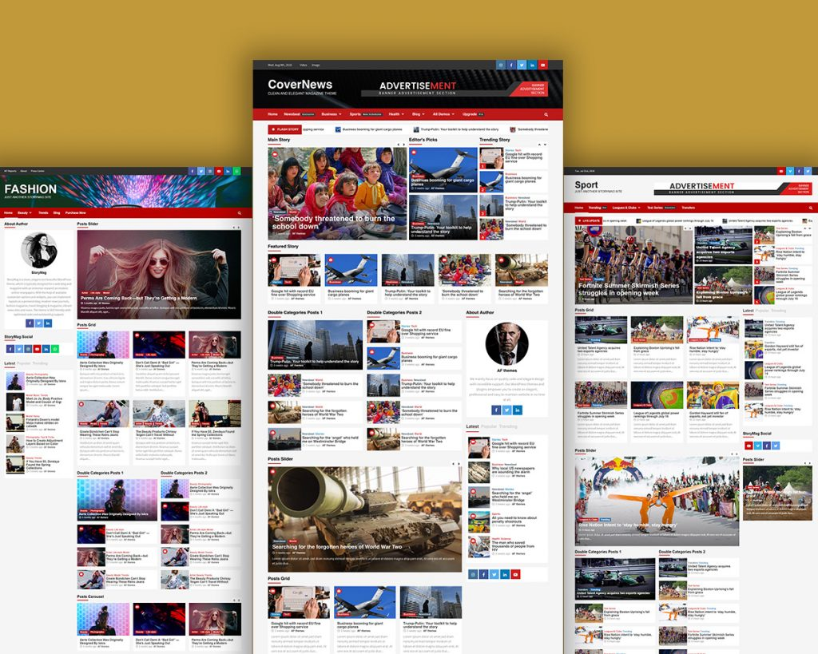
Webpages vary dramatically in terms of both design and content, but many use a traditional magazine-style format. At the top of the page is a masthead or banner graphic. Below the banner you usually find a list of content items, often with brief descriptions. These items usually link to other pages on the site, or to other, external sites. Sometimes these links are highlighted words in the body of the text, or are arranged in a list, like an index. They can also be a combination of both. A Webpage may also have images that link to other content.

