Slide 1
AN INTRODUCTION TO MOVEMENT chapter2
Dr. ATIF MALIK

Slide 2
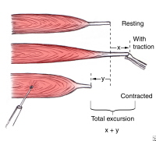
Range of muscle work
Muscle excursion
The amount of shortening or lengthening possible during movement
Muscle excursion is estimated to be 50% of the muscle maximum extended length

Slide 3
Full range
Maximum amount of lengthening possible
Any excursion which falls short of this is called Inner, Outer or Middle Range

Slide 4
The inner range
The part nearest to the point at which the muscle is in its shortest position

Slide 5
The Outer range
The part nearest to the point at which the muscle is most fully extended

Slide 6
Middle range
Muscle is neither fully shortened nor fully extended

Slide 7
The Strength of muscle contraction

Slide 8
Muscle ability to generate tension (intramuscular tension)
Varies in proportion to tension exerted by forces oppose its action
Strength is made possible by system of motor units

Slide 9
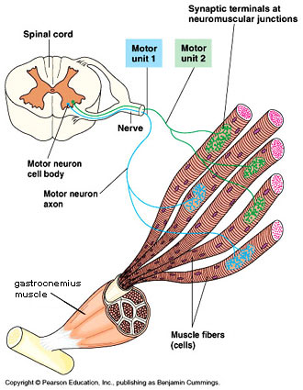
Motor unit
Consist of a single neuron, and group of muscle fibers it supplies
When the unit is activated by stimulation of its cell (anterior horn cell) all its fibers contract

Slide 10
Each muscle is made up of fibers of considerable motor units
The strength of contraction depends on number of motor units activated at any one time

Slide 11
Number of motor units activated is directly proportional to strength of muscle contraction
Weak contraction require few motor units to be activated
Strong contraction require more motor units activated
Maximal contraction is obtained when fibers of its all motor units are contracting

Slide 12
The group action of muscles

Slide 13
A single muscle can work alone to produce a particular movement or to secure stability
Functionally, muscles work together in groups
Each muscle has some specific part to play
Integrated activity of many groups is required to produce efficient functional movement

Slide 14
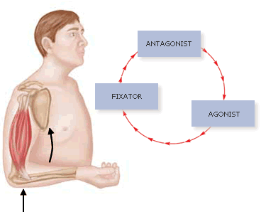
Agonist (prime movers)
They contract to provide force required to produce movement

Slide 15
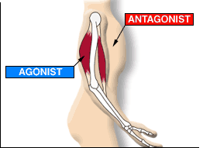
Antagonist
Their action would oppose the action of agonists
Their activity is inhibited and relax to allow movement

Slide 16
Synergist
Syn-Greek-With
They work with agonists
Provide suitable background of activity
Facilitate movement
Modify direction of movement
Control joints which are not involved (in case of 2 joint muscle)

Slide 17
Fixator
Stabilize the bone of origin
Increase the efficiency of agonist
Stabilize the body as a whole

Slide 18
Pattern of movement
Site and direction of movement are described as pattern of movement
Functional movement require involvement of several joints

Slide 19
Timing of movement

Slide 20
Timing of movement
Sequence of muscular contraction which take place to produce movement
Each contraction is timed, so that it is on its maximum when subsequent force superimposed

Slide 21
Poor timing
There is waste of energy if timing is too slow or too fast
It accounts for inefficiency of movement for the purpose for which it is designed
E.g. swimming, golf playing, cricket

Slide 22
Good timing
Good timing proceeds from distal to proximal
Because distal areas receive most of stimuli and control movement
Smooth and orderly sequence of contraction result in coordinated movement

Slide 23
Rhythm of movement

Slide 24
Rhythm of movement
Regular beat, recurrence of movement

Slide 25
Rhythm of involuntary muscles
Inspiratory and heart muscles contract rhythmically throughout the life
With period of rest and contraction

Slide 26
Rhythm of skeletal muscles
Skeletal muscles can also contract rhythmically for longer time
Provided their contraction alternate with period of complete rest for
Replenishment with blood supply bringing oxygen and removing metabolic products
Rhythm of work and rest reduce fatigue
Hiker walker walk rhythmically

Slide 27
Natural rhythm
Each individual has its own rhythm
Varied with age
Children has quicker rhythm
And elderly has slower

Slide 28
Poor rhythm
Rhythmical movement taken too slowly or too quickly results in
Faulty timing
Loss of efficiency
Increase in muscle work
Diminution of range of movement

Slide 29
Nervous control of movement

Slide 30
Motor unit
Functional unit of NM system
Motor unit is activated by stimulation of its cell: A.H.C
A.H.C are stimulated by the impulses which reach them from many sources from CNS
Some of these are excitatory and other are inhibitory
Dominance of one result in consequent results

Slide 31
.
Pattern of movement is planned
Voluntary movement Is performed in response to conscious effort
Reflex movement is performed in response to demand made by sensory stimulation

