Slide 1
Plant cell organelles

Slide 2
Nucleus and Nucleolus

Slide 47
Chloroplasts

Slide 48
Types of plastids
Thr term plastid was used by Schimper in 1885 and he classified plastids as following
Leucoplast
Leuco means white plast means living
Colourless plastids are found in embryonic and germ cells
Found in those regions of the plant which are not receiving light
They store carbohydrate, lipids and protein
And they are of following types
Amyloplast
Elaioplast
Proteinoplast/Aleuroplast

Slide 49
Protein_Aleuroplast
Starch_Amyloplast
Oil_Elaioplast
Aleuroplast –A leucoplast type of plastid that is involved in storage of protein
Amyloplast_Double-enveloped organelles in plant cells involved in various biological pathways, colorless, non pigment containing plastids
Elaioplast-Primarily involved in storing fats or lipids inside fat droplets in plants

Slide 50
Chromoplast
Chroma means “colour” and plast means “living”
They are the coloured plastids containing carotenoids and other pigments.
They impart colour ( yellow, orange and red) to certain portion of plants such as flower petals (rose) fruits (tomato),roots (carrot)
Two types Phaeoplast and Rhodoplast

Slide 51
Chloroplasts
Chloro means “green” and plast means “living”
They are found mostly in the green algae and plants .
They contain pigments like chlorophyll-a and chlorophyll-b and DNA and RNA
Chlorophyll is essential for photosynthesis, the process by which plants make food

Slide 52
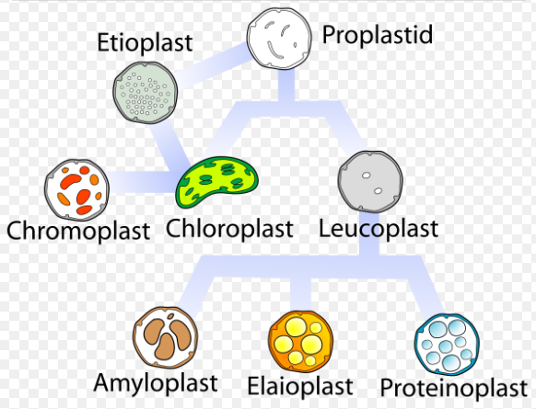

Slide 53
Historical
Chloroplast was describes as early as seventeenth century by Nehemiah Grew and Antoni van Leuwenhoek
The term plastid was used by Schimper in 1885 he also classified the plastids of plant
A Meyer, F. Schmitz and A.F.W Schimper showed that chloroplasts always arise from pre-existing chloroplast
Wilstatter and Stoll isolated and characterized green pigments-chlorophyll A and B
Julius sachs showed that chlorophyll is confined to chloroplast not distributed throughout the plant cell
J

Slide 54
What is a chlorplast?
Chloroplasts are the organelles present within plants and algae which carry out photosynthesis,where solar enegy is utilized to fix CO2 to synthesize carbohydrates.In this process oxygen is releases
Chloroplast are type of plastid
Shape varies
Contain their own genome
They show maternal inheritence

Slide 55
Site of photosynthesis
Double outer membrane
Inner membrane folded into stacks (granna)
Stroma (fluid interior)
Owns DNA and ribosomes

Slide 56
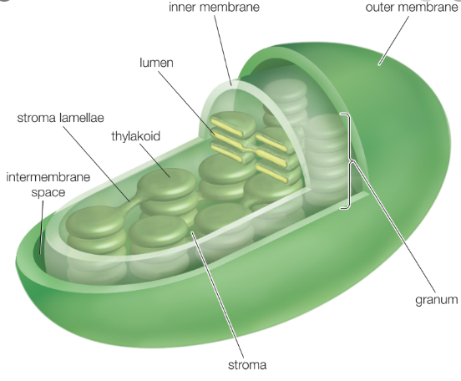

Slide 57
Distribution
The chloroplasts remain distributed homogeneously in the cytoplasm o plant cell
The algae usually have a single huge chloroplast the cells of higher plant have 20-40 chloroplast
If the number of chloroplast is inadequate, it is increased by division when excessive, it is reduced by degeneration

Slide 58
Ultrastructure of chloroplast
Envelope
The entire chloroplast is bounded by an envelope which is made of a double unit membranes
Across this double membrane envelope exchange of molecules between chloroplast and cystol occurs
Stroma
The matrix or stroma fills most of the volume of the chloroplast and is a kind of gel-fluid phase that surrounds the thylakoids

Slide 59
It contains proteins, ribosomes and DNA
It is the site of CO2 fixation and where the synthesis of sugar, starch, fatty acids and some proteins occurs
Thylakoids
The thylakoids consists of flattened and closed vesicles arranged as a membrane network
Thylakoids may be stacked like a net pile of coins forming grana
There my be 40-60 granna in the matrix of a chloroplast
Light reaction occurs in thylakoids membrane

Slide 60
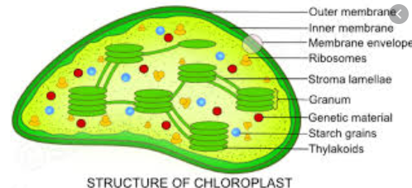

Slide 61
Chloroplast-can divide themselves
Semi autonomous
Moving, changing shape and dividing
Can reproduce by pinching in two

Slide 62
Chloroplast as semiautonomous organelle
Like the mitochondria the chloroplast have their own DNA, RNA and protein synthetic machinery
DNA of chloroplast
Ris and plant (1962) reported DNA in chloroplast
Chloroplast DNA is double heliical circle with an average length of 45 micro metre (about 135,000bp)
Ribosomes
Ribosomes of chloroplast are smaller than cytoplasmic ribosme

Slide 63
Cytoplasmic ribosome is of 70S type
And this resembles with the bacterial ribosomes
Contain t-RNA
Protein synthesis
DNA of chloroplast codes for chloroplast mRNA, rRNA, tRNA and ribosomal proteins

Slide 64
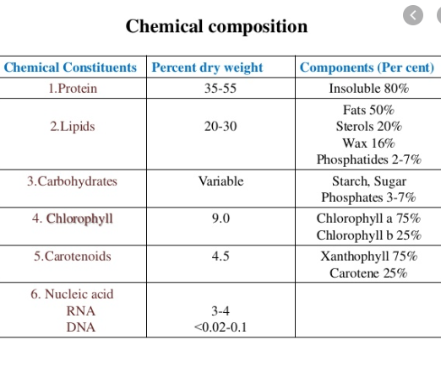

Slide 65
Chloroplast also contains some metallic ions like Fe,Cu,Mn and Zn

Slide 66
Biogenesis of chloroplast
The chloroplasts never originates de novo
Chloroplast multiply by fission a process that implies growth of daughter organelles
During the development of the chloroplast the first structure to appear is the so-called proplastid
Proplastid is then develops into chloroplast

Slide 68
The symbiotic origin of chloroplast
Chloroplast divide, grow and differentiate; they contain circular DNA,ribosoal RNA, messenger RNA and are able to conduct protein synthesis
By visualizing the similarities between micro-organisms and chloroplast it has been suggested that chloroplast might have relationship between autotrophic micro-organism
But some of the enzymes of chloroplast are coded by nuclear genes so there still exist certain doubt about the symbiotic origin of chloroplast (kirk, 1966)

Slide 69
Function of chloroplast:Photosynthesis
Process of photosynthesis consists of the following two steps
Light reaction
Also known as Hill reaction, photosynthetic electron transfer reaction or photochemical reaction
In light reaction solar energy is trapped in the form of chemical energy of ATP and NADPH
During it oxygen is evolved by photolysis

Slide 70
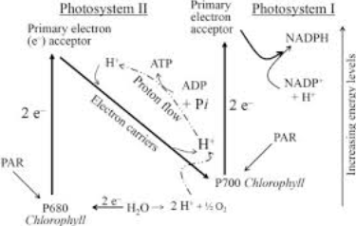

Slide 71
Dark reaction
Also known as Calvin cycle, photosynthetic carbon reduction cycle, carbon fixation reaction or thermochemical reaction
Reducing capacity of NADPH and energy of ATP is utilized for the conversion of carbon dioxide to carbohydrate
Occurs in the stroma

Slide 72
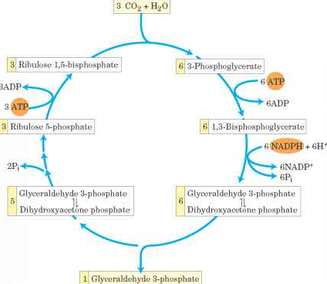

Slide 73
Endosymbiotic theory
According to this theory several organelles of eukaryotes originated as symbiosis between separate single celled organisms
Cyanobacteria is considered the ancestor of chloroplasts
The new cellular resident provided the food for host, hence weren’t eliminated
Can be divided into three lineages:
Glaucophyte, Red algal and Green chloroplast

Slide 74
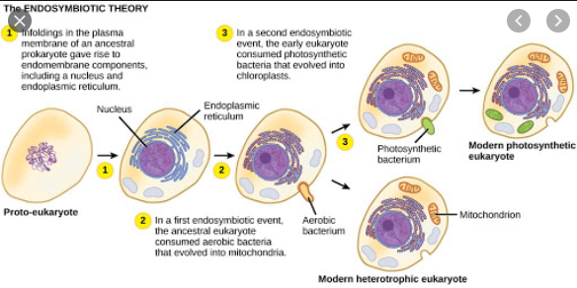

Slide 75
Genome
Contains their own genome, called ctDNA
Earlier thought to be circular but now considered mostly linear, size is 120kbp to 170kbp
Distributed in several clusters called nucleoid
Most of the genes have been transferred to the host nucleus
Proteins contain parts both from nuclear and chloroplast encoded genes

Slide 76
Protein translocation
The vast majority of chloroplast proteins are imported from the cytosol
The outer and inner envelop membranes contain distinct translocation complexes (Toc and Tic complexes, respectively)
Chaperones aid in the unfolding of the polypeptides in the cytosol and folding of the proteins in the chloroplast
Most proteins destined for the chloroplast are synthesized with a removable N-terminal signal sequence (termed the transit peptide)

Slide 77
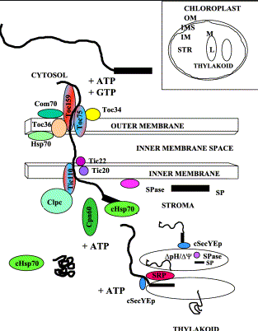

Slide 78
Endoplasmic reticulum

Slide 79
CELL?
The cell (from Latin cella, meaning "small room") is the basic structural, functional, and biological unit of all known organisms. A cell is the smallest unit of life. Cells are often called the "building blocks of life". The study of cells is called cell biology, cellular biology, or cytology.
Cells consist of cytoplasm enclosed within a membrane, which contains many biomolecules such as proteins and nucleic acids. Most plant and animal cells are only visible under a microscope.

Slide 80
Cells were discovered by Robert Hooke in 1665.
Cell consist of many organelles and one of them is Endoplasmic Reticulum which discuss as following:

Slide 81
Endoplasmic reticulum
The endoplasmic reticulum (ER) is a type of organelle made up of two subunits:–
Rough endoplasmic reticulum (RER).
Smooth endoplasmic reticulum (SER).
The endoplasmic reticulum is found in most eukaryotic cells and forms an interconnected network of flattened, membrane-enclosed sacs known as cisternae (in the RER), and tubular structures in the SER. The membranes of the ER are continuous with the outer nuclear membrane.

Slide 82
The endoplasmic reticulum is not found in:
red blood cells or
spermatozoa.
The two types of ER share many of the same proteins and engage in certain common activities such as the synthesis of certain lipids and cholesterol. Different types of cells contain different ratios of the two types of ER depending on the activities of the cell.

Slide 83
History:-
The ER was observed with light microscope by Garnier in 1897, who coined the term "ergastoplasm".
With electron microscopy, the lacy membranes of the endoplasmic reticulum were first seen in 1969 by Keith R. Porter, Albert Claude, and Ernest F. Fullam.
Later, the word "reticulum", which means "network", was applied by Porter in 1953 to describe this fabric of membranes.

Slide 84
Structure:-

Slide 85
Structure….
1 Nucleus
2 Nuclear pore
3 Rough endoplasmic reticulum (RER)
4 Smooth endoplasmic reticulum (SER)
5 Ribosome on the rough ER
6 Proteins that are transported
7 Transport vesicle
8 Golgi apparatus
9 Cis face of the Golgi apparatus
10 Trans face of the Golgi apparatus
11 Cisternae of the Golgi apparatus

Slide 86
Structure….
The general structure of the endoplasmic reticulum is a network of membranes called cisternae. These sac-like structures are held together by the cytoskeleton. The phospholipid membrane encloses the cisternal space (or lumen), which is continuous with the perinuclear space but separate from the cytosol.

Slide 88
Rough endoplasmic reticulum:-
The surface of the rough endoplasmic reticulum (often abbreviated RER or Rough ER) (also called granular endoplasmic reticulum) is studded with protein-manufacturing ribosomes giving it a "rough" appearance (hence its name).
The binding site of the ribosome on the rough endoplasmic reticulum is the translocon.

Slide 89
RER…
However, the ribosomes are not a stable part of this organelle's structure as they are constantly being bound and released from the membrane.
A ribosome only binds to the RER once a specific protein-nucleic acid complex forms in the cytosol. This special complex forms when a free ribosome begins translating the mRNA of a protein destined for the secretory pathway.

Slide 90
RER….
The membrane of the rough endoplasmic reticulum forms large double-membrane sheets that are located near, and continuous with, the outer layer of the nuclear envelope. The double membrane sheets are stacked and connected through several right- or left-handed helical ramps, the "Terasaki ramps", giving rise to a structure resembling a multi-story car park.

Slide 91
RER….
Although there is no continuous membrane between the endoplasmic reticulum and the Golgi apparatus, membrane-bound transport vesicles shuttle proteins between these two compartments. Vesicles are surrounded by coating proteins called:
COPI and
COPII.
COPII targets vesicles to the Golgi apparatus and
COPI marks them to be brought back to the rough endoplasmic reticulum.

Slide 92
RER….
The rough endoplasmic reticulum works in concert with the Golgi complex to target new proteins to their proper destinations.
The second method of transport out of the endoplasmic reticulum involves areas called membrane contact sites, where the membranes of the endoplasmic reticulum and other organelles are held closely together, allowing the transfer of lipids and other small molecules.

Slide 93
Functions of RER:-
Rough endoplasmic reticulum has a number of functions:
One of the main functions of the rough endoplasmic reticulum is to produce and process specific proteins. These are the exported through the secretory pathway. After they are exported via membrane vesicles, they can be sent to the Golgi Apparatus to be further processed or to organelles. They can even be exported to outside the cell and into another part of the body.

Slide 94
Continue….
In certain leukocytes (white blood cells)
The rough ER produces antibodies
In pancreatic cells, the rough ER produces insulin.

Slide 95
Smooth endoplasmic reticulum:-
The smooth endoplasmic reticulum consists of tubules, which are located near the cell periphery. This network increases the surface area for the storage of key enzymes and the products of these enzymes.

Slide 96
SER Functions:-
The smooth ER has a wide range of functions:
including carbohydrate and lipid synthesis. Lipids such as phospholipids and cholesterol are necessary for the construction of cell membranes.
Smooth ER also serves as a transitional area for vesicles that transport ER products to various destinations.
In liver cells the smooth ER produces enzymes that help to detoxify certain compounds.
In muscles the smooth ER assists in the contraction of muscle cells, and in brain cells it synthesizes male and female hormones.

Slide 97
Sarcoplasmic reticulum:-

Slide 98
Skeletal muscle fiber, with sarcoplasmic reticulum colored in blue.
The sarcoplasmic reticulum (SR), from the Greek sarx ("flesh"), is smooth ER found in myocytes.
The only structural difference between this organelle and the smooth endoplasmic reticulum is the medley of proteins they have, both bound to their membranes and drifting within the confines of their lumens.

Slide 99
Difference…
This fundamental difference is indicative of their functions:
The endoplasmic reticulum synthesizes molecules, while the sarcoplasmic reticulum stores calcium ions and pumps them out into the sarcoplasm when the muscle fiber is stimulated. After their release from the sarcoplasmic reticulum, calcium ions interact with contractile proteins that utilize ATP to shorten the muscle fiber. The sarcoplasmic reticulum plays a major role in excitation-contraction coupling.

Slide 100
Transitional ER:-
In most cells the smooth endoplasmic reticulum (abbreviated SER) is scarce.
Instead there are areas where the ER is partly smooth and partly rough, this area is called the transitional ER.
The transitional ER gets its name because it contains ER exit sites. These are areas where the transport vesicles that contain lipids and proteins made in the ER, detach from the ER and start moving to the Golgi apparatus.

Slide 101
FUNCTIONS….
Specialized cells can have a lot of smooth endoplasmic reticulum and in these cells the smooth ER has many functions.
It synthesizes lipids, phospholipids, and steroids.
Cells which secrete these products, such as those in the testes, ovaries, and sebaceous glands have an abundance of smooth endoplasmic reticulum.
It also carries out the metabolism of carbohydrates, detoxification of natural metabolism products and of alcohol and drugs, attachment of receptors on cell membrane proteins, and steroid metabolism.
In muscle cells, it regulates calcium ion concentration.

Slide 102
Plants Cell:-

Slide 104
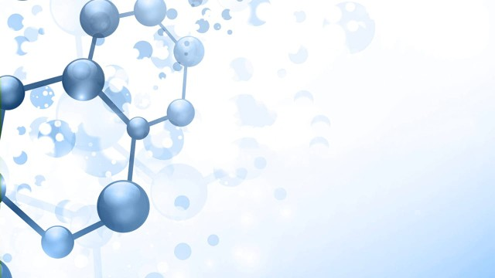
Ribosomes

Slide 105
History & Discovery
Albert claude showed that the cytoplasmic RNA was included in tiny particles of ribonucleoprotein later to be called “ribosomes”
George Palade in 1952, described the ribosomes
In 1958, the papers presented at a meeting of biophysical society at the Massachusetts institute of technology were published in a book form
R.B. Roberts edited this collection of papers and coined the name ribosomes in his introductory comments

Slide 106
Tissieres and Watson in 1958, isolated 70S E.coli ribosomes and showed that they consists of two subunits, 50S and 70S
Recently, various workers such as Lake, Nomura, Wittman, Traut, Stoffler etc have studied the relationship between rRNA and ribosomal proteins to work out the topology of ribosomes ( topology include study of detailed shape and positions of the individual proteins and rRNA molecules relative to each other)

Slide 107
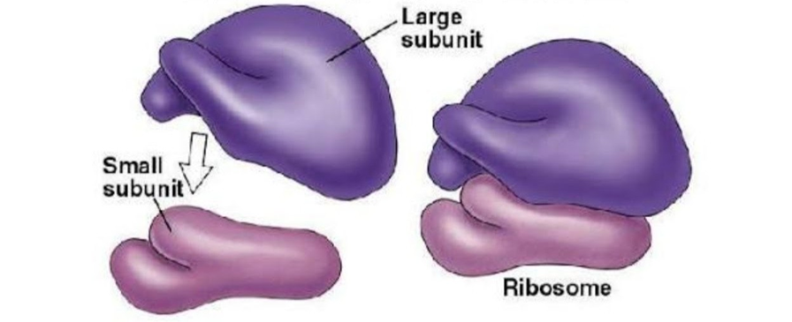
Definition
Cell organelle consisting of proteins and RNA and function as protein synthesizer
A ribosome complex is made up of different ribosomal subunits

Slide 108
Occurrence & Distribution
Ribosomes are small organelles found in each type of cell i.e.
Prokaryotic
Eukaryotic
In prokaryotic cells, the ribosomes often occur freely in the cytoplasm
In eukaryotic cells, the ribosomes either occur freely in the cytoplasm or remain attached to the outer surface of the membrane of endoplasmic reticulum
These are not membrane bounded

Slide 109
The cells in which active protein synthesis take place, the ribosomes remain attached with the membrane of the endoplasmic reticulum
Such cells are pancreatic cells, plasma cells, thyroid cells and mammary gland cells
The cells which synthesize specific proteins for the intercellular utilization and storage often contain large number of ribosomes
such cells are the erythroblasts, developing muscle cells, skin and hair

Slide 110
Number
The number of ribosomes differ greatly
A E.coli cell may have 10,000 ribosomes, forming 25% of the total mass of the bacterial cell
In contrast, mammalian culture cell contain 10 million ribosomes per cell, each of which is twice as large as a prokaryotic ribosome

Slide 111
Domains of ribosomes
There are two domains of ribosomes
Translational domain:
The region responsible for translation is called translational domain
Both subunits are contribute to this domain, located in the upper half of the small subunit and in the associated areas of large subunit
Exit domain:
The growing peptide chain emerge from the large subunit at the exit domain
This is located on the side of subunit

Slide 112
Structure of ribosomes
A ribosome has two main constituent elements
Proteins = 25-40%
RNA = 37 – 62%
Two main subunits are present i.e.
A larger subunit
A smaller subunit

Slide 113
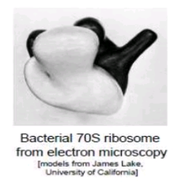
Structure of ribosomes
Prokaryotic subunits
Larger subunit = 50S
Smaller subunit = 30S
Total ribosomal complex = 70S

Slide 114
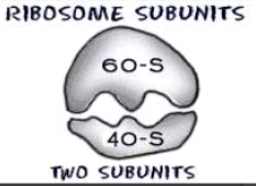
Structure of ribosomes
Eukaryotic subunits
Larger subunit = 60S
Smaller subunit = 40S
Total ribosomal complex = 80S

Slide 115
Svedberg Unit
The S in 70S or 80S stands for Svedberg units
The faster a particle travel when centrifuged, the greater its Svedberg value
The sedimentation coefficient is a function of a particles molecular weight, volume and shape
Heavier and more compact particles normally have larger Svedberg numbers

Slide 116
TYPES OF RIBOSOMES
There are two types of ribosomes
70S Ribosomes
80S Ribosomes

Slide 117
1: 70S Ribosomes
The 70S ribosomes are comparatively smaller in size and have sedimentation coefficient 70S and the molecular weight 2.7 *10⁶
daltons (Dalton is unit of molecular weight)
These are constructed by 50S and 30S subunits
They occur in the prokaryotic cells of the blue green algae and bacteria
Also occur in mitochondria and chloroplast of eukaryotes

Slide 118
2: 80S Ribosomes
The 80S ribosomes have the sedimentation coefficient of 80S and the molecular weight 40 * 10⁶ daltons
the 80S ribosomes occur in eukaryotic cells of the plants and animals
The ribosome of mitochondria and chloroplast are always smaller than 80S cytoplasmic ribosomes and are comparable to prokaryotic ribosomes in both size and sensitivity to antibiotics, although their sedimentation value very in different phyla

Slide 119
E.g. 77S in mitochondria of fungi,
60S in mitochondria of mammals,
The ribosomes of chloroplast are 70S types

Slide 120
Structure Of Larger Subunit
Consists of two RNA strands
A longer and a shorter strand wrap upon each other
Strands are dotted with protein coats
Proteins often glue RNA strands in their characteristic shape

Slide 121
Structure Of smaller Subunit
Consist of a single RNA strand
It is also covered with a protein coat
Smaller subunit though smaller than the larger subunit, is quite enormous than the normal proteins

Slide 122
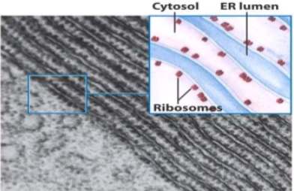
Location
Ribosomes can be found either:
Dispersed freely in the cytosol
Attached to the surface of endoplasmic reticulum

Slide 123
Types On The Basis Of Location
On the basis of location, ribosomes are divided into two types:
Free ribosomes
Bounded ribosomes

Slide 124
Free Ribosomes
These ribosomes are found freely dispersed in the cytosol
They are involved in the synthesis of proteins that work inside the cytosol
They vary in number depending upon the functionality of the cell types and its need to synthesize proteins

Slide 125
Bounded ribosomes
They are found attached to the surface of endoplasmic reticulum making the “rough endoplasmic reticulum”
The proteins assembled in these ribosomes are either transported to the outside of the cell or are included in the cell membrane

Slide 126
Function
Main function of ribosomes is the translation of genetic information encoded in nucleotide bases of DNA into amino acid sequence of proteins
This is also known a gene expression

Slide 127
Translation
The two ribosomal subunits join to translate the mRNA into proteins
Following are the steps of translation
Initiation
Elongation
Termination

Slide 128
Effects of antibiotics on protein synthesis
Several antibiotics work by inhibiting protein synthesis on prokaryotic ribosomes
Antibiotic such as streptomycin and gentamicin attach to the 30S subunit and interfere with protein synthesis
Other antibiotics, such as erythromycin and chloramphenicol, interfere with protein synthesis by attaching to the 50S subunit

Slide 129
Ribosomes associated diseases
During overburdening or stress condition of endoplasmic reticulum and thus ribosomes present on them function properly
This improper functioning is characterized by improper folding of protein
As proper characteristic final folding of proteins determine their functioning

Slide 130
Improper folding disrupts the normal functioning of proteins causing a number of deadly diseases
Some of such diseases are:
Diabetes
Cystic fibrosis
Neurodegenerative disorders
And other disorders

Slide 131
Latest researches
According to Alexander Mankin:
“The ribosomes is one of the most complex molecular machines in the cell”

Slide 132
His discoveries are:
The ribosome is responsible for activating some antibiotic resistant genes in the presence of certain proteins
Under normal conditions, the ribosome’s catalytic centre can accept any of the 20 natural amino acids, which are then added to the growing protein chain

