Slide 1
Nervous Regulation of Circulation
It affects redistribution of blood flow to different areas of body, increases pumping activity of heart and provides very rapid control of arterial pressure.
Nervous regulation is achieved by autonomic (sympathetic & parasyrnpathetic) nervous system.

Slide 2
Role of Parasympathetic Nervous System in Nervous Control of Blood Flow
Parasympathetic nervous system has minor role in nervous control of blood flow. It affects heart only not blood vessels.
Parasympathetic stimulation causes decrease in heart rate and contractility, causing blood flow to decrease.

Slide 3
Role of Sympathetic Nervous System in Nervous Control of Blood Flow
Sympathetic nervous system has major role in nervous control of blood flow.
Heart and all blood vessels are innervated by sympathetic vasoconstrictor and vasodilator fibers.

Slide 4
Role of Sympathetic Nervous System in Nervous Control of Blood Flow
Stimulation of sympathetic vasoconstrictor fibers causes constriction of blood vessels inc. tone in vessel wall, Inc. arterial pressure, Inc. heart rate & Inc. blood flow.
Stimulation of sympathetic vasodilator fibers (in skeletal muscle) at onset of exercise A vasodilation Anticipating increase in blood flow.

Slide 5
Vasomotor Center
"Sympathetic control of circulation is achieved by an area in brain called vasomotor center".
Location
Bilaterally in reticular substance of medulla and
lower port.

Slide 6
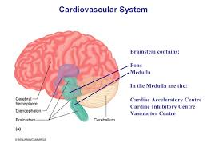

Slide 7
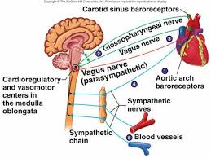

Slide 8
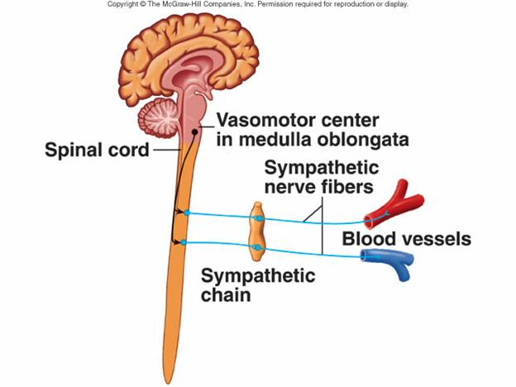

Slide 9
Vasomotor Center
Parts
It consists of three parts
Vasoconstrictor Area or Area C-I
Location
Bilaterally in anterolateral portion ol upper medulla and lower pons.
Function its neurons secrete norepinephrine and excite vasoconstrictor nervous system to cause vasoconstriction.

Slide 10
Vasomotor Center
Vasodilator Area or Area A-l.
Location Bilaterally in anterolateral portion of lower half of medulla.
Function Its neurons secrete norepinephrine and inhibit vasoconstrictor area to cause vasodilation of blood vessels.

Slide 11
Vasomotor Center
Sensory Area (A-2)
Location Bilaterally in tractus solitarius in posterolateral portion of medulla and lower pons
Function
Its neurons receive sensory signals from vagus & glossopharyngeal nerves, & output signals from sensory area provide "reflex" control of many circulatory functions, e.g Baroreceptor reflex.

Slide 12
Vasomotor Center
Control of Vasomotor Center By Higher Nervous Centers
Reticular Substance of Pons, Mesencephalon & Diencephalon
Lateral & superior portions of reticular substance cause excitation of vasomotor center
Medial & inferior portions of the reticular substance cause inhibition of vasomotor center

Slide 13
Vasomotor Center
Hypothalamus
Posterolateral portion of hypothalamus cause excitation of vasomotor center
Anterior part of hypothalamus can cause mild excitation or inhibition of vasomotor center

Slide 14
Vasomotor Center
Cerebral Cortex
Motor cortex excites vasomotor center (hi Anterior temporal lobe, Orbital areas of frontal cortex Ant. part of cingulate gyrus, Amygdala, Septum & Hippocampus can excite or inhibit vasomotor center

Slide 15
Vasomotor Center
Factor Affecting Vasomotor Center or Vasoconstrictor Area
Excitatory factors CO₂ , Hypoxia , excitatory signals from cerebral cortex via hypothalmus , Pain , Signals from chemoreceptors.
Inhibitory Factors , Signals from lung stretch receptors , Inhibitory signals from cortex, via hypothalamus , Signals from baroreceptors

Slide 16
Vasomotor Tone
"Partial state of contraction in blood vessels caused by continual slow firing of vasoconstrictor area is called vasomotor lone“.

Slide 17
Vasomotor Tone
Significance
Vasomotor tone maintains arterial pressure at normal level and prevents its fall

Slide 18
Vasovagal Syncope
Emotional Fainting or Vasovagal Syncope
"Fainting (Syncope) due to intense emotional experiences, is called emotional fainting or vasovagal syncope".

