Slide 1
Wind as an ecological factor

Slide 6
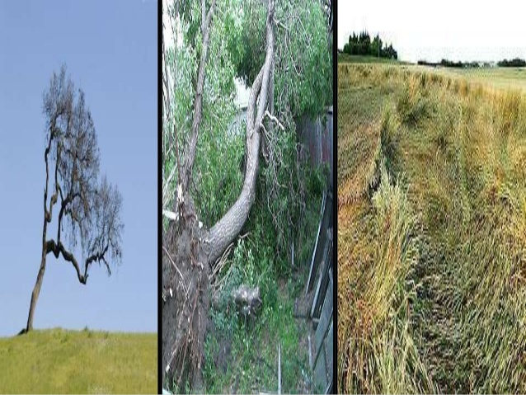

Slide 13
Wind as an ecological factor an disturbance agent
Wind is essential to precipitation , crucial for all type of forest ecosystem.
Wind affects evaporation, transpiration ,spatial disturbance of snow and regulate temperature and moisture regime in forest.
In arid region with areolation sand soil ,wind cause intense erosion and may sub Stanly modify the relief.

Slide 15
Wind contributes to the transpiration of industrial pollutant , some of which affect tree health.
Wind has long been regarded as an ecological factor in forests owing to the dramatic damage hurricanes can wreak.
A relatively large amount is known about to acclimation of tree to wind but less intra or interspecific adaptation in high winds.

Slide 16
These changes results from the effects of wind may have the greater effect on ecology of forests than the more acute effects of destructive storms.
Mechanical effects of wind helps in forest:
Manage their plantation.
Better for local and geographical variation in ecology factor.

Slide 17
Main Ecological Factors
The ecological factors that affect the growth of plants and determine the nature of plant communities are divided into three parts:
Climatic Factors which include:
Rainfall
Atmospheric humidity
Wind
Temperature
light

Slide 18
Physiographic Factor are include:
Effects of steepness.
Sunlight on vegetation and direction of slopes.
Biotic Factors:
Inter relationship b/w plants and animal.
Inter relationship b/w soil micro organism and plant.

Slide 19
Effect of wind
Wind as an factor:
Effect both directly and indirectly;
Direct effect on violent winds.
Violent winds break off twigs ,branches of plant and even uproot the tree and shrubs.
Prevents the growing of larger tree at certain height .
Vegetation such areas have a prostrate habit growth and underground root and rhizome system.

Slide 20
Larger plants which are offtenexposed by voilent wind has following character
Their trunks and branches are bent.
Branches is irregular.
The crown present a very peculiar shape.
Leaves are small than usual , sometime fast cold wind results in cushioned growth in plants e.g., Androsace Helvetica.
Some plants that grow in areas subjected to strong wind in all year round develop an over all shape that resistance to wind.

Slide 21
.
Growth is restricted on the side on which wind effect is most.
Its effect is quite common on sea cost.
Mountain plants as there the wind is more effective in killing buds.

Slide 22
Checking plant on windward side

