Slide 1
HISTORY OF EBPT

Slide 2
w
Term EBM was first introduced in 1992 By a team at Mc master uni , Canada
They produced a series of guides to help those teaching medicine to introduce the notion of finding, appraising and using high quality evidence to improve the effectiveness of the care given to patients
Appraisal: (assessment) classification of someone or something with respect to its worth
Notes:
Notion:idea
Appraisal: (assessment)The classification of someone or something with respect to its worth

Slide 3
MAIN DRIVER TO EBPT…
Gap b/w Research & Practice
Belief Vs sound information
1991 Director of Research & Development belief exert too much influence in health care
1980 clot bursting drugs & mortality
Still in 1990 not a routine Rx
Rapidly increasing volume of literature

Slide 4
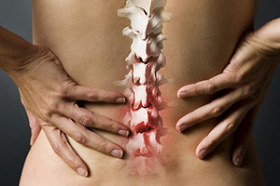
despite high quality evidence that showed bed rest was ineffective in the treatment of acute back pain, physicians were still advising patients to take to their beds (Cherkin et al 1995).

Slide 5
Rapidly increasing volume of literature
Concept about poor quality published research
Time issue
daily need for reliable information about diagnosis, prognosis, therapy and prevention

Slide 6
Early driver in EBPT
Department of Epidemiology at the University of Maastricht in the Netherlands.
Since the early 1990s this department has trained several ‘generations’ of excellent researchers who have produced an enormous
volume of high quality clinical research relevant to physiotherapy.
1999 PEDro

Slide 7
Importance for Patient
Offering safest & effective treatment
Expectation of best possible clinical outcomes
Demand of info about disease and treatment option
Internet source but for high quality need assistance
In some countries encouragement…….

Slide 8
For Physical Therapist
Profession?
Unique element is Trustworthiness
professionals strive to do good,
have the patient’s best interests at heart
high ethical standards
Practice informed by evidence ,to be called a professional.

Slide 9
Change in last 60 years
Autonomy…….responsibility
patients are given accurate diagnoses and prognoses, and are well-informed about benefits, harms and risks of intervention

Slide 10
Funders of Physical Therapy
Decisions on investment of health services need to be based on evidence (Gray 1997).

Slide 12
STEPS FOR PRACTISING EVIDENCE-BASED PHYSIOTHERAPY
Step 1 Convert information needs into answerable questions.
Step 2 Track down the best evidence with which to answer those questions.
Step 3 Critically appraise the evidence for its validity, impact and applicability.

Slide 13
Step 4 Integrate the evidence with clinical expertise and with patients’ unique biologies , values and circumstances.
Step 5 Evaluate the effectiveness and efficiency in executing steps 1–4 and seek ways to improve them both for next time.

Slide 14
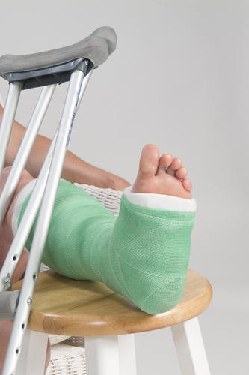
# fibula
1st advice subsiding swelling
Then cast for 6 weeks
2nd opinion using supportive bandage and Wt bearing till ankle hurts and so on.
How to judge b/w two clinical approach ???
>>Randomized clinical trials
Notes:
A clinical trial in which the participants are assigned randomly (by chance alone) to different treatments. randomized trials were for
people who were uncertain whether or not they were right, and he was certain that he was right!

Slide 15
Randomized clinical trials
Uncertainty
Control Group
Trial Group

