Slide 1
Data and Computer Communications
Chapter 8 – Multiplexing
Eighth Edition
William Stallings
Notes:
Lecture slides prepared by Dr Lawrie Brown (UNSW@ADFA) for “Data and Computer Communications”, 8/e, by William Stallings, Chapter 8 “Multiplexing”.

Slide 2
Multiplexing
Multiple links on 1 physical line
Common on long-haul, high capacity, links
Have FDM, TDM, STDM alternatives
Notes:
To make efficient use of high-speed telecommunications lines, some form of multiplexing is used. Multiplexing allows several transmission sources to share a larger transmission capacity. A common application of multiplexing is in long-haul communications. Trunks on long-haul networks are high-capacity fiber, coaxial, or microwave links. These links can carry large numbers of voice and data transmissions simultaneously using multiplexing. Common forms of multiplexing are frequency division multiplexing (FDM), time division multiplexing (TDM), and statistical TDM (STDM).
Stallings DCC8e Figure 8.1 depicts the multiplexing function in its simplest form. There are n inputs to a multiplexer. The multiplexer is connected by a single data link to a demultiplexer. The link is able to carry n separate channels of data. The multiplexer combines (multiplexes) data from the n input lines and transmits over a higher-capacity data link. The demultiplexer accepts the multiplexed data stream, separates (demultiplexes) the data according to channel, and delivers data to the appropriate output lines.

Slide 3
Frequency Division Multiplexing
Notes:
Frequency division multiplexing can be used with analog signals. A number of signals are carried simultaneously on the same medium by allocating to each signal a different frequency band. FDM is possible when the useful bandwidth of the transmission medium exceeds the required bandwidth of signals to be transmitted. A number of signals can be carried simultaneously if each signal is modulated onto a different carrier frequency and the carrier frequencies are sufficiently separated that the bandwidths of the signals do not significantly overlap. A general case of FDM is shown in Stallings DCC8e Figure 8.2a. Six signal sources are fed into a multiplexer, which modulates each signal onto a different frequency (f₁, …, f₆). Each modulated signal requires a certain bandwidth centered on its carrier frequency, referred to as a channel. To prevent interference, the channels are separated by guard bands, which are unused portions of the spectrum. The composite signal transmitted across the medium is analog. Note, however, that the input signals may be either digital or analog. In the case of digital input, the input signals must be passed through modems to be converted to analog. In either case, each input analog signal must then be modulated to move it to the appropriate frequency band.

Slide 4
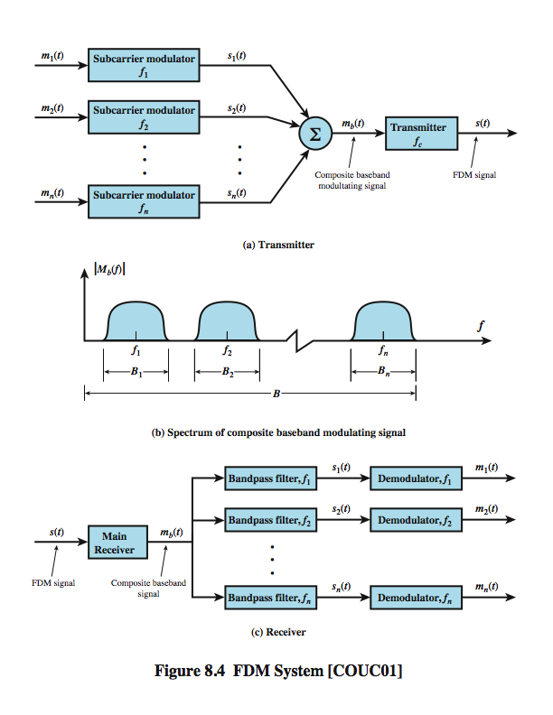
FDM System Overview
Notes:
A generic depiction of an FDM system is shown in Stallings DCC8e Figure 8.4. A number of analog or digital signals [m_{i}(t), i = 1, n] are to be multiplexed onto the same transmission medium. Modulation equipment is needed to move each signal to the required frequency band, and multiplexing equipment is needed to combine the modulated signals. Each signal m_{i}(t) is modulated onto a carrier f_{i}; because multiple carriers are to be used, each is referred to as a subcarrier. Any type of modulation may be used. The resulting analog, modulated signals are then summed to produce a composite baseband signal m_{b}(t). Figure 8.4b shows the result. The spectrum of signal m_{i}(t) is shifted to be centered on f_{i}. For this scheme to work, f_{i} must be chosen so that the bandwidths of the various signals do not significantly overlap. Otherwise, it will be impossible to recover the original signals. The composite signal may then be shifted as a whole to another carrier frequency by an additional modulation step. The FDM signal s(t) has a total bandwidth B = Sum B_{i} . This analog signal may be transmitted over a suitable medium. At the receiving end, the FDM signal is demodulated to retrieve m_{b}(t), which is then passed through n bandpass filters, each filter centered on f_{i} and having a bandwidth B_{i}, for 1 ≤ i ≤ n. In this way, the signal is again split into its component parts. Each component is then demodulated to recover the original signal.

Slide 5
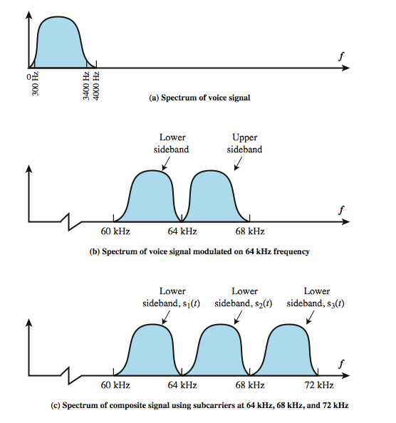
FDM Voice band Example
Notes:
Stallings DCC8e Example 8.2 illustrates a simple example of transmitting three voice signals simultaneously over a medium. As was mentioned, the bandwidth of a voice signal is generally taken to be 4 kHz, with an effective spectrum of 300 to 3400 Hz (Figure 8.5a). If such a signal is used to amplitude-modulate a 64-kHz carrier, the spectrum of Figure 8.5b results. The modulated signal has a bandwidth of 8 kHz, extending from 60 to 68 kHz. To make efficient use of bandwidth, we elect to transmit only the lower sideband. If three voice signals are used to modulate carriers at 64, 68, and 72 kHz, and only the lower sideband of each is taken, the spectrum of Figure 8.5c results.
This figure points out two problems that an FDM system must cope with. The first is crosstalk, which may occur if the spectra of adjacent component signals overlap significantly. In the case of voice signals, with an effective bandwidth of only 3100 Hz (300 to 3400), a 4-kHz bandwidth is adequate. The spectra of signals produced by modems for voice band transmission also fit well in this bandwidth. Another potential problem is intermodulation noise. On a long link, the nonlinear effects of amplifiers on a signal in one channel could produce frequency components in other channels.

Slide 6
Analog Carrier Systems
Long-distance links use an FDM hierarchy
AT&T (USA) and ITU-T (International) variants
Group
12 voice channels (4kHz each) = 48kHz
Range 60kHz to 108kHz
Super group
FDM of 5 group signals supports 60 channels
The resulting signal occupies 312 to 552KHz
Notes:
The long-distance carrier system provided in the United States and throughout the world is designed to transmit voice band signals over high-capacity transmission links, such as coaxial cable and microwave systems. The earliest, and still a very common, technique for utilizing high-capacity links is FDM. In the United States, AT&T has designated a hierarchy of FDM schemes to accommodate transmission systems of various capacities. A similar, but unfortunately not identical, system has been adopted internationally under the auspices of ITU-T (Table 8.1).
At the first level of the AT&T hierarchy, 12 voice channels are combined to produce a group signal with a bandwidth of 12 × 4 kHz = 48 kHz, in the range 60 to 108 kHz. The next basic building block is the 60-channel supergroup, which is formed by frequency division multiplexing five group signals. The subcarriers have frequencies from 420 to 612 kHz in increments of 48 kHz. The resulting signal occupies 312 to 552 kHz. The next level of the hierarchy is the mastergroup, which combines 10 supergroup inputs. The mastergroup has a bandwidth of 2.52 MHz and can support 600 voice frequency (VF) channels. Higher-level multiplexing is defined above the mastergroup, as shown in Table 8.1.
Note that the original voice or data signal may be modulated many times. Each stage can distort the original data; this is so, for example, if the modulator/multiplexer contains nonlinearities or introduces noise.

Slide 7
Analog Carrier Systems
Long-distance links use an FDM hierarchy
Coaxial cable and microwave systems
Master group
FDM of 10 super groups supports 600 channels (2.52 MHz bandwidth)
So original signal can be modulated many times
Notes:
The long-distance carrier system provided in the United States and throughout the world is designed to transmit voiceband signals over high-capacity transmission links, such as coaxial cable and microwave systems. The earliest, and still a very common, technique for utilizing high-capacity links is FDM. In the United States, AT&T has designated a hierarchy of FDM schemes to accommodate transmission systems of various capacities. A similar, but unfortunately not identical, system has been adopted internationally under the auspices of ITU-T (Table 8.1).
At the first level of the AT&T hierarchy, 12 voice channels are combined to produce a group signal with a bandwidth of 12 × 4 kHz = 48 kHz, in the range 60 to 108 kHz. The next basic building block is the 60-channel supergroup, which is formed by frequency division multiplexing five group signals. The subcarriers have frequencies from 420 to 612 kHz in increments of 48 kHz. The resulting signal occupies 312 to 552 kHz. The next level of the hierarchy is the mastergroup, which combines 10 supergroup inputs. The mastergroup has a bandwidth of 2.52 MHz and can support 600 voice frequency (VF) channels. Higher-level multiplexing is defined above the mastergroup, as shown in Table 8.1.
Note that the original voice or data signal may be modulated many times. Each stage can distort the original data; this is so, for example, if the modulator/multiplexer contains nonlinearities or introduces noise.

Slide 8
Wavelength Division Multiplexing
FDM with multiple beams of light at different frequencies
Carried over optical fiber links
Commercial systems with 160 channels of 10 Gbps
Lab demo of 256 channels 39.8 Gbps
Notes:
The true potential of optical fiber is fully exploited when multiple beams of light at different frequencies are transmitted on the same fiber. This is a form of frequency division multiplexing (FDM) but is commonly called wavelength division multiplexing (WDM). With WDM, the light streaming through the fiber consists of many colors, or wavelengths, each carrying a separate channel of data. Commercial systems with 160 channels of 10 Gbps are now available. In a lab environment, Alcatel has carried 256 channels at 39.8 Gbps each, a total of 10.1 Tbps, over a 100-km span.
A typical WDM system has the same general architecture as other FDM systems. A number of sources generate a laser beam at different wavelengths. Most WDM systems operate in the 1550-nm range. These are sent to a multiplexer, which consolidates the sources for transmission over a single fiber line. Optical amplifiers, typically spaced tens of kilometers apart, amplify all of the wavelengths simultaneously. Finally, the composite signal arrives at a demultiplexer, where the component channels are separated and sent to receivers at the destination point.
The term dense wavelength division multiplexing (DWDM) is often seen in the literature. There is no official or standard definition of this term. The term connotes the use of more channels, more closely spaced, than ordinary WDM. In general, a channel spacing of 200 GHz or less could be considered dense.

Slide 9
Wavelength Division Multiplexing
Architecture similar to other FDM systems
Multiplexer consolidates laser sources (1550nm) for transmission over single fiber
Optical amplifiers amplify all wavelengths
Demux separates channels at the destination
Also have Dense Wavelength Division Multiplexing (DWDM)
Notes:
The true potential of optical fiber is fully exploited when multiple beams of light at different frequencies are transmitted on the same fiber. This is a form of frequency division multiplexing (FDM) but is commonly called wavelength division multiplexing (WDM). With WDM, the light streaming through the fiber consists of many colors, or wavelengths, each carrying a separate channel of data. Commercial systems with 160 channels of 10 Gbps are now available. In a lab environment, Alcatel has carried 256 channels at 39.8 Gbps each, a total of 10.1 Tbps, over a 100-km span.
A typical WDM system has the same general architecture as other FDM systems. A number of sources generate a laser beam at different wavelengths. Most WDM systems operate in the 1550-nm range. These are sent to a multiplexer, which consolidates the sources for transmission over a single fiber line. Optical amplifiers, typically spaced tens of kilometers apart, amplify all of the wavelengths simultaneously. Finally, the composite signal arrives at a demultiplexer, where the component channels are separated and sent to receivers at the destination point.
The term dense wavelength division multiplexing (DWDM) is often seen in the literature. There is no official or standard definition of this term. The term connotes the use of more channels, more closely spaced, than ordinary WDM. In general, a channel spacing of 200 GHz or less could be considered dense.

Slide 10
Synchronous Time Division Multiplexing
Notes:
Synchronous time division multiplexing can be used with digital signals or analog signals carrying digital data. In this form of multiplexing, data from various sources are carried in repetitive frames. Each frame consists of a set of time slots, and each source is assigned one or more time slots per frame. The effect is to interleave bits of data from the various sources. The interleaving can be at the bit level or in blocks of bytes or larger quantities. For example, the multiplexer in Stallings DCC8e Figure 8.2b has six inputs that might each be, say, 9.6 kbps. A single line with a capacity of at least 57.6 kbps (plus overhead capacity) could accommodate all six sources.
Synchronous TDM is called synchronous not because synchronous transmission is used, but because the time slots are preassigned to sources and fixed. The time slots for each source are transmitted whether or not the source has data to send.

Slide 11
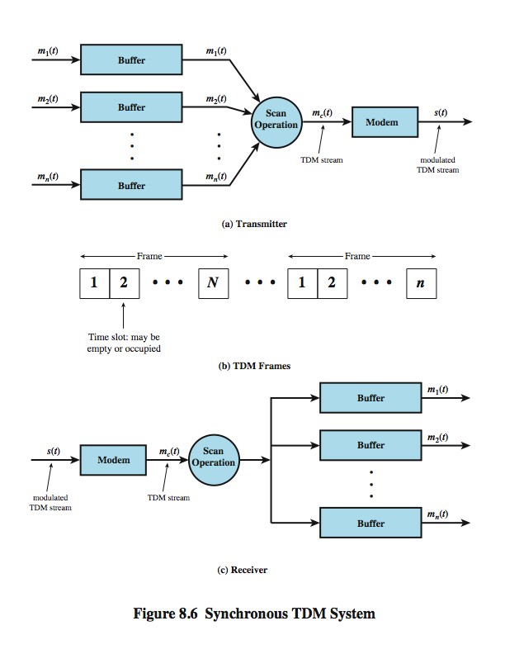
TDM System Overview
Notes:
A generic depiction of a synchronous TDM system is provided in Stallings DCC8e Figure 8.6. A number of signals [m_{i}(t), i = 1, n] are to be multiplexed onto the same transmission medium. The signals carry digital data and are generally digital signals. The incoming data from each source are briefly buffered. Each buffer is typically one bit or one character in length. The buffers are scanned sequentially to form a composite digital data stream m_{c}(t). The scan operation is sufficiently rapid so that each buffer is emptied before more data can arrive. Thus, the data rate of m_{c}(t) must at least equal the sum of the data rates of the m_{i}(t). The digital signal m_{c}(t) may be transmitted directly, or passed through a modem so that an analog signal is transmitted. In either case, transmission is typically synchronous.
The transmitted data may have a format something like Figure 8.6b. The data are organized into frames. Each frame contains a cycle of time slots. In each frame, one or more slots are dedicated to each data source. The sequence of slots dedicated to one source, from frame to frame, is called a channel. The slot length equals the transmitter buffer length, typically a bit or a byte (character).
At the receiver, the interleaved data are demultiplexed and routed to the appropriate destination buffer. For each input source m_{i}(t), there is an identical output destination that will receive the output data at the same rate at which it was generated.

Slide 12
TDM Link Control
No headers and trailers
Data link control protocols not needed
Flow control
Data rate of multiplexed line is fixed
If one channel receiver can not receive data, the others must carry on
Leaving empty slots
Error control
Errors detected & handled on individual channel
Notes:
Note that the transmitted data stream depicted in Stallings DCC8e Figure 8.6b does not contain the headers and trailers that we have come to associate with synchronous transmission, as the control mechanisms provided by a data link protocol are not needed. It should be clear that, as far as the multiplexer and demultiplexer (Figure 8.1) are concerned, flow control is not needed. The data rate on the multiplexed line is fixed, and the multiplexer and demultiplexer are designed to operate at that rate. If one of the individual output lines attaches to a device that is temporarily unable to accept data, transmission must continue, since the remaining output lines are expecting to receive data at predetermined times. Thus, the channel in question will carry empty slots, but the frames as a whole will maintain the same transmission rate.
The reasoning for error control is the same. It would not do to request retransmission of an entire TDM frame because an error occurs on one channel. The devices using the other channels do not want a retransmission nor would they know that a retransmission has been requested by some other device on another channel. Again, the solution is to apply error control on a per-channel basis.

Slide 13
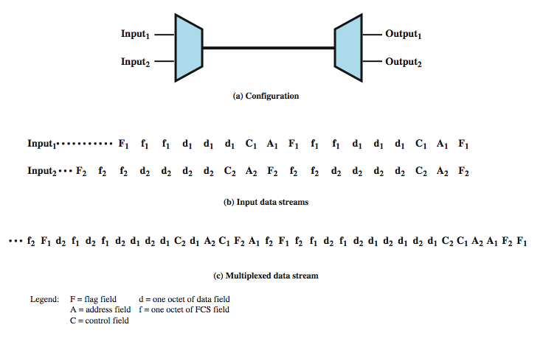
Data Link Control on TDM
Notes:
Flow control and error control can be provided on a per-channel basis by using a data link control protocol such as HDLC on a per-channel basis. A simplified example is shown in Stallings DCC8e Figure 8.7. Assume two data sources, each using HDLC. One is transmitting a stream of HDLC frames containing three octets of data each, and the other is transmitting HDLC frames containing four octets of data. For clarity, we assume that character-interleaved multiplexing is used, although bit interleaving is more typical. The octets of the HDLC frames from the two sources are shuffled together for transmission over the multiplexed line. Note that even though the HDLC frames have lost their integrity in some sense, the pieces are reassembled correctly before they are seen by the device on the other end of the HDLC protocol. In this sense, the multiplexing/demultiplexing operation is transparent to the attached stations; to each communicating pair of stations, it appears that they have a dedicated link.
One refinement is needed in this figure. Both ends of the line need to be a combination multiplexer/demultiplexer with a full-duplex line in between. Then each channel consists of two sets of slots, one traveling in each direction. The individual devices attached at each end can, in pairs, use HDLC to control their own channel. The multiplexer/demultiplexers need not be concerned with these matters.

Slide 14
Framing
No flag or SYNC chars bracketing TDM frames
Must still provide synchronizing mechanism between source and destinations clocks
Added digit framing
One control bit added to each TDM frame
Identifiable bit pattern used on control channel
E.g. alternating 1010101…unlikely on a data channel
Compare incoming bit patterns on each channel with known sync pattern
Notes:
See that a link control protocol is not needed to manage the overall TDM link. There is, however, a basic requirement for framing. Because we are not providing flag or SYNC characters to bracket TDM frames, some means is needed to assure frame synchronization. It is clearly important to maintain framing synchronization because, if the source and destination are out of step, data on all channels are lost.
Perhaps the most common mechanism for framing is known as added-digit framing. In this scheme, typically, one control bit is added to each TDM frame. An identifiable pattern of bits, from frame to frame, is used as a "control channel." A typical example is the alternating bit pattern, 101010…. This is a pattern unlikely to be sustained on a data channel. Thus, to synchronize, a receiver compares the incoming bits of one frame position to the expected pattern. If the pattern does not match, successive bit positions are searched until the pattern persists over multiple frames. Once framing synchronization is established, the receiver continues to monitor the framing bit channel. If the pattern breaks down, the receiver must again enter a framing search mode.

Slide 15
Framing

Slide 16
Pulse Stuffing
Have problem of synchronizing data sources
With clocks in different sources drifting
Also issue of data rates from different sources not related by simple rational number
Pulse Stuffing a common solution
Notes:
Perhaps the most difficult problem in the design of a synchronous time division multiplexer is that of synchronizing the various data sources. If each source has a separate clock, any variation among clocks could cause loss of synchronization. Also, in some cases, the data rates of the input data streams are not related by a simple rational number. For both these problems, a technique known as pulse stuffing is an effective remedy. With pulse stuffing, the outgoing data rate of the multiplexer, excluding framing bits, is higher than the sum of the maximum instantaneous incoming rates. The extra capacity is used by stuffing extra dummy bits or pulses into each incoming signal until its rate is raised to that of a locally generated clock signal. The stuffed pulses are inserted at fixed locations in the multiplexer frame format so that they may be identified and removed at the demultiplexer.

Slide 17
Pulse Stuffing
Pulse Stuffing a common solution
Have outgoing data rate (excluding framing bits) higher than sum of incoming rates
Stuff extra dummy bits or pulses into each incoming signal until it matches local clock
Stuffed pulses inserted at fixed locations in frame and removed at demultiplexer
Notes:
Perhaps the most difficult problem in the design of a synchronous time division multiplexer is that of synchronizing the various data sources. If each source has a separate clock, any variation among clocks could cause loss of synchronization. Also, in some cases, the data rates of the input data streams are not related by a simple rational number. For both these problems, a technique known as pulse stuffing is an effective remedy. With pulse stuffing, the outgoing data rate of the multiplexer, excluding framing bits, is higher than the sum of the maximum instantaneous incoming rates. The extra capacity is used by stuffing extra dummy bits or pulses into each incoming signal until its rate is raised to that of a locally generated clock signal. The stuffed pulses are inserted at fixed locations in the multiplexer frame format so that they may be identified and removed at the demultiplexer.

Slide 18
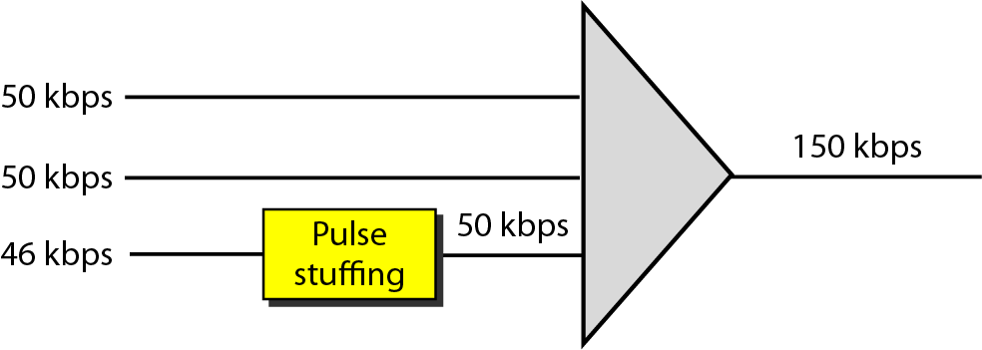
Pulse Stuffing
Notes:
Perhaps the most difficult problem in the design of a synchronous time division multiplexer is that of synchronizing the various data sources. If each source has a separate clock, any variation among clocks could cause loss of synchronization. Also, in some cases, the data rates of the input data streams are not related by a simple rational number. For both these problems, a technique known as pulse stuffing is an effective remedy. With pulse stuffing, the outgoing data rate of the multiplexer, excluding framing bits, is higher than the sum of the maximum instantaneous incoming rates. The extra capacity is used by stuffing extra dummy bits or pulses into each incoming signal until its rate is raised to that of a locally generated clock signal. The stuffed pulses are inserted at fixed locations in the multiplexer frame format so that they may be identified and removed at the demultiplexer.

Slide 19
Statistical TDM
Synch TDM wasted many slots are
Statistical TDM allocates time slots dynamically based on demand
Multiplexer scans input lines and collects data until frame full
Statistical TDM takes advantage of the fact that the attached devices are not all transmitting all of the time
Line data rate lower than aggregate input line rates
Notes:
In a synchronous time division multiplexer, many of the time slots in a frame are often wasted. Statistical time division multiplexing provides a generally more efficient service than synchronous TDM for the support of terminals. With statistical TDM, time slots are not preassigned to particular data sources. Rather, user data are buffered and transmitted as rapidly as possible using available time slots. As with a synchronous TDM, the statistical multiplexer has a number of I/O lines on one side and a higher speed multiplexed line on the other. Each I/O line has a buffer associated with it. In the case of the statistical multiplexer, there are n I/O lines, but only k, where k < n, time slots available on the TDM frame. For input, the function of the multiplexer is to scan the input buffers, collecting data until a frame is filled, and then send the frame. On output, the multiplexer receives a frame and distributes the slots of data to the appropriate output buffers. Because statistical TDM takes advantage of the fact that the attached devices are not all transmitting all of the time, the data rate on the multiplexed line is less than the sum of the data rates of the attached devices. Thus, a statistical multiplexer can use a lower data rate to support as many devices as a synchronous multiplexer. However there is more overhead per slot for statistical TDM because each slot carries an address as well as data. The difficulty with this approach is that, while the average aggregate input may be less than the multiplexed line capacity, there may be peak periods when the input exceeds capacity. The solution to this problem is to include a buffer in the multiplexer to hold temporary excess input. There is a tradeoff between the size of the buffer used and the data rate of the line. We would like to use the smallest possible buffer and the smallest possible data rate, but a reduction in one requires an increase in the other.

Slide 20
Statistical TDM
More overhead per slot for statistical TDM because each slot carries an address as well as data
May have problems during peak periods
Must buffer inputs
Tradeoff between the size of the buffer used and the data rate of the line
Better to use the smallest possible buffer and the smallest possible data rate, but a reduction in one requires an increase in the other
Notes:
In a synchronous time division multiplexer, many of the time slots in a frame are often wasted. Statistical time division multiplexing provides a generally more efficient service than synchronous TDM for the support of terminals. With statistical TDM, time slots are not preassigned to particular data sources. Rather, user data are buffered and transmitted as rapidly as possible using available time slots. As with a synchronous TDM, the statistical multiplexer has a number of I/O lines on one side and a higher speed multiplexed line on the other. Each I/O line has a buffer associated with it. In the case of the statistical multiplexer, there are n I/O lines, but only k, where k < n, time slots available on the TDM frame. For input, the function of the multiplexer is to scan the input buffers, collecting data until a frame is filled, and then send the frame. On output, the multiplexer receives a frame and distributes the slots of data to the appropriate output buffers. Because statistical TDM takes advantage of the fact that the attached devices are not all transmitting all of the time, the data rate on the multiplexed line is less than the sum of the data rates of the attached devices. Thus, a statistical multiplexer can use a lower data rate to support as many devices as a synchronous multiplexer. However there is more overhead per slot for statistical TDM because each slot carries an address as well as data. The difficulty with this approach is that, while the average aggregate input may be less than the multiplexed line capacity, there may be peak periods when the input exceeds capacity. The solution to this problem is to include a buffer in the multiplexer to hold temporary excess input. There is a tradeoff between the size of the buffer used and the data rate of the line. We would like to use the smallest possible buffer and the smallest possible data rate, but a reduction in one requires an increase in the other.

Slide 21
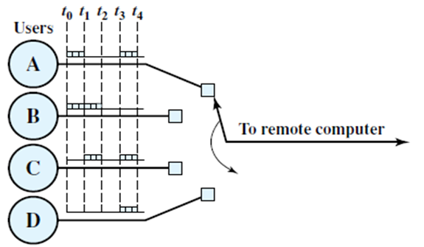
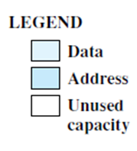
Synchronous Vs Statistical TDM

Slide 22
Synchronous Vs Statistical TDM

Slide 23
Statistical TDM Frame Format
Two possible formats
In the first case, only one source of data is included per frame. That source is identified by an address
Work well when load is lighter, inefficient under heavy load
In the second case, multiple data sources to be packaged in a single frame to improve efficiency
Length of data for each source is provided(Address+ length)

Slide 24
Statistical TDM Frame Format
Several techniques can be used to make this approach even more efficient
Address field can be reduced using
Relative addressing
Length field can be reduced
By using a 2-bit label with the length field

Slide 25
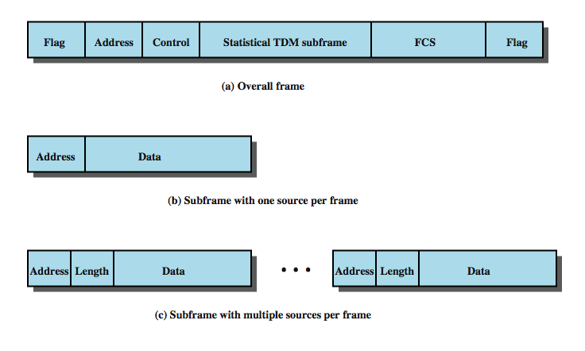
Statistical TDM Frame Format

Slide 26
Cable Modems (Statistical TDM - App)
Dedicate two cable TV channels to data transfer
Each channel shared by number of subscribers, using statistical TDM
Downstream
Cable scheduler delivers data in small packets
Active subscribers share downstream capacity
Also allocates upstream time slots to subscribers
Upstream
User requests timeslots on shared upstream channel
Head end scheduler notifies subscriber of slots to use

Slide 27
Cable Modem Scheme
Notes:
A form of statistical TDM is typically used with Cable Modems, as illustrated in Stallings DCC8e Figure 8.16. This also shows the request and allocation of upstream time slots.

Slide 28
Summary
Looked at multiplexing multiple channels on a single link
FDM
TDM
Statistical TDM
Notes:
Chapter 8 summary.

Slide 29
Chapter Preparation
Thorough reading of slide related material from the book

