Slide 1
Mode

Slide 2
Introduction:
Mode is that observation which occurs maximum number of times in the data.
Most repeated value in the data set.
A distribution having a single mode, in a distribution is called a unimodal distribution.
If there are two modes, in a distribution is called a bimodal distribution.
If there are more than two modes, in a distribution is called a multimodal distribution.

Slide 3
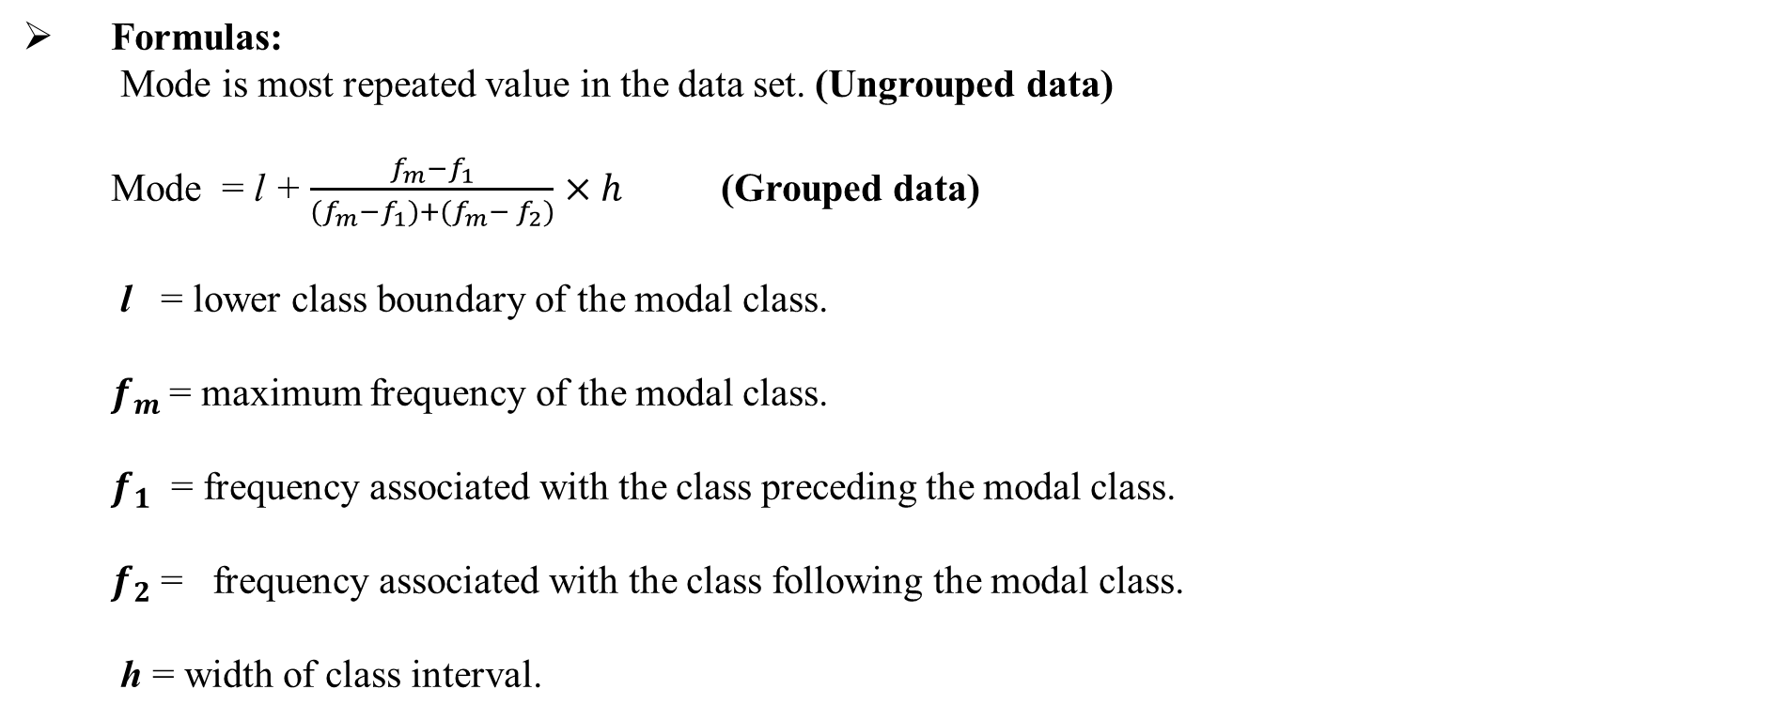
Formulas: Mode is most repeated value in the data set. (Ungrouped data) Mode = l + $\frac{f_{m}−f_{1}}{{(f}_{m}−f_{1})+(f_{m}− f_{2})}$ $×h$ (Grouped data) l = lower class boundary of the modal class. $f_{m}$= maximum frequency of the modal class. $f_{1}$ = frequency associated with the class preceding the modal class. $f_{2}$ = frequency associated with the class following the modal class. h = width of class interval.

Slide 4
Example: (Ungrouped data) Find the mode of each of the following sets of values. 412,426,435,412,428,435,427 Solution: There are two modes 412 and 435 because both items occur equal number of times. So, the distribution with modes is called a bimodal distribution.

Slide 5
Question no#1
Take a second look at the definition of the mode and answer defining point: the mode is the most frequent score or category-it is not the frequency associated with the score or category. 10 11 12 13 15 16 18 19 21 21 26 27 28 31 32 Which score (or scores) occurs with the most frequency?
Answer
you can see, the score 21 appears twice, as all the other scores appear only once. The mode of this simple distribution, then, is 2l.

Slide 6
Question n0# 2
In the set of scores 58, 82, 82, 90, 98 find the mode
Solution:
The mode is 82 because it occurs twice and the other scores occur only once.

Slide 7
Example: (Grouped data) Classes Frequency 0-9 2 10-19 10 20-29 5 30-39 9 40-49 6 50-59 7 60-69 1

Slide 8
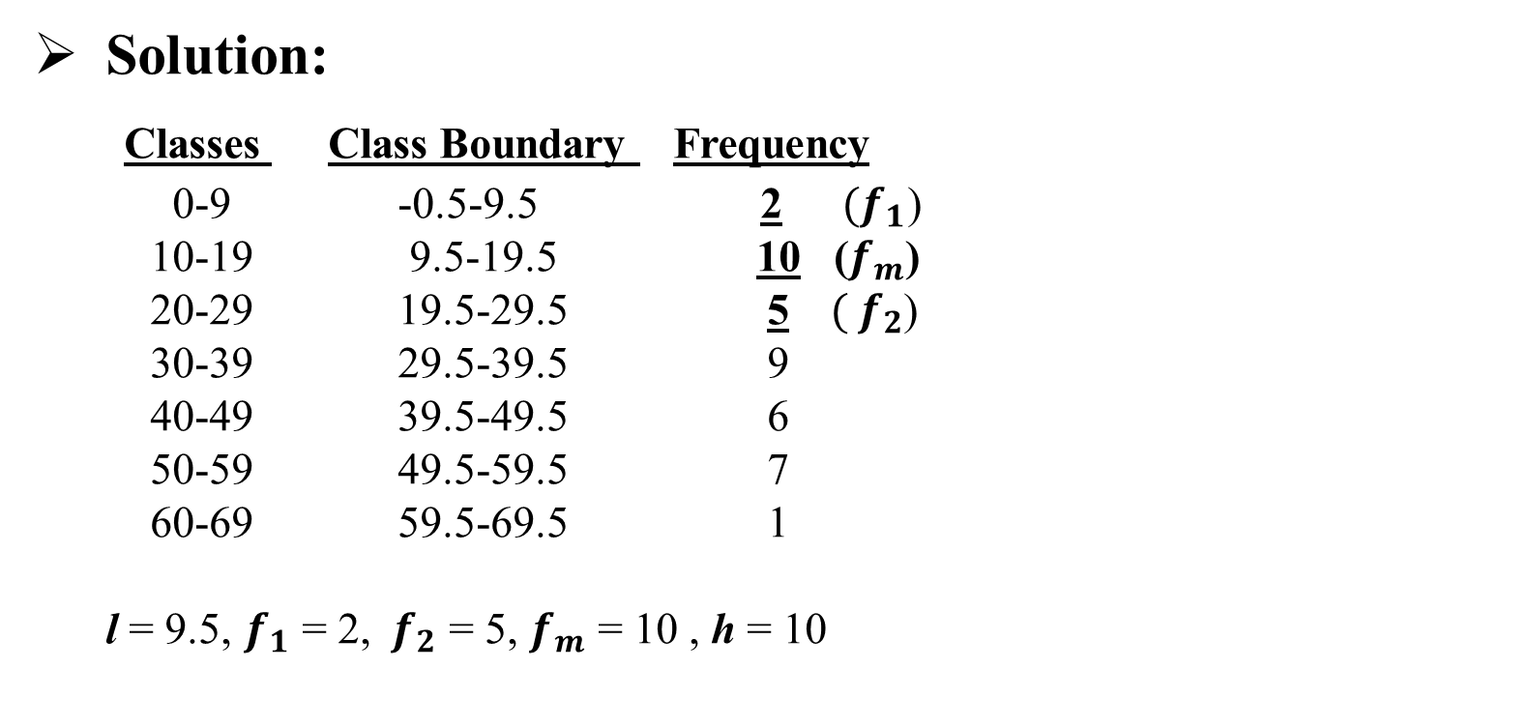
Solution: Classes Class Boundary Frequency 0-9 -0.5-9.5 2 ${ (f}_{1}$) 10-19 9.5-19.5 10 ($f_{m}$) 20-29 19.5-29.5 5 ${ ( f}_{2}$) 30-39 29.5-39.5 9 40-49 39.5-49.5 6 50-59 49.5-59.5 7 60-69 59.5-69.5 1 l = 9.5, $f_{1}$ = 2, ${ f}_{2}$ = 5, $f_{m}$ = 10 , h = 10

Slide 9

Mode = l + $\frac{f_{m}−f_{1}}{{(f}_{m}−f_{1})+(f_{m}− f_{2})}$ $×h$ Mode = 9.5 + $\frac{10−2}{(10−2)+(10−5)}$ $×10$ = 9.5 + $\frac{8}{(8)+(5)}$ $×10$ = 9.5 + $\frac{80}{13}$ = 9.5 + 6.15= = 15.65

Slide 10
Merits of Mode:
It is not affected by extreme observations.
It can be determined for both the quantitative and qualitative data.

Slide 11
Demerits of Mode:
It is not based on all the observation made.
It is not capable of lending itself to further statistical treatment.

Slide 12
Assignment Questions: Question no 1: (a) 4,2,6,6,6,5,9,10,13,15 (b) 5,2,3,4,5,7,9,16,20,12,7,4 ( c) 4,6,10,7,9,90,26,18,24,11, Question no 2: (a) Calculate the mode. Classes Frequency 11-20 12 21-30 14 31-40 26 41-50 35 51-60 23 61-70 5 71-80 1

Slide 13
(b) Compute mode of the data. Groups Frequency 9.3-9.7 2 9.8- 10.2 5 10.3-10.7 12 10.8-11.2 17 11.3-11.7 14 11.8-12.2 6 12.3-12.7 3 12.8-13.2 1

